Slide 1
1. What are the CSS frameworks?
Semantic UI: Semantic UI uses human-friendly HTML class names to create responsive and visually appealing interfaces. It offers a wide range of ready-to-use components such as buttons, modals, and forms, with a focus on clean, semantic code.
Tailwind CSS: The utility-first Tailwind CSS framework is different, as it provides low-level classes to create custom designs, therefore eliminating the need to write custom CSS. Its focus on rapid development and flexibly designed components makes it tailored for component-based UI architectures.
Materialize CSS: Materialize CSS is a responsive front-end framework based on Google’s Material Design principles. It offers you pre-styled components, animations and a mobile-first grid system to quickly build sleek and consistent UIs.
Primer: Primer is GitHub’s design system and CSS framework created with scalability and maintainability in mind. It provides a collection of configurable accessible components and utilities that help in building consistent user interfaces across GitHub products.
Foundation: Foundation is a responsive front-end CSS framework developed by Zurb. It comes with a powerful grid system along with user interface components and accessibility features that allow the construction of responsive websites and apps at an enterprise level.
Gumby: Gumby is a responsive CSS framework that features a flexible 960-grid system along with configurable user interface (UI) elements. In addition, it supports Sass out of the box, making it easier to modify styles, thus prioritizing speed.
UIkit: UIkit is a lightweight and modular CSS framework for developing fast and powerful web interfaces. Its responsive grid system comes complete with pre-built components, animations, and a minimalistic design.
Bootstrap: Bootstrap is a well known front-end CSS framework developed by Twitter. It gives you a responsive grid system, pre-designed UI components, and JavaScript plugins, making it convenient for building consistent and mobile-first web applications quickly.

Slide 2
2. What are the advantages and disadvantages of using external style sheets?
Advantages | Disadvantages
Styles of numerous documents can be organized from a single file. | An extra download is necessary to import style information for each file.
Classes can be made for use on numerous HTML element types in many parts of the site. | The execution of the file may be delayed until the external style sheet is fully loaded.
In complex contexts, methods such as selectors and grouping can be implemented to apply styles. | Web pages must be tested across multiple browsers to check for compatibility issues

Slide 3
3. What are the advantages and disadvantages of embedded style sheets?
Advantages | Disadvantages
Classes can be created for use on multiple tag types within the same document. | Styles cannot be controlled for multiple web pages from a single location.
No extra download is required to import style information, unlike external style sheets. | Increases the overall size of the HTML file, making it bulkier and harder to manage.
Easy to override external or browser default styles for a specific page. | Poor maintainability – style code is mixed with content, which makes updates more difficult.
Ideal for single-page documents or when quick custom styling is needed. | Duplication of styles across multiple pages of the same embedded CSS is reused, leading to code redundancy.

Slide 4
4. How can you include CSS in a web page?
There are different ways by which you can include CSS in a web page:
External Style Sheet:
An external file is linked to the HTML document using the <link> tag.
Syntax:
<link rel="stylesheet" type="text/css" href="styles.css">
Embed CSS with a Style Tag:
Another way to include CSS in a web page is by having a set of CSS styles included within the HTML page.
Syntax:
<style type="text/css">
/* Add style rules here */
</style>
The CSS rules have to be added between the opening and closing <style> tags. The CSS is written exactly like in standalone style-sheet files.
Inline Styles to HTML Elements:
Style can be added directly to the HTML element with the help of a <style> attribute.
<h2 style="color: red; background: black;">Inline Style</h2>
Import a Style-sheet File:
Another way to add CSS is by using the @import rule. Here, an external file is imported into another CSS file. This is useful for adding a new CSS file within the CSS itself.
@import "path/to/style.css";

Slide 5
5. What are the different types of selectors in CSS?
A CSS selector in a CSS rule set helps select the content that needs to be styled. The different types of selectors are listed below:
Universal Selector: The universal selector selects all elements on a page. The provided styles will get applied to all the elements on the page.
<!-- Style Part -->
<style>
* {
color: "green";
font-size: 20px;
line-height: 25px;
}
</style>

Slide 6
Element Type Selector: The element type selector selects one or more HTML elements of the same name. In the example below, the provided styles will be applied to all the ul elements on the page.
<!-- Style Part -->
<style>
ul {
line-style: none;
border: solid 1px #ccc;
}
</style>
ID Selector: The ID selector is used for selecting any HTML element that has an ID attribute same as the selector. In the below example, the assigned styles will get applied to all the elements having the ID container.
<!-- Style Part -->
<style>
#container {
width: 960px;
margin: 0 auto;
}
</style>
<!-- Body Part -->
<div id="container"></div>

Slide 7
Class Selector: The class selector choses all the page elements with class attributes that are set to the same value as the class. The styles get applied to all the elements having the same ID on the page.
<!-- Style Part -->
<style>
.box {
padding: 10px;
margin: 10px;
width: 240px;
}
</style>
<!-- Body Part -->
<div class="box"></div>
Descendant Combinator: The descendant selector or, more accurately, the descendant combinator lets you combine two or more selectors and be more specific in the selection method.
<!-- Style Part -->
<style>
#container .box {
float: left;
padding-bottom: 15px;
}
</style>
<!-- Body Part -->
<div id="container">
<div class="box"></div>
<div class="box-2"></div>
</div>
<div class="”box”"></div>

Slide 8
In the above example, the declaration block applies to all elements having a class, “box”, that are inside an element with the ID, “container”. It is worth noting that the .box element does not have to be an immediate child; there can be another element wrapping the .box, and the styles will still apply.
Child Combinator: The child combinator is similar to the descendant combinator, except it only targets immediate child elements.
<!-- Style Part -->
<style>
#container > .box {
float: left;
padding-bottom: 15px;
}
</style>
<!-- Body Part -->
<div id="container">
<div class="box"></div>
<div>
<div class="box"></div>
</div>
</div>
The selector will match all elements that have a class, “box”, and are immediate children of the element, “container”.

Slide 9
General Sibling Combinator: The general sibling combinator matches elements based on sibling relationships. The selected elements are adjacent to each other in HTML.
<!-- Style Part -->
<style>
h2 ~ p {
margin-bottom: 20px;
}
</style>
<!-- Body Part -->
<h2>Title</h2>
Paragraph example.
Paragraph example.
Paragraph example.
<div class="”box”">
Paragraph example.
</div>
In the above example, all paragraph elements, (<p>), will be styled with the specified rules, but only if they are siblings of <h2> elements. Even if there are other elements in between <h2> and <p>, the styles will still apply.

Slide 10
Adjacent Sibling Combinator: The adjacent sibling combinator is almost the same as the general sibling selector but the targeted element must be an immediate sibling, not just a general sibling. The adjacent sibling combinator uses the plus symbol, (+).
<!-- Style Part -->
<style>
p + p {
text-indent: 1.Sem;
margin-bottom: 0;
}
</style>
<!-- Body Part -->
<h2>Title</h2>
Paragraph example.
Paragraph example.
Paragraph example.
<div class="”box”">
Paragraph example.
Paragraph example.
</div>
In the above example, the specified styles will apply only to those paragraph elements that immediately follow other paragraph elements. This means that the first paragraph element on a page will not receive these styles.If there are other elements appearing between two paragraphs, the styles will not apply to the second paragraph.

Slide 11
Attribute Selector: The attribute selector targets elements based on the presence and/or value of HTML attributes. It is declared using square brackets.
<!-- Style Part -->
<style>
input[type=”text”] {
background-color: #444;
width: 200px;
}
</style>
<!-- Body Part -->
<input type="text">

Slide 12
6. What is the difference among inline, inline-block, and block elements?
Block Element: Block elements always start on a new line and occupy an entire row or width. Examples of block elements are <div> and <p>.
Inline Elements: Inline elements do not start on a new line; they appear on the same line as the content and tags beside them. Some examples of inline elements are <a>, <strong>, <span>, and <img>.
Inline-block Elements: Inline-block elements are similar to inline elements, but they can have padding, margins, and set height and width values.

Slide 13
7. What are pseudo elements and pseudo classes?
Pseudo-elements help to create items that do not normally exist in the document tree. The examples of pseudo-elements are:
  ::before:Inserts content before the content of an element.
p::before {
content: "Note: ";
color: red;
}
  ::after: Inserts content after the content of an element.
p::after {
content: " [End]";
color: gray;
}
  ::selection: Styles the portion of text selected by the user.
::selection {
background: yellow;
color: black;
}

Slide 14
  ::first-letter:Styles the first letter of the text in an element.
p::first-letter {
font-size: 200%;
color: green;
}
  ::first-line: Styles the first line of text inside an element.
p::first-line {
font-weight: bold;
}
Pseudo classes select regular elements under specific conditions such as when a user is hovering over a link. The examples of pseudo classes are:
:hover:Applies when the user hovers the mouse pointer over an element.
a:hover {
color: orange;
text-decoration: underline;
}
:active:Applies when an element is being clicked or activated.
button:active {
background-color: red;
}

Slide 15
:link:Targets all unvisited hyperlinks.
a:link {
color: blue;
}
:visited:Targets hyperlinks that the user has already visited.
a:visited {
color: purple;
}
:focus:Applies when an element (like a form field) is focused via keyboard or mouse.
input:focus {
border: 2px solid green;
}

Slide 16
8. What are the differences between adaptive design and responsive design?
Adaptive Design | Responsive Design
It focuses on multiple fixed layout sizes in website development. | It focuses on showing content based on available browser space.
In this kind of website design, first the available space is detected and then the layout, with the most appropriate size, is picked and used to display the content. Resizing the browser window has no effect on the design. | In this kind of website design, when the browser window is resized, the content of the website is dynamically and optimally rearranged to accommodate the window.
It uses six standard screen widths, 320 px, 480 px, 760 px, 960 px, 1200 px, and 1600 px. | Depending on the target device’s properties, it uses CSS media queries to change styles for adapting to different screens.
It takes a lot of time and effort because the options and realities of the end users need to be examined first and then the best possible adaptive solutions are designed. | Building and designing fluid websites that can accommodate content depending on the screen size does not take much work.
It gives a lot of control over the design for specific screens. | It does not allow much control over the design.

Slide 17
9. What are the properties of Flexbox?
The numerous characteristics of CSS Flexbox can be used to create intricate and powerful compositions.
display is used to describe a flex container. The flex value is utilized to establish a flex container.
flex-direction is employed to determine the direction of the primary axis, which is the axis that flex items are arranged along. This property can have the values row, row-reverse, column, and column-reverse.
justify-content aligns flex items parallel to the primary axis. This property can take many different values, including flex-start, flex-end, center, space-between, space-around, and space-evenly.
align-items align flex items perpendicular to the primary axis. Flex-start, flex-end, center, baseline, and stretch are all possible values for this attribute.
flex-wrap determines whether or not flex items should wrap when their width exceeds the width of the flex container. This property’s possible values are nowrap, wrap, and wrap-reverse.
align-content is used to align flex lines perpendicular to the major axis when there is extra space in the flex container. This property’s likely values are flex-start, flex-end, center, space-between, space-around, and stretch.
flex is employed to establish the flex grow, flex shrink, and flex basis of a flex item. The shorthand property flex creates all three values at the same time. The individual properties are flex-grow, flex-shrink, and flex-basis.

Slide 18
10. What is the difference between physical and logical tags?
Logical tags mainly focus on the content and are older as compared to the physical tags. Logical tags are hardly used in terms of presentation. In terms of aesthetics, logical tags do not serve any purpose. However, physical tags find their application in presentation.

Slide 19
Basic CSS Interview Questions
11. What is the difference between min(), max(), and clamp()?
min(), max(), and clamp() are CSS functions used to create responsive values like widths, padding, or font sizes.
min(value1, value2) returns the smallest of the given values.
width: min(100%, 600px); /* Uses 100% unless it's more than 600px */
max(value1, value2) returns the largest of the values.
width: max(300px, 50%); /* Ensures at least 300px width */
clamp(min, preferred, max) sets a range and picks the preferred value within that range.
font-size: clamp(1rem, 2vw, 2rem); /* Responsive font size */
These functions are great for making designs fluid and adaptable across devices without using multiple media queries.

Slide 20
12. What are :is() and :where() pseudo-classes? How do they differ?
The :is() and :where() pseudo-classes allow you to group multiple selectors together in a clean and readable way. They simplify your CSS and reduce repetition when applying the same styles to multiple elements.
Example using :is():
:is(h1, h2, h3) {
margin-bottom: 1em;
}
This applies the style to h1, h2, and h3.
The difference lies in specificity:
:is() takes the highest specificity of the matched selector.
:where() always has zero specificity, so it never wins over other rules with higher specificity.
Example using :where():
:where(h1, h2, h3) {
color: gray;
}
This won’t interfere with more specific styles elsewhere in your CSS. Use :where() when you want to apply base styles without the risk of overriding other styles unintentionally.

Slide 21
13. What is the syntax to link an external style sheet?
An external style sheet comprises style description that can be linked with the HTML document externally. An external style sheet is one of the best and most organized ways to keep the style separate from the structure.
The syntax for linking an external style sheet is as follows:
<head>
<link rel="stylesheet" type="text/css" href="styles.css">
</head>

Slide 22
14. How can embedded style be linked with HTML documents?
Embedded style can be implemented within HTML code. It is written using the <Style> tag and used under the <Head> structure.
Its syntax is as follows:
<head>
<style type="text/css">
/* CSS rules go here */
body {
background-color: lightblue;
font-family: Arial, sans-serif;
}
h1 {
color: darkblue;
text-align: center;
}
</style>
</head>

Slide 23
15. Why is the @import function an easy way to insert a file?
The syntax is shown by coding as:
<style>
@import url("https://www.example.com/styles.css");
</style>
16. What are the advantages of using CSS?
The main advantages of using CSS are:
Separation of Content from Presentation: CSS enables presentation of the same content in multiple formats for mobile, desktop, or laptop.
Bandwidth: When CSS is used effectively, the browser cache can store the style sheets and these can be used on multiple pages without the need to redownload.
Easy to Maintain: By making small changes, CSS can be used to completely change the look and feel of a web page. For a global change, we simply have to change the style, and all elements in all web pages will be automatically updated.

Slide 24
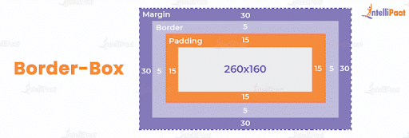
17. How is border-box different from content-box?
The border-box property contains the content, border, and padding in height and width properties. If you look at the example below, the box-sizing for the div element is set as border-box. The height and width considered for the div content will also include the padding and border:
div {
width: 300px;
height: 200px;
padding: 15px;
border: 5px solid grey;
margin: 30px;
-moz-box-sizing: border-box;
-webkit-box-sizing: border-box;
box-sizing: border-box;
}
The actual height of the div content in this case is:
Actual height = height – padding on top and bottom – border on top and bottom
= 200 – (15 × 2) – (5 × 2)
= 160 px

Slide 25
The actual width of the div content in this case is:
Actual width = width – padding on right and left – border on right and left
= 300 – (15 × 2) – (5 × 2)
= 260 px
Let us take a look at the border-box model for the above example:
Content-box, on the other hand, is the default value box-sizing property. Height and the width properties do not include border and padding and only have content.
div {
width: 300px;
height: 200px;
padding: 15px;
border: 5px solid grey;
margin: 30px;
-moz-box-sizing: content-box;
-webkit-box-sizing: content-box;
box-sizing: content-box;
}

Slide 26
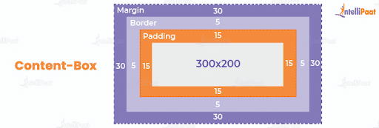
Here, content-box is the box-sizing for the div element. The height and width for the div content do not include padding and border. The full height and width parameters are specified for the content as shown below:

Slide 27
18. Explain the RGB stream
RGB represents the colors in CSS. The RGB streams are red, green, and blue. The intensity of the colors can be set from 0 to 255. It enables CSS to have a spectrum of visible colors. Example code using RGB in CSS:
div {
background-color: rgb(255, 0, 0); /* Pure red */
color: rgb(255, 255, 255); /* White text */
padding: 20px;
font-size: 18px;
}
In this example:
rgb(255,0,0) sets a red background.
rgb(255,0,0) sets the text color to white.

Slide 28
19. Define z-index
Z-index helps specify the stack order of elements that overlap each other. While the default value of z-index is zero, it can take both positive and negative values.The element with a greater stack order is always above the element with a lower stack order.
Z-index can assume the following values:
auto: It sets the stack order equal to its parents.
number: It sets the stack order of the element. Negative values are allowed.
initial: It sets this property to its default value.
inherit: It inherits this property from its parent element.

Slide 29
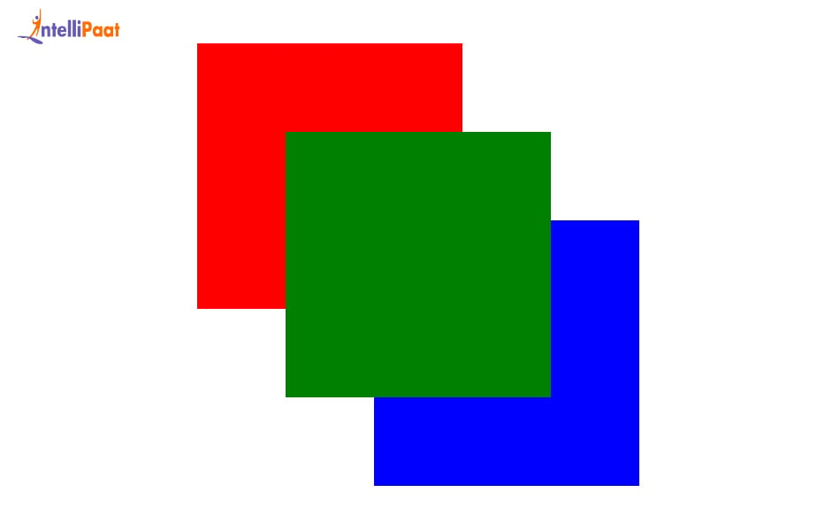
.box3 {
width: 150px;
height: 150px;
background-color: blue;
position: absolute;
top: 150px;
left: 150px;
z-index: 0;
}
</style>
</head>
<body>
<div class="box1"></div>
<div class="box2"></div>
<div class="box3"></div>
</body>
</html>
<!DOCTYPE html>
<html>
<head>
<style>
.box1 {
width: 150px;
height: 150px;
background-color: red;
position: absolute;
top: 50px;
left: 50px;
z-index: 1;
}
.box2 {
width: 150px;
height: 150px;
background-color: green;
position: absolute;
top: 100px;
left: 100px;
z-index: 2;
}

Slide 30
20. Name the different ways to position some aspects in CSS
The positioning method type is determined by the positioning property. The five different position values are:
1. fixed:This is the default position value.Elements are positioned according to the normal document flow. top, right, bottom, and left properties do not affect static elements.
2. static:The element is positioned relative to its normal position.Offsets with top, left, etc., move the element without removing it from the flow.
3. absolute: The element is positioned relative to the nearest positioned ancestor (not static).If no such ancestor exists, it is positioned relative to the <html> (root).It is removed from the normal document flow.
4. fixed: The element is positioned relative to the browser window.It stays fixed in place even when the page is scrolled.Useful for sticky headers, footers, or buttons.
5. sticky:A hybrid of relative and fixed.The element toggles between relative and fixed based on the scroll position.It “sticks” to a defined offset (top, left, etc.) when the scroll crosses that threshold.
The elements are positioned with the help of top, left, right, and bottom properties. These properties need to be set first, and they work depending on position value.

Slide 31
21. What is the property that is used to control image scrolling?
The background-attachment property is used to set whether the background image remains fixed or is scrollable with the rest of the page. Here is an example for a fixed background-image:
body {
background-image: url("url_of_image");
background-repeat: no-repeat;
background-attachment: fixed;
}

Slide 32
22. In CSS, what are pseudo-classes? Give an illustration.
Pseudo-classes are keywords that specify a special state of an element. An example is the :hover pseudo-class, which applies styles when the mouse is over an element.
For instance,
a:hover {
color: red;
}

Slide 33
CSS Interview Questions for Experienced Professionals
23. What is the purpose of the @layer rule in CSS?
The @layer rule allows you to manage various components known as layers in CSS, especially in a scenario where multiple resets and bases are being pulled from several different libraries. It streamlines the process of managing prioritization while avoiding conflicts by grouping CSS rules into specified layers with a definite hierarchy of importance.
When rules are set using the same specificity, layers set priority will take over.
Example:
@layer reset, base, components;
@layer base {
h1 {
color: black;
}
}
@layer components {
h1 {
color: red;
}
}
In this case, the h1 from the components layer will take precedence, even though both selectors are equally specific, because components was declared after base.

Slide 34
24. What distinguishes visibility: hidden from display: none?
Display: none eliminates an element from the layout, preventing it from showing up on the page or occupying any space.
Visibility: hidden makes the element invisible, although it still takes up room in the arrangement.
25. In CSS, how can an element be centered vertically?
.container {
display: flex;
justify-content: center; /* horizontally center */
align-items: center; /* vertically center */
height: 100vh; /* adjust as needed */
}

Slide 35
26. Why would you use a CSS preprocessor such as Sass or Less?
Preprocessors for CSS add features like variables, nesting, mixins, and functions to extend the possibilities of CSS. They make stylesheets more scalable and maintainable.
27. How may CSS be used to create a responsive design?
Responsive design can be achieved using CSS media queries to apply different styles based on the device’s screen size or orientation.
A media query is a CSS technique that allows you to apply styles conditionally based on characteristics of the user’s device, such as screen width, height, resolution, and orientation. It plays a crucial role in building responsive web designs.
@media screen and (max-width: 600px) {
/* Styles for small screens */
body {
background-color: lightgray;
font-size: 14px;
}
}
This media query applies specific styles only when the screen width is 600px or less, making it ideal for smartphones.

Slide 36
28. What distinguishes inline display attributes from inline-block display properties?
Inline elements don’t begin on a new line; instead, they flow with the surrounding content. Two instances are <span> and <a>.
Similar to inline elements, inline-block elements can also have height/width, padding, and margin values. They can be positioned using the top, bottom, left, and right attributes and do not begin on a new line.
29. Why is the CSS z-index attribute used?
The stacked order of positioned items is managed by the z-index attribute. It describes an element’s stack order in relation to other elements on the page. Elements with lower z-index values are stacked underneath those with higher z-index values.

Slide 37
30. How do you create a CSS animation?
@keyframes slidein {
from {
/* Start the element fully to the left (off-screen) */
transform: translateX(-100%);
}
to {
/* End with the element in its original position */
transform: translateX(0);
}
}
.element {
animation: slidein 1s ease-in-out; /* Animate over 1 second with ease-in-out timing */
}

Slide 38
31. What are sprites in CSS? How can website performance be enhanced?
CSS sprites use CSS to display particular portions of a picture by combining many images into a single image. By lowering the numbers of HTTP requests needed to load many images, they enhance website performance by speeding up page loads.
32. What is the overflow property in CSS used for?
The handling of material that extends beyond the boundaries of its contained element is determined by the overflow attribute. It has four settings: scroll, auto, hidden, and visible.
Syntax:
.box {
width: 200px;
height: 100px;
border: 2px solid black;
overflow: auto; /* Try changing to hidden, scroll, visible */
}

Slide 39
33. What are container queries in CSS, and how do they differ from media queries?What are container queries in CSS, and how do they differ from media queries?
With container queries, you can now style CSS with respect to a parent container instead of the entire browser window. This is useful when building modular, reusable components that respond to the space available to them. Media queries, on the other hand, employ a “one-size-fits-all” approach by styling the entire layout based on the viewport (the whole screen).
If you have a card or a sidebar that needs to adapt with the amount of space it is provided with (as opposed to the screen), then container queries are your best bet.
For example:
.container {
container-type: inline-size;
}
@container (max-width: 600px) {
.text {
font-size: 14px;
}
}
In this example, the .text element will only change font size when its parent .container is less than 600px wide, regardless of the screen size.

Slide 40
34. Describe the advantages of the CSS grid layout paradigm.
A two-dimensional layout method for grouping elements in rows and columns is the CSS grid layout. When compared to more conventional techniques like flexbox or floats, it offers a more potent and adaptable way to design grid-based layouts. The precise arrangement and alignment of items within a grid are made possible by grid layout.

Slide 41
Advanced CSS Interview Questions
35. How can a responsive navigation menu be made with CSS?
One method for making the navigation menu’s layout flexible is to utilize CSS flexbox or CSS grid. The menu’s style and layout can then be modified using media queries in accordance with the screen size. For improved usability, other methods, such as employing the checkbox hack to hide the menu behind a toggle button on smaller screens, might be utilized.
HTML + CSS: Responsive Navigation Menu:

Slide 42
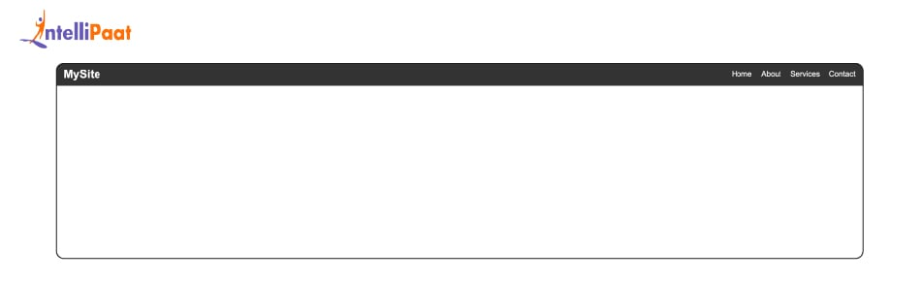
.menu-icon {
display: block;
font-size: 1.5rem;
cursor: pointer;
}
#menu-toggle:checked + .menu-icon + .nav-links {
display: flex;
}
}
</style>
</head>
<body>
<nav>
<div class="nav-container">
<div class="logo">MySite</div>
<!-- Hidden checkbox hack for toggle -->
<input type="checkbox" id="menu-toggle" class="menu-toggle">
<label for="menu-toggle" class="menu-icon">&#9776;</label>
<div class="nav-links">
<a href="#">Home</a>
<a href="#">About</a>
<a href="#">Services</a>
<a href="#">Contact</a>
</div>
</div>
</nav>
</body>
</html>
.logo {
font-size: 1.5rem;
font-weight: bold;
}
.nav-links {
display: flex;
gap: 20px;
}
.nav-links a {
color: white;
text-decoration: none;
font-size: 1rem;
}
/* Hide menu toggle checkbox and label by default */
.menu-toggle, .menu-icon {
display: none;
}
/* Responsive: For screens less than or equal to 768px */
@media (max-width: 768px) {
.nav-links {
display: none;
flex-direction: column;
background-color: #444;
width: 100%;
padding: 10px 0;
}
<!DOCTYPE html>
<html lang="en">
<head>
<meta charset="UTF-8">
<title>Responsive Nav Menu</title>
<style>
* {
margin: 0;
padding: 0;
box-sizing: border-box;
}
body {
font-family: Arial, sans-serif;
}
nav {
background-color: #333;
color: white;
padding: 10px 20px;
}
.nav-container {
display: flex;
justify-content: space-between;
align-items: center;
}

Slide 43
36. How do you create a sticky header using CSS?
To make a sticky header with CSS, you apply the property position: sticky; and assign a top value. This keeps the header attached to the top portion of the page as the user scrolls down past it . If you are interested in changing the header using a CSS animation, like fading or sliding down when it “sticks”, you can use position: sticky together with keyframe animations or transitions.

Slide 44
<!DOCTYPE html>
<html lang="en">
<head>
<meta charset="UTF-8">
<title>Sticky Header (No Animation)</title>
<style>
/* Sticky Header */
header {
position: sticky;
top: 0;
background-color: #333;
color: white;
text-align: center;
}
section {
height: 1200px; /* Simulate scrollable content */
background: linear-gradient(to bottom, #f0f0f0, #ccc);
}
</style>
</head>
<body>
<header>
<h1>Sticky Header</h1>
</header>
<section>
<p>This is some long content. Scroll down to see the header stay fixed at the top of the page.</p>
<p>More dummy content to help scrolling...</p>
</section>
<section>
<p>You're still scrolling, and the header is still there!</p>
</section>
</body>
</html>

Slide 45
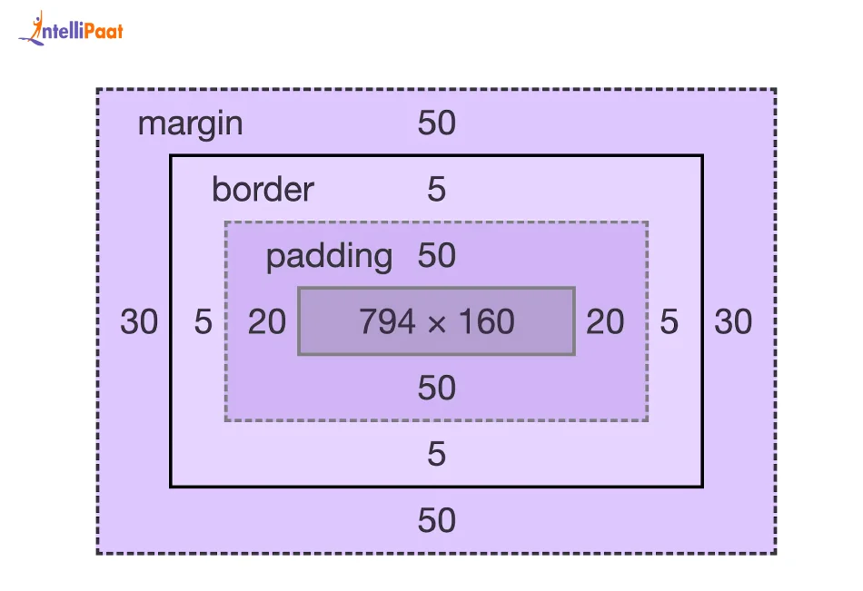
37. Describe the effects of the CSS box model on layout.
The organization of the items on a web page is described by the CSS box model. Content, padding, border, and margin make up its components. Text and images are displayed in the content area, which is surrounded by a border; the space outside the border is known as the margin. Padding is the area that appears between the content and the border. It determines how an element fits into the layout and how it works with other elements.

Slide 46
38. Describe the advantages of the CSS flexbox layout approach over conventional layout techniques.
A style concept known as CSS Flexible Box style, or flexbox, enables the development of responsive and adaptable layouts with a single-dimensional axis (horizontal or vertical).
Compared to more conventional layout techniques like floats or positioning, it offers a more effective and natural approach to dividing up space and orienting objects inside a container.
Powerful capabilities offered by Flexbox include the ability to quickly rearrange objects, manage space alignment and distribution, and automatically modify the layout according to the amount of available space and the size of the content.
Its benefits include better responsiveness, simpler and cleaner markup, and enhanced support for intricate layouts without the need for workarounds or hacks.

Slide 47
40. How may a responsive design be created without the use of media queries?
Applying relative measurements for widths, heights, and margins, such as percentages and viewport units (vw, vh)
Using CSS grids and flexbox for flexible layouts
Using proportionate, em, or rem-based font sizes with flowing typography.
41. How can CSS performance be optimized for faster page loading?
CSS files can be made smaller by minifying them.
Reducing the number of HTTP requests by combining several CSS files into one file
Avoiding picks with excessive precision and nesting
Minimizing the usage of pricey CSS attributes like border-radius and box-shadow
Reducing the number of server requests by integrating smaller images into a single image using CSS sprites

Slide 48
42. Describe the differences between the CSS selectors :nth-child() and :nth-of-type().
:nth-child(): Regardless of type, this function chooses elements based on where they are in a group of siblings.
:nth-of-type(): Chooses components of a particular type according to where they fall in a sibling group.
43. How can a modal dialogue that uses only CSS be implemented?
To build a modal dialogue without JavaScript, use a combination of CSS sibling selectors and HTML input elements, such as a checkbox. Make use of CSS to display the modal once the input element is checked.

Slide 49
44. Provide examples of when and how to utilize CSS vendor prefixes, along with an explanation of their function.
CSS vendor prefixes are used to add experimental or browser-specific CSS features that may not be fully supported across all browsers.
.box {
-webkit-border-radius: 10px; /* Safari, Chrome */
-moz-border-radius: 10px; /* Firefox */
border-radius: 10px; /* Standard */
}

Slide 50
45. Describe the function of CSS custom properties, often known as variables, and give instances of how to use them.
CSS custom properties, or variables, allow for the definition of reusable values in CSS.
:root {
--primary-color: #3498db;
}
.button {
background-color: var(--primary-color);
}
Explanation
:root is a pseudo-class selector that targets the highest-level element in the DOM (usually <html>). It’s commonly used for defining global CSS variables.
–primary-color: #3498db; defines a custom property (CSS variable) for the primary color (a shade of blue).
.button is a class selector. The button’s background color is set using the variable –primary-color with var(–primary-color).This makes your design more maintainable and scalable, as you can update the color in one place and apply it throughout your CSS.

Slide 51
46. Write a sample CSS container query that changes the font size when the parent container is less than 600px wide.
.container {
container-type: inline-size;
}
@container (max-width: 600px) {
.responsive-text {
font-size: 14px;
}
}
Here, the font-size of .responsive-text changes only when the .container it is inside becomes narrower than 600px. This enables component-level responsiveness.

Slide 52
47. Explain the distinction between the transition properties and the CSS transform properties.
Transform gives an element a 2D or 3D transformation (such as rotation, scaling, or translation) without changing the document flow or layout.
Transition animates the change between multiple property values and defines how CSS properties should change over time in response to user actions (e.g., hover, click).

