Slide 1

Session - 1
2024 – March - 04
Dr. Umalavanya Chintapanti
Python

Slide 2
Items | Decimal | Binary
Nothing | 0 | 0
* | 1 | 1
** | 2 | 10
*** | 3 | 11
**** | 4 | 100
Items | Decimal | Binary

Slide 3
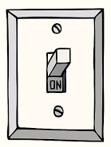
Off
On

Slide 4
0
0
0
1
1
0
1
1

Slide 5
0
0
0
0
0
1
0
1
0
0
1
1
1
0
0
1
0
1
1
1
0
1
1
1

Slide 6
0
0
0
0
0
0
0
0
1
1
1
1
1
1
1
1

Slide 7
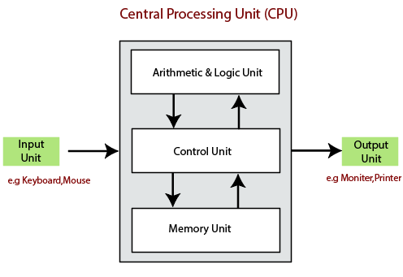
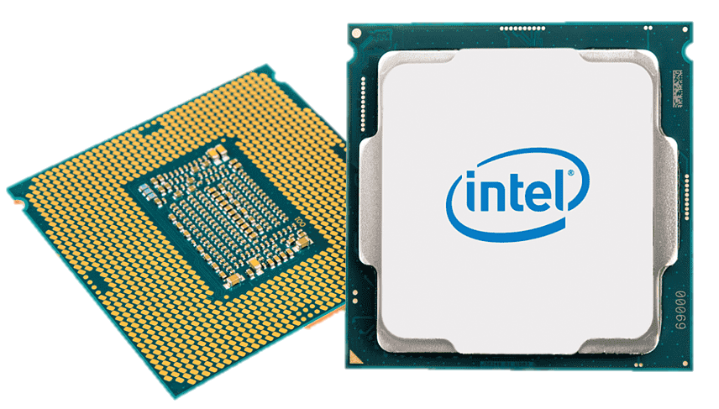


Slide 8
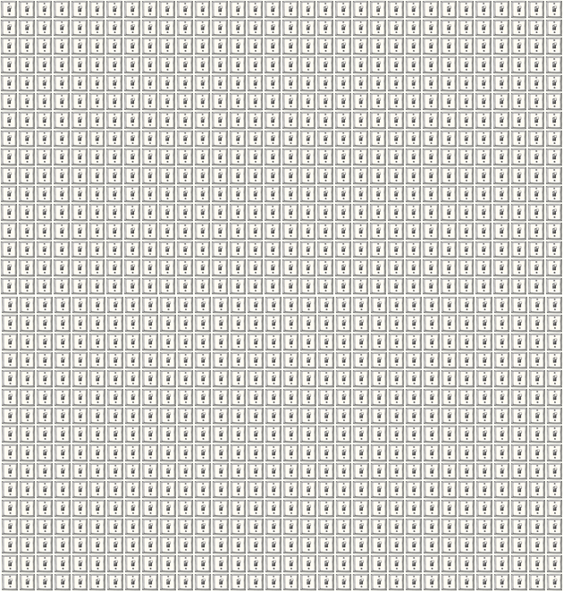

Slide 9
RAM
8 bits = 1 byte
1024 bytes = 1 Kilo Byte
1024 Kilo bytes = 1 Mega Byte
1024 Mega bytes = 1 Giga Byte
1024 Giga bytes = 1 Tera Byte

Slide 10
RAM
8 bits = 1 byte
1024 bytes = 1 Kilo Byte
4 GB RAM
4 X 1024 X 1024 X 1024 X 8
34,359,738,368
1024 Kilo bytes = 1 Mega Byte
1024 Mega bytes = 1 Giga Byte
8 GB RAM
8 X 1024 X 1024 X 1024 X 8
68,719,476,736
1024 Giga bytes = 1 Tera Byte
32-bit processor
64-bit processor
2³²
4,294,967,296
2⁶⁴
18,446,744,073,709,551,616

Slide 11
Rise your questions now

Slide 12
How does any programming Language Work?
Input
(Commands)
User
Computer
Python Interpreter
Set of tasks/
Source Code
Output
Expressions
Statements
Filename.py

Slide 13
How does any programming Language Work?
Input
Tasks will be worked out one by one (line by line)
Task 1
All tasks can not be done at a time
Flow
Task 2
All lines can not be executed at a time
Task 3
Sudden Jumps also will not be done
Task 4
If it finds a Task is wrong It stops immediately. No output.
Output

Slide 14
Variables and Data Types
Mathematical Equation
X = 5
Assigning data to the Variable

Slide 15
How does Memory Work?
Assigning data to the Variable
X = 5
Y = 10
Z = X + Y
Input
(Commands)
User
Computer
Output
X = 5
Y = 10
Set of tasks
Z = X + Y

Slide 16
How does Memory Work?
0000 0101
X
X = 5
0
0
Y = 10
0
0
Z = X + Y
0
1
0
1
X
5

Slide 17
How does Memory Work?
X
0000 0101
X = 5
5
Y = 10
+
Z = X + Y
Y
This happens when you see = sign
10
= is called assignment operator
Z
OUTPUT
15

Slide 18
Rise your questions now

Slide 19
Variable, Data Types
X = 5
Variable
=
Data
Variable ?
Data ?

Slide 20
Variables
Rules
Must
variables - store and manipulate data
Names of memory locations
a to z
A to Z
0 to 9
_ underscore
_variable
my_variable
x1
Should not start with number
case-sensitive
No Reserved Keywords: int, float, True, False, str, if, while, for, class, def, import, etc
No Whitespace
No special characters
~ ! @ # $ % ^ & * ( ) -

Slide 21
Variables
Conventions
Liberal
to use lowercase letters for variable names
my_variable My_Variable or myVariable
snake_case user_name, total_score username, totalscore
uppercase for constants PI, MAX_VALUE, PLANCKS_CONST
Descriptive Names:
This makes your code more readable and maintainable.
Avoid One-letter Names
Improve the code clarity

Slide 22
Variables
Valid
Invalid
age = 30
user_name = "Alice“
total_score = 100
pi = 3.14
is_valid = True
MAX_ATTEMPTS = 3
2nd_attempt = 2
my-variable = 5
for = "loop"

Slide 23
Rise your questions now

Slide 24
Data Types
Python Data Types
Numeric
Boolean
Sequence
Set
Dictionary
Integer
Float
Complex
String
List
Tuples

Slide 25
Strings
greeting
0 | 1 | 2 | 3 | 4 | 5
H | e | l | l | o | !
-6 | -5 | -4 | -3 | -2 | -1
0 | 1 | 2 | 3 | 4 | 5 | 6 | 7 | 8 | 9 | 10 | 11
H | e | l | l | o |  | w | o | r | l | d | !
-12 | -11 | -10 | -9 | -8 | -7 | -6 | -5 | -4 | -3 | -2 | -1

Slide 26
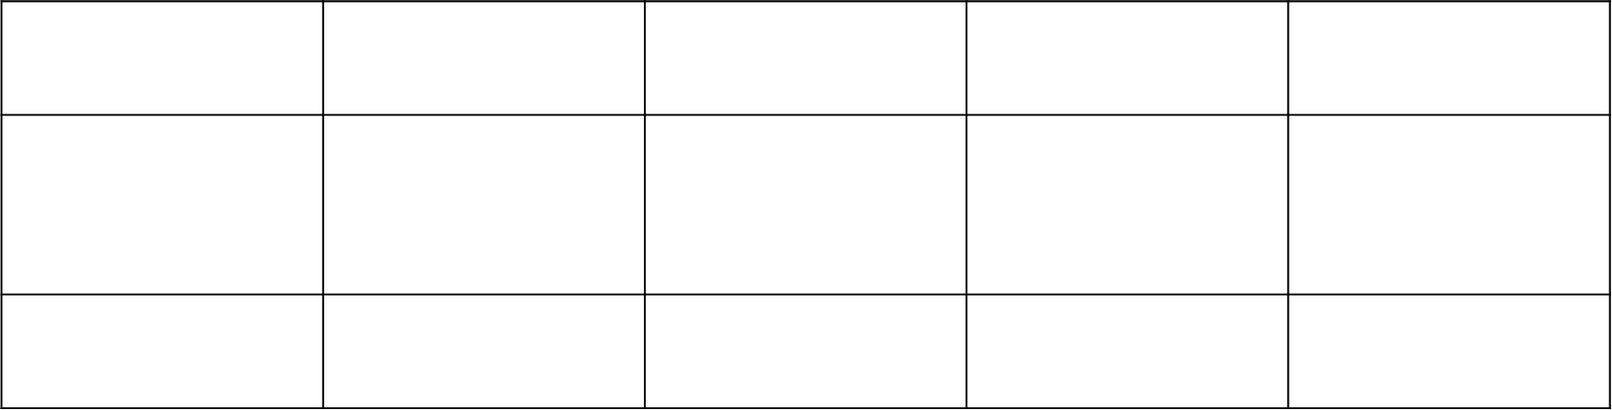
Lists
flowers
0
1
2
3
0 | 1 | 2 | 3 | 4 | 5
j | a | s | m | i | n
 |  |  |  |  | -1
0 | 1 | 2 | 3
r | o | s | e
-4 | -3 | -2 | -1
m | a | r | i | g | o | l | d
t | u | l | i | p
-4
-3
-2
-1

Slide 27
Properties = {name : “jasmine”,
color: “White”,
smell: “sweet”}

Slide 29
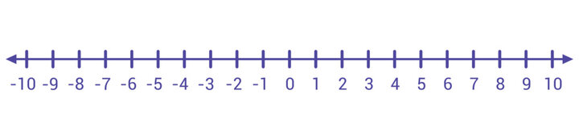

Slide 44
Errors
Types of Errors
Syntax Errors: Violations of language grammar rules.
Missing parentheses, incorrect indentation.
Runtime Errors Occur during program execution.
Division by zero, array index out of bounds
.
Logical Errors: Lead to incorrect program behavior.
Flawed algorithm, incorrect conditions.

Slide 45
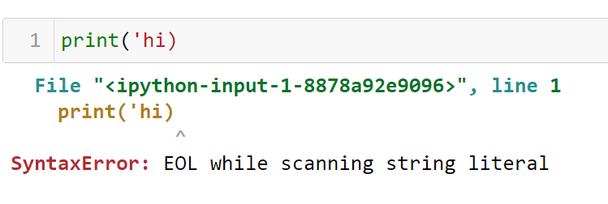
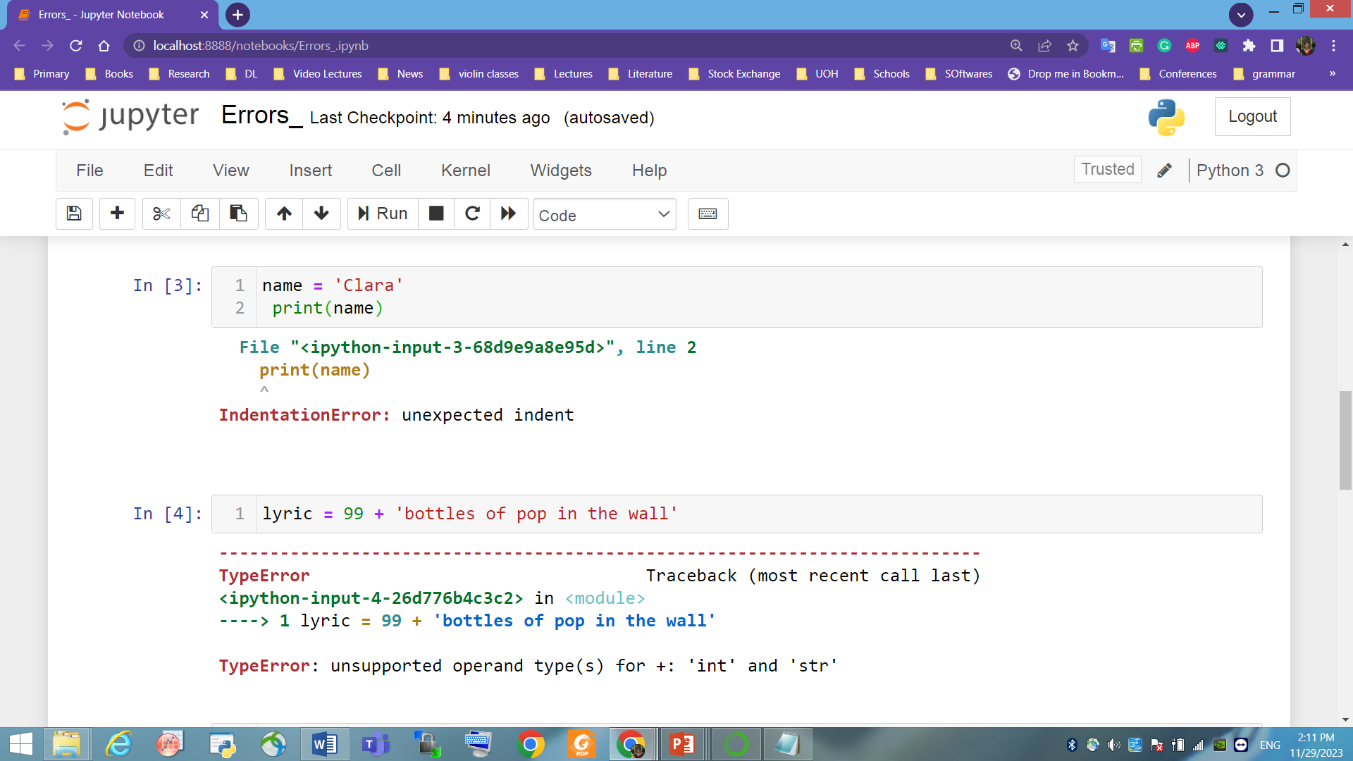
Syntax Errors

Slide 46
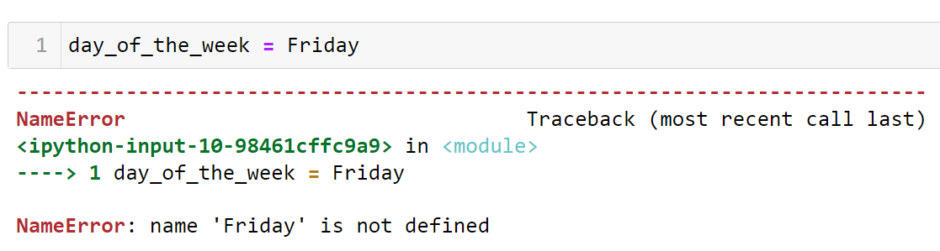
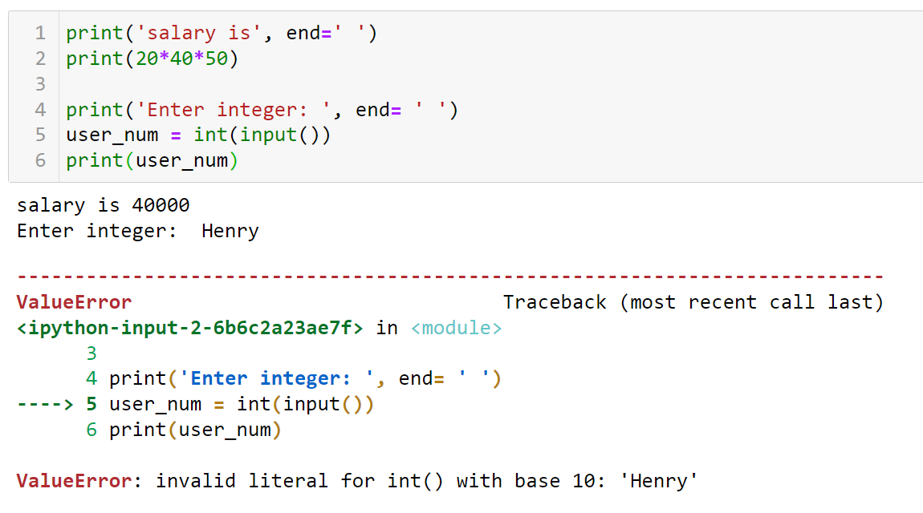
Runtime Errors

Slide 47
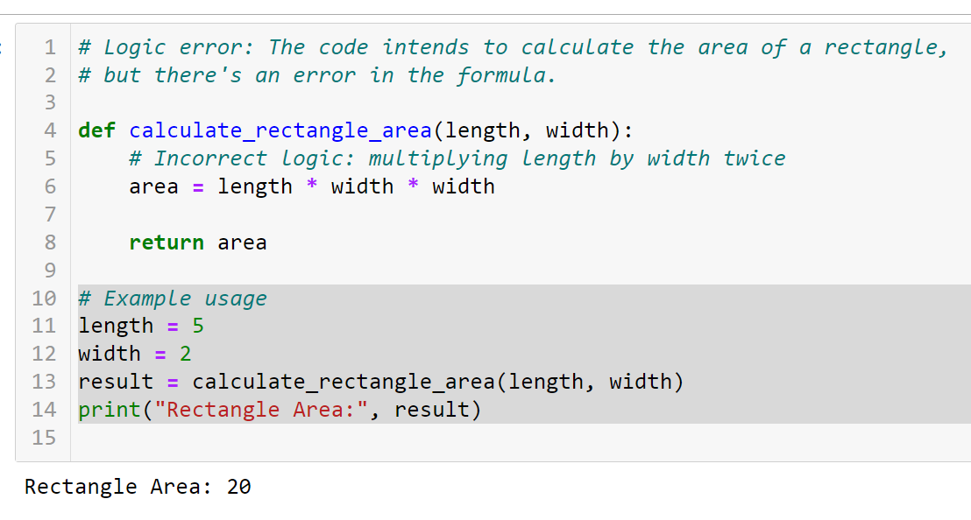
Logic Errors

Slide 48
