Slide 1
CleanTech : Transforming Waste Management with Transfer Learning
Team ID : LTVIP2025TMID35058 Team Size : 4
Team Leader : Kuna Mohan
Team members : Kesana Dharani Sri Kolavennu Kusuma K Devi Dileep Kumar

Slide 2
Problem statement
Waste management is a growing concern in urban and rural areas, where the classification and disposal of waste are often inefficient, leading to environmental pollution, health hazards, and increased operational costs. Traditional waste sorting methods are manual, time-consuming, and error-prone. There is a need for a smart, automated system that can classify different types of waste (organic, plastic, metal, paper, etc.) accurately to enable efficient recycling, composting, or disposal.

Slide 3
Content:
Project name and Team introduction
Problem Statement
Abstract
Proposed solution
Target users
Sample outcome
Use cases
How will it work
Summary
Thankyou

Slide 4
Abstract:
A smart waste management system that uses a machine learning model trained on Kaggle data to classify waste as recyclable or non-recyclable, integrated with a user-friendly HTML webpage for real-time image-based predictions.

Slide 5
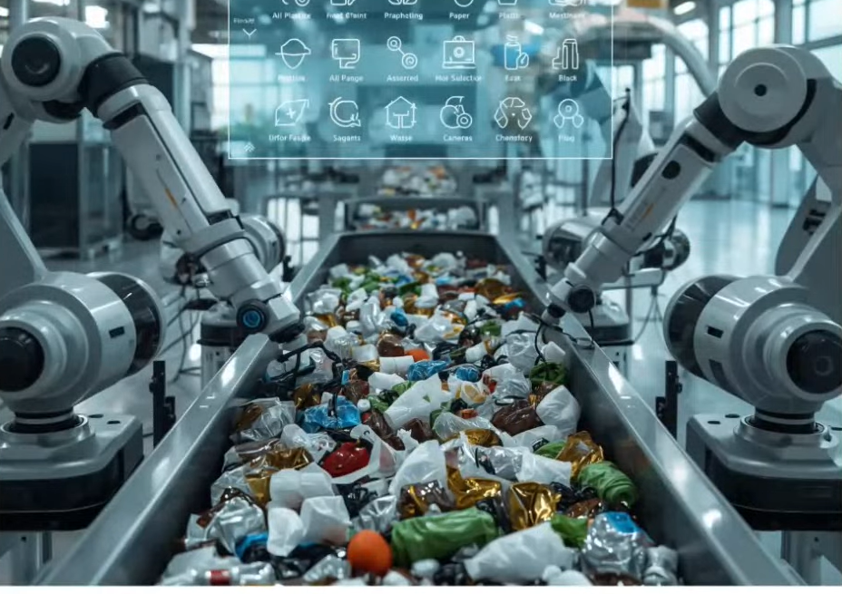
Proposed Solution:
Use image classification to automatically detect and classify waste as recyclable or non-recyclable.
Train a machine learning model using a labeled dataset from Kaggle containing various waste categories.
Preprocess the dataset with resizing, normalization, and data splitting to improve model accuracy and reduce noise.
Develop a lightweight, user-friendly HTML web
interface where users can:
Upload images of waste
Get instant classification results
(Recyclable / Non-Recyclable)

Slide 6
Target Users:Who will benefit from this?
🏙️ Municipal Corporations & Smart Cities
🧼 Cleanliness Workers & Waste Collectors
For deploying smart waste bins and automating waste sorting processes at collection points
Can use the system to reduce manual effort in classifying waste and improve their safety

Slide 7
Target Users:Who will benefit from this?
👨‍👩‍👧‍👦 Public General
🏭 Recycling Centers
Anyone who wants to learn to
properly sort waste at home
or in public spaces using a
simple web interface.
To streamline initial sorting processes and increase efficiency in managing recyclable materials.

Slide 8
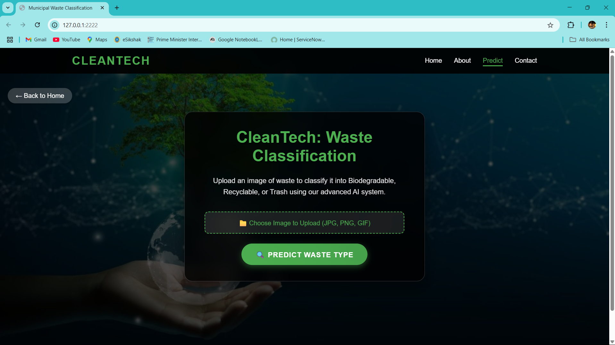
Sample outcomes:

Slide 9
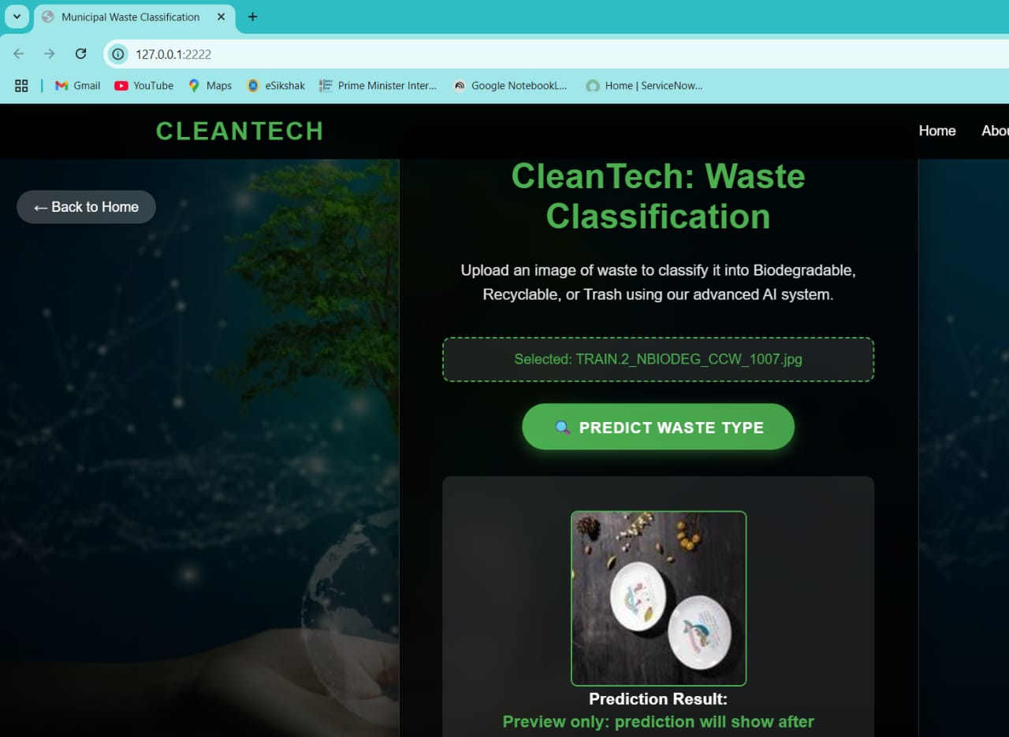
Sample Outcome:

Slide 10
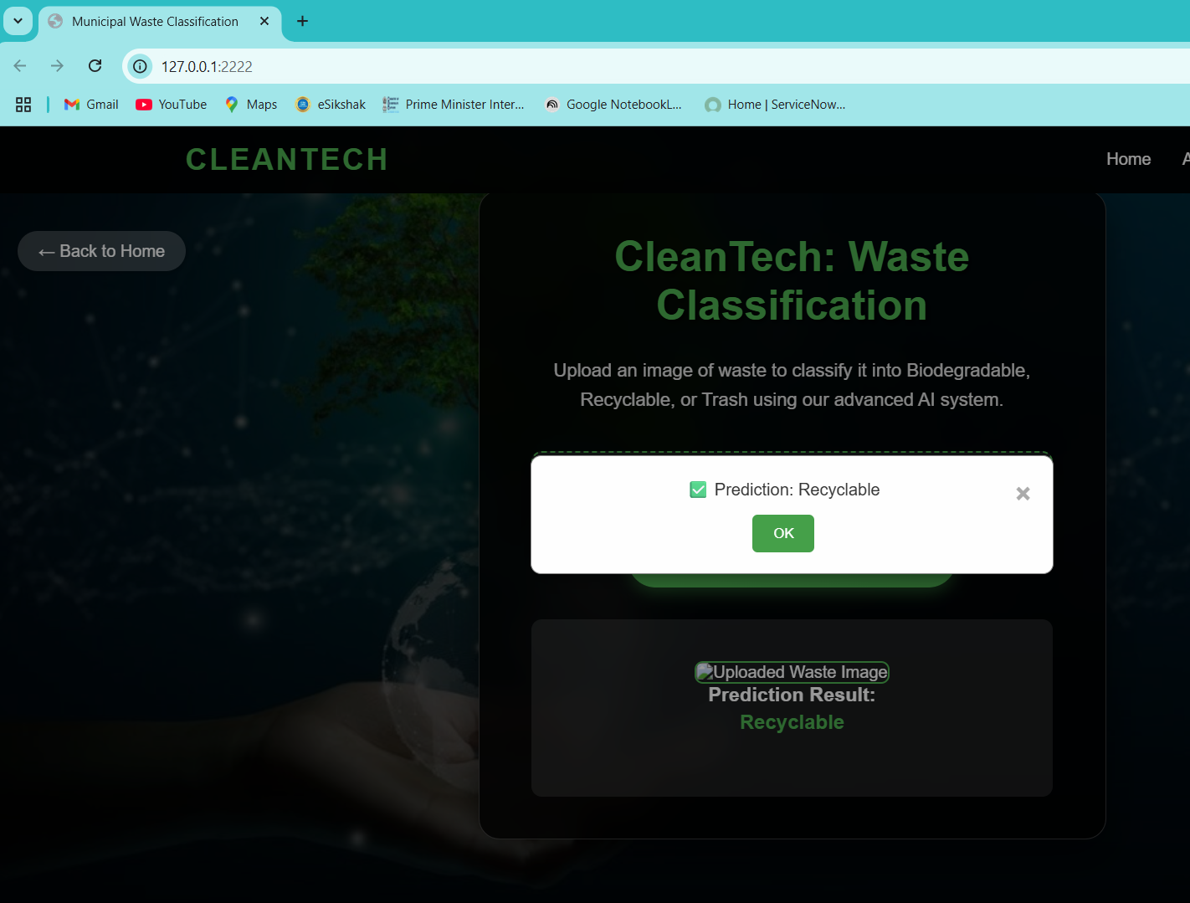
Sample Outcome:

Slide 11
🚀Use Cases:
🗑️ Smart Waste Bins
🤖Automatically identify the type of waste dropped into bins and segregate it using robotic arms or separate compartments.
🔄Recycling Centers
🦾Accelerate the sorting process by classifying waste on conveyor belts using camera feeds

Slide 12
How will it work?
🖼️ User Uploads Image
The user opens the webpage and clicks the Upload button.
They select an image of waste (e.g., plastic bottle, food wrapper, etc.).
📤 Image is Sent to the Model
Once uploaded, the image is either:
Sent to the backend (Flask/Django) where the ML model is hosted
Or processed directly in-browser (if using client-side inference like TensorFlow.js)
🧠 Model Processes the Image
The model checks the image and predicts whether it is:
♻️ Recyclable
🚯 Non-Recyclable
📋 Prediction is Displayed
The result is shown on the webpage — either as text, label, or icon.

Slide 13
Summary:
This project presents a Waste Management System that leverages Machine Learning and a web-based interface to promote efficient and eco-friendly waste segregation.
Using a waste classification dataset from Kaggle, we trained a model to distinguish between recyclable and non-recyclable waste. The model is integrated with an HTML webpage, allowing users to upload images of waste and receive instant classification results.

Slide 14



