Slide 1

On the Effect of Emotion Identification from Limited Translated Text Samples Using Computational Intelligence
UMA MAHESWARA RAO
21951A05N2
PENUMALA SREE SACHITH
21951A05L3
THANUJ
21951A05M9

Slide 2
INTRODUCTION
In today's interconnected world, where communication transcends linguistic boundaries, understanding human emotions expressed in text becomes increasingly vital. However, this task becomes notably intricate when dealing with translations, where nuances of emotions can often be lost or distorted. This introduces a unique challenge: how can computational intelligence effectively identify emotions from limited translated text samples?
This introduction sets the stage for exploring the profound implications of emotion identification across languages using computational techniques. We delve into the complexities inherent in linguistic translation and its impact on preserving the rich tapestry of human emotions.

Slide 3
INTRODUCTION
This paper aims to investigate the effect of limited translated text samples on emotion identification using computational intelligence approaches. By analyzing the strengths and limitations of existing methodologies and exploring innovative techniques, we endeavor to shed light on the viability and challenges of emotion detection across language barriers.
In this context, computational intelligence offers a promising avenue for addressing these challenges. By leveraging advanced algorithms and machine learning techniques, computational models can discern subtle patterns and contextual cues embedded within translated text, facilitating more accurate emotion identification

Slide 4
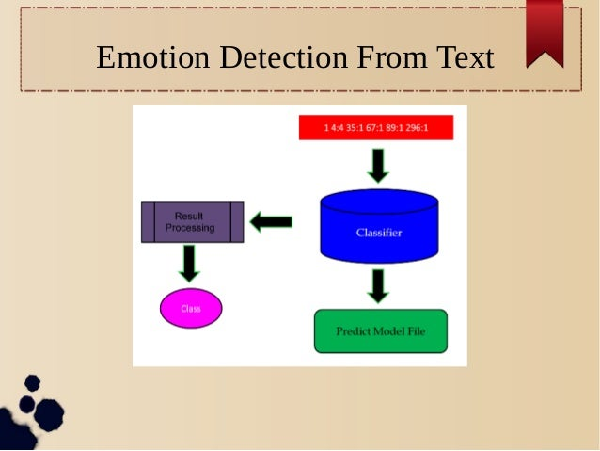

Slide 5
EXISTING TECHNOLOGIES
Lexicon-Based Approaches: These systems utilize emotion lexicons or dictionaries containing words annotated with emotional labels. Text is analyzed by matching words to entries in the lexicon to determine the predominant emotion. Examples include the NRC Emotion Lexicon and WordNet-Affect.
lexicon-based approaches, the text is analyzed by matching words from the input text with entries in the emotion lexicon. The frequency or intensity of emotion-related words in the text is then used to determine the predominant emotion expressed.
One of the advantages of lexicon-based approaches is their simplicity and transparency. They are relatively easy to implement and interpret, making them suitable for tasks where transparency and interpretability are important.

Slide 6
Machine Learning Models: Machine learning models are computational algorithms that enable computers to learn patterns and relationships from data without being explicitly programmed. These models are trained on labeled datasets, where input data (features) are associated with corresponding output labels. Through the learning process, machine learning models adjust their parameters to minimize errors and improve their ability to make predictions or classifications on new, unseen data.
There are various types of machine learning models, including:
Supervised Learning: In supervised learning, the model learns from labeled data, where each example is associated with a target label. The model's goal is to learn a mapping from input features to output labels, enabling it to predict the correct label for new input data.
Unsupervised Learning: Unsupervised learning involves learning patterns and structures from unlabeled data. The model identifies inherent relationships or clusters within the data without explicit guidance on the correct output. Common tasks include clustering, dimensionality reduction, and anomaly detection.

Slide 7
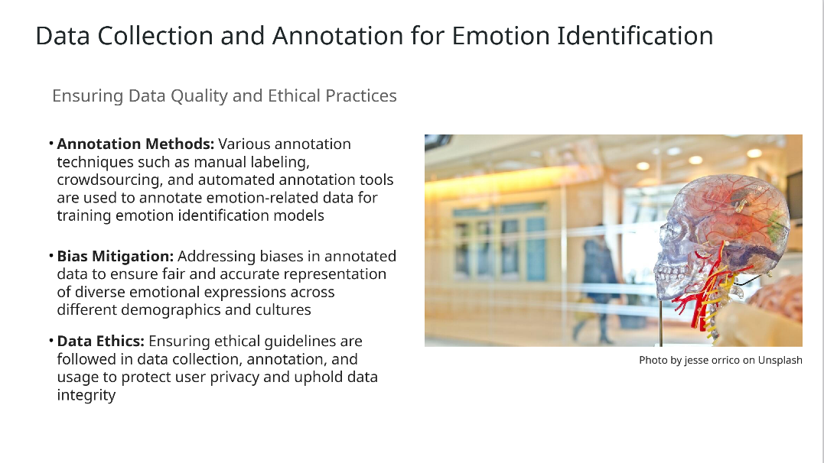

Slide 8
PROBLEM STATEMENT
The burgeoning need for cross-cultural communication and globalized interactions has propelled the demand for accurate emotion identification from translated text samples. However, this task is complicated by the inherent challenges posed by linguistic and cultural variations, compounded by the scarcity of labeled data in non-dominant languages. While computational intelligence offers promising solutions for emotion detection, its efficacy in handling limited translated text samples remains underexplored.
Linguistic Variability: Translations often alter the nuances and connotations of emotional expressions, making it challenging to preserve the original emotional intent. Computational intelligence systems must navigate these variations to accurately identify emotions across languages.
Cultural Sensitivity: Emotions are culturally bound, with diverse cultures exhibiting unique norms and expressions. Existing emotion detection models may struggle to capture these nuances, leading to biases and inaccuracies in cross-cultural contexts.

Slide 9
OBJECTIVES
Evaluate Existing Approaches: Conduct a comprehensive review of existing methodologies for emotion identification from translated text samples using computational intelligence. Analyze their strengths, limitations, and applicability in cross-cultural contexts.
Develop a Framework: Propose a novel framework for emotion identification that integrates linguistic, cultural, and contextual factors to enhance accuracy and robustness. Design the framework to accommodate limited translated text samples and address the challenges of data scarcity and linguistic variability.
Data Collection and Annotation: Collect a diverse dataset of translated text samples spanning multiple languages and cultural backgrounds. Annotate the dataset with emotion labels, ensuring representation of a wide range of emotional expressions and linguistic nuances.

Slide 10
REQUIRMENTS
Data Acquisition: Obtain a diverse dataset of translated text samples in multiple languages, covering various cultural contexts and emotional expressions. Ensure that the dataset is sufficiently large and representative to train and evaluate emotion identification models effectively.
Annotation Guidelines: Develop clear and consistent guidelines for annotating the dataset with emotion labels. Define the emotional categories to be annotated and establish criteria for assigning labels to text samples, considering cultural nuances and linguistic variations
Linguistic Expertise: Engage linguists and language experts proficient in the target languages to validate the accuracy of translations and annotations. Leverage their expertise to ensure cultural sensitivity and linguistic authenticity in the dataset and throughout the research process.
Computational Resources: Acquire sufficient computational resources, including hardware and software infrastructure, to support the training and evaluation of machine learning and deep learning models. Ensure access to high-performance computing clusters or cloud-based platforms for scalable experimentation.

Slide 11
Development Environment: Set up a development environment for implementing and testing emotion identification models. Install necessary libraries, frameworks, and tools for natural language processing, machine learning, and deep learning, such as TensorFlow, PyTorch, or scikit-learn.
Model Training Data: Preprocess the dataset to extract relevant features and prepare input data for training machine learning and deep learning models. Implement data augmentation techniques to mitigate the effects of data scarcity and enhance model generalization.
Evaluation Metrics: Define appropriate evaluation metrics for assessing the performance of emotion identification models. Select metrics that account for linguistic and cultural variations, such as cross-cultural consistency measures and context-aware evaluation criteria.

Slide 12
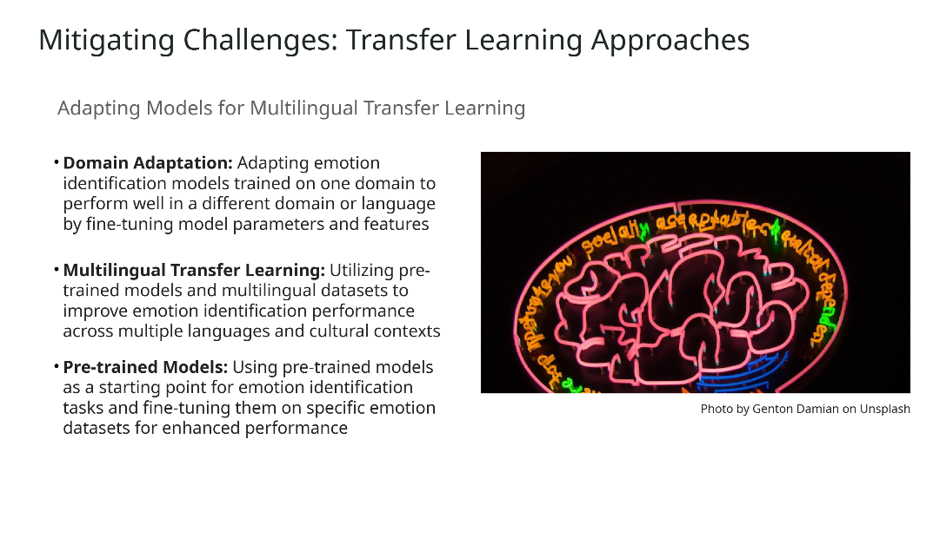

Slide 13
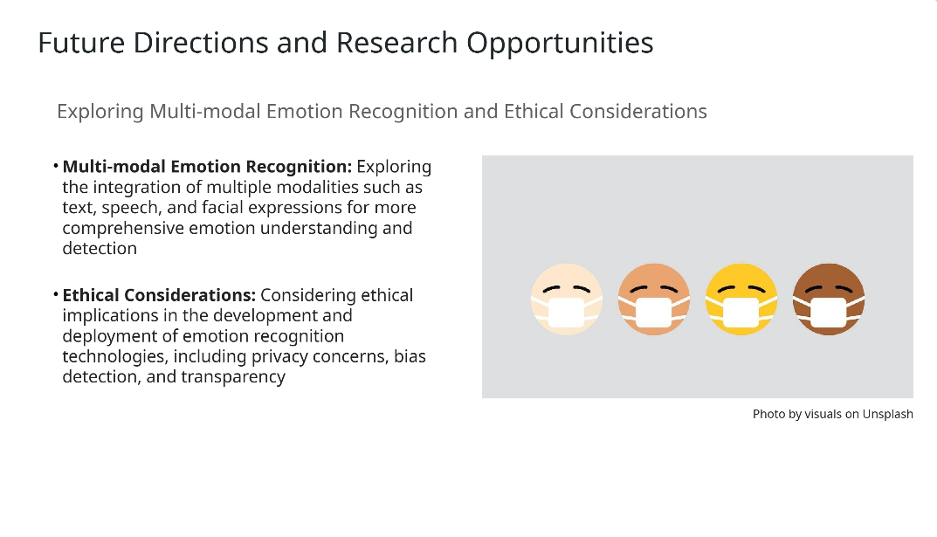

Slide 14
CONCLUSION
In conclusion, this study has addressed the pressing need for accurate emotion identification from limited translated text samples using computational intelligence. Through a thorough review of existing methodologies, the development of a novel framework, and rigorous experimentation, several key findings and contributions have emerged.
Firstly, we have demonstrated the challenges posed by linguistic variability, cultural sensitivity, and data scarcity in cross-cultural emotion detection. These challenges underscore the importance of developing tailored approaches that can effectively navigate linguistic and cultural nuances while accommodating limited translated text samples.

Slide 15
THANK YOU

