Slide 1

PROJECT REVIEW-2
INSTITUTE OF AERONAUTICAL ENGINEERING
DEPARTMENT OF COMPUTER SCIENCE AND ENGINEERING.
Supervisor:
DR. J SIRISHA DEVI
- PROFESSOR, CSE.
M. UMA MAHESH – 21951A05N2
P. SREE SACHITH – 21951A05L3
THANUJ REDDY – 21951A05M9

Slide 2
On the Effect of Emotion Identification from Limited Translated Text Samples. (ML-Framework to identify emotion that is hidden in limited translated text data)
PROJECT NAME:

Slide 3
CONTENTS:
Abstract.
Introduction.
Literature review.
Problem definition.
Objectives and Outcomes.
Methodology
References.
Conclusion.

Slide 4
Abstract:
Many times , the original text is written in a different language and the end-user translates it to there native language using online utilities.
A framework to detect emotions on translated text data in four different languages.
The source language is English, whereas the four target languages include Chinese, French, German, and Spanish.
Computational intelligence (CI) techniques are applied to extract features, dimensionality reduction, and classification of data into five basic classes of emotions.
These emotions included angry, disgusting, fear, happy, and surprise.

Slide 5
Introduction :
Emotion is a biological state linked with the human nervous system.
Emotions can be expressed through verbal communication, gestures, actions, and written expressions.
The communication that is made from a long distance, it is a challenging task. Such communication usually involves the text-based modes of message passing, like emails and letters.
Nowadays, everyone uses the internet, and people are interconnected through it. Most of our communication occurs via text messages. Therefore, the identification of emotions conveyed through text is important.

Slide 6

Introduction :
Importance of text:: “Happy Fathers Day.” care’s emotions like happiness, love.
The communication between speakers of different native languages requires utilization of text translation from one language to another.
This is made convenient through various free online translation tools, especially via Google Translate.

Slide 7
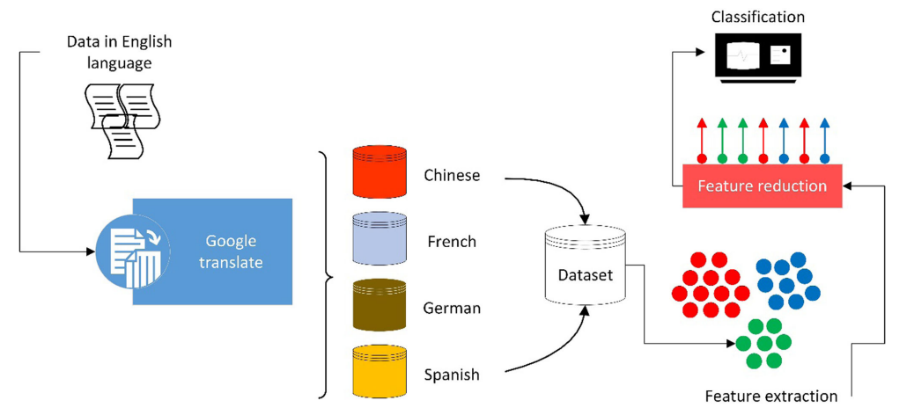
Introduction :
Flow Chart:

Slide 8
Literature review :
s.no | Name of the Author | Title of the paper | Model | Performance
1) | Shalunt’s | Sentiment analysis of German social media data for natural disasters. | SentiStrength, (NLP) | 91.12%
They specifically cover the natural disasters in general news.
The languages examined in their work are English, German, and Russian.

Slide 9
Literature review :
s.no | Name of the Author | Title of the paper | Model | Performance
2) | Wang | Emotion detection in code switching texts via Bilingual and Sentimental Information. | Bidirectional Encoder Representations from Transformers,CNN | 89.04%
The key issue of emotion detection in code switching texts is to deal with the emotions expressed through different languages.
Thus bridging the gap between different languages becomes essential for emotion detection in code-switching texts.

Slide 10
Literature review :
s.no | Name of the Author & year | Title of the paper | Model | Performance
3) | Chen,Yang | Lyric-based song emotion detection with affective lexicon and fuzzy clustering method | vector space model, Wu’s fuzzy clustering method | 81.05%

Slide 11
Literature review :
s.no | Name of the Author | Title of the paper | Model | Performance
4) | Zuo | A multilingual database of natural stress emotion. | Feature Extraction Techniques:: Mel-Frequency Cepstral Coefficients (MFCCs) | 50.29%

Slide 12
Literature review :
s.no | Name of the Author | Title of the paper | Model | Performance
5) | Sagha | Enhancing multilingual recognition of emotion in speech by language identification, | i-vector, Bottleneck Feature Extraction,Neural networks | 64.01%

Slide 13
Problem definition:
Development of ML-Model, for emotion identification from translated text
Basically, problem can be identified by 2 ways 1)Language → (English,Chinese, French, German, and Spanish) 2)Emotion → (Angry, disgusting, fear, happy, and surprise)
Problem can be sloved by ml by many algorithems.
1) SVM and PCA.
2) RNN.

Slide 14
Objectives and Outcomes :
Evaluate Emotion Recognition Accuracy: Assess the performance of computational intelligence techniques, such as machine learning models, in identifying emotions from limited translated text samples across multiple languages
Optimize Computational Models: Develop and refine computational models tailored for emotion identification from limited translated text samples, considering factors such as translation quality, sample size, and linguistic variations.
Analyze Cross-Linguistic Variability: Investigate how emotions are expressed and interpreted differently across languages through translated text, and identify challenges and opportunities in cross-linguistic emotion recognition

Slide 15
Neural Networks: Recurrent Neural Networks (RNNs): Use RNNs, such as Long Short-Term Memory (LSTM) or Gated Recurrent Units (GRUs), to model sequential data and capture contextual information in translated text for emotion classification. Nonlinear Dimensionality Reduction: t-Distributed Stochastic Neighbor Embedding (t-SNE): t-SNE is a nonlinear dimensionality reduction technique that is effective for visualizing high-dimensional data and preserving local structures. It can be useful for exploring the distribution and clustering of emotion-related features extracted from text data.
Methodology :

Slide 16
1. Bhugra, D., McKenzie, K.: Expressed emotion across cultures. Adv. Psychiatr. Treat. 9(5), 342–348 (2003) 2. Canfora, C., Ottmann, A.: Risks in neural machine translation. Transl. Spaces 9(1), 58–77 (2020) 3. Cao, F., Perfetti, C.A.: Neural signatures of the reading-writing connection: greater involvement of writing in Chinese reading than English reading. PLoS ONE 11(12), e0168414 (2016) 4. Chang, C.C., Lin, C.J.: LIBSVM: a library for support vector machines. ACM Trans. Intell. Syst. Technol. (TIST) 2(3), 1–27 (2011) of cross-cultural color emotion. Color Res Appl 32(3), 223–229 (2007)
References:

Slide 17
Conclusion :
Machine learning methods were used to classify the data into five classes of emotions.
Term frequency-inverse document frequency (TFIDF)-based features were extracted from text data. Later, principal component analysis (PCA) was used for feature reduction as dimensions obtained from TFIDF were high.
Feature Reduction: | Principal component Analysis (PCA) | Recurrent Neural Networks (RNNs)
Performed By: | Support vector machine (SVM) -(Eigan vectors) | Nonlinear dimensionality reduction technique.

Slide 18
THANK YOU.

