Slide 1

PROJECT REVIEW-3
INSTITUTE OF AERONAUTICAL ENGINEERING
DEPARTMENT OF COMPUTER SCIENCE AND ENGINEERING.
Supervisor:
DR. J Roopesh Kumar
- PROFESSOR, CSE.
M. UMA MAHESH – 21951A05N2
P. SREE SACHITH – 21951A05L3
K. THANUJ REDDY – 21951A05M9

Slide 2
On the Effect of Emotion Identification from Limited Translated Text Samples.
PROJECT NAME:

Slide 3
CONTENTS:
Introduction.
Abstract.
Problem definition.
Methhodology.
Implementation.
References.
Conclusion.

Slide 4
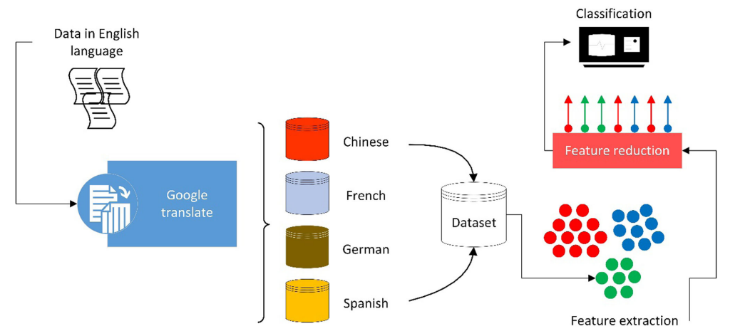
Introduction :
Flow Chart:

Slide 5
Abstract:
Many times , the original text is written in a different language and the end-user translates it to there native language using online utilities.
A framework to detect emotions on translated text data in four different languages.
The source language is English, whereas the four target languages include Chinese, French, German, and Spanish.
Computational intelligence (CI) techniques are applied to extract features, dimensionality reduction, and classification of data into five basic classes of emotions.
These emotions included angry, disgusting, fear, happy, and surprise.

Slide 6
Problem definition:
Development of ML-Model, for emotion identification from translated text
Basically, problem can be identified by 2 ways 1)Language→(English,Chinese, French, German, and Spanish) 2)Emotion →(Angry, disgusting, fear, happy, and surprise)
Problem can be sloved by ml by many algorithem.
1) RNN.
2)SVM.

Slide 7
Methodology :
Data-Flow Diagram.
Algorithm.
Data set used.
Architecture

Slide 8
Data-Flow Diagram.
INPUT Text
Translated Text
Pre-Processing (cleaning text)
RNN(LSTM)
Detection of emotion.

Slide 9
Algorithm.
Recurrent Neural Network (RNN)
Recurrent Neural Network(RNN) is a type of Neural Network where the output from the previous step is fed as input for the next step.
LSTM(long short term memory) used for the model input predictions.
LSTM is one of the RNN .
SVM is ruled out because of the effiency of the algorithm is low.

Slide 10
Data set used.
ISEAR: International Survey on Emotion Antecedents and Reactions:
On the bases of this the dataset contains mainly 2 column namly ‘Emotion’ and ‘Text’.
The ISEAR dataset, which stands for International Survey on Emotion Antecedents and Reactions, is a widely used dataset in emotion research.
It consists of responses from people describing their emotions in response to various events or situations. Here's some information about it:

Slide 11
Architecture of algorithm.(Implementation)
Let go in steps :
1)Cleaning of the text ,Tockenization and spilting .
2)Modeling by layers.
3)Building and complied.

Slide 12
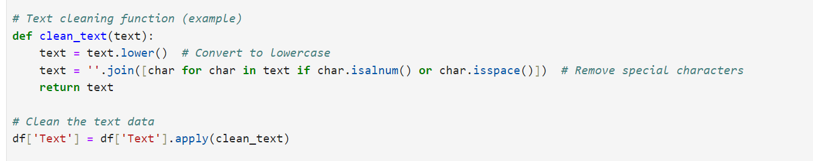
1)Cleaning of the text
The Raw text will be cleaned ,by removing the special charcters ,and converting into .lower letters

Slide 13
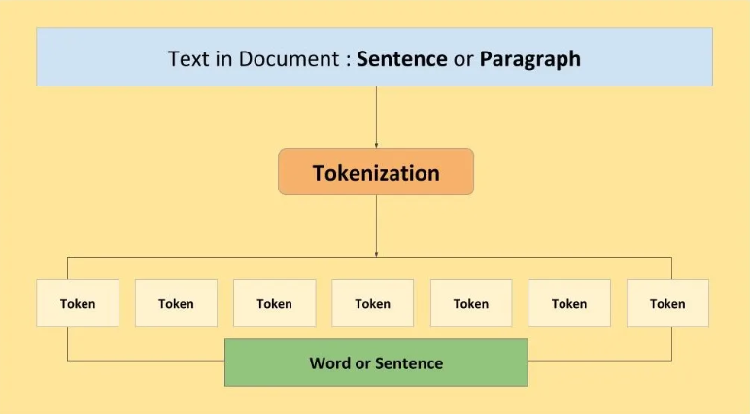
1)Tockenization and spilting
Tokenization: The process of converting text into a sequence of integers. Each word is assigned a unique integer based on its frequency in the corpus.
Input :: Dataset(text file)(emotion,text)
Output:: 2D tensor Vector(with integer indexing with maping of words).

Slide 14
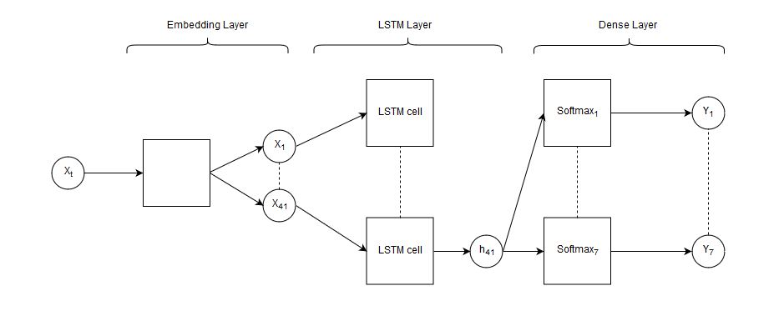
2)Modelling by layers.
Embedding Layer.
SpatialDropout1D Layer.
LSTM (Long Short-Term Memory).
Dense Layer.

Slide 15
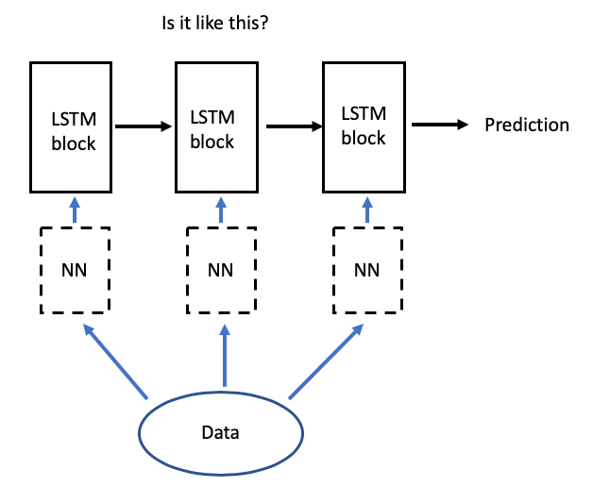
1)Embedding Layer .
Embedding Layer:
This layer maps each integer in the input sequences to a dense vector of fixed size. .
Input :: 2D tensor Vector.
Output: 3D tensor .(Array)

Slide 16
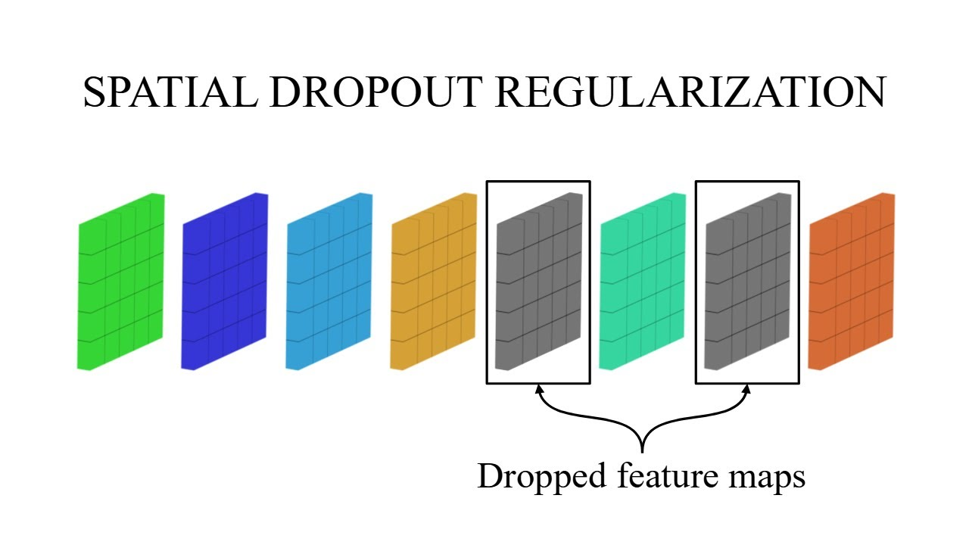
2)SpatialDropout
Input :: 3D tensor Vector.
Output: 3D tensor Vector.
The tockenized vector space with similar space will be set to zero or null.

Slide 17
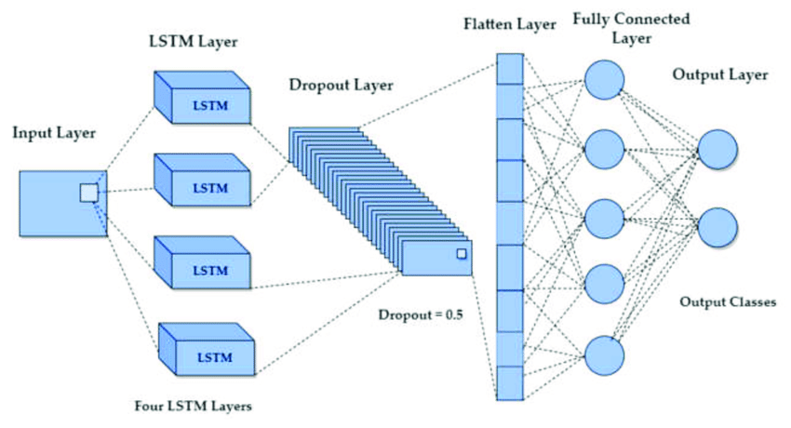
3)LSTM (Long Short-Term Memory).
It addresses the vanishing gradient problem.
The user input text be droped out (nearly 20-30%).
The recurrent dropouts in the recurrent states
Input :: 3D tensor Array.
Output :: 2D tensor vector.(in the form of nodes or neutons).

Slide 18
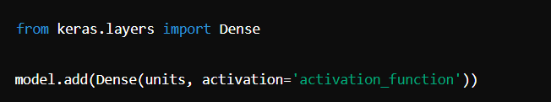
4)Dense Layer
This fully connected layer applies a ReLU activation function.
neuron (or node) in the layer is connected to every neuron in the previous layer.
Input: 2D tensor
Output: 2D tensor(where each value represents the probability)

Slide 19
Conclusion :
Machine learning methods were used to classify the data into five classes of emotions.
Term frequency-inverse document frequency (TFIDF)-based features were extracted from text data. Later, principal component analysis (PCA) was used for feature reduction as dimensions obtained from TFIDF were high.
Detection rate of Chinese language was lower than other languages because Chinese is different in many aspects than English.

Slide 20
1. Bhugra, D., McKenzie, K.: Expressed emotion across cultures. Adv. Psychiatr. Treat. 9(5), 342–348 (2003) 2. Canfora, C., Ottmann, A.: Risks in neural machine translation. Transl. Spaces 9(1), 58–77 (2020) 3. Cao, F., Perfetti, C.A.: Neural signatures of the reading-writing connection: greater involvement of writing in Chinese reading than English reading. PLoS ONE 11(12), e0168414 (2016) 4. Chang, C.C., Lin, C.J.: LIBSVM: a library for support vector machines. ACM Trans. Intell. Syst. Technol. (TIST) 2(3), 1–27 (2011) of cross-cultural color emotion. Color Res Appl 32(3), 223–229 (2007)
References:

Slide 21
THANK YOU.

