Slide 1





CMR ENGINEERING COLLEGE
(UGC AUTONOMOUS)
(Accredited by NBA,Approved by AICTE NEW DELHI, Affiliated to JNTU, Hyderabad)
Kandlakoya, Medchal Road, Hyderabad-501 401.
Department of Computer Science & Engineering A Mini Project
On
GARBAGE SEGREGATION USING DL
Presented By V.Uma Maheshwari T.Vinod Goud G.Sahana V.Balaram Prasad
Internal Guide:- Dr.K.Vijaya Babu
Assistant Professor, Dept. of CSE.
: (218R1A05J4)
: (218R1A05F6)
: (218R1A05F5)
: (218R1A05J5)
A.Y 2024-2025

Slide 2
Table of Content
Abstract
Introduction about Project
Literature survey
Existing System
Proposed Methodolgy
Software Requirements
Hardware Requirements
System Architecture
System Design
Output Screens
Conclusion
References

Slide 3
Abstract
Waste Segregation means to group Waste into different Categories. Each waste goes into its category at the point of dumping or collection. Under the Waste Regulations 2011, you must segregate cardboard, glass, metal, paper, plastic, trash and at source unless it is technically or economically unfeasible. Under the same regulations, you should implement the waste hierarchy; reduce, reuse, recycle, other recovery and disposal. By law, you should implement this hierarchy and segregation helps with recycling in particular. Waste segregation is included in law because it is much easier to recycle. Effective segregation of wastes means that less waste goes to land fill which makes it cheaper and better for people and the environment. It is important to segregate for public health. In particular, hazardous wastes can cause long term health problems, so it is very important that they are disposed of correctly and safely and not mixed in with the normal waste coming out of your home or office.

Slide 4
Introduction
Garbage Segregation Using DL is an application built using Jupiter Notebook platform so that we can use in phones or desktops.
In this project client uploads a photo and he gets the knowledge about the garbage.
According to the description given it is classified as recyclable or non-recyclable so that the segregation of waste is done properly.
The garbage and recycling businesses are being overwhelmed by the ever-increasing volume of global garbage.
As a result, the demand for smart solutions for environmental monitoring and recycling process improvement is stronger than ever.
Human life and the environment both affected by waste disposal, whether directly or indirectly.
The negative consequences of waste materials can be mitigated with the use of a competent waste management system..

Slide 5
Literature survey
AUTH0RS NAME | PAPER TITLE AND PUBLISHING YEAR | JOURNAL NAME | METHODOLOGY | OVER VIEW | KEY FINDINGS
D.Narayan, A.Mishra | IoT-Based Waste Segregation with Location Trackingand Air Quality Monitoring 2023 | Smart Cities | IoT and machine learning for air quality monitoringand waste segregation | The paper introduces a smart waste management system utilizing IoT and machine learning for segregating waste. | The system is cost-effective and enhances waste management productivity by categorizing waste.
A. Singh, R. Kaur, P. Gupta | A Method for Waste Segregation using Convolutional Neural Networks 2022 | arXiv | Convolutional Neural Networks (CNNs) for image- based waste classification | This research proposes a CNN-based approach for theclassification of waste types based on images, using advanced neural network architectures like ResNet-34 | The Proposed model achieves high accuracy in classifying waste, making it suitable for automated Waste segregation systems.

Slide 6
AUTH0RS NAME | PAPER TITLE ANDPUBLISHING YEAR | JOURNAL NAME | METHODOLOGY | OVER VIEW | KEY FINDINGS
T. R. Sahoo, P. K. Mohapatra, S. Mohanty | Waste Segregation and Management: A Comprehensive Review 2021 | Journal of Environmental Management | Comprehensive review of existing waste segregation and management practices | This paper provides an in- depth review of current waste segregation and management practices, examining various technological and methodological approaches. | The review identifies gaps in current practices and suggests improvements through technological advancements and policy changes.
V. Kumar, S. Verma, A. Sharma | Smart Waste Management System: A Survey 2019 | International Journal of Engineering Research & Technology | Review of smart waste management systems, including IoT and machine learning methodologies | This survey reviews various smart waste management systems, focusing on technologies that enhance the efficiency of waste collection and segregation processes. | The survey highlights the importance of integrating IoT and machine learning for effective waste management and presents future research directions.

Slide 7
AUTHORS NAME | PAPER TITLE ANDPUBLISHING YEAR | JOURNAL NAME | METHODOLOGY | OVER VIEW | KEY FINDINGS
G.Manogaran,M. Thota,D.Lopez | Machine Learning- Based Garbage and Management 2018 | IEEE Transactions On Automation Science and Engineering | Machine learning algorithms for garbage classification | This Paper Presents a system that uses machine learning techniques to classify garbage into different categories for efficient management | The system improves the accuracy of garbage classification and reduces the manual effort involved in waste segregation

Slide 8
Existing system
Garbage segregation is critical for efficient waste management, ensuring that recyclable materials are properly processed and non-recyclable waste is disposed of responsibly.
Traditional methods are labor-intensive and prone to errors. Deep Learning (DL) offers automated, accurate, and efficient solutions.
DRAWBACKS OF EXISTING SYSTEM
There are some serious drawbacks in existing system. They are:
Setting up deep learning systems requires substantial investment in hardware, such as GPUs and specialized sensors, as well as software development costs.
Deep learning models require vast amounts of labeled data for training. Collecting, annotating,and processing these datasets can be resource-intensive and time-consuming.

Slide 9
Proposed System
Our project only needs internet connection and a device which has camera. So that it is easy to take a snap of object and upload it .Convolutional Neural Network(CNN) is prominently used for image analysis. Its hidden layers called convolutional layers to make it more special. Each convolutional layer contains a set of filters.
These filters detect patterns or features in the images. A simplest CNN has the following layers:
Convolutional layer:
A convolutional layer extracts features of images by using filters. Filters are small matrices of dimensions of our wish filled with random values. These filters detect patterns by striding over the input images after which we get the resultant feature map which is passed to the next layer.
Pooling layer:
In this layer, a window normally a size of 2x2 is placed over the feature map and the maximum value is selected
in the window neglecting all other values. It results in a decreased picture scale. Fully connected layer: The actual
image recognition and classification happens in this sheet. The shrink images are taken and inserted into a single vector. This vector is compared and the image is classified with the vectors obtained from the trained images.

Slide 10
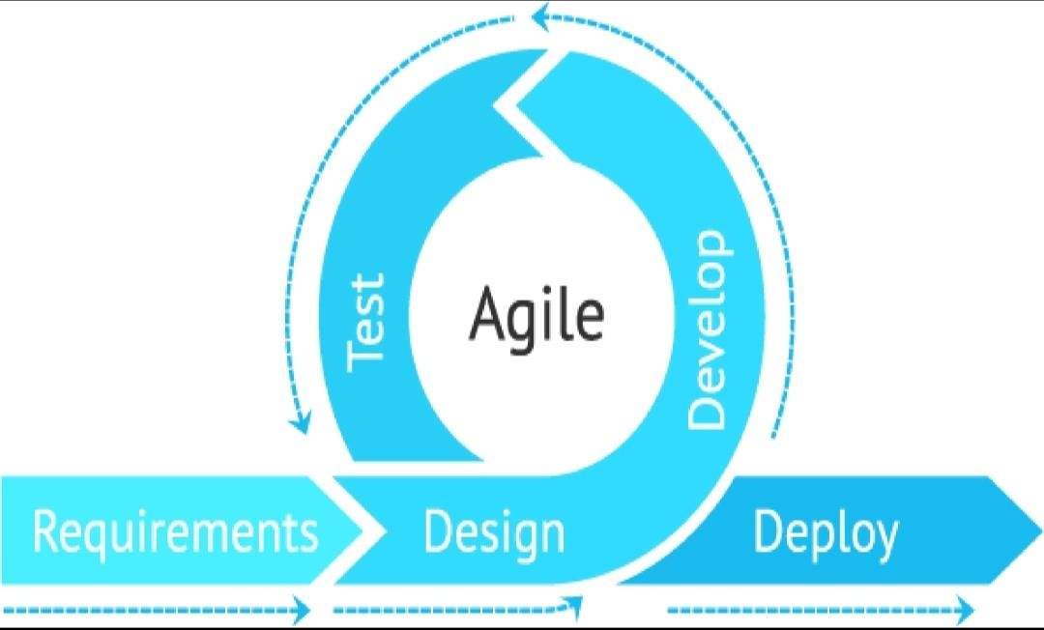
ADVANTAGES OF PROPOSED SYSTEM
The following are the advantages of proposed system:
Deep learning models, especially convolutional neural networks (CNNs), can achieve high accuracy in identifying and sorting different types of waste materials. This reduces contamination and increases the quality of recyclable materials.
Automation of sorting processes through robotic arms and conveyor belts integrated with deep learning reduces the need for manual labor, speeding up operations and lowering costs.

Slide 11
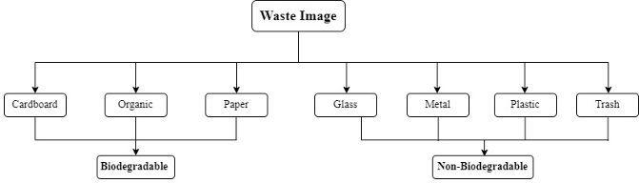
SYSTEM ARCHITECTURE

Slide 12
Software Requirements
Operating systems | Windows 7,10 or Higher Versions
Platform | Jupiter Notebook
Front End | Python & Files
Programming Language | Python
Algorithm | CNN

Slide 13
Hardware Requirements
Device | Monitor,Keyboard
Hard Disk | 100 GB(Minimum)
Processor | Dual core, i3/i5/i7
Ram | 4 GB

Slide 14
SYSTEM DESIGN

Slide 15
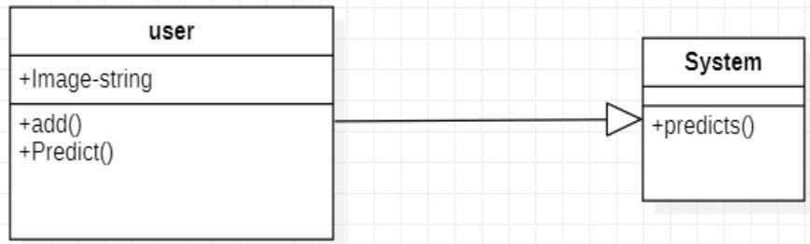
UML DIAGRAMS
CLASS DIAGRAM:

Slide 16
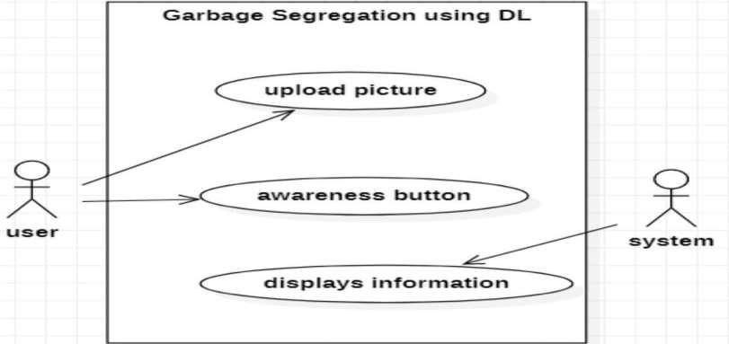
USE CASE DIAGRAM:

Slide 17
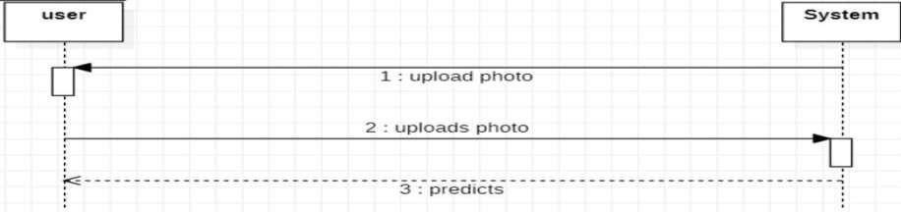
SEQUENCE DIAGRAM

Slide 18
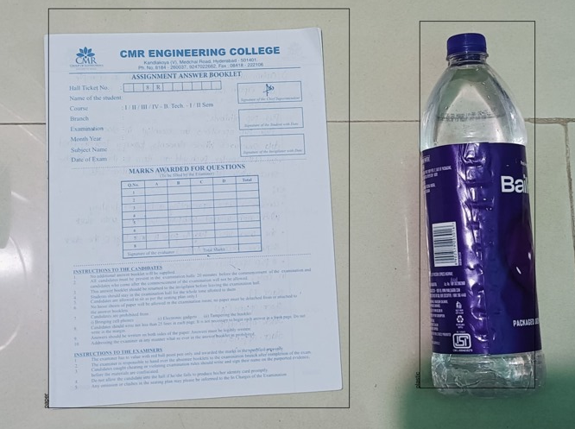
Output Screens
The above images are uploaded to detect the material

Slide 19
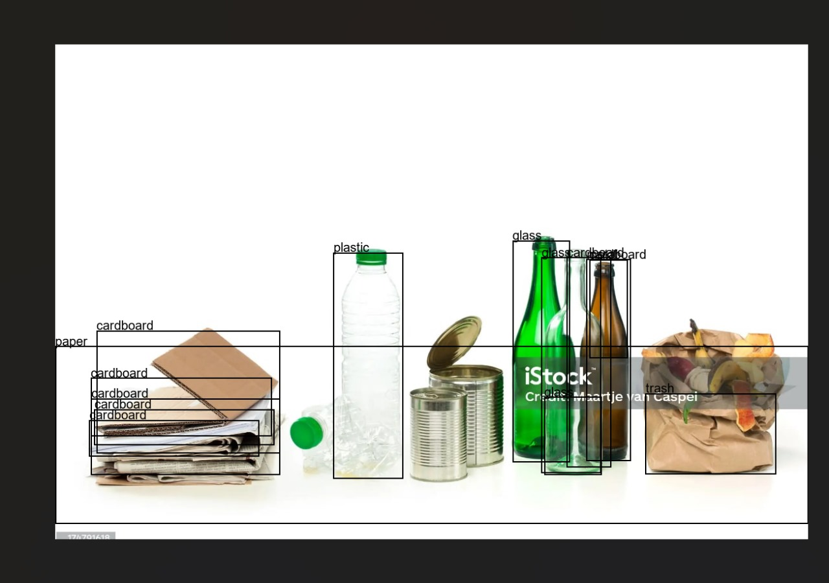
The uploaded images will classify the waste into different categories

Slide 20
CONCLUSION
In this research, our goal is to segregate the waste materials using machine learning. We made use of the pre-trained architectures and six waste classification categories to accomplish this goal.
Web scraping is done for removal of misclassified images and it has been working well in developing low precision models. Compared with other versions.
DenseNet169 performed better. The output of ResNet50 is likewise closer to DenseNet169.

Slide 21
REFERENCES
Miranda, Ruben, Blanco and Angeles. 2010. “Environmental awareness and paper recycling”. Cellulose Chemistry and Technology. Vol. 44. pp. 431-449.
Chandaluru Priyanka, Sri Ramya P. 2020. Image Based Classification of Waste Material Using Convolution Neural Network, International Journal of Advanced Science and Technology Vol. 29, 5, pp. 2967 – 2975
Albawi S, Mohammed T A and Al-Zawi S. 2017. "Understanding of a convolutional neural network,", International Conference on Engineering and Technology (ICET), Antalya, pp. 1-6
Deng J, Dong W, Socher R, L.-J. Li, Li K, and Fei-Fei L. 2009. “ImageNet: A Large-Scale Hierarchical Image Database”, IEEE Conference on Computer Vision and Pattern Recognition, pp. 248-255.
Bakator M, Radosav D. 2018. “Deep Learning and Medical Diagnosis: A Review of Literature”, Multimodal Technologies and Interaction.Vol. 2, 47, pp. 1-12.
Thung, Gary and Ming Xiang Yang. 2016. “Classification of Trash for Recyclability Status.”, Corpus Id-27517432.

Slide 22
Yang, M.; Thung, G. Classification of trash for recyclability status. CS229 Project Report 2016, 2016.
Lowe, D.G. Distinctive image features from scale-invariant keypoints. International journal of computer vision 2004, 60, 91–110.
Krizhevsky, A.; Sutskever, I.; Hinton, G.E. Imagenet classification with deep convolutional neural networks. Communications of the ACM 2017, 60, 84–90.
Sakr, G.E.; Mokbel, M.; Darwich, A.; Khneisser, M.N.; Hadi, A. Comparing deep learning and support vector machines for autonomous waste sorting. 2016 IEEE International Multidisciplinary Conference on Engineering Technology (IMCET). IEEE, 2016, pp. 207–212.
Arebey, M.; Hannan, M.; Begum, R.; Basri, H. Solid waste bin level detection using gray level co- occurrence matrix feature extraction approach. Journal of environmental management 2012, 104, 9–18

Slide 23


