Slide 1

Flipkart Television Market and Price Analysis
Exploratory Data Analysis
Poloju Uma Maheshwari

Slide 2
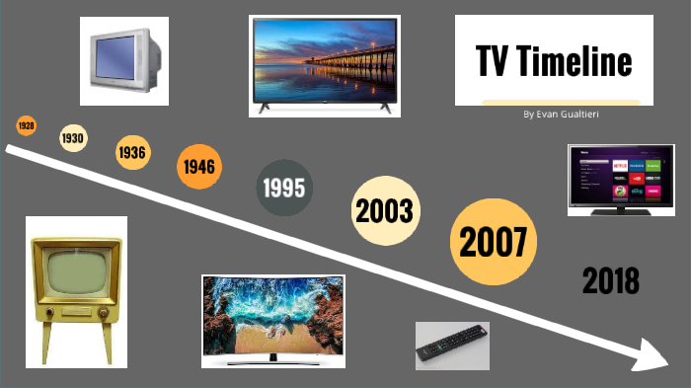
Problem Statement :
Understanding consumer preferences in the TV market: Analyzing best-selling brands,
price segments, and key features to optimize product stocking and maximize sales on
Flipkart."

Slide 3

Libraries Used:
• Regular Expressions
• Beautiful soup
• Numpy
• Pandas
• Matplotlib
• Seaborn

Slide 4
Web scraping Process:
Web scraping is the automated extraction of structured information from websites using Python tools.
LINK : https://www.flipkart.com/search?q=television&sid=ckf%2Cczl&as=on&as-show=on&otracker=AS_QueryStore
TOOLS: Python , Requests, Beautiful Soup, Regex , Pandas
Steps followed:
Fetched multiple Flipkart pages using Requests.
Parsed HTML content with Beautiful Soup
Extracted laptop details: Brand, Screen size, Quality, Price, Screen Type, Rating, Price.
Stored the cleaned results in a Data Frame and exported as CSV for analysis.

Slide 5
Exploratory Data Analysis:
EDA is the process of examining, cleaning, and understanding a dataset to uncover patterns, trends, and relationships. It helps validate data quality and provides insights through statistical summaries and visualizations.
Steps:
1.Data Collection ~ Gather raw data from the source.
2. Data Cleaning ~ Remove null values.
3. Univariate Analysis
4. Bivariate Analysis
5. Visualization & Insights.

Slide 6
Univariate Analysis:
Univariate analysis studies one feature at a time to understand its basic behavior. It shows patterns like distribution, central values, and outliers for that single variable.
Categorical:
Data that represents labels or categories instead of numbers (here, brand name, OS, Model name).
We used
Bar Plot- A bar plot is used to compare categories using bars whose heights represent a numeric value.
Shows average price for each category.
Helps compare which brands/models cost more.
Count Plot- A count plot automatically counts how many times each category appears in the dataset.
Shows how many times each category appears
Helps understand category popularity, frequency, and market dominance.

Slide 7
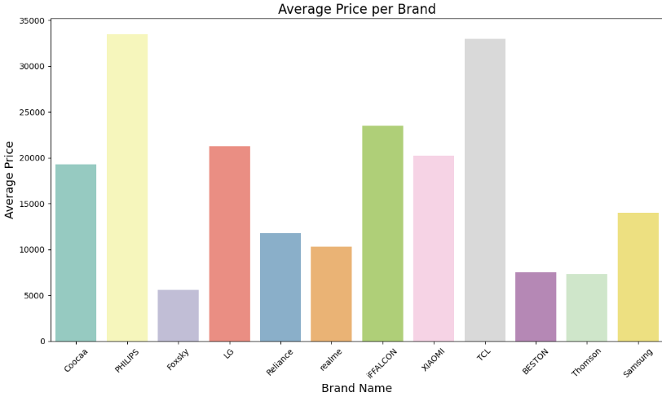
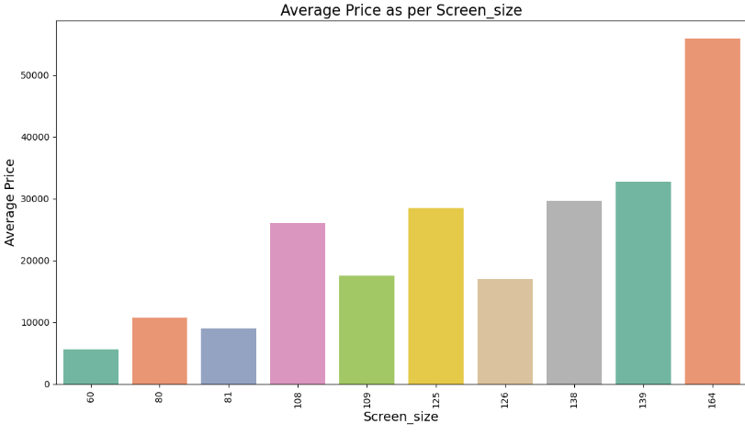
Univariate Analysis:
Bar Plot- A bar plot is used to compare categories using bars whose heights represent a numeric value.
1.For the brands like Blueprint, TCL, Samsung and PHILIPS has higher prices and other brands has average Prices.The brands like Foxsky, Thomson has very low prices.
2.The more the screen size the higher the prices.

Slide 8
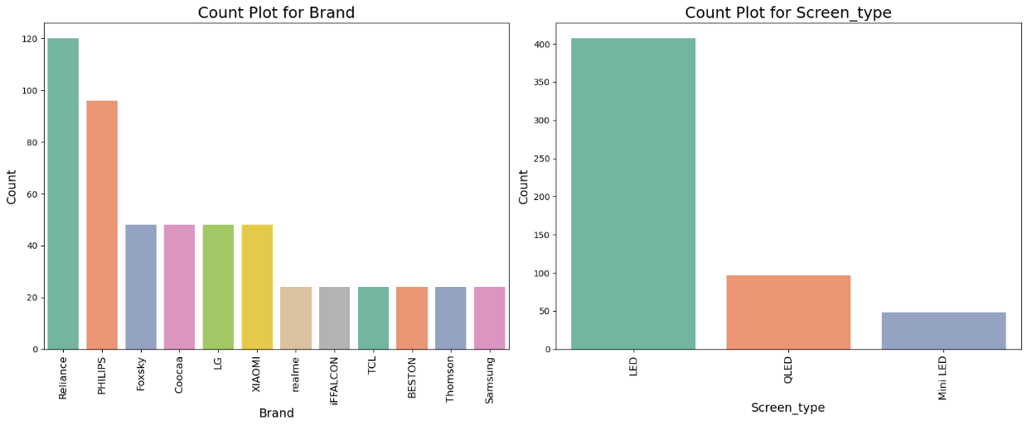
Count Plot
Count Plot- A count plot automatically counts how many times each category appears in the dataset.
1.Most Televisions in the dataset come from Reliance and Philips showing they dominate the market. Foxsky, Coocaa, LG and Xiaomi have a moderate number of listings. Many other brands appear only a few times, indicating they are less popular or rarely listed.
2.Mostly preferred screen type is LED.

Slide 9
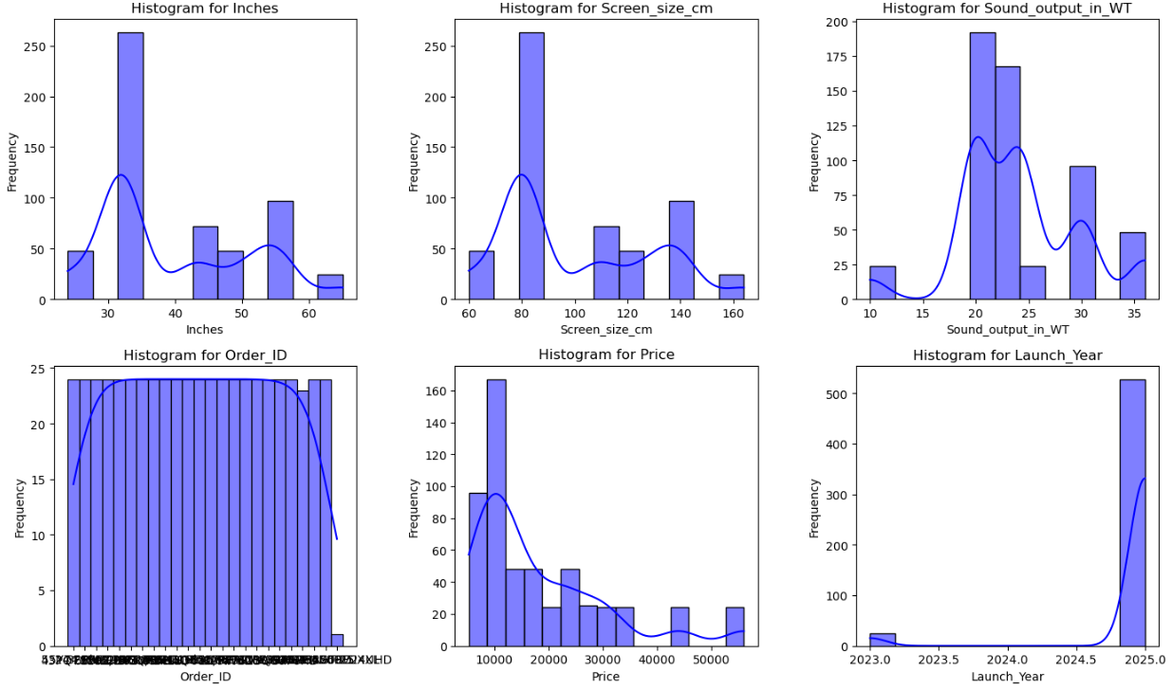
Histogram Plot
A histogram is a plot that shows how frequently different ranges of numerical values occur in a dataset.
Here, mostly prefered screen size varies between is 100-140 ,sound output is in between20-30WTfor the most TV's the price ranges between 20000-40000 and most of the TV's launched in the year 2025.

Slide 10
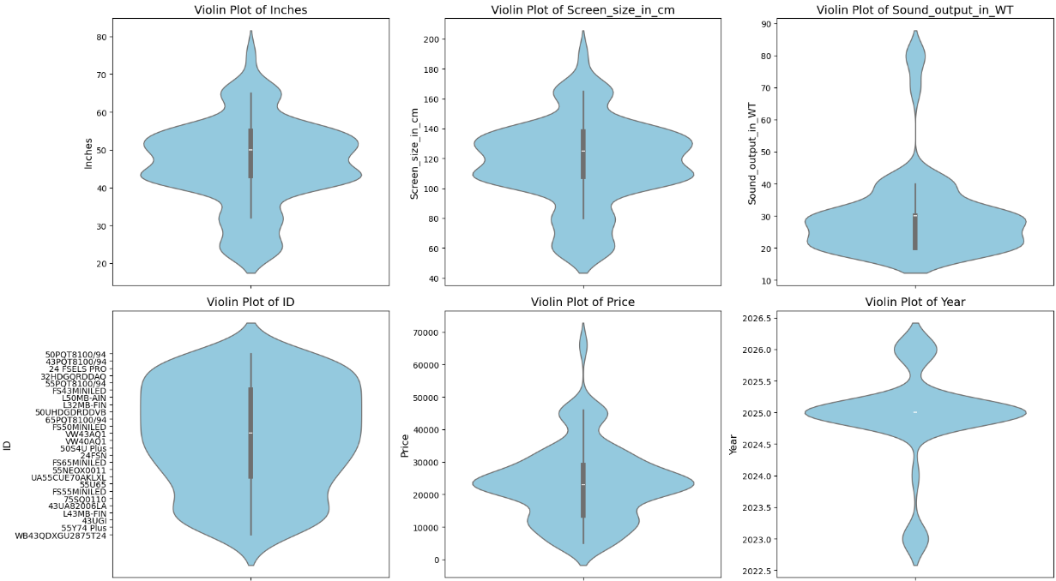
Violin Plot
It Shows how each numeric feature is spread and concentrated .Inches , and screen size have clear central clusters, while sound output and year has has a tight peak.

Slide 11
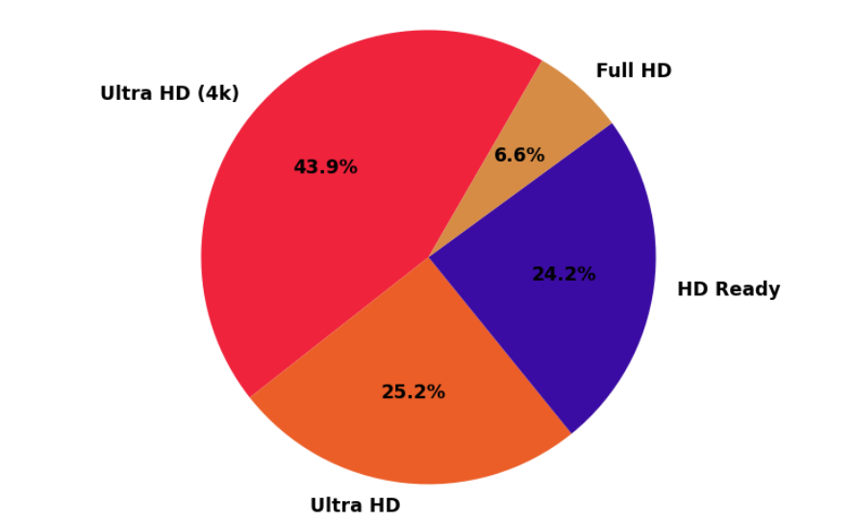
Pie Chart
Ultra HD LED TV seems to be in greater demand as more than 40% of the products categorized as 'Television' on the website are of this type.

Slide 12
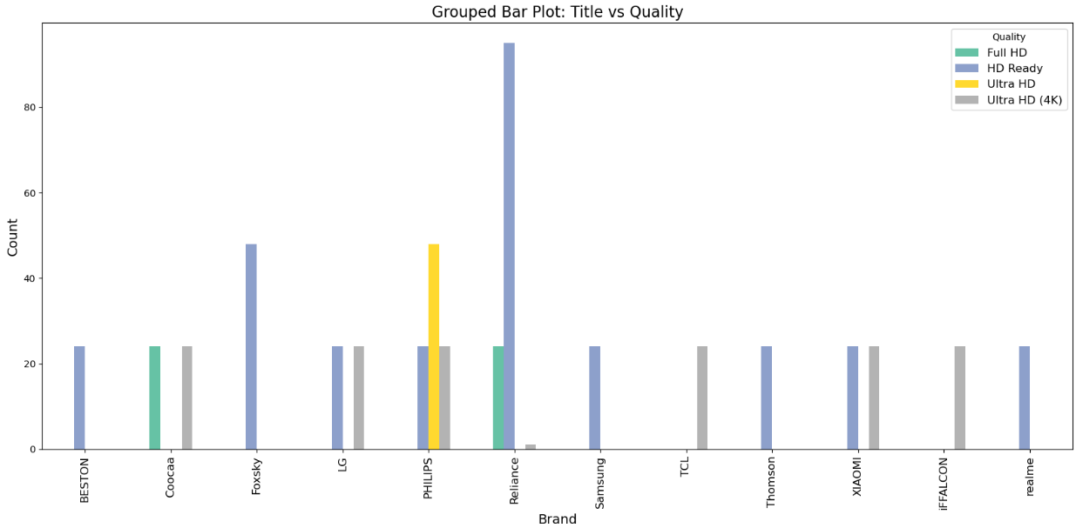
BIVARIATE ANALYSIS
• The bar plot shows the count of TVs by brand and resolution.
• Reliance , Foxsky has the highest number of TVs, mostly with HD ready (4k) resolution.
• Foxsky has the second highest number of TVs, with Ultra HD resolution. Very less brand TVs spread between Full HD.
•Ultra HD (4k) is the most common resolution across brands.

Slide 13
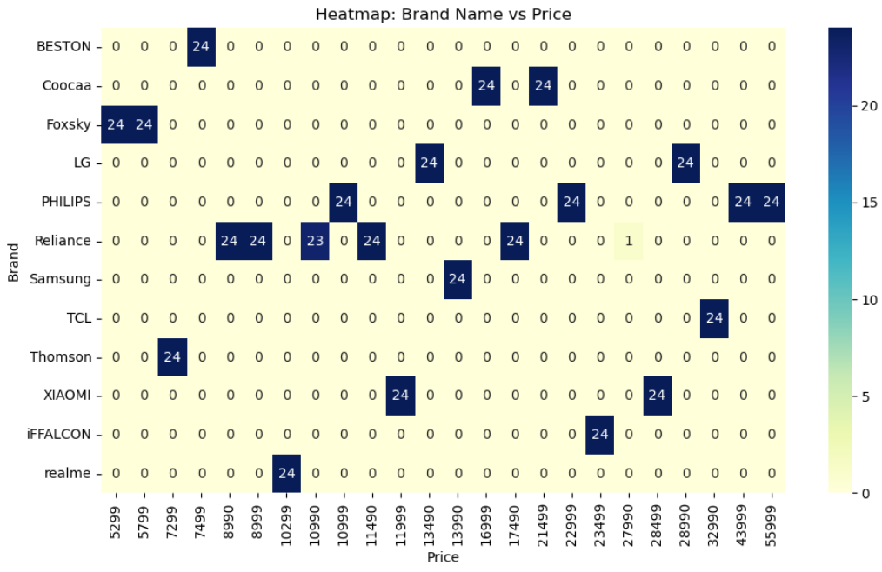
Crosstab Heatmap
Here the price varies based on the Brand. Every brand falls under its unique price rating.

Slide 14
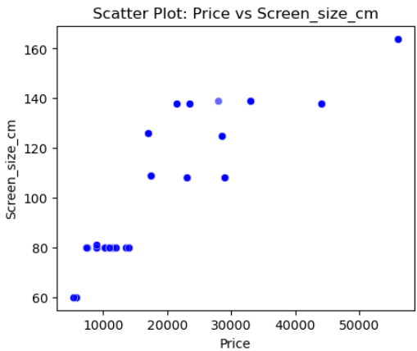
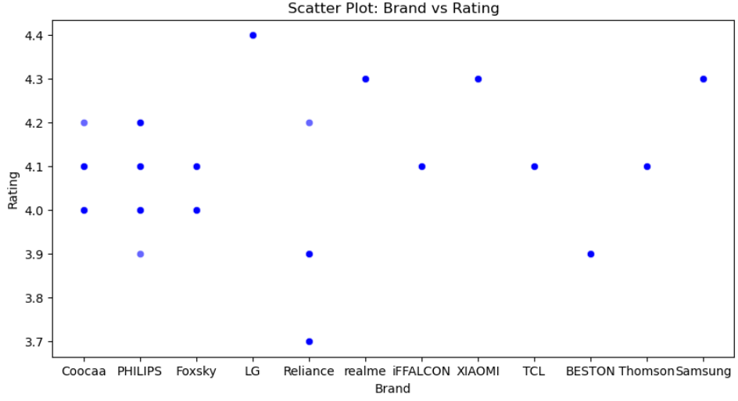
Scatter Plot
1.Here, we can see more the screen size high the price for TV’s. Hence price for the TV is depends on screen size.
2.Brands like LG, realme, Xiaomi ,Samsung has higher ratings and other brands has average ratings.

Slide 15
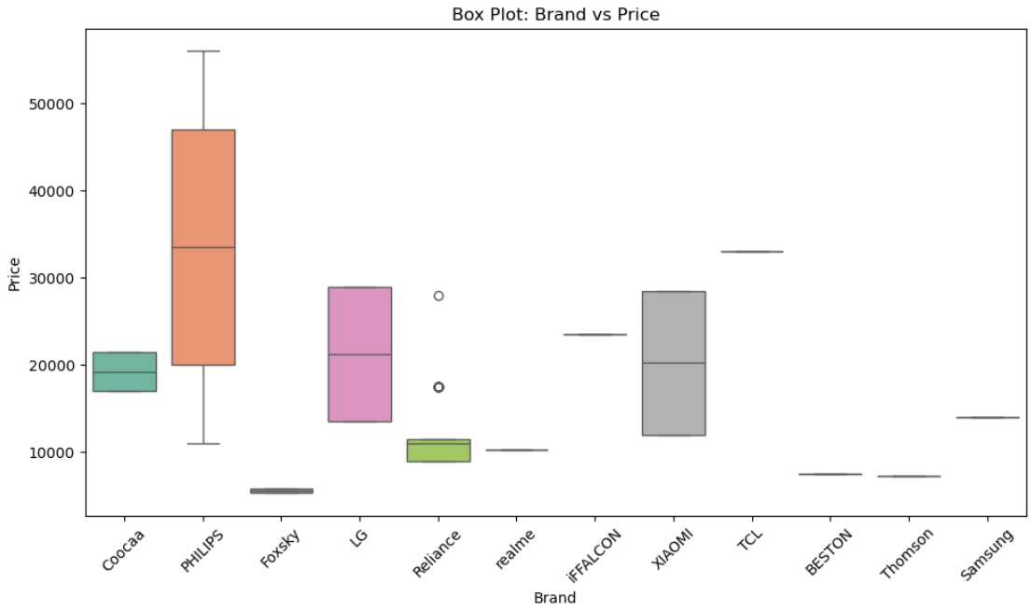
Numerical vs Categorical
Shows price variation across brands ,brands like PHILIPS and LG and XIAOMI have higher median prices. Common brands like PHILIPS, FOXSKY appear most frequently.

Slide 16
Key Business Questions
1.Which television brands and models perform best on Flipkart?
Brands such as realme, Xiaomi ,Samsung receive higher customer ratings and a larger number
of reviews, indicating strong brand trust and consistent product performance.
2.How do price and discounts influence customer demand and satisfaction?
Televisions in the mid-price range with moderate discounts tend to attract more customers and receive
better ratings, while very high prices or heavy discounts do not always guarantee higher satisfaction.
3.What screen sizes and resolutions are most preferred by customers?
32-inch and 43-inch TVs, especially with HD Ready and Ultra HD, are the most popular due to their
balance between price, viewing experience, and space requirements.

Slide 17
Key Business Questions
4.Which product features have the greatest impact on purchase decisions?
Smart TV functionality, Ultra HD resolution, and LED screen type significantly influence
customer preference and are commonly associated with higher ratings.
5.How can TVs be segmented to improve business strategy?
Televisions can be grouped into budget, mid-range, and premium segments, allowing Flipkart to tailor
pricing, inventory planning, and marketing campaigns for each customer segment more effectively.

Slide 18
Conclusion
Most popular TVs are priced between ₹20,000 to ₹60,000. Mid-sized TVs (32-40 inches) receive higher ratings than larger TVs.
Ultra HD TVs are more common and preferred by most of the people, Where Full HD and HD ready are rarely preferred.
Brands like LG, realme, Xiaomi, Samsung has higher ratings and other brands has average ratings.
TVs with higher ratings attract more reviews, indicating a positive correlation between popularity and feedback.
Best value TVs are mid-sized, affordable Ultra HD models with Ultra HD resolution.

Slide 19
Challenges
Inconsistent HTML structure while scraping different Television pages.
Missing, messy, unstructured text in product descriptions.
Difficulty removing unwanted characters, symbols, and noise.
Converting Screen size, Sound output, ratings and price into proper numerical formats.

Slide 20

THANK YOU

