Slide 1
E LAND REGISTRY

Slide 2
PROBLEM STATEMENT:
Now a days land registration process has become a long procedure creating a major issue.
Then there is a problem of fake land documents
Delay of money transactions in lots of amount
Some government authorities are giving the fake documents by taking
money

Slide 4
SOLUTIONS:
Block chain technology paved a way for this problems
Once we have to cross check the land while we are going to buy
He have to put the documents from the particular government office
There will be no online transaction problems

Slide 5
PROPOSED SOLUTIONS:
To reduce the time consuming in the registration process.
We save all documents information in a block.
Data store in blockchain is secure , transparent , easy to access ,hard to dispute.
Every file once stored is recorded and can,t be modified but viewed by everyone.

Slide 6
PROPERTY USED IN BLOCK CHAIN:
Blockchain is a shared , immutable ledger for recording the history of transactions
It create a new generation of transactional applications .
That establish trust , accountability and transparency _from contracts to deeds to payments
THANK YOU………………

Slide 7
Code Deployment Steps

Slide 8
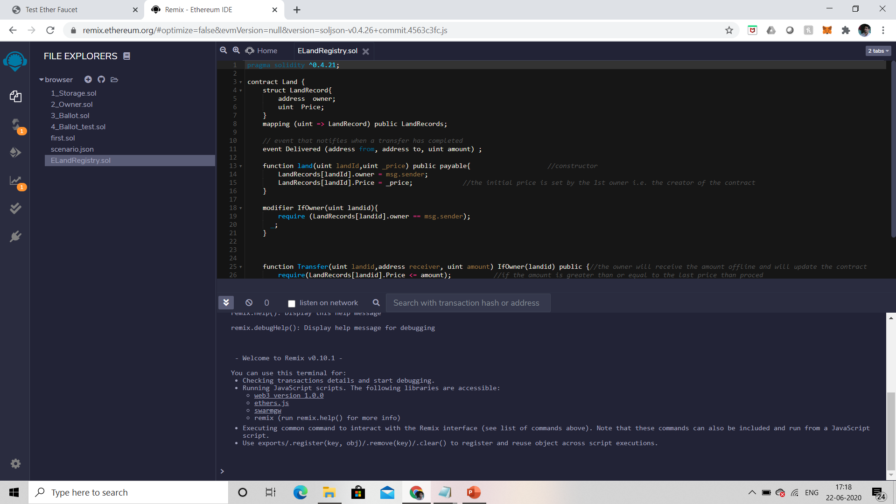

Slide 9
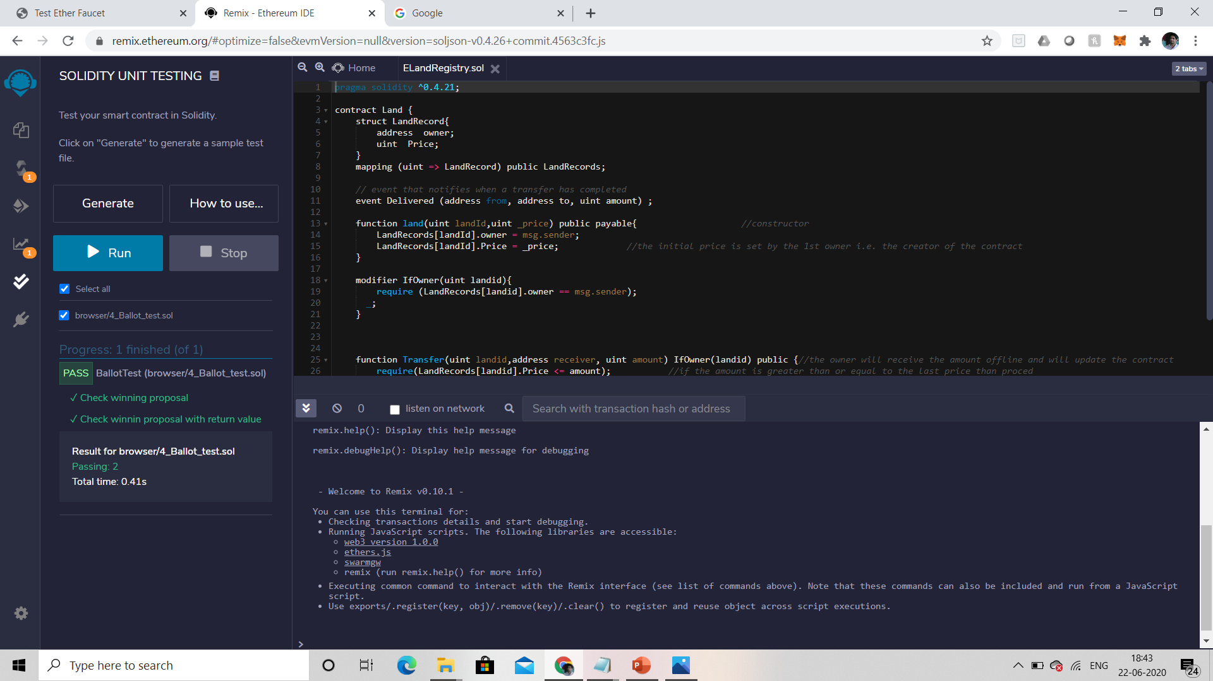

Slide 10
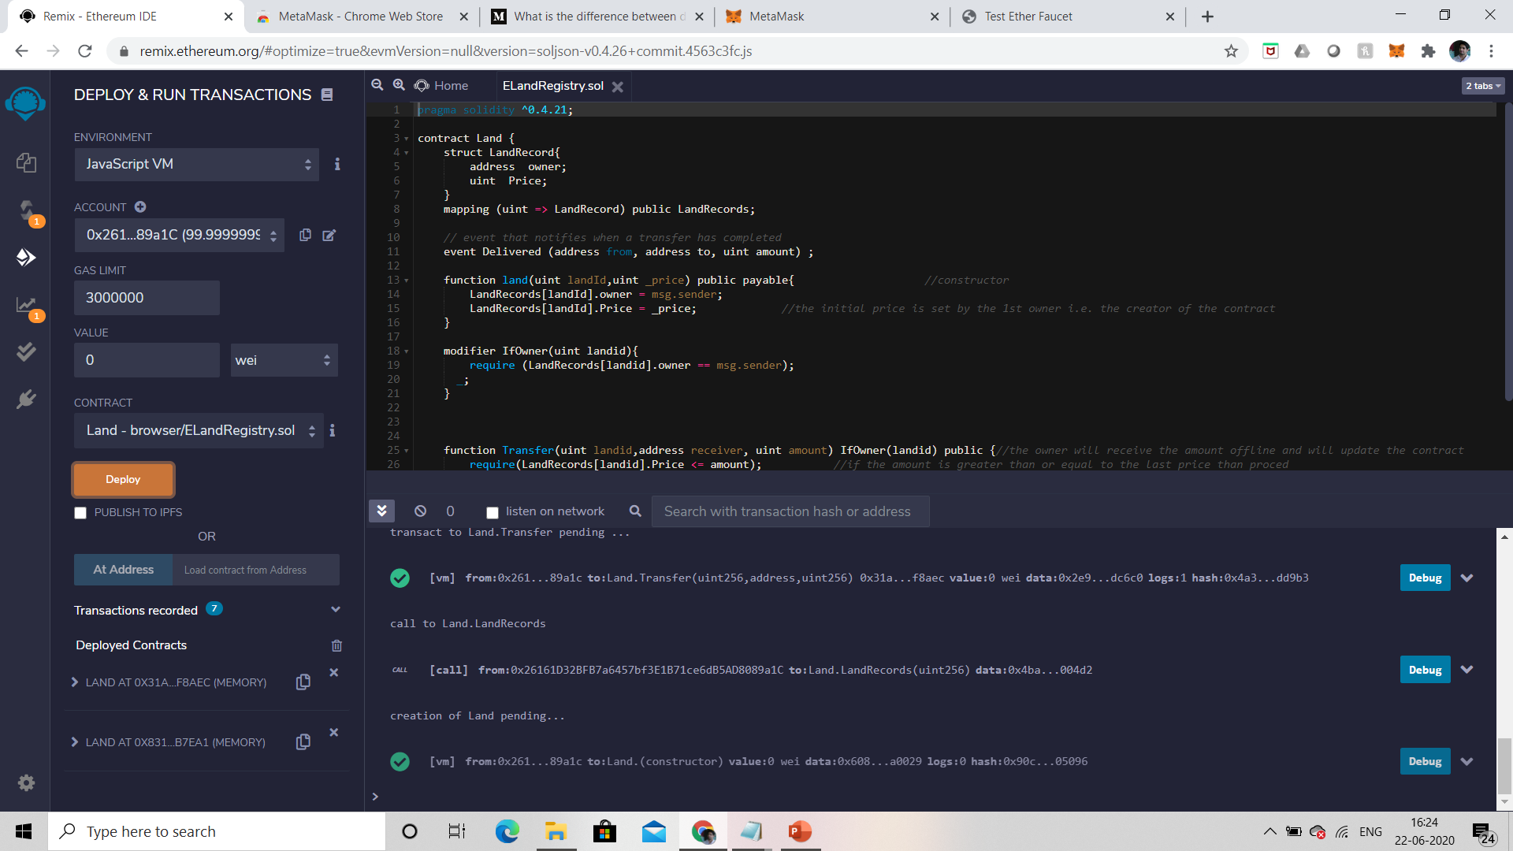

Slide 11
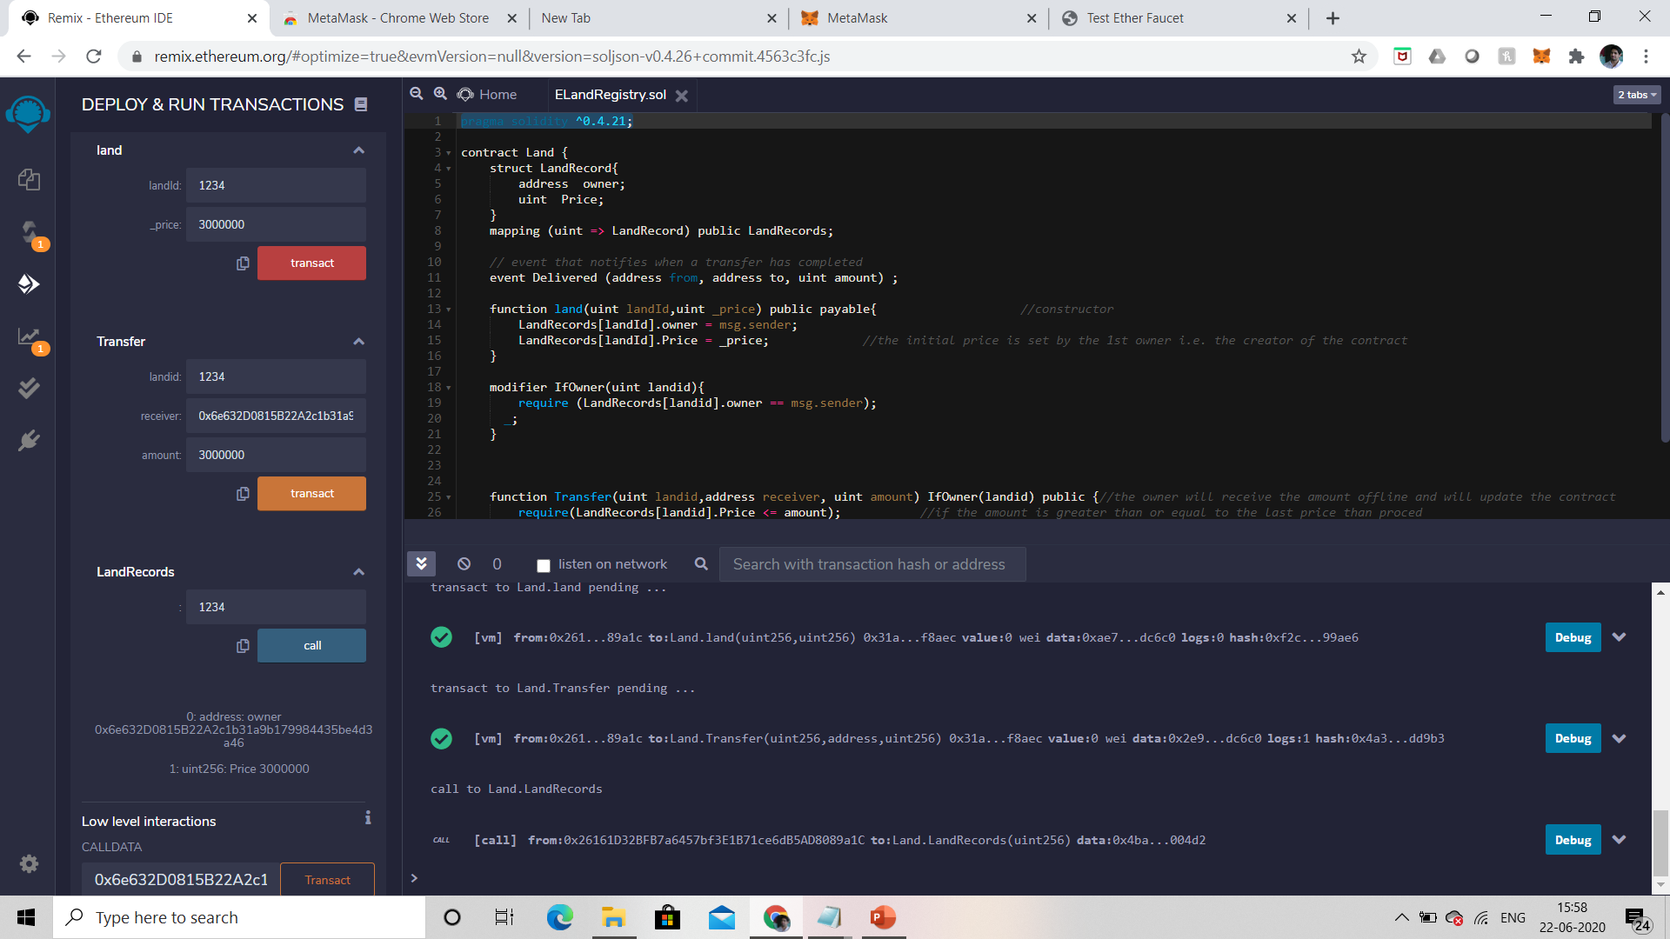

Slide 12
Software Requirements:
Operating System : windows10
Coding Language : Solidity
Tool :Remix online compiler

Slide 13
Hardware Requirements:
System :Pendium Dual Core
Hard disk :500Gb
Monitor :15 LED
Input device :Keyboard, Mouse
Ram :1Gb

Slide 14
Conclusion:
In the end we propose that E Land registry is the real-time method to digital register land registration. By this we can detect and reduce many types of frauds done by traditional land registration process and also reduce time for travelling ,we can avoid third party involvement.

