Slide 1
Lecture#25
1. Shift register(SIPO,PIPO,SISO,PISO)
2. Serial addition with registers
3. Shift register with parallel load
4. Bidirectional Shift Register
5. Serial In/Parallel Out

Slide 2
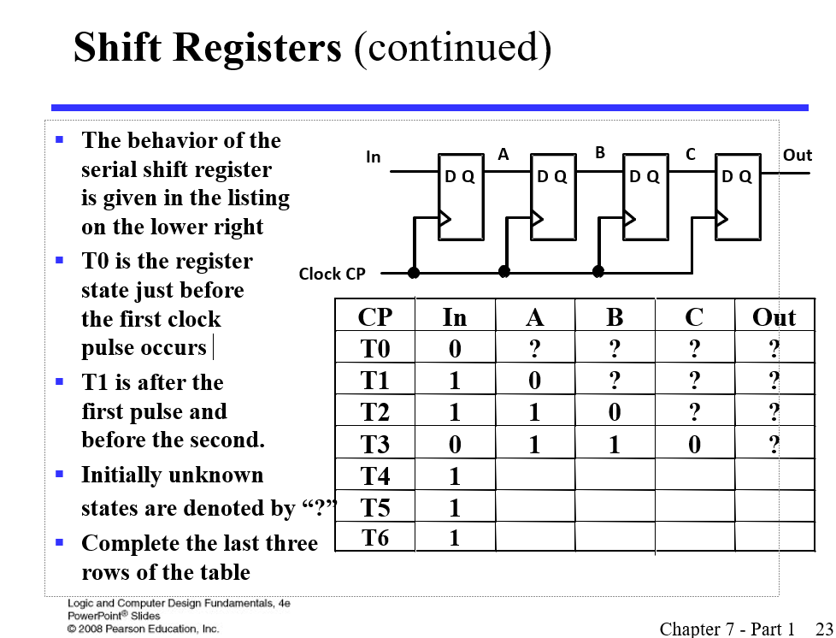
Shift Registers
Notes:
ROW T4: 10110
Row T5: 11011
Row T6: 11101

Slide 3
Parallel Load Shift Registers /PISO
The shift register, which allows parallel input (data is given separately to each flip flop and in a simultaneous manner) and produces a serial output is known as Parallel-In Serial-Out shift register.
SIPO,PIPO,SISO(covered in class)

Slide 4
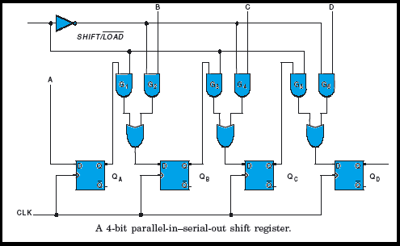
PISO
Notes:
REFERENCE https://www.google.com/url?sa=i&url=https%3A%2F%2Fwww.electronicsengineering.nbcafe.in%2Fparallel-in-serial-out-shift-register-piso%2F&psig=AOvVaw2vRlgC0sZ9DKKckgVNXI0X&ust=1652255291156000&source=images&cd=vfe&ved=0CAwQjRxqFwoTCKD8jee41PcCFQAAAAAdAAAAABAO

Slide 5
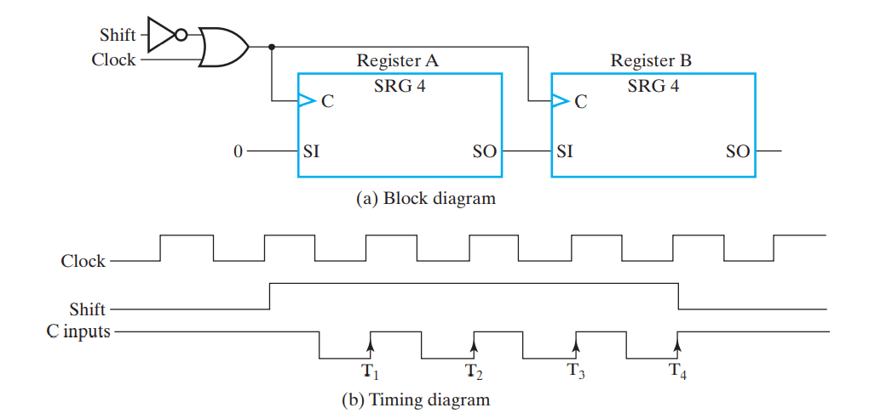
Serial transfer of information
A digital system is said to operate in a serial mode when information in the system is transferred or manipulated one bit at a time.
The serial transfer of information from register A to register B is done with shift registers, as shown in the block diagram of Figure

Slide 6
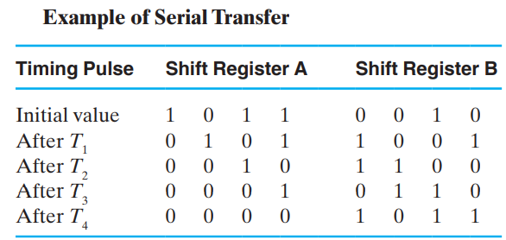
Serial transfer of information

Slide 7
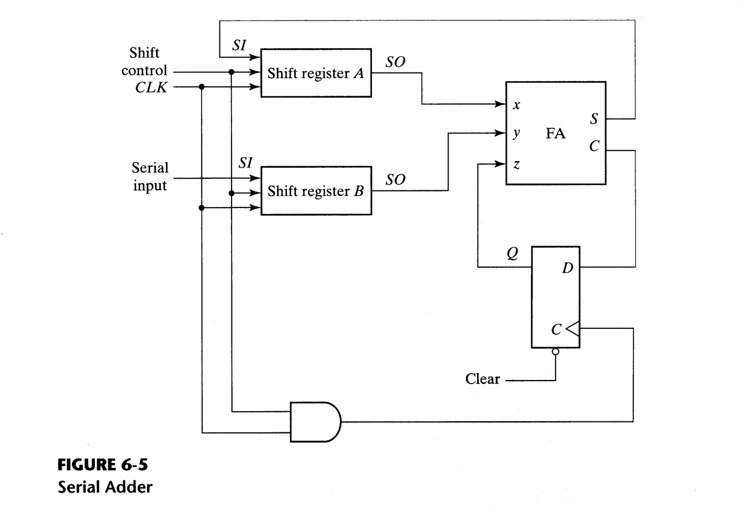
Serial addition with registers

Slide 8
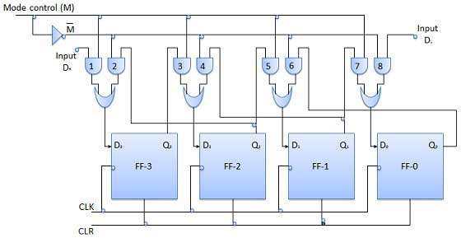
Bidirectional Shift Register

