Slide 1
Microoperations

Slide 2
Microoperations
A microoperation is an elementary operation performed on data stored in registers or in memory.
The microoperations most often encountered in digital systems are of four types:
1. Transfer microoperations, which transfer binary data from one register to another.
2. Arithmetic microoperations, which perform arithmetic operations on data in registers.
3. Logic microoperations, which perform bit manipulation on data in registers.
4. Shift microoperations, which shift data in registers.

Slide 3
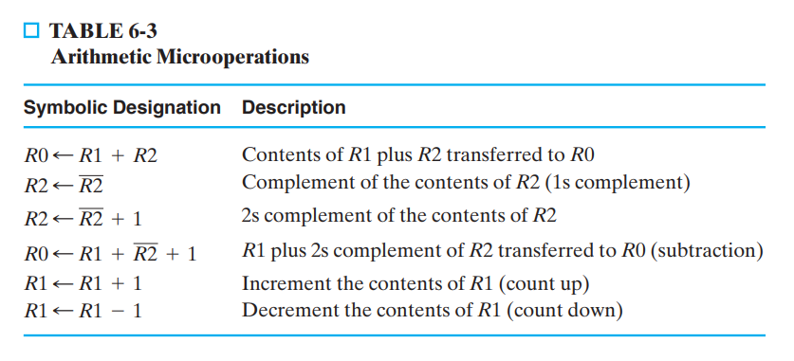
Arithmetic Microoperations

Slide 4
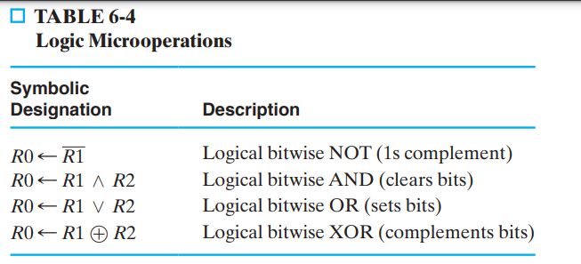
Logic microoperations
Logic microoperations are useful in manipulating the bits stored in a register. These operations consider each bit in the register separately and treat it as a binary variable.

Slide 5
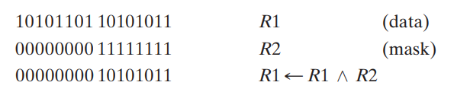
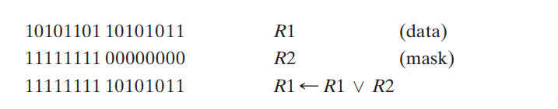
Logic microoperations
AND operation can be used to selectively clear bits of a register. This operation is sometimes called masking out the bits, because it masks or deletes all 1s in the data in R1, based on bit positions that are 0 in the mask provided in R2. The high-order byte of R1 is set to all 1s by ORing it with all 1s in the R2 operand. The low-order byte remains unchanged because it is ORed with 0s

Slide 6
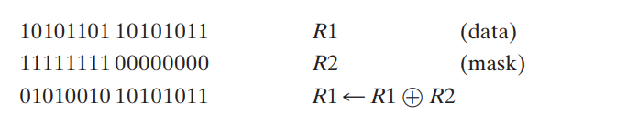
Logic microoperations
The Boolean equations X ⊕ 1 = X and X ⊕ 0 = X dictate that, when a binary variable X is XORed with 1, it is complemented, but when XORed with 0, the variable remains unchanged.

Slide 7
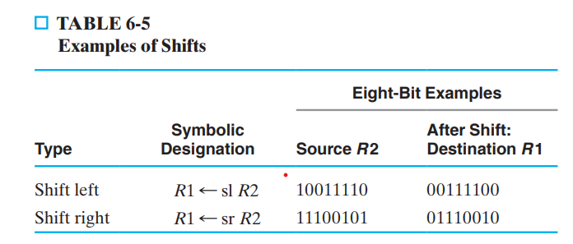
Shift microoperations
Shift microoperations are used for lateral movement of data. The contents of a source register can be shifted either right or left. A left shift is toward the most significant bit, and a right shift is toward the least significant bit. Shift microoperations are used in the serial transfer of data.

Slide 8
Counters
A register that goes through a prescribed sequence of distinct states upon the application of a sequence of input pulses is called a counter
An n-bit binary counter consists of n flip-flops and can count in binary from 0 through 2n - 1.
Counters are available in two categories:
ripple counters and
synchronous counters.

Slide 9
Counters
In a ripple counter, the flip-flop output transitions serve as the sources for triggering the changes in other flip-flops. In other words, the C inputs of some of the flip-flops are triggered not by the common clock pulse, but rather by the transitions that occur on other flip-flop outputs.
In a synchronous counter, the C inputs of all flip-flops receive the common clock pulse, and the change of state is determined from the present state of the counter. Synchronous counters are discussed in the next two subsections. Here we present the binary ripple counter and explain its operation

Slide 10
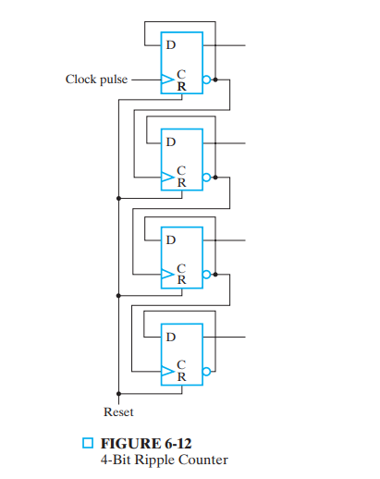
4 bit binary ripple counter

Slide 11
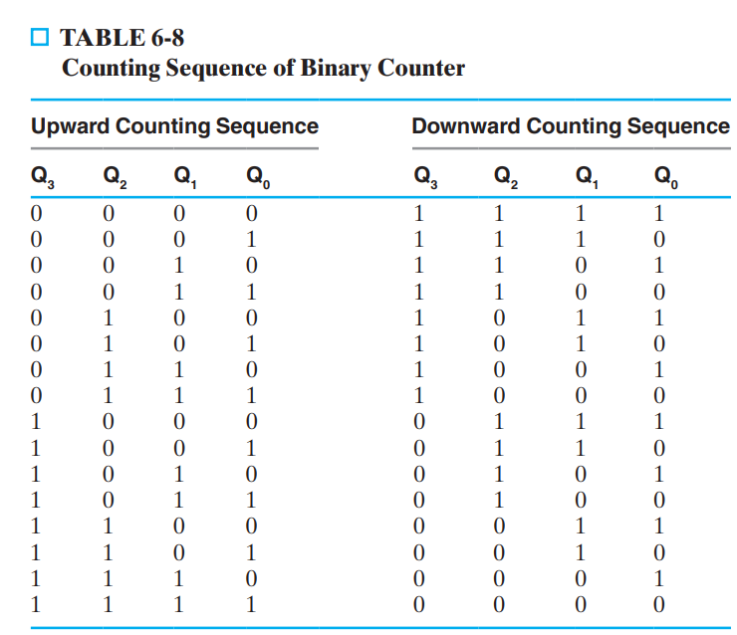
Counter

