Slide 1
Data Modeling Using the Entity-Relationship Model

Slide 2
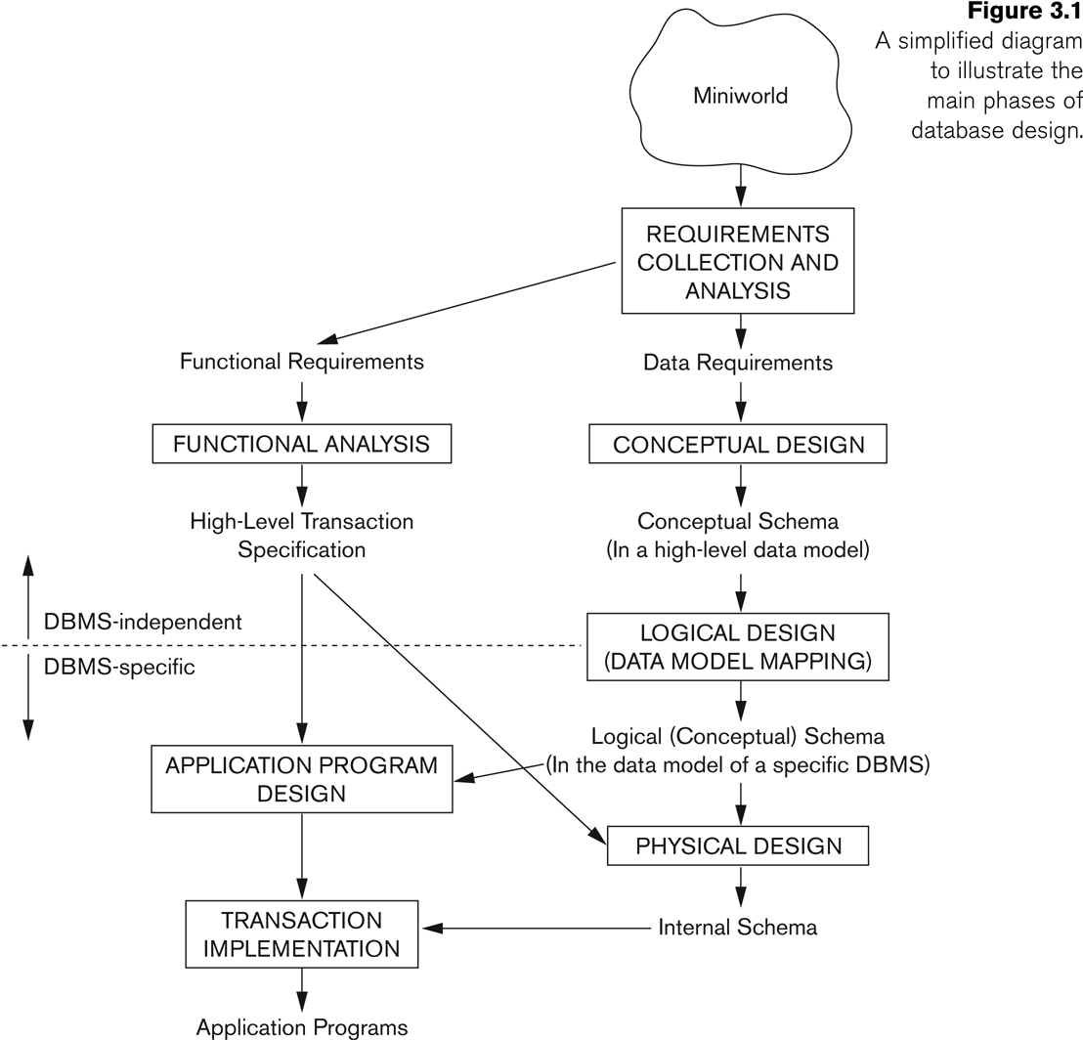
Database Design Process

Slide 3
Major Components
Entities
Attributes
Relationships

Slide 4
Entity
Term used to mean three different meanings
Entity type
Entity instance
Entity set

Slide 5
Entity Type
A name/label assigned to items/objects that exist in an environment and that have similar properties
It could be person, place, event or even concept

Slide 6
Entity Instance & Set
A particular object belonging to a particular entity type
Entity Type: Employee
Entity Instance: M. Sharif
Entity Set: All employees

Slide 7
Types of Entity Types
Entity types can be classified into regular/strong/independent ETs or weak/dependent ETs

Slide 8
Weak Entity Types
An entity type whose instances cannot exist without being linked with instances of some other entity type, i.e., they cannot exist independently

Slide 9
Strong Entity Type
A strong/regular entity type is the one whose instances can exist independently, i.e., without being linked to other instances
Strong ETs have their own identity

Slide 10
Naming Entity Types
Singular noun recommended
Organization specific names
Write in capitals
Abbreviations can be used, be consistent

Slide 11
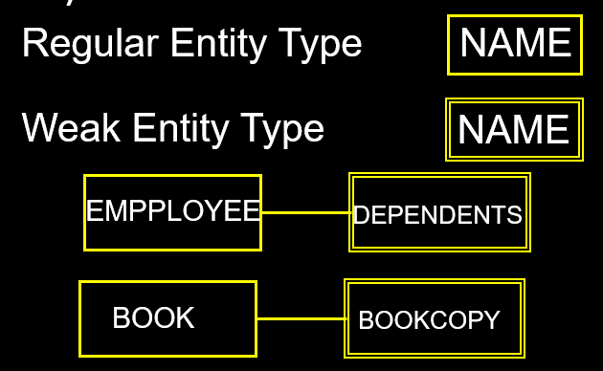
Symbols

Slide 12
ER Model Concepts
Attributes
They are properties used to describe an entity.
Each attribute has a data type
E.g. integer, string, subrange, enumerated type, …

Slide 13

Symbols for Attributes
Each represented as an oval, linked with an ET symbol

Slide 14
Types of Attributes
Single vs composite
Single valued vs multi-valued
Stored vs derived
Complex attribute

Slide 15
Types of Attributes
Simple
Each entity has a single atomic value for the attribute. For example, SSN or Sex.
Composite
The attribute is composed of several components. For example:
Address(House#, Street, City, State, ZipCode, Country),
Name(FirstName, MiddleName, LastName).
Multi-valued
An entity may have multiple values for that attribute. For example:
PreviousDegrees of a STUDENT.
Stored and Derived

Slide 16
Types of Attributes
Complex attribute - The composite and multi-valued attributes may be nested arbitrarily to any number of levels,
For example, PreviousDegrees of a STUDENT is a composite multi-valued attribute denoted by {PreviousDegrees (College, Year, Degree, Field)}
Multiple PreviousDegrees values can exist
Each has four subcomponent attributes:
College, Year, Degree, Field

Slide 17
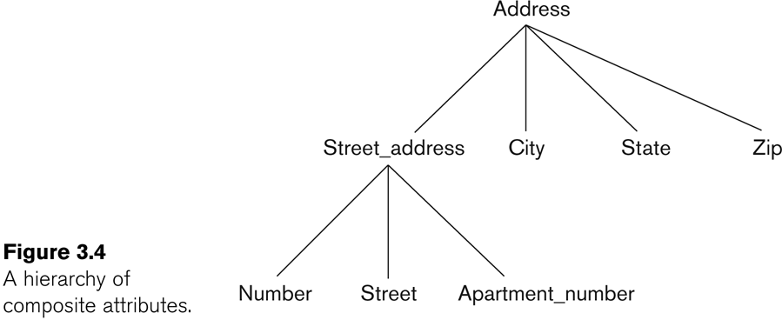
Example of a composite attribute

Slide 18
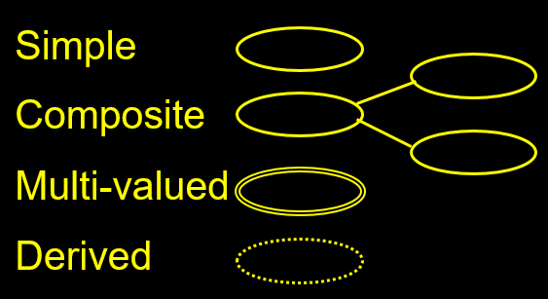
Symbols for Attributes

Slide 19
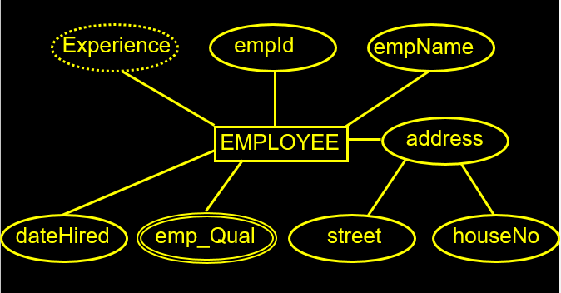
Example

Slide 20
Entity Types and Key Attributes
Entities with the same basic attributes are grouped into an Entity type.
For example, the entity type EMPLOYEE and PROJECT.
Key attribute
For example, SSN of EMPLOYEE.

Slide 21
Key Attributes
A key attribute may be composite.
VehicleTagNumber is a key of the CAR entity type with components (Number, State).
An entity type may have more than one key.
The CAR entity type may have two keys:
VehicleId (popularly called VIN)
VehicleTagNumber (Number, State), aka license plate number.
Each key is underlined

Slide 22
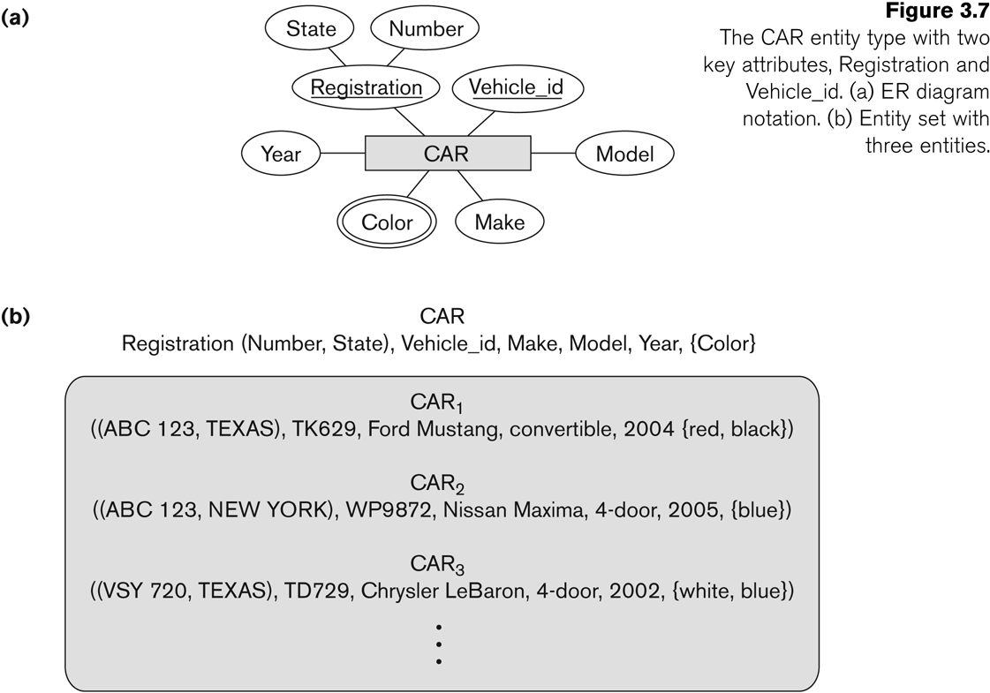
Entity Type CAR with two keys and a corresponding Entity Set
Entity set is the current state of the entities that is stored in the database

Slide 23
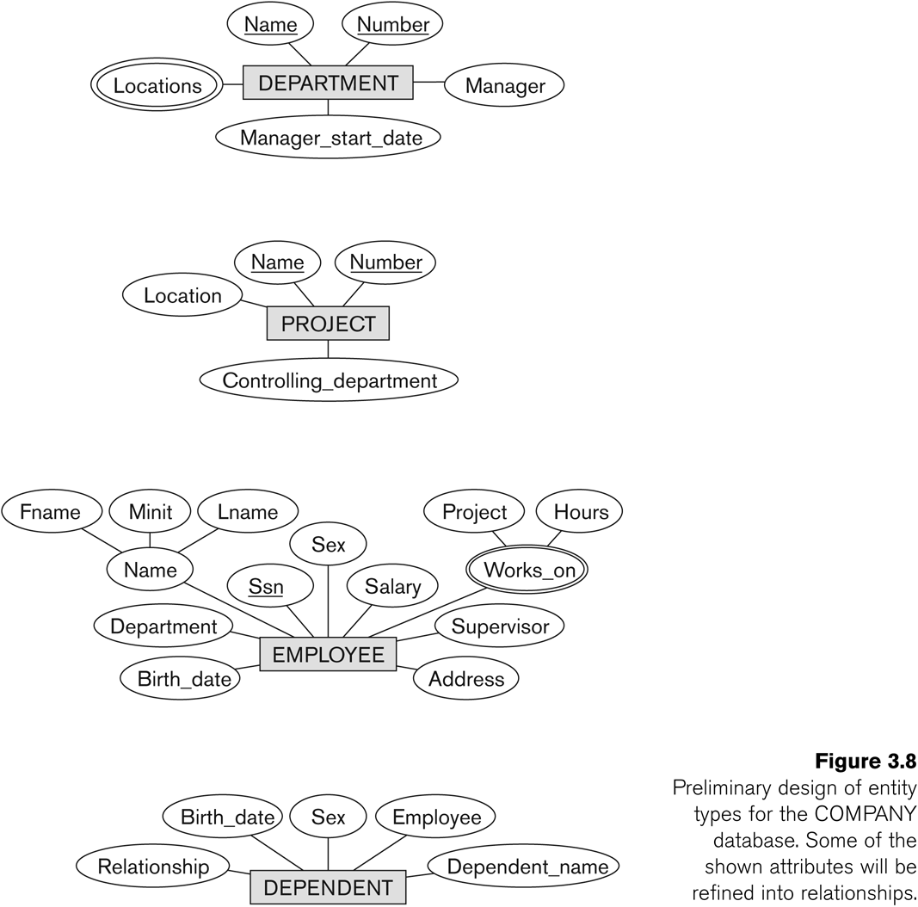
Initial Design of Entity Types: EMPLOYEE, DEPARTMENT, PROJECT, DEPENDENT
Entity types in the COMPANY database:
DEPARTMENT
PROJECT
EMPLOYEE
DEPENDENT

Slide 24
Refining the initial design by introducing relationships
Some aspects in the requirements will be represented as relationships
ER model has three main concepts:
Entities (and their entity types and entity sets)
Attributes (simple, composite, multivalued)
Relationships (and their relationship types and relationship sets)

Slide 25
Relationships
A relationship relates two or more distinct entities with a specific meaning.
For example, EMPLOYEE John works on the ProductX PROJECT,
EMPLOYEE Franklin manages the Research DEPARTMENT.
Relationships of the same type are grouped into a relationship type.
Degree of a relationship type is the no of participating entity types.
Both MANAGES and WORKS_ON are binary relationships.

Slide 26
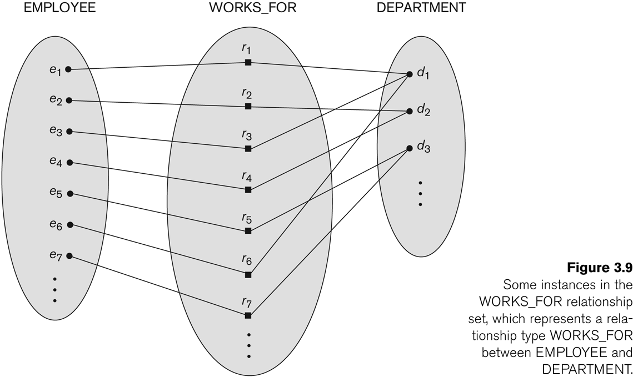
Relationship instances of the WORKS_FOR relationship between EMPLOYEE and DEPARTMENT

Slide 27
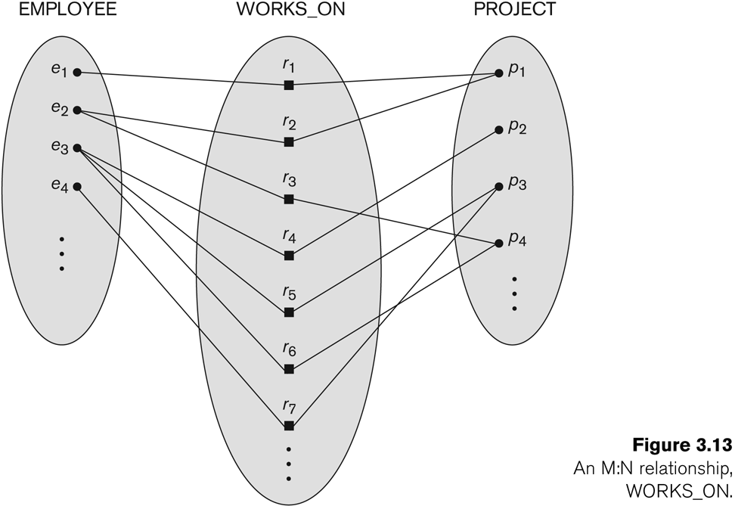
Relationship instances of the WORKS_ON relationship between EMPLOYEE and PROJECT

Slide 28
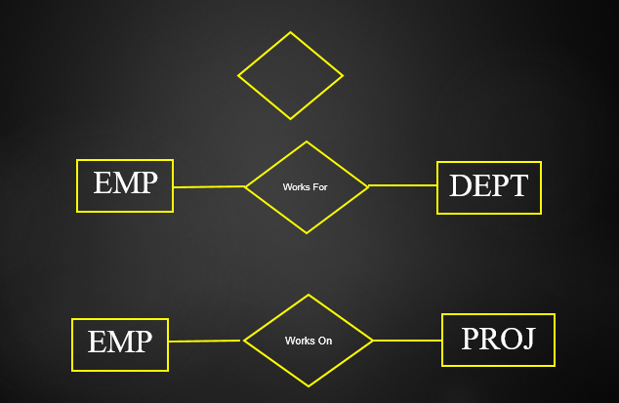
Symbol

Slide 29
Relationship type vs. relationship set
Relationship Set:
A relationship set is a set of relationships of same type.
Relationship Type:
Identifies the relationship name and the participating entity types
Also identifies certain relationship constraints

Slide 30
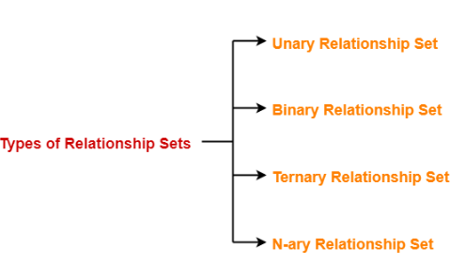
Types of Relationship Set
The number of entity sets that participate in a relationship set is termed as the degree of that relationship set. Thus

Slide 31
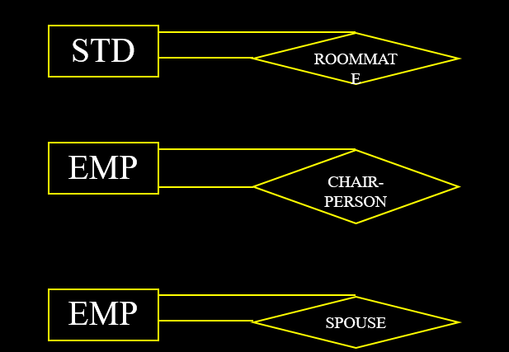
Unary Relationship
An ET linked with itself, also called recursive relationship
Example Roommate, where STUDENT is linked with STUDENT

Slide 32
COMPANY database: relationships
Six relationship types are identified
All are binary relationships( degree 2)
WORKS_FOR (between EMPLOYEE, DEPARTMENT)
MANAGES ( between EMPLOYEE, DEPARTMENT)
CONTROLS (between DEPARTMENT, PROJECT)
WORKS_ON (between EMPLOYEE, PROJECT)
SUPERVISION (between EMPLOYEE (as subordinate), EMPLOYEE (as supervisor))
DEPENDENTS_OF (between EMPLOYEE, DEPENDENT)

Slide 33
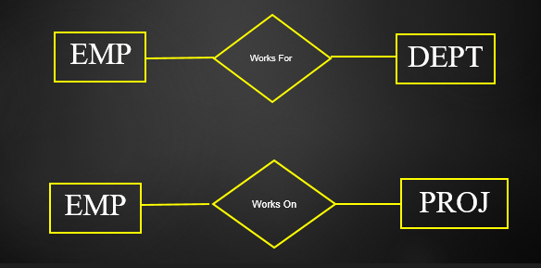
Example

Slide 34
Binary Relationships
May also have instances, that can be formally described in an ordered pair form
Employee and Project
{(E1001, A), (E1020, B), (E1002, B), (E1058, C)}

Slide 35
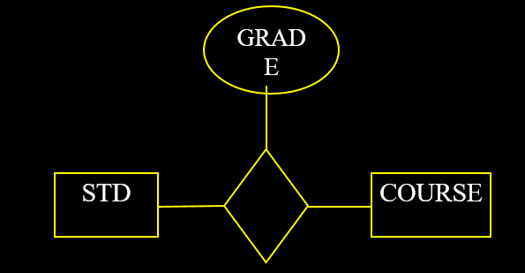
Attributes of the Relationships
The key ( combination of key STD+Course )
The relationships can have their descriptive attributes
Where to place

Slide 36
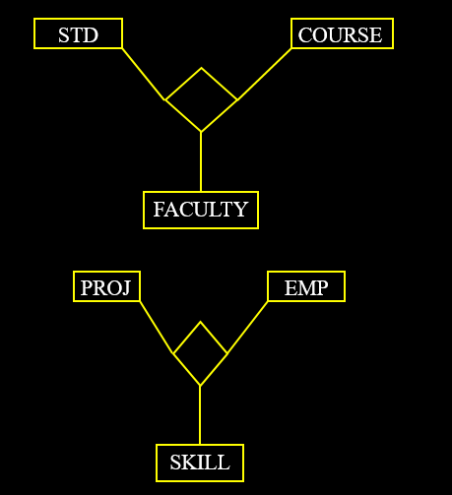
Ternary Relationships
One that involves three entity types
STUDENT-CLASS-FACULTY

Slide 37
Constraints on Relationships type
Constraints on Relationship Types (ratio constraints)
Cardinality Ratio (specifies maximum participation)
One-to-one (1:1)
One-to-many (1:N) or Many-to-one (N:1)
Many-to-many (M:N)
Existence Dependency Constraint (specifies minimum participation) (also called participation constraint)
zero (optional participation, not existence-dependent)
one or more (mandatory participation, existence-dependent)

Slide 38
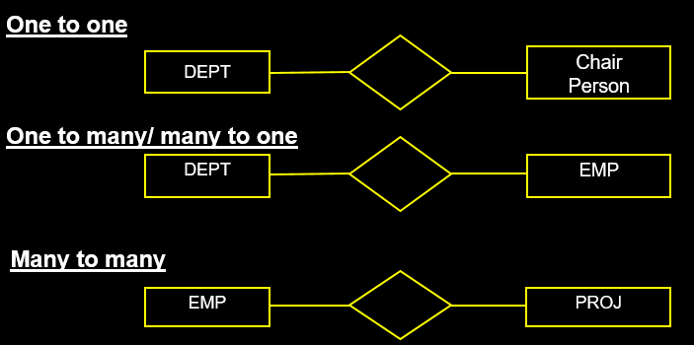
Types of Cardinalities

Slide 39
Many-to-one (N:1) Relationship

Slide 40
Many-to-many (M:N) Relationship

Slide 41
Minimum Cardinality
Determines whether the link is compulsory or optional
Important, since it effects the implementation

Slide 42
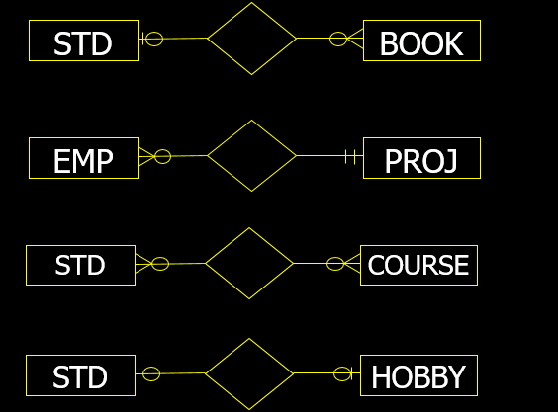
Cardinality Example

Slide 43
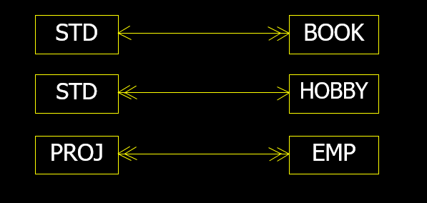
Other Notations

Slide 44
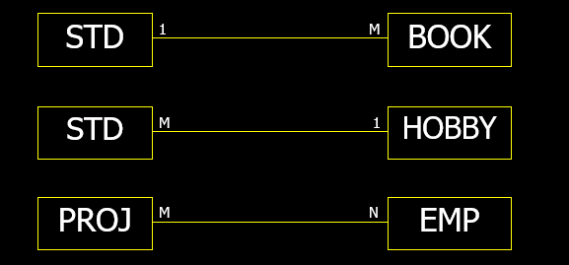
Other Notations

Slide 45
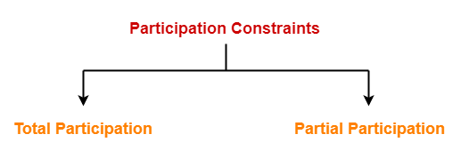
Participation Constraints-
Participation constraints define the least number of relationship instances in which an entity must compulsorily participate.
There are two types of participation constraints-

Slide 46
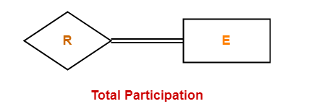
Total Participation-
It specifies that each entity in the entity set must compulsorily participate in at least one relationship instance in that relationship set.
That is why, it is also called as mandatory participation.
Total participation is represented using a double line between the entity set and relationship set.

Slide 47
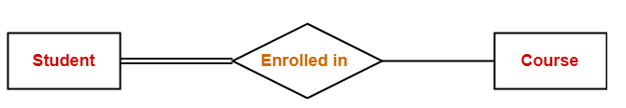
Example
Double line between the entity set “Student” and relationship set “Enrolled in” signifies total participation.
It specifies that each student must be enrolled in at least one course.

Slide 48
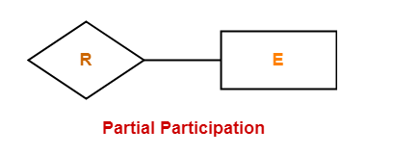
Partial Participation-
It specifies that each entity in the entity set may or may not participate in the relationship instance in that relationship set.
That is why, it is also called as optional participation.
Partial participation is represented using a single line between the entity set and relationship set.

Slide 49
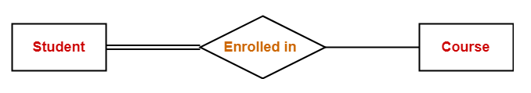
Example
Single line between the entity set “Course” and relationship set “Enrolled in” signifies partial participation.
It specifies that there might exist some courses for which no enrollments are made.

Slide 50
Relationship between Cardinality and Participation Constraints-
Minimum cardinality tells whether the participation is partial or total.
If minimum cardinality = 0, then it signifies partial participation.
If minimum cardinality = 1, then it signifies total participation.
Maximum cardinality tells the maximum number of entities that participates in a relationship set.

Slide 51
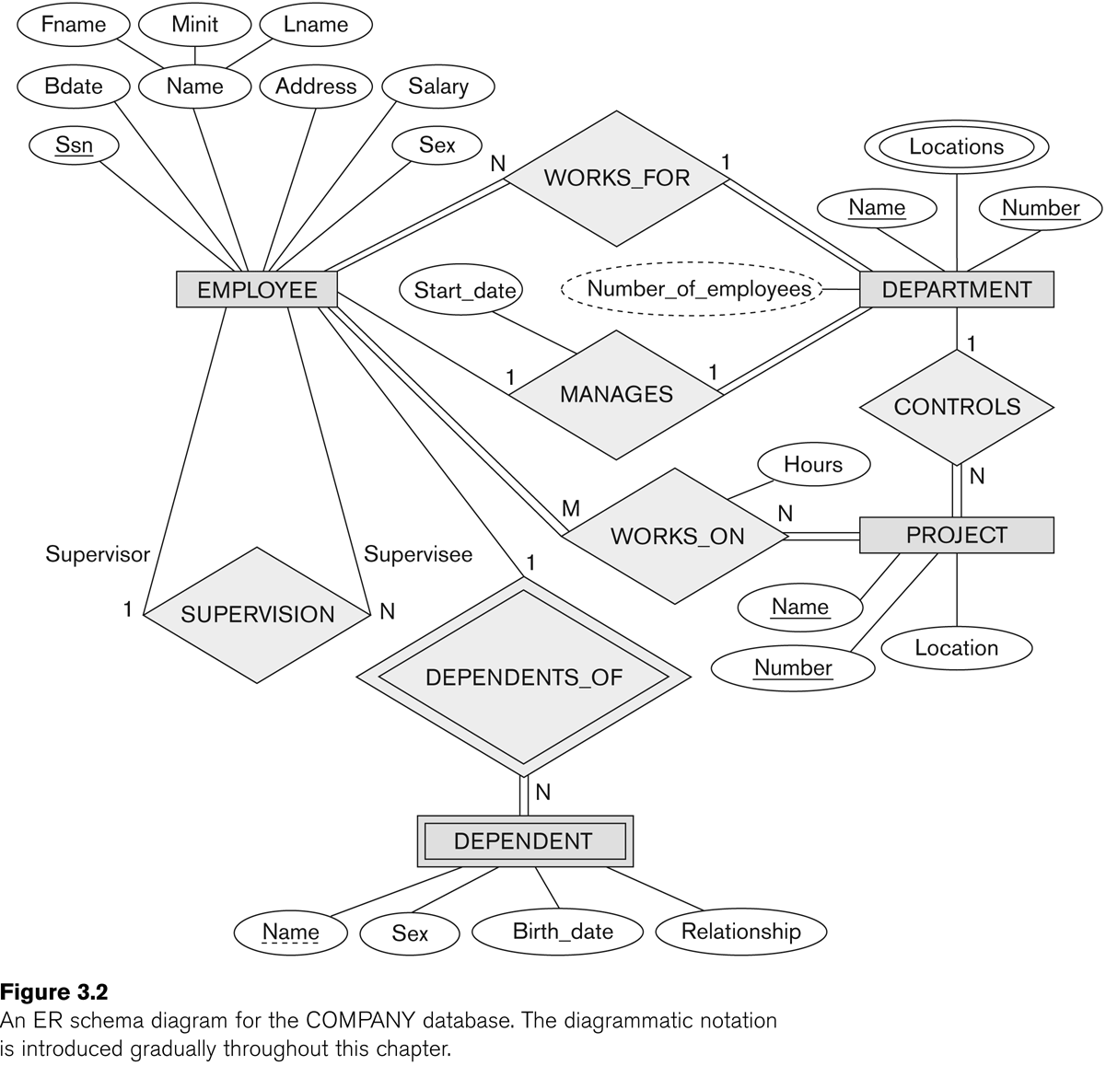
ER DIAGRAM – Relationship Types are: WORKS_FOR, MANAGES, WORKS_ON, CONTROLS, SUPERVISION, DEPENDENTS_OF

Slide 52
Steps to draw an ER diagram
Get problem description
Define Entities
Add Attributes
Specify Key, multiple, composite attributes
Add Relations
Specify Cardinality, total/partial relations
Iterate

Slide 53
Steps to draw an ER diagram
Essential to further design, but often given little care:
Is an entity a weak entity (key?)
Multivalued attributes
Derived attribute
Total/partial participation
Cardinality ratio

Slide 54
Problem 1
Draw E\R model for the Publishing company database with the following requirements
A publishing company produces books on various subjects. The books are written by authors who specialize in one particular subject. The company employs editors who, not necessarily being specialists in a particular area, each take sole responsibility for editing one or more book publications. Every book require some items for publication. These items supplied by suppliers. One supplier can supply many items. Shop owner buys books from the publisher . Shop owner can buy many books but one book can be bought by one shop owner only. Books are uniquely identified by Bookid.

Slide 55
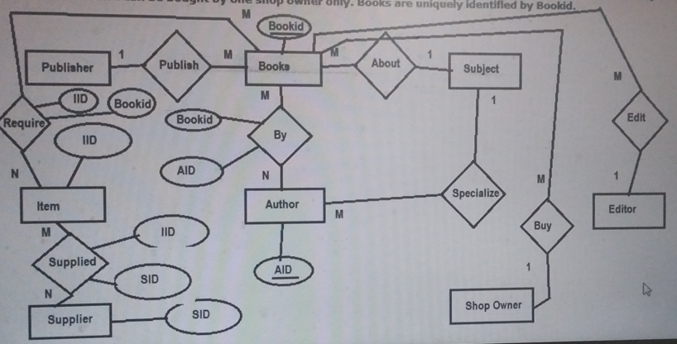
ERD

Slide 56
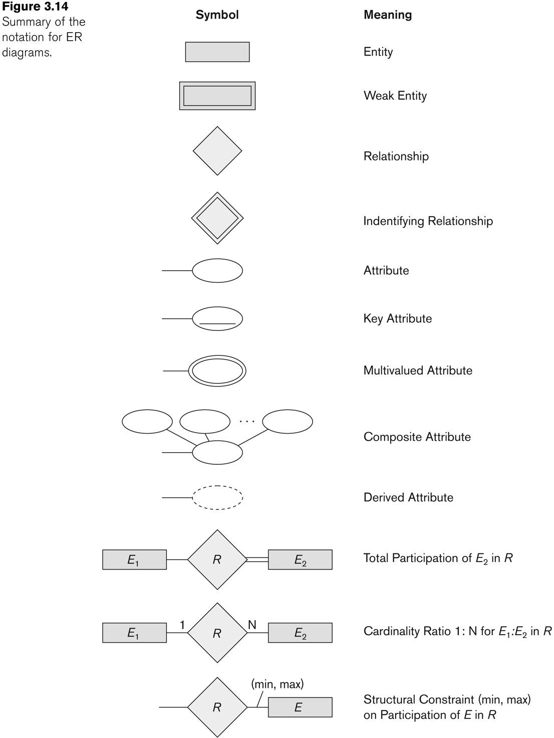
Alternative (min, max) notation for relationship Structural constraints:
Specifies that each entity e in E participates in at least min and at most max relationship instances in R
Default(no constraint): min=0, max=n
Must have min ≤ max, min ≥ 0, max ≥ 1
Derived from the knowledge of mini-world constraints

Slide 57
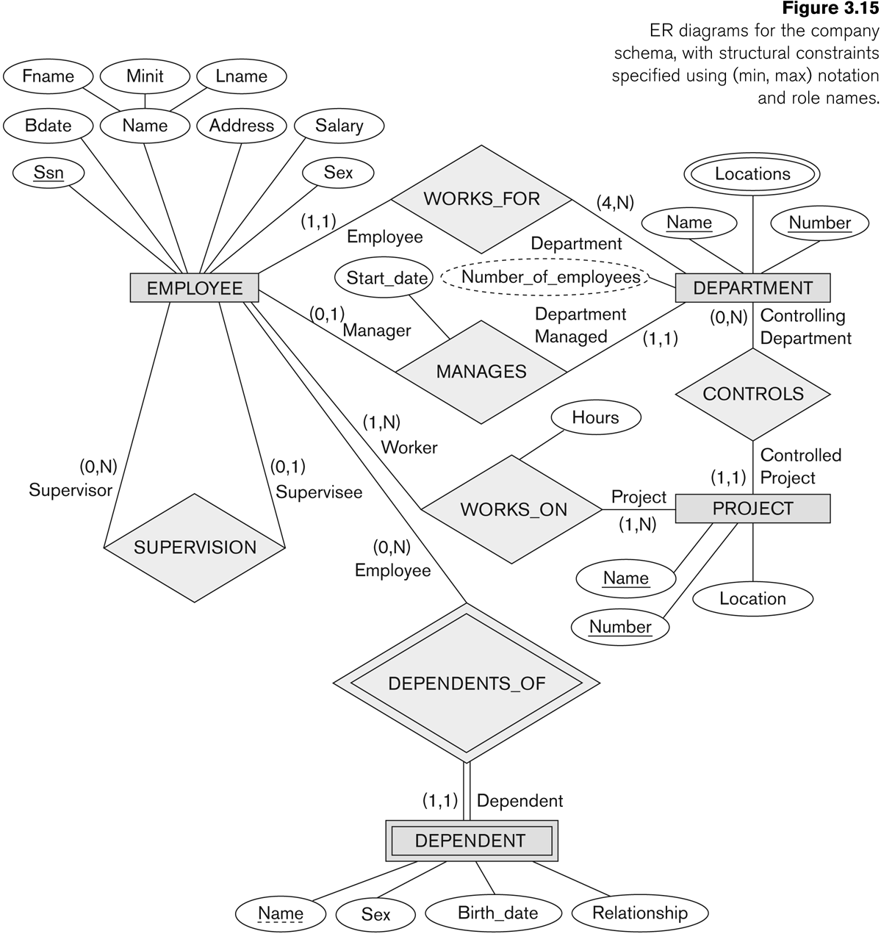
min, max - notation

Slide 58
notation for ER diagrams

Slide 59
Relationships of Higher Degree
Relationship types of degree 2 are called binary
Relationship types of degree 3 are called ternary and of degree n are called n-ary
Constraints are harder to specify for higher-degree relationships (n > 2) than for binary relationships

Slide 60
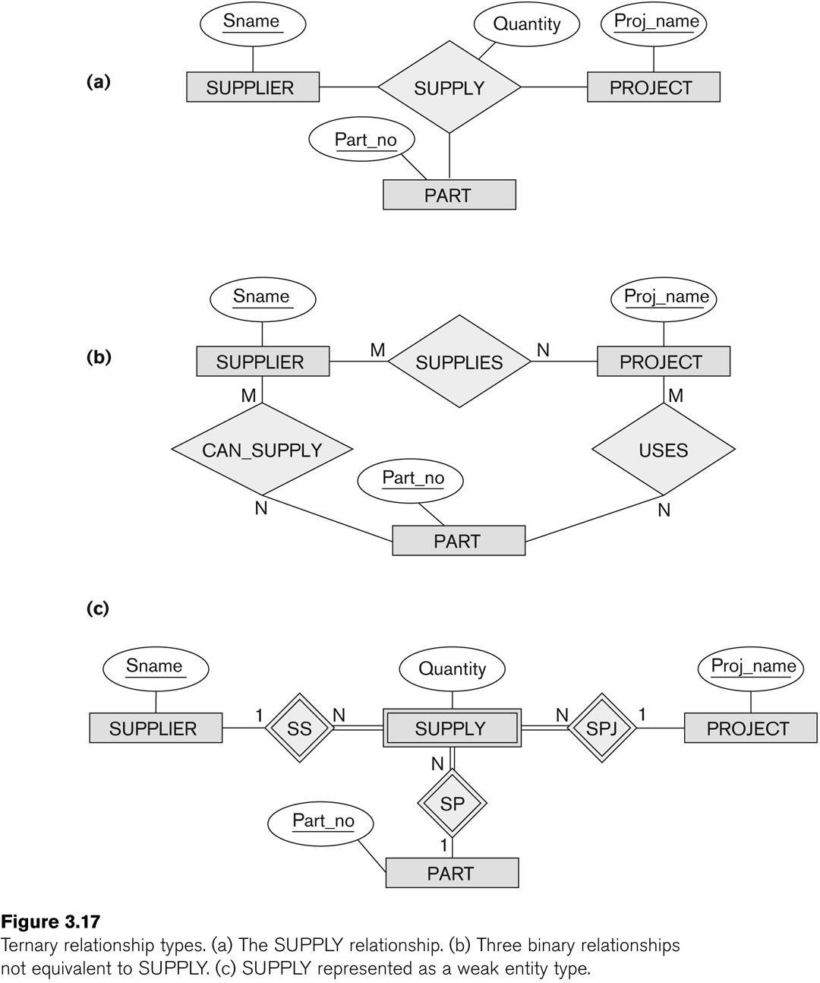
n-ary relationships (n > 2)
Three binary relationships represents different information than a single ternary relationship
In some cases, a ternary relationship can be represented as a weak

Slide 61
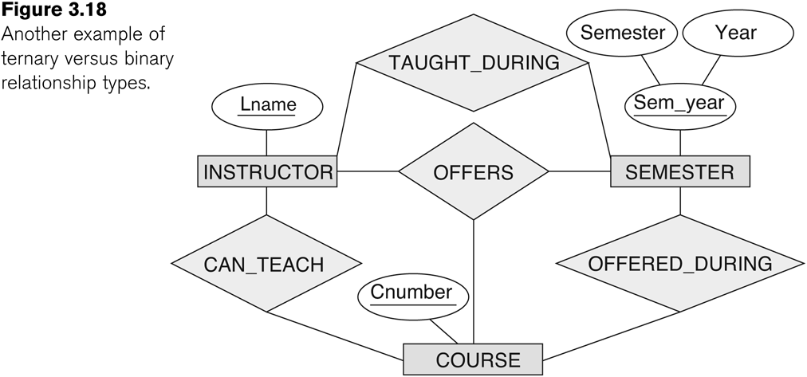
Example 3 of a ternary relationship
Notes:
For example, a relationship
instance (i, s, c) should not exist in OFFERS unless an instance (i, s) exists in
TAUGHT_DURING, an instance (s, c) exists in OFFERED_DURING, and an instance (i,
c) exists in CAN_TEACH. However, the reverse is not always true; we may have
instances (i, s), (s, c), and (i, c) in the three binary relationship types with no corresponding
instance (i, s, c) in OFFERS.Note that in this example, based on the meanings
of the relationships, we can infer the instances of TAUGHT_DURING and
OFFERED_DURING from the instances in OFFERS, but we cannot infer the
instances of CAN_TEACH; therefore, TAUGHT_DURING and OFFERED_DURING are
redundant and can be left out.

Slide 62
n-ary relationships (n > 2)
If a particular binary relationship can be derived from a higher-degree relationship at all times, then it is redundant
For example, the TAUGHT_DURING binary relationship can be derived from the ternary relationship OFFERS (based on the meaning of the relationships)

Slide 63
Displaying constraints on higher-degree relationships
Displaying a 1, M, or N indicates
1 indicates that an entity can participate in at most one relationship instance that has a particular combination of the other participating entities
M or N indicates no constraint
(min, max) constraints can be displayed on the edges – however, they do not fully describe the constraints
In general, both (min, max) and 1, M, or N are needed to describe fully the constraints

Slide 64
Cardinality for ternary relationship
Constraint: For a particular project-part combination, only one supplier will be used (only one supplier supplies a particular part to a particular project).
Notes:
In this case, we
place 1 on the SUPPLIER participation, and M, N on the PROJECT, PART participations
in Figure 7.17. This specifies the constraint that a particular ( j, p) combination
can appear at most once in the relationship set because each such (PROJECT, PART)
combination uniquely determines a single supplier. Hence, any relationship
instance (s, j, p) is uniquely identified in the relationship set by its ( j, p) combination,
which makes ( j, p) a key for the relationship set.
In this notation, the participations that have a 1 specified on them are not required to be part of the identifying
key for the relationship set. If all three cardinalities are M or N, then the key will
be the combination of all three participants.

Slide 65
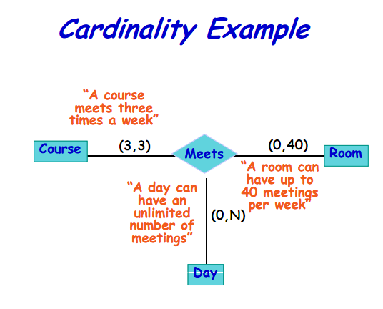
Displaying constraints on higher-degree relationships
Notes:
A (min, max) on a participation here specifies that each
entity is related to at least min and at most max relationship instances in the relationship
set. These constraints have no bearing on determining the key of an n-ary relationship,
where n > 2,17 but specify a different type of constraint that places
restrictions on how many relationship instances each entity can participate in.

Slide 66
Alternative diagrammatic notation
ER diagrams is one popular example for displaying database schemas
UML class diagrams is representative of another way of displaying ER concepts

Slide 67
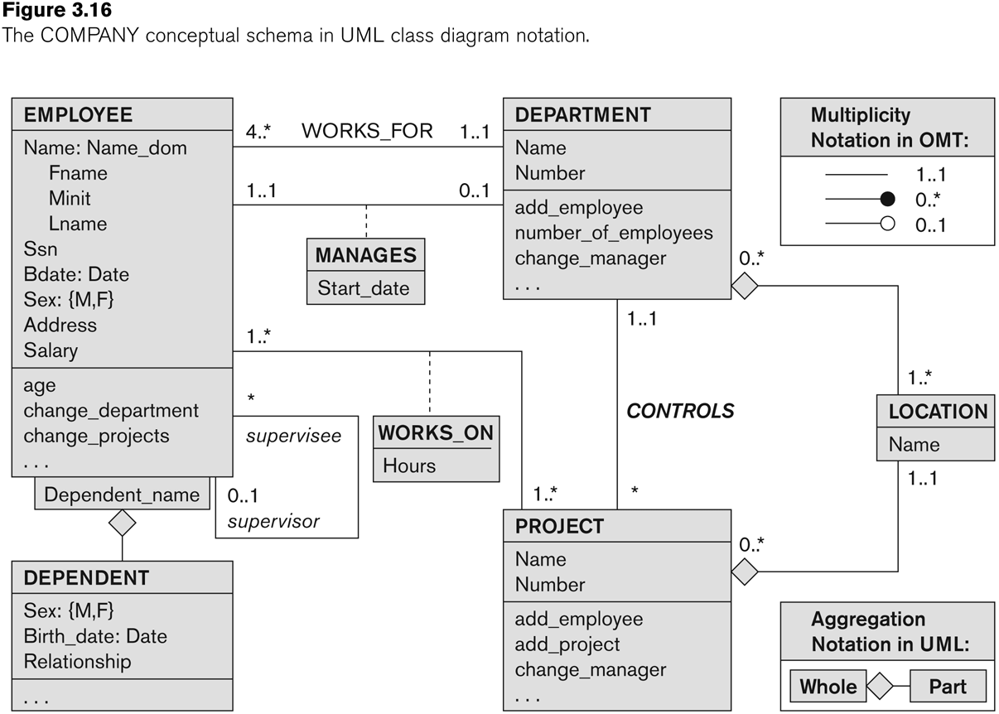
UML class diagrams
Represent classes (similar to entity types) as large boxes with three sections:
Top section includes entity type (class) name
Second section includes attributes
Third section includes class operations (operations are not specified in ER model)
Composite attribute is modeled as a structured domain
Name of EMPLOYEE
Multivalued attribute is modeled as a separate class
LOCATION class

Slide 68
UML class diagrams
Relationship types are called associations in UML
Relationship instances are called links
Relationships are represented as lines connecting the classes
The (min, max) notation is used to specify relationship constraints (multiplicities)
multiplicities are placed on the opposite ends of the relationship
A recursive relationship is called a reflexive association in UML
Weak entities can be modeled using the construct called qualified association
Notes:
the multiplicities are placed on the opposite ends of the relationship when
compared with the notation discussed in ER model

Slide 69
UML class diagram for COMPANY database schema
Qualified association for weal entity
Notes:
In UML, there are two types of relationships: association and aggregation.
Aggregation is meant to represent a relationship between a whole object and its
component parts, and it has a distinct diagrammatic notation. In Figure, we
modeled the locations of a department and the single location of a project as aggregations.
However, aggregation and association do not have different structural
properties, and the choice as to which type of relationship to use is somewhat subjective.
In the ER model, both are represented as relationships.

Slide 70
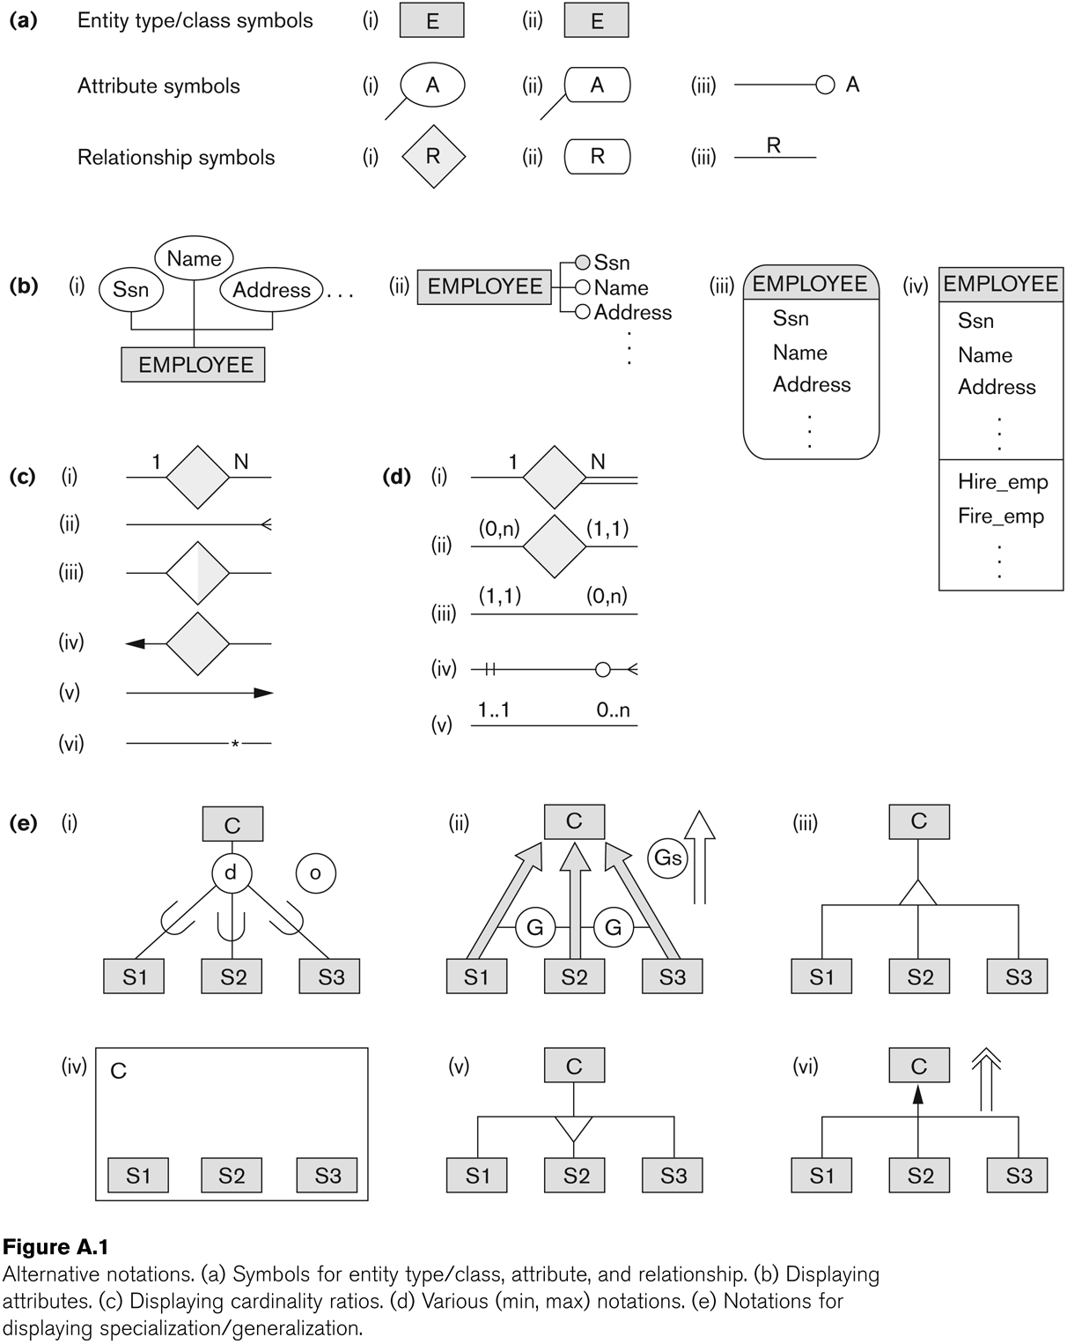
Other alternative diagrammatic notations

Slide 71
Chapter Summary
ER Model Concepts: Entities, attributes, relationships
Constraints in the ER model
Using ER in step-by-step conceptual schema design for the COMPANY database
ER Diagrams - Notation
Alternative Notations – UML class diagrams, others

Slide 72
HW 1
Draw E\R model for the university database with the following requirements
The university keeps track of each student's name, rollno, SSN, current address and phone, permanent address and phone, birthdate, sex, class (freshman, sophomore, ..., graduate), major department, minor department (if any), and degree program (B.A., B.S., ..., Ph.D.). Some user applications need to refer to the city, state, and zip of the student's permanent address, and to the student's last name. Both SSN and Rollno have unique values for each student.
Each department is described by a name, code, office number, office phone, and college. Both name and code have unique values for each department.
Each course has a course name, description, course number, number of semester hours, level, and offering department. The value of course number is unique for each course.
Each section has an instructor, semester, year, course, and section number. The section number distinguishes different sections of the same course that are taught during the same semester/year; its values are 1, 2, 3, ...; up to the number of sections taught during each semester.
A grade report has a student, section, letter grade, and numeric grade (0, 1, 2, 3, 4 for F, D, C, B, A, respectively).

Slide 73
HW 2: ER for Notown Records
Each musician has an SSN, name, address, phone. Poor musicians often share the same address, and no address has more than one phone.
Each instrument that is used in songs recorded at Notown has a name (e.g., guitar, flute) and a musical key (e.g., C, B-flat).
Each album has a title, a copyright date, a format (e.g., CD or MC), and an album identifier.
Each song recorded at Notown has a title and an author.
Each musician may play several instruments, and an instrument may be played by several musicians.
Each album has a number of songs on it, but no song may appear on more than one album.
Each song is performed by one or more musicians, and a musician may perform a number of songs.
Each album has exactly one musician who acts as its producer. A musician may produce several albums, of course.

