Slide 1
COMPUTER ORGANIZATION

Slide 2
Major Topics for Today
Buses
I/O Controller
Registers
Caches
Fetch-Decode-Execute Cycle
Pipelining

Slide 3
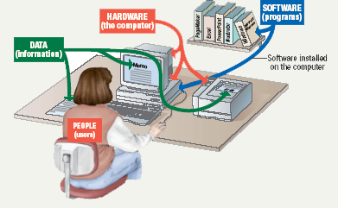
COMPUTER ORGANIZATION
It deals with the hardware components of a computer system such as the input/output devices, CPU and memory devices
Notes:
Computer systems have four parts—Hardware—Software—Data--User
Hardware---Mechanical devices in the computer---Anything that can be touched
Software---Tell the computer what to do---Also called a program---Thousands of programs exist
Data---Pieces of information---Computer organize and present data
Users---People operating the computer---Most important part---Tell the computer what to do

Slide 4
HARDWARE

Slide 5
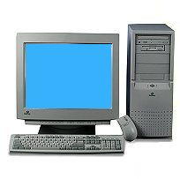
ESSENTIAL COMPUTER HARDWARE
Computers use the same basic hardware
CRT Display
“The Box”
Keyboard
Mouse
Notes:
Computers use the same basic hardware
Hardware categorized into four types
CRT (cathode ray tube) monitors
LCD (liquid crystal display) monitors
LED (light-emitting diodes) monitors

Slide 6
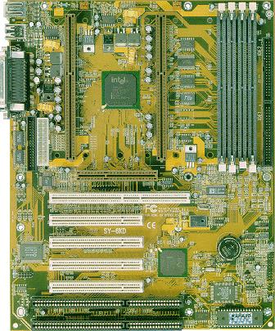
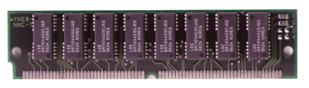
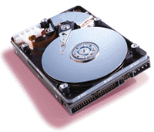
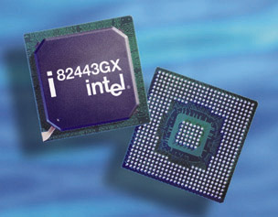
INSIDE THE BOX
Motherboard
(RAM)
CPU
(Central Processing Unit)
HDD
(Hard Disk Drive)

Slide 7
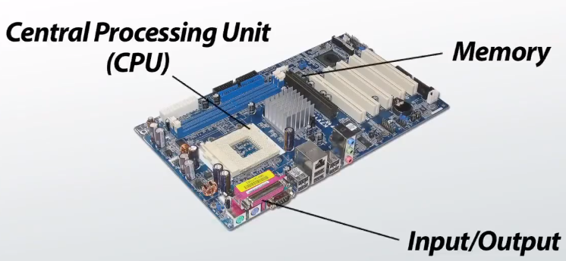
MOTHER-BOARD
It holds together many of the crucial components of a computer
Parts of a Motherboard
A CPU socket
A power connector
Slots for RAM
A second chip that controls the input and output (I/O) functions
Slots for one or more hard drives
A read-only memory (ROM) chip
A slot for a video or graphics card
Notes:
A motherboard is one of the most essential parts of a computer system. It holds together many of the crucial components of a computer, including the central processing unit (CPU), memory and connectors for input and output device

Slide 8
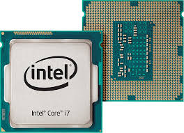
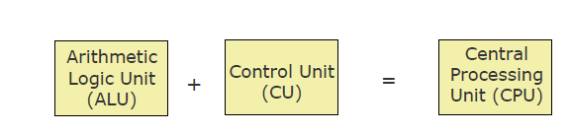
CENTRAL PROCESSING UNIT
It is the brain of a computer system.
Carries out instructions from the program.
Performs the basic arithmetical, logical, and input/output operations.
!!Remember that this is all about speed.
Components
ALU
CU
Cache
Notes:
ALU—Calculations occure
Control Unit----manages and coordinates the operations of all other components--
Cache---, which serves as high-speed memory where instructions can be copied to and retrieved

Slide 9
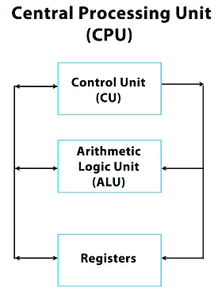
ARITHMETIC LOGIC UNIT- ALU
An arithmetic logic unit (ALU) is a digital circuit used to perform arithmetic and logic operations.
The control unit moves the data between these registers, the ALU, and memory.
Notes:
It represents the fundamental building block of the central processing unit (CPU).
Modern CPUs contain very powerful and complex ALUs. In addition modern CPUs contain a control unit (CU).
Most of the operations of a CPU are performed by one or more ALUs, which load data from input registers.
A register is a small amount of storage available as part of a CPU.
The control unit tells the ALU what operation to perform on that data, and the ALU stores the result in an output register.

Slide 10
HOW AN ALU WORKS
Arithmetic operations
Logic operations
addition
Subtraction
Multiplication
division
comparisons of values such as
NOT
AND
OR
There are also circuits for multiplying, for comparing two numbers, etc.
Transistor switches are used to manipulate binary numbers
An open transistor represents a 0.
A closed transistor represents a 1.
Notes:
ALU performs basic arithmetic and logic operations
All information in a computer is stored and manipulated in the form of binary numbers, i.e. 0 and 1.
Transistor switches are used to manipulate binary numbers since there are only two possible states of a switch: open or closed. An open transistor, through which there is no current, represents a 0. A closed transistor, through which there is a current, represents a 1.

Slide 11
CONTROL UNIT (CU)
One of the two basic components of CPU
Acts as the central nervous system of a computer system
Selects and interprets program instructions, and coordinates execution
Fetch 🡪 decode 🡪 execute 🡪 write back
Has some special purpose registers and a decoder to perform these activities
!!The control unit moves the data between these registers, the ALU, and memory.

Slide 12
RAM&ROM
Stores data or programs
Random Access Memory (RAM)
Volatile
Stores current data and programs
More RAM results in a faster system
2 to 8 GB
Read Only Memory (ROM)
Permanent storage of programs
Holds the computer boot directions
Notes:
Intel, the manufacturer of popular CPUs, originally made RAM for mainframe and minicomputers. Today Kingston is a leading RAM manufacturer.
A RAM device makes it possible to access data in random order, which makes it very fast to find a specific piece of information.
RAM is considered volatile memory, which means that the stored information is lost when there is no power.

Slide 13
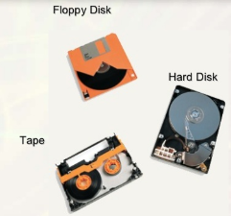
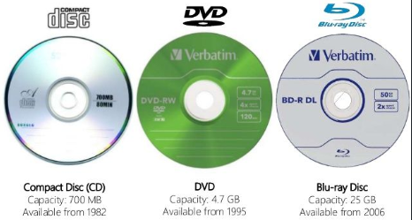
STORAGE DEVICES
Hold data and programs permanently
Different from RAM
Magnetic storage
Floppy and hard drive
Uses a magnet to access data
Optical storage
CD and DVD drives
Uses a laser to access data
Notes:
Each tiny bit of the disk carries a magnetic charge; the direction of that charge determines whether it represents a 1 or a 0. Optical storage, meanwhile, uses disks made of reflective material; how each bit reflects light–or doesn't reflect it–determines whether it's a 1 or a 0.
VIDEO OF THE DAY

Slide 14
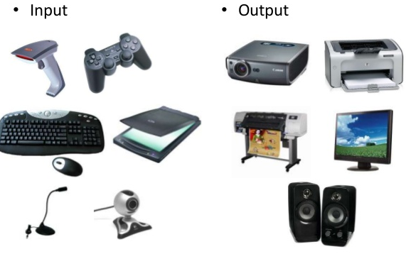
I/O DEVICES
Allows the user to interact
Some devices are input and output
Touch screens
Input Devices
Any peripheral (piece of computer hardware equipment) used to provide data and control signals to a computer.
Allows the user to put data into the computer.
Output Devices
Any peripheral that deliver data
Computer hardware equipment used to communicate the results of data processing carried out by a computer to the outside world.
Notes:
Examples of Input Device—Keyboard—Mouse--Touchscreen--Graphic tablet---Microphone---Scanner
Examples of Output Device--Monitor--Printer--Speakers--Projector

Slide 15
I/O CONTROLLERS
The main purpose of this system is to help in the interaction of peripheral devices with the control units (CUs).
Put simply, the I/O controller helps in the connection and control of various peripheral devices, which are input and output devices.
I/O controllers are also known as channel I/O, DMA controllers, peripheral processors or I/O processors.

Slide 16
SOFTWARE

Slide 17
SOFTWARE
Software
Tells the computer what to do
Reason people purchase computers
Two types
System software
Application software
System software
Most important software
Operating system
Windows XP
Network operating system (OS)
Windows Server 2003
Utility
Symantec Antivirus
Application software
Accomplishes a specific task
Most common type of software
MS Word
Covers most common uses of computers
System software
Application software
Operating system
Custom built
Utility software
Packaged software
Device drivers
Notes:
System software--Most important software---Operating system---Windows XP---Network operating system (OS)---Windows Server 2003---Utility---Symantec Antivirus
Application software---Accomplishes a specific task---Most common type of software---MS Word---Covers most common uses of computers

Slide 18
BASIC ORGANIZATION OF COMPUTER SYSTEM

Slide 19
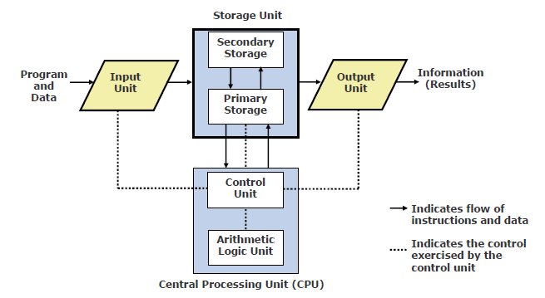
BASIC ORGANIZATION OF COMPUTER SYSTEM
Notes:
1. The Central Processing Unit (CPU)
2. The Main Memory Unit (RAM)
3. The Input / Output Device

Slide 20
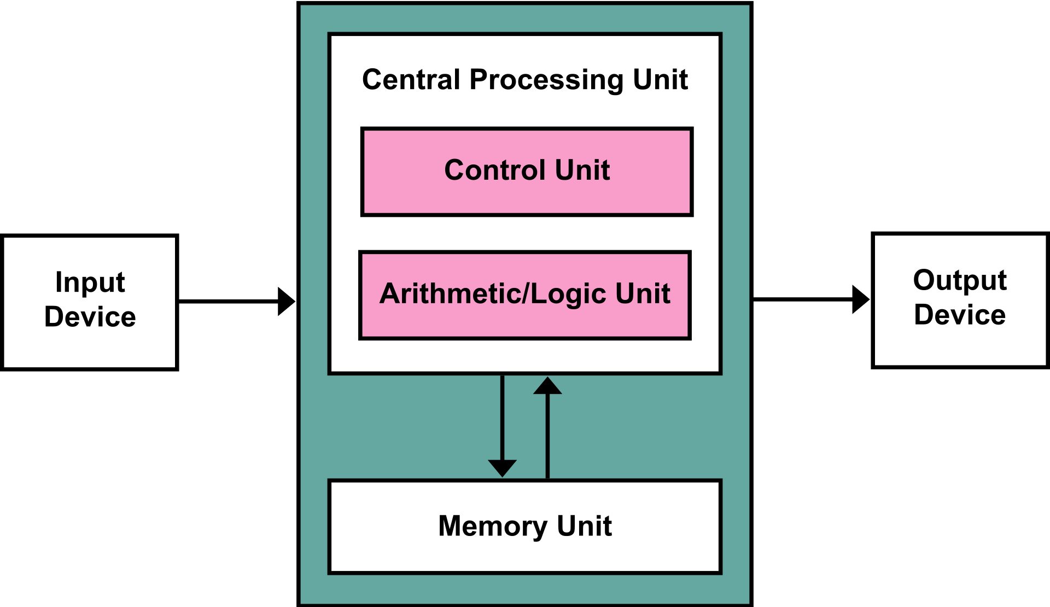
VON NEUMANN BASIC STRUCTURE
Let’s consider them in detail.
Arithmetic and Logic Unit (ALU)
The arithmetic logic unit is that part of the CPU that handles all the calculations the CPU may need, e.g. Addition, Subtraction, Comparisons.
It performs Logical Operations, Bit Shifting Operations, and Arithmetic Operation.
Control Unit
A control unit (CU) handles all processor control signals. It directs all input and output flow, fetches code for instructions and controlling how data moves around the system.

Slide 21
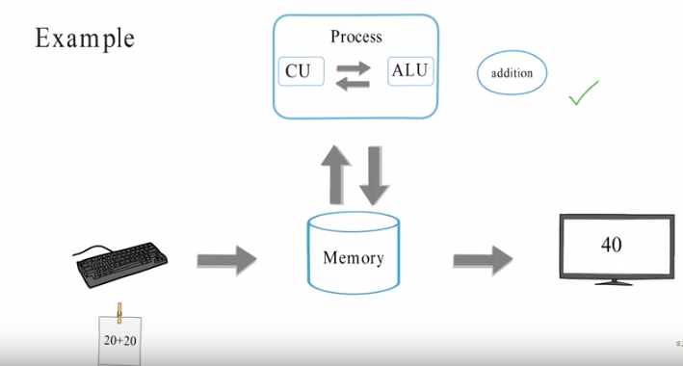

Slide 22
PROCESSOR AND MEMORY

Slide 23
BASIC PROCESSOR & MEMORY ARCHITECTURE OF A COMPUTER SYSTEM
^{ROM} PROM Flash
Main Memory (RAM)
I/ O
D E V I C E S
Cache Memory
Decode r Program
control register
Instruction register
Memory address register
Memory buffer register
Accumulato
r register
General-
purpose register
General- purpose register
Input/Output
register
General- purpose register
Control Unit
General-purpose register
Ref Page

Slide 24
COMPUTER BUS
Bus:
Inside computers, there are many internal components. For these components to communicate with each other they make use of wires that are known as a ‘bus’ .
A bus is a common pathway through which information flows from one computer component to another. This pathway is used for communication purpose and it is established between two or more computer components.
Types of Bus:
Data bus is used for transfer of data between subunits
Address bus is used to transmit location information between units such as where the data is going or coming from.
Control bus control working of other components. It is used to provide information as to how data is being sent.

Slide 25
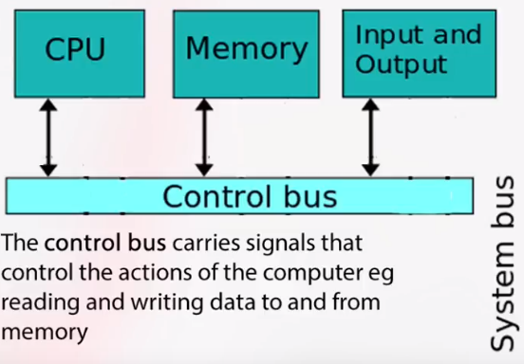
Notes:
Control bus specifies the type of operation that is to be performed (read write commands, bus request/grant etc) travel on control bus
E.g. acknowledgement signals travel on control bus

Slide 26
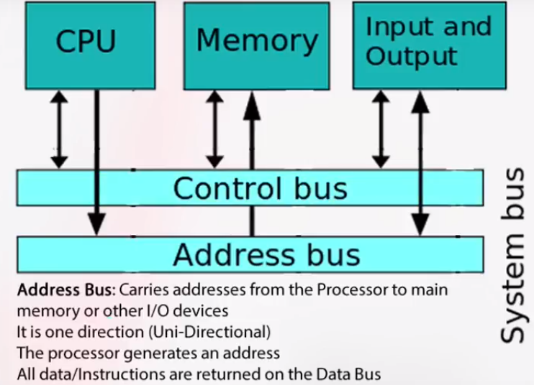
Notes:
Carries address signal to read or write data to memory

Slide 27
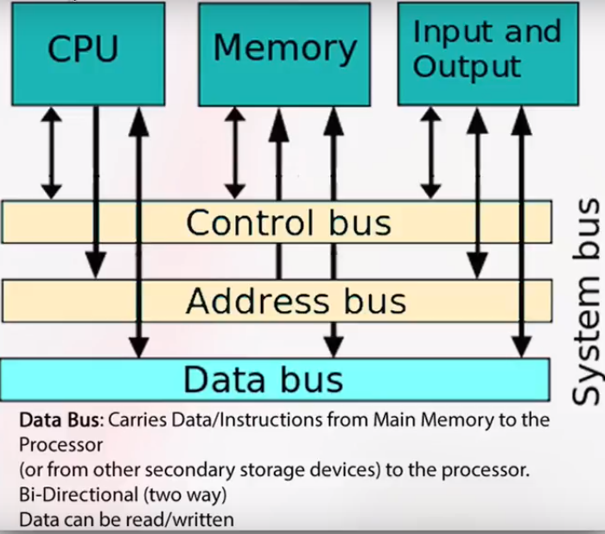

Slide 28
INSTRUCTION SET
The complete set of all the instructions in machine code that can be recognized and executed by a central processing unit.
CPU has built-in ability to execute a set of machine instructions, called its instruction set
Most CPUs have 200 or more instructions (such as add, subtract, compare, etc.) in their instruction set
CPUs made by different manufacturers have different instruction sets
Manufacturers tend to group their CPUs into “families” having similar instruction sets
New CPU whose instruction set includes instruction set of its predecessor CPU is said to be backward compatible with its predecessor

Slide 29
REGISTERS
Special memory units, called registers, are used to hold information on a temporary basis as the instructions are interpreted and executed by the CPU
Registers are part of the CPU (not main memory) of a computer and is super fast memory.
The length of a register, sometimes called its word size, equals the number of bits it can store
With all other parameters being the same, a CPU with 32-bit registers can process data twice larger than one with 16-bit registers

Slide 30
CPU REGISTERS
Accumulator: Stores the results of calculations made by ALU.
Program Counter (PC): Keeps track of the memory location of the next instructions to be dealt with. The PC then passes this next address to Memory Address Register (MAR).
Memory Address Register (MAR): Holds the address of the location in memory, which contains data, that is required by the current instruction being executed. simply MAR points to the memory location that contains data required.
Memory Data Register (MDR): It stores instructions fetched from memory or any data that is to be transferred to, and stored in, memory.
Current Instruction Register (CIR): Holds the instruction currently being executed or decoded.
Instruction Buffer Register (IBR): The instruction that is not to be executed immediately is placed in the instruction buffer register IBR.

Slide 31
CPU REGISTERS
General Purpose Registers:
Some registers can be used for more than one purpose. Such registers are called general purpose registers.

Slide 32
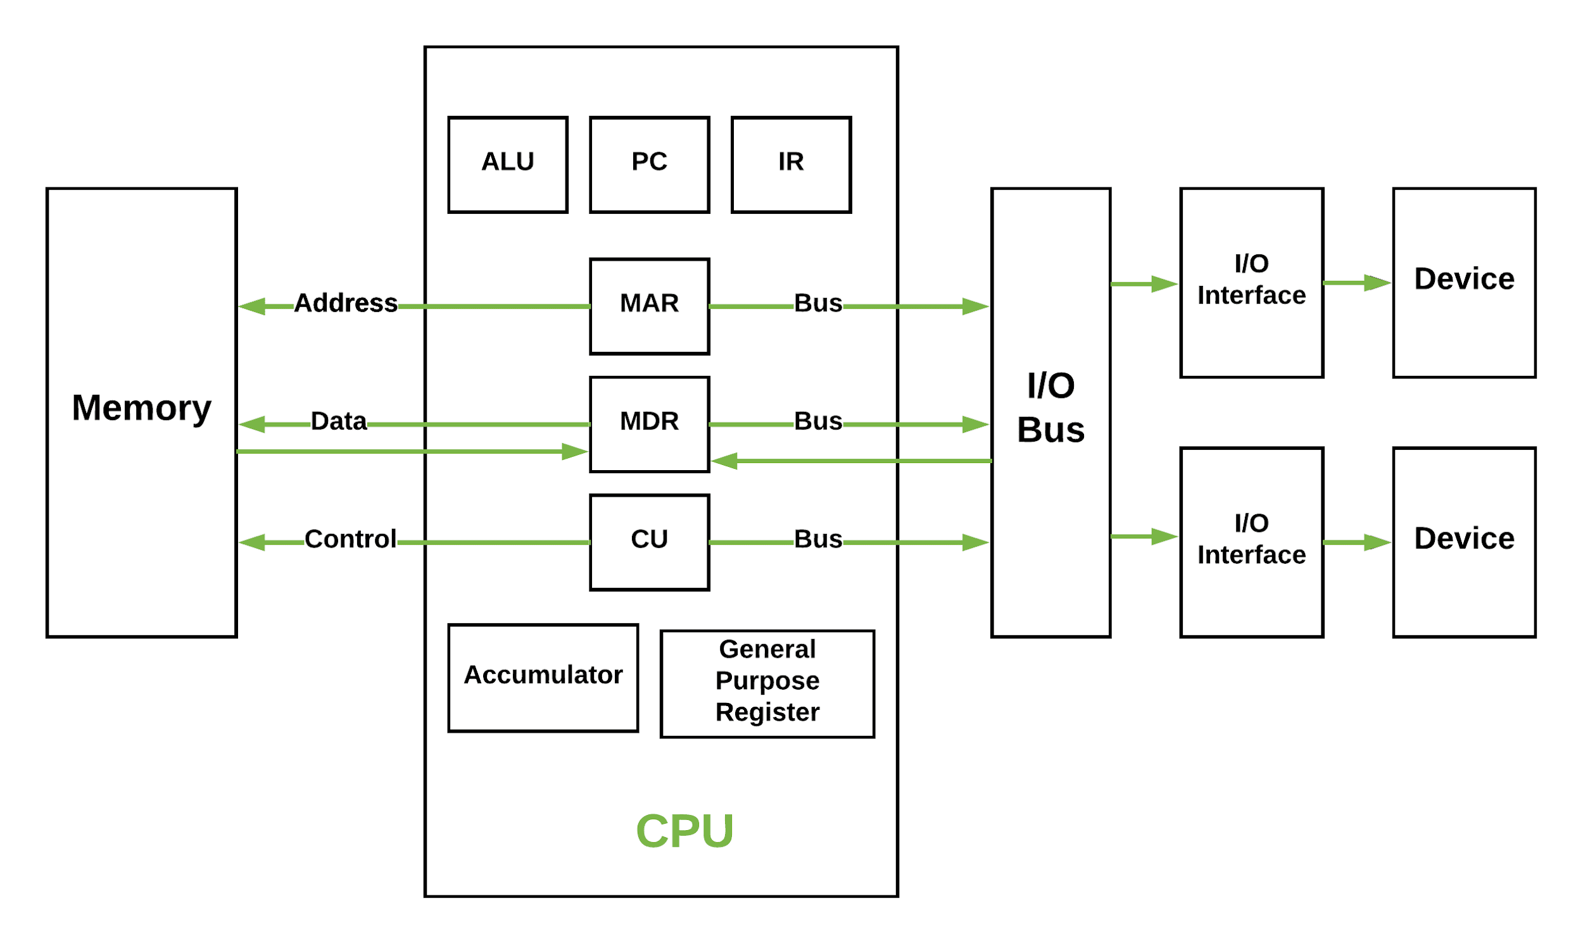
CPU REGISTERS

Slide 33
FETCH DECODE EXECUTE CYCLE
Fetch :
Get an instruction from main memory
Decode:
Translate it into computer command
Execute:
Actual processing of command
Mem:
Write result to memory.

Slide 34
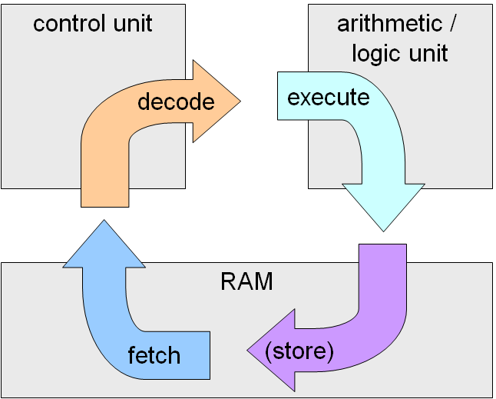
FETCH DECODE EXECUTE CYCLE

Slide 35
THE FETCH/EXECUTE CYCLE
“Instruction Execution Engine”…a machine that cycles through a series of operations
Series is called: Fetch/Execute Cycle
Get the next instruction
Figure out what to do
Gathering the data needed to do it
Do it
Save the result, and
Repeat (billions of times/second)!

Slide 36
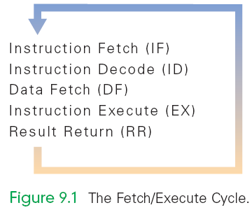
A FIVE-STEP CYCLE
These operations are repeated in a never-ending sequence
A five-step cycle:
Instruction Fetch (IF)
Instruction Decode (ID)
Data Fetch (DF) / Operand Fetch (OF)
Instruction Execution (EX)
Result Return (RR) / Store (ST)

Slide 37
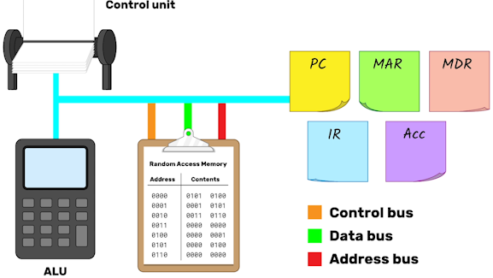
A FIVE-STEP CYCLE

Slide 38
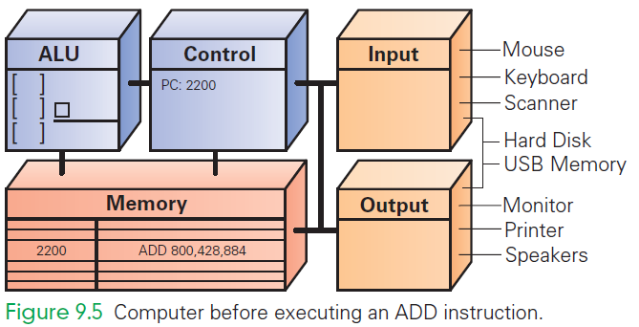
ADD 800, 428, 884

Slide 39
INSTRUCTION FETCH (IF)
Execution begins by moving the instruction at the address given by the (PC 2200) from memory to the control unit
Once instruction is fetched, the PC can be changed for fetching the next instruction

Slide 40
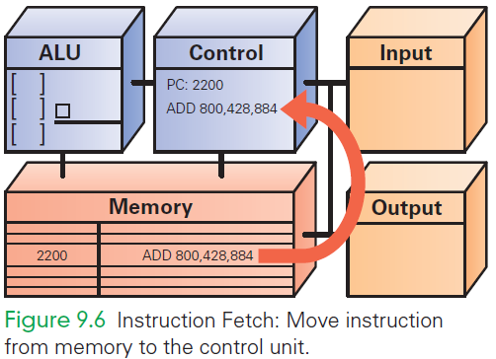
IF
Notes:
Execution begins by moving the instruction at the address given by the PC (PC 2200) from memory to the control unit
Once instruction is fetched, the PC can be readied for fetching the next instruction

Slide 41
INSTRUCTION DECODE (ID)
ALU is set up for the operation
Decoder finds the memory address of the instruction's data (source operands)
Most instructions operate on two data values stored in memory (like ADD), so most instructions have addresses for two source operands
These addresses are passed to the circuit that fetches them from memory during the next step
Decoder finds the destination address for the Result Return step and places the address in the RR circuit
Decoder determines what operation the ALU will perform (ADD), and sets up the ALU

Slide 42
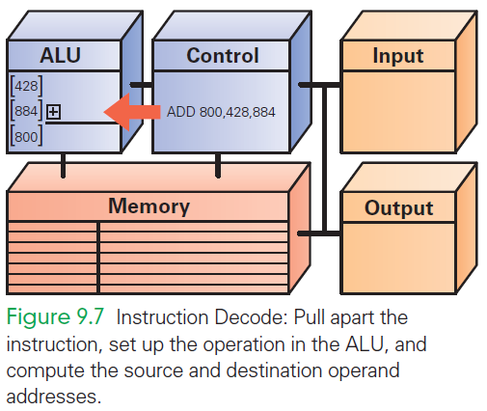
ID

Slide 43
DATA FETCH (DF)
The data values to be operated on are retrieved from memory
Bits at specified memory locations are copied into locations in the ALU circuitry
Data values remain in memory (they are not destroyed)

Slide 44
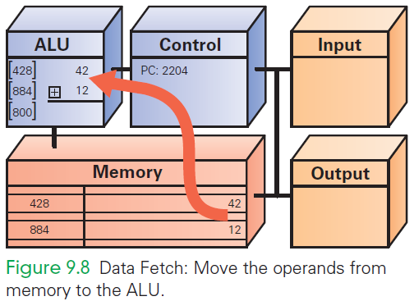
DF

Slide 45
INSTRUCTION EXECUTION (EX)
For this ADD instruction, the addition circuit adds the two source operands together to produce their sum
Sum is held in the ALU circuitry
This is the actual computation

Slide 46
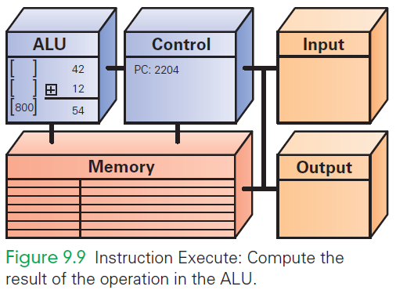
EX

Slide 47
RETURN RESULT (RR)
RR returns the result of EX to the memory location specified by the destination address.
Once the result is stored, the cycle begins again

Slide 48
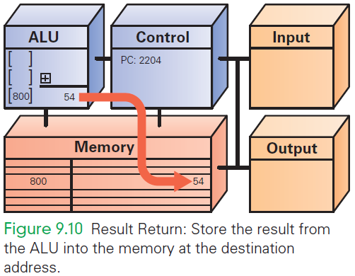
RR

Slide 49
CYCLING THE FETCH/EXECUTE CYCLE
ADD is representative of the complexity of computer instructions…some are slightly simpler, some slightly more complex
Computers achieve success at what they can do with speed.
They show their impressive capabilities by executing many simple instructions per second

Slide 50
MANY, MANY SIMPLE OPERATIONS
Computers “know” very few instructions
The decoder hardware in the controller recognizes, and the ALU performs, only about 100 different instructions (with a lot of duplication)
There are only about 20 different kinds of operations.
Everything that computers do must be reduced to some combination of these primitive, hardwired instructions

Slide 51
PROCESSOR AND MEMORY

Slide 52
MEMORY
Memory stores both the program while it is running and the data on which the program operates
Properties of memory:
Discrete locations
Memory is organized as a sequence of discrete locations
In modern memory, each location is composed of 1 byte (8 bits)

Slide 53
MEMORY
Addresses
Every memory location has an address, whole numbers starting at 0
Values
Memory locations record or store values
Finite capacity
Memory locations have a finite capacity (limited size),
Data may not “fit” in the memory location

Slide 54
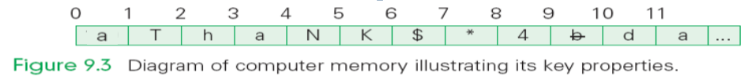
BYTE-SIZE MEMORY LOCATION
Common visualization of computer memory
Discrete locations are shown as boxes holding 1-byte each
Address of location is displayed above the box and the contents of location is shown in the box

Slide 55
BYTE-SIZE MEMORY LOCATION
That 1-byte memory location can store one ASCII character or a number less than 256
Blocks of four bytes are used as a unit so often that they are called memory words.

Slide 56
RAM
Computer memory is called random access memory (RAM)
“Random access” is out-of-date and simply means that the computer can refer to the memory locations in any order
RAM is measured in megabytes (MB) or gigabytes (GB)
Lots of memory is need to handle the space required of programs and data

Slide 57
MEMORY CAPACITY
Memory capacity of a computer is equal to the number of bytes that can be stored in its primary storage
Its units are:
Kilobytes (KB) : 1024 (2¹⁰) bytes
Megabytes (MB) : 1,048,576 (2²⁰) bytes
Gigabytes (GB) : 1,073,741824 (2³⁰) bytes

Slide 58
CONTROL UNIT-CU
The control unit of a computer is where the Fetch/Execute Cycle occurs
Its circuitry fetches an instruction from memory and performs the other operations of the Fetch/Execute Cycle on it
A typical machine instruction has the form ADD 4000, 2000, 2080

Slide 59
TASK
ADD 4000, 2000, 2080
Looks like those three numbers should be added together
What it really means is that whatever numbers are stored in memory locations 2000 and 2080 be added together, and the result be stored in location 4000

Slide 60
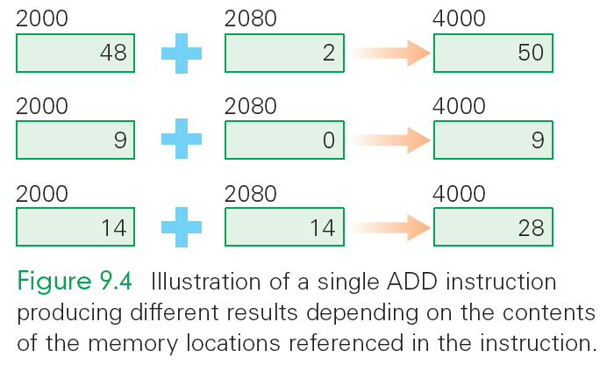
TASK

Slide 61
CACHES
The data/instructions stored in RAM are retrieved faster than hard disks. That’s why the data/instructions required by CPU is kept in RAM.
There is another type of memory which is much faster than RAM. It’s called cache. Some part of data/instructions currently required by CPU is copied into cache from RAM.
The CPU then gets instructions and data from caches.
Caches are much smaller in capacity than RAMs.
They are built-in on the CPU

Slide 62
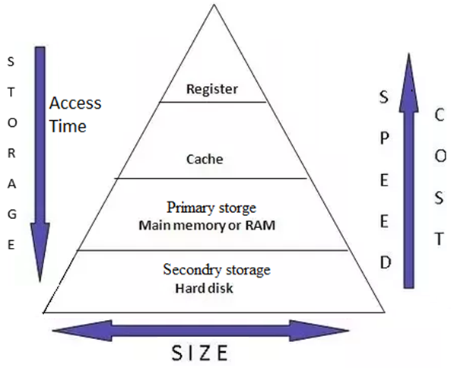
STORAGE HIERARCHY
Capacity and access are inversely proportional to each other

Slide 63
THE PROGRAM COUNTER (PC)
How does the computer determine which instruction it should execute next?
Address of the Next Instruction
The instruction is stored in memory and the computer has its address
Computers use the address (known as the program counter or PC) to keep track of the next instruction

Slide 64
THE PROGRAM COUNTER
The computer gets ready to process the next instruction
It assumes that the next instruction is the next instruction in sequence
Because instructions use 4 bytes of memory, the next instruction must be at the memory address PC + 4 or 4 bytes further along the sequence

Slide 65
THE COMPUTER CLOCK
Computers are instruction execution engines.
Since the computer does one instruction per cycle in principle, the speed of a computer depends on the number of Fetch/Execute Cycles it completes per second.

Slide 66
THE COMPUTER CLOCK
The rate of the Fetch/Execute Cycle is determined by the computer’s clock, and it is measured in megahertz, or millions (mega) of cycles per second (hertz).
A 1,000 MHz clock ticks a billion (in American English) times per second, which is one gigahertz (1 GHz)

Slide 67
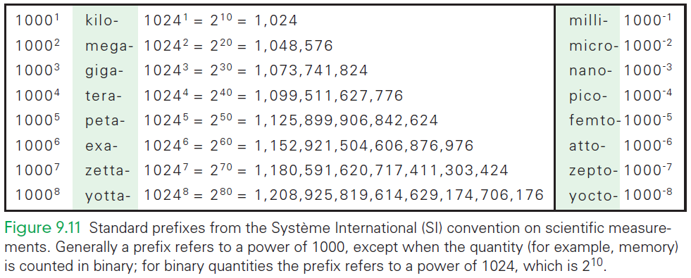
STANDARD PREFIXES

Slide 68
ONE CYCLE PER CLOCK TICK
A computer with a 1 GHz clock has one billionth of a second—one nanosecond—between clock ticks to run the Fetch/Execute Cycle.
In that amount of time, light travels about one foot (~30 cm).
Modern computers try to start an instruction on each clock tick.

Slide 69
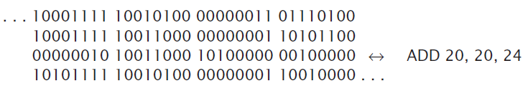
COMPUTER’S VIEW OF SOFTWARE
A program “sees” software as a long sequence of 4-byte groups of bits (0's and 1’s)
This binary object file can be hundreds of thousands to millions of words long

Slide 70
COMPUTER’S VIEW OF SOFTWARE
Once installed, the computer runs the software by:
copying the binary instructions into the RAM
interpreting them using the Fetch/Execute Cycle.
It does whatever the instructions tell it to do

Slide 71
PROCESSOR SPEED
Computer has a built-in system clock that emits millions of regularly spaced electric pulses per second (known as clock cycles)
It takes one cycle to perform a basic operation, such as moving a byte of data from one memory location to another
Normally, several clock cycles are required to fetch, decode, and execute a single program instruction
Hence, shorter the clock cycle, faster the processor
Clock speed (number of clock cycles per second) is measured in Megahertz (10⁶ cycles/sec) or Gigahertz (10⁹ cycles/sec)

Slide 72
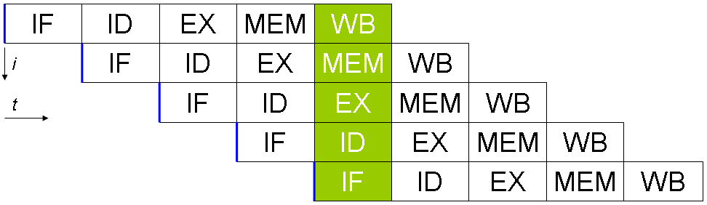
PIPELINING
Ignore the WB stage.

Slide 73
RECOMMENDED
https://www.futurelearn.com/courses/how-computers-work/0/steps/49284

