Slide 1
Introduction to Artificial Intelligence IICT Lecture 07

Slide 2
Intelligence
A very general mental capability that involves the ability to reason, plan, solve problems, think abstractly, comprehend complex ideas, learn quickly and learn from experience. [1]
Measurement of Intelligence:
Intelligence Quotient (IQ)
An intelligence quotient or IQ is a score derived from a set of standardized tests developed to measure a person's cognitive abilities ("intelligence") in relation to their age group
[1] Mainstream Science on Intelligence reprinted in Gottfredson (1997). Intelligence p. 13

Slide 3

Planning: Knight’s Plight Can we move the given knight to the “Target” location?
Target

Slide 4
Planning: Knight’s Plight Can we move the given knight to the “Target” location?
Target

Slide 5
Calculative Puzzle: Calculation, Computation, Reasoning
The number of times the digit 0 appears in this puzzle is ?. The number of times the digit 1 appears in this puzzle is ?. The number of times the digit 2 appears in this puzzle is ?. The number of times the digit 3 appears in this puzzle is ?. The number of times the digit 4 appears in this puzzle is ?. The number of times the digit 5 appears in this puzzle is ?. The number of times the digit 6 appears in this puzzle is ?. The number of times the digit 7 appears in this puzzle is ?. The number of times the digit 8 appears in this puzzle is ?. The number of times the digit 9 appears in this puzzle is ?.
Replace ? sign with count of numbers?

Slide 6
Calculative Puzzle: Calculation, Computation, Reasoning
The number of times the digit 0 appears in this puzzle is 1. The number of times the digit 1 appears in this puzzle is 11. The number of times the digit 2 appears in this puzzle is 2. The number of times the digit 3 appears in this puzzle is 1. The number of times the digit 4 appears in this puzzle is 1. The number of times the digit 5 appears in this puzzle is 1. The number of times the digit 6 appears in this puzzle is 1. The number of times the digit 7 appears in this puzzle is 1. The number of times the digit 8 appears in this puzzle is 1. The number of times the digit 9 appears in this puzzle is 1.
Replace ? sign with count of numbers?

Slide 7
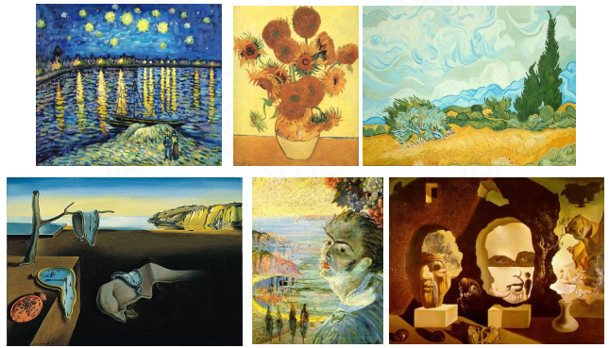
Painting by two different painters: Supervised Learning
Painter A
Painter B

Slide 8
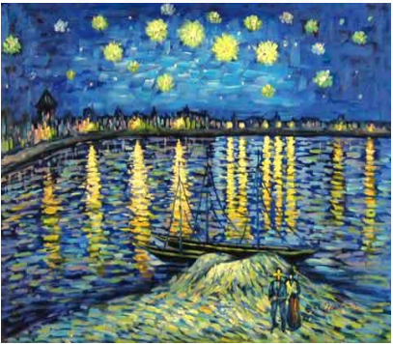
Now your turn… Who’s painting is this?

Slide 9
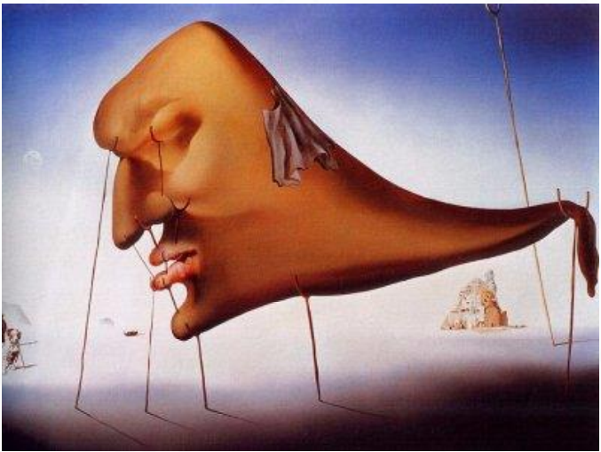
And this?

Slide 10
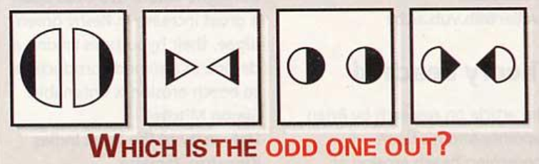
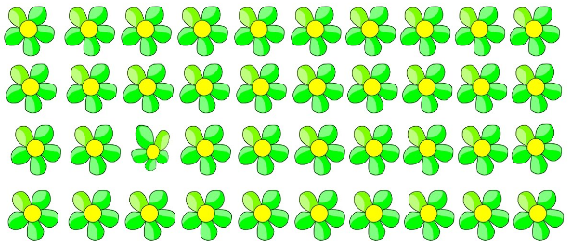
Finding the odd one out: Unsupervised Learning

Slide 11
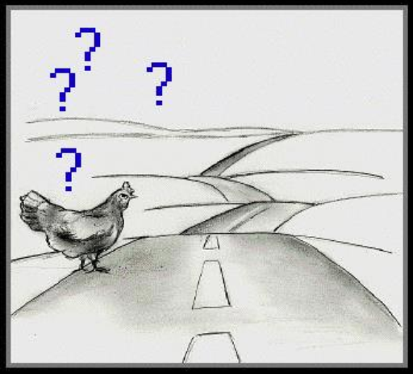
Some more…
What is the next number in this series?
1, 1, 2, 3, 5, ?
Would you cross a road when a fast car is approaching?

Slide 12
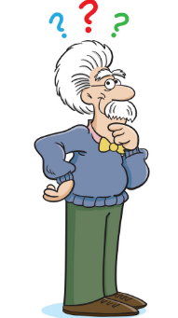
Conclusion
These are the very characteristics of Intelligent beings!!
Searching for a solution is central to intelligence
Knight’s Plight
Planning
Calculative Puzzle
Calculation, Computation, Reasoning
Finding the odd one out
Unsupervised Learning
Painting by two different painters
Supervised Learning
Series Completion
Prediction
Road Crossing
Rational Actions
Process of Writing this Conclusion
Summarizing, Abstraction

Slide 13
What is Artificial Intelligence?
Computers are ______.
Making a machine (computer) to perform the same tasks which you have just done is called______.
Artificial Intelligence
If you learn to do these tasks using existing data, then this is called _____.
Machine Learning
Dumb

Slide 14
Artificial Intelligence
Artificial Intelligence takes the problem of understanding how we think a step further
It attempts not just to understand it – but – also to build intelligent entities
A more proper definition of Artificial Intelligence
The art of creating machines that perform functions that require intelligence when performed by people [1]
Measurement of Artificial Intelligence
Turing Test
[1] Rich E., and Knight K., (1991). Artificial Intelligence (2e), McGraw-Hill, NewYork.

Slide 15
Artificial Intelligence
Artificial Intelligence has many subfields. For example, machine learning, natural language processing, computer vision, big data, data mining, robotics, etc.
Many of these subfields have a huge overlap.

Slide 16
Turing Test
A method proposed by Alan Turing to determine whether a machine can demonstrate human intelligence.
The machine will engage in a conversation with a human. The conversation will not be face to face.
If after the human cannot detect that the other person is actually a machine, then the machine has human intelligence.

Slide 17
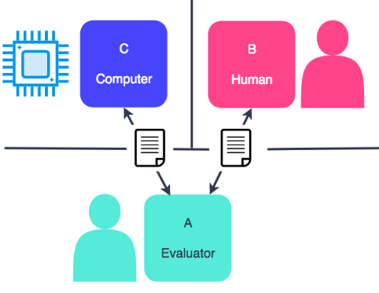
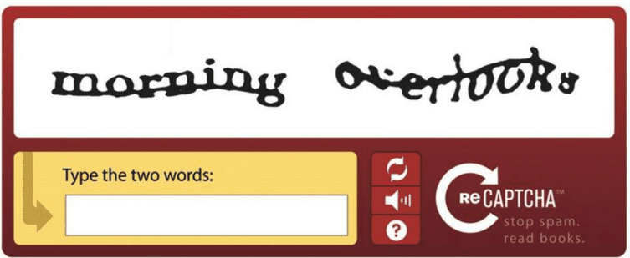
Turing Test
Turing Test
Suggested major components of AI: knowledge, reasoning, language understanding, learning
Application of the Turing Test
CAPTCHA: Completely Automated Public Turing test to tell Computers and Humans Apart

Slide 18
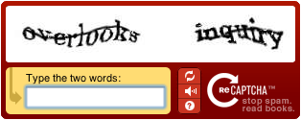
CAPTCHA
Completely Automated Public Turing Test To Tell Computers and Humans Apart
CAPTCHA protects websites against bots by generating and grading tests that humans can pass but computer programs cannot. For example, humans can read distorted text as the one shown below, but current computer programs can't:

Slide 19
CAPTCHA
USES:
Preventing Comment Spam
Preventing Automated Registrations
Protecting online voting/polls.

Slide 20
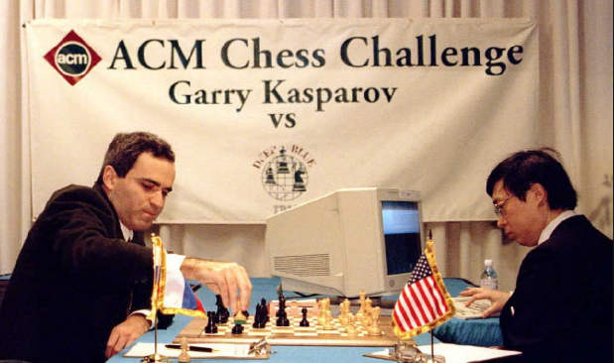
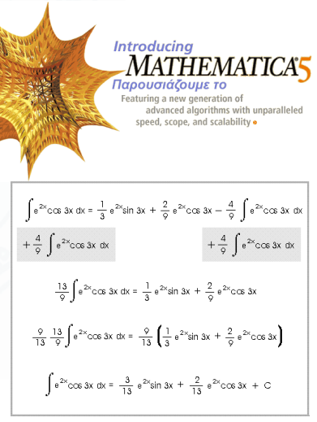
Is AI intelligent?
Planning
Kasparov Vs. IBM Blue (1997)
Calculation
Symbolic Integration in Mathematica
Theorem Provers

Slide 21
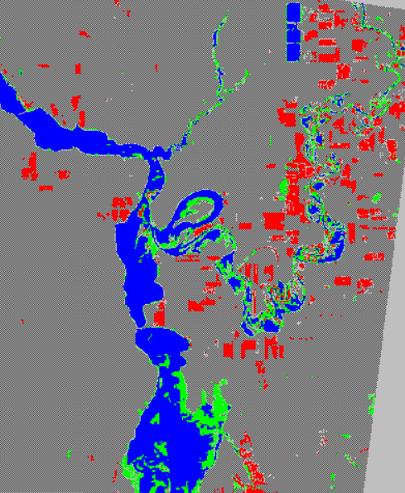
Is AI intelligent?
Learning without a Teacher
ERDAS Imagine
Classification of Land Use
ERDAS:
World Class Remote Sensing
Software
Notes:
Earth Resource Data Analyses System

Slide 22
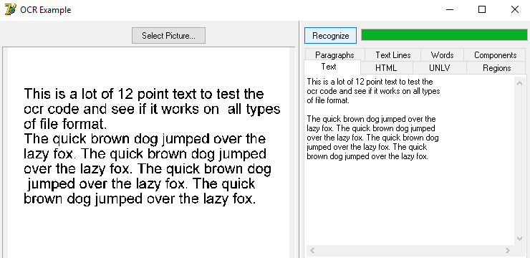
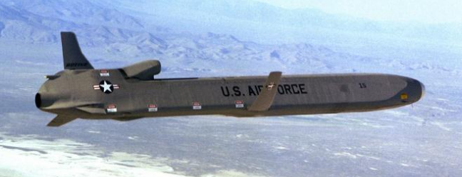
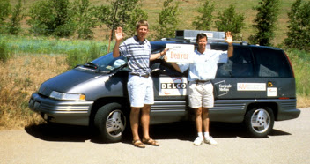
Is AI intelligent?
Learning with a teacher
No Hands Across America!
Optical Character Recognition

Slide 23
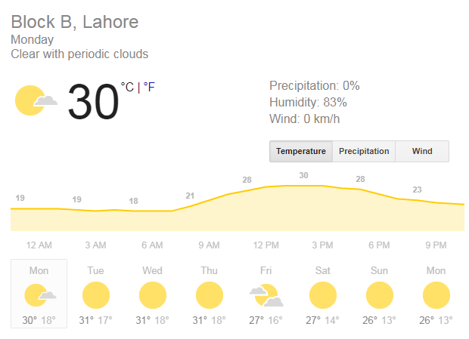
Forecasting and Prediction

Slide 24
Is deep blue Intelligent?
Deep Blue defeated the world chess champion Garry Kasparov. Does this make Deep Blue an intelligent machine?
Think about it for a few seconds and take a stance
Write down at least two items that support your claim either way
Pair up with your neighbor and Exchange opinions
Try to argue for your stance
Listen carefully to the arguments of your neighbor
Try to reach an agreement, if possible
Make your verdict: YES (machine is intelligent) or NO (machine is not intelligent) or X (no agreement)

Slide 25
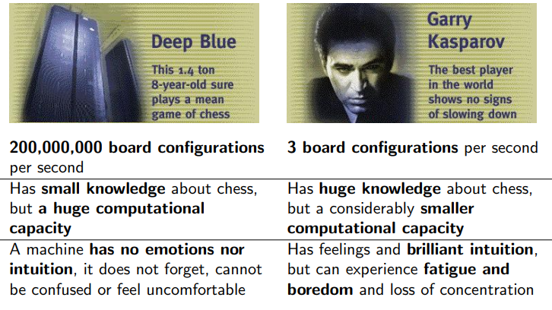
Deep Blue Vs Garry Kasparov

Slide 26
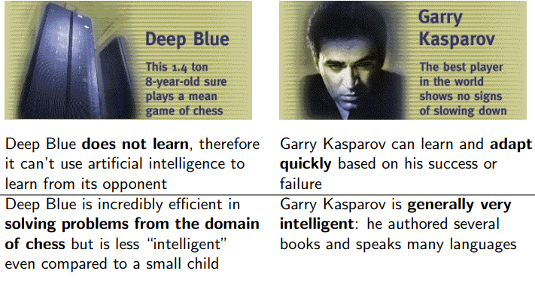

Slide 27
Natural Language Processing
A branch of AI
The man tried to take a picture of a man with a turban.
Did the man try to take a picture with a turban, or
take a picture of a man who is wearing a turban?
The man saw the boy with the telescope
Communicating in natural language assumes world knowledge and the understanding of context, both of which are required to resolve the ambiguities

Slide 28
Natural Language Processing
Google Now, Apple’s Siri, Microsoft’s Cortana, Amazon Alexa, etc. are examples of natural language processing.
They help to find useful information when we ask for using speech.
They can also perform other tasks when you ask, such as setting the alarm, making a phone call, etc.

Slide 29
Computer Vision
A branch of AI that enables computer to understand the content of images and videos.
Applications:
Optical character recognition (OCR)
Traffic Rule Violation
Object Detection and Recognition

