Slide 1
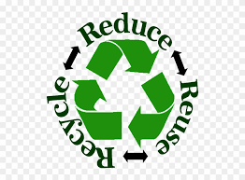
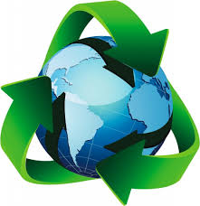
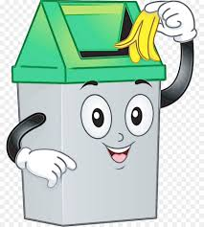
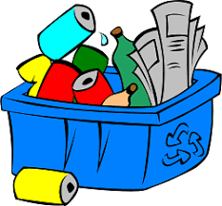
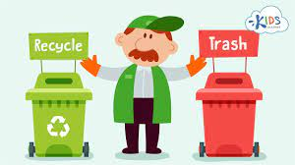
What is recycling ?
RECYCLING- Is when you put things like glass,plastic,paper/cardboard into diferent coloured bins to be turned into something new eg. Cardboard can be turned into a new cereal box. • Up to 60% of the rubbish that ends up in the bin could be recycled, the unreleased energy in a dustbin could power a television for 5,000 huors. • The largest lake in the UK can be filed with rubbish in only 8 months, on average 16% of the money you spend on a product pays for the packaging which ends up being rubbish anyway but it could be recycled • Many people would recycle if it was easier because the recycling bins for glass plastic paper/cardboard can be far away.

