Slide 1
AUTOCORRECT
ESC101 PROJECT
BY- UMANG MALIK

Slide 2

The broad problem
A good Autocorrect is of prime importance in today’s world.
Useful for everyone, from authors to bloggers to anyone you can think of.
An amazing tool for saving time and effort.

Slide 3
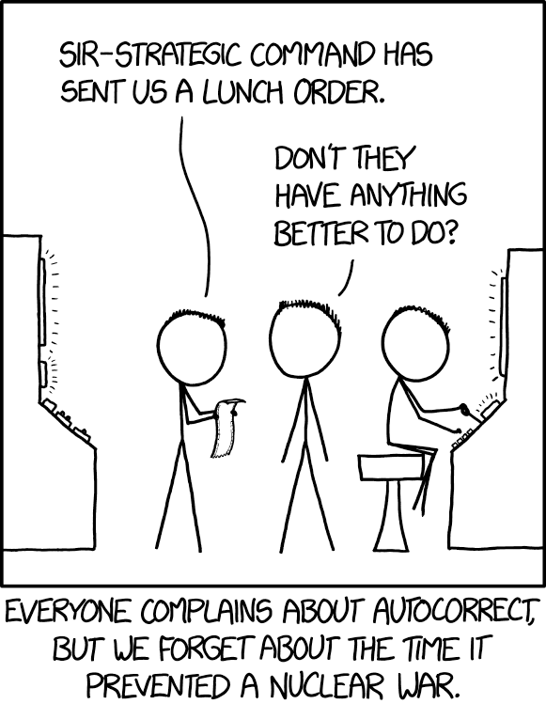
But…
A satisfactory autocorrect is hard to find.
Wrong corrections mess things up, a lot.

Slide 4
Scope of work
Project was divided in phases-
First phase- Develop a spelling corrector.
Second phase- Develop a basic model of Autocorrect based on the developed spelling corrector.
Third phase- Develop a GUI and add various other features.
Improvements on the error model were made throughout the duration of the project.
Model based on errors during typing.

Slide 5
Working on the software-
Process a large collection of text, previously typed data, and personal dictionary.
Take in the input during runtime.
Propose the top 3 corrections if the word is wrong.
Person chooses what he wants. If he doesn’t, most probable word chosen.

Slide 6
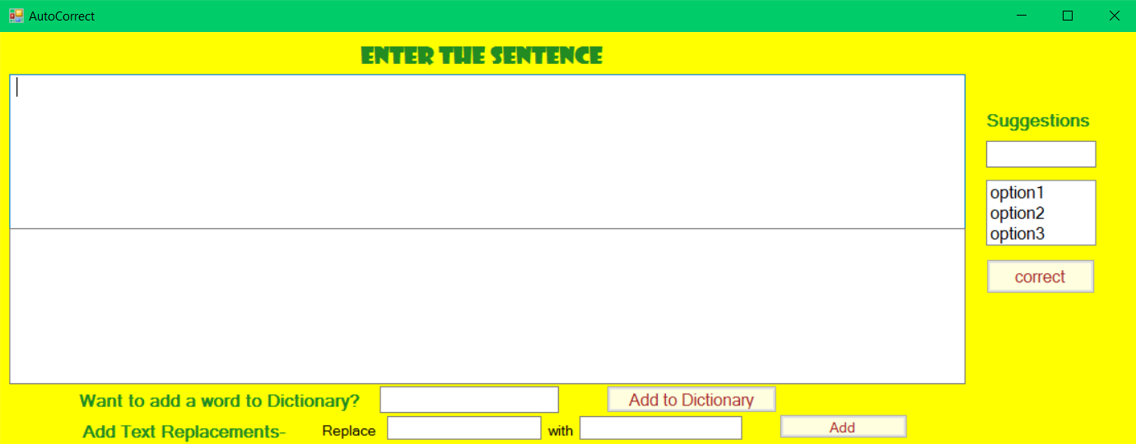
Work done so far
The error model has been developed and furnished.
Based on the frequency of words in the a big dataset of text files.
The Autocorrect based on the model has been implemented.
The GUI for the Autocorrect has been developed.

Slide 7
Work done so far
Various other features have been added, namely-
Placement of keys on the keyboard.
Personal dictionary
Self improving model on the basis of typing habits
Text Replacement for abbreviations etc.
Alternative corrections

Slide 8
ESC101 Concepts used
Working with strings
Structures and classes
Pointers and iterators
Data structures like map/vector
File i/o
Arrays, loops, functions etc.

Slide 9
Testing of the software
Model tested against standard data from GNU aspell and Wikipedia.
Software tested by friends, mentor and other students.
For a test sample consisting of 4000+ words, ~75% accuracy yielded at 15 words per second.
Accuracy can be improved by collecting more data.

Slide 10

Demonstration

Slide 11
Issues faced
Error Model
Development of GUI
Implementation of various features

Slide 12
Future Work
Incorporating the autocorrect into various applications through plug-ins, extensions etc.
Contest sensitive model required if accuracy over 85% needed.

Slide 13
Conclusion
Had an experience of software development
Learned to work in a phase-by-phase manner
Strengthened coding skills and learned a plethora of new things about C++

