Slide 1


AI-Driven Sustainable Energy Analytics and Renewable Energy Prediction Using Machine Learning
Charmin Patel
Nikhilsingh Rajput
Miten Patel
Umang Parmar
Yash Parekh
<Team Member 4>
Mentor:-Sagar Chouhan/Priya Shah
College Name – R.N.G.Patel institute of technology

Slide 2

Project Objectives
Problem Statement
Project Overview – Introduction
End Users
Wow Factor in Project
Modelling/Block Diagram/Flow of Project
Result/outcomes
Conclusion
Future Perspective

Slide 3
Problem Statement
Renewable energy sources such as solar and wind are highly dependent on environmental conditions. Accurate prediction of energy generation is essential for efficient power management. Challenges: - Unpredictable weather conditions. - Large amounts of historical energy data. - Difficulty in accurate forecasting. - Inefficient utilization of renewable resources. - High dependency on fossil fuels due to inaccurate predictions.
Proposed Solution - EcoAI uses Artificial Intelligence and Machine Learning algorithms to analyze historical energy datasets and generate accurate renewable energy predictions.

Slide 4
Project Overview - Introduction
Introduction
- EcoAI is an AI-powered renewable energy analytics system designed to predict future renewable energy generation using Machine Learning.
Project Workflow
- Collect renewable energy dataset.
- Clean and preprocess the data.
- Perform Exploratory Data Analysis (EDA).
- Train Machine Learning models.
- Evaluate model performance.
- Generate renewable energy predictions.
Benefits
- Improves forecasting accuracy.
- Helps optimize energy production.
- Supports sustainable development.
- Enables data-driven decision-making.

Slide 5
End Users
Target Users
- EcoAI can be used by various organizations involved in renewable energy planning and management.
End Users
- Renewable Energy Companies
- Government Energy Departments
- Smart Grid Operators
- Environmental Researchers
- Educational Institutions
- Sustainability Organizations
- Data Scientists and Researchers
- Policy Makers
Benefits for Users
- Better energy planning.
- Cost reduction.
- Improved resource utilization.
- Environmental sustainability.

Slide 6
Wow Factors in Project
Unique Features
AI-Based Prediction
- Uses Machine Learning algorithms to predict renewable energy generation.
Data Visualization
- Provides meaningful charts and graphs for better understanding.
Automated Data Processing
- Performs preprocessing, feature selection, and prediction automatically.
Sustainable Development
- Supports clean energy initiatives and SDGs.
Scalable Solution
- Can be extended to real-time prediction systems.
Decision Support
- Helps governments and industries make informed energy decisions.

Slide 7
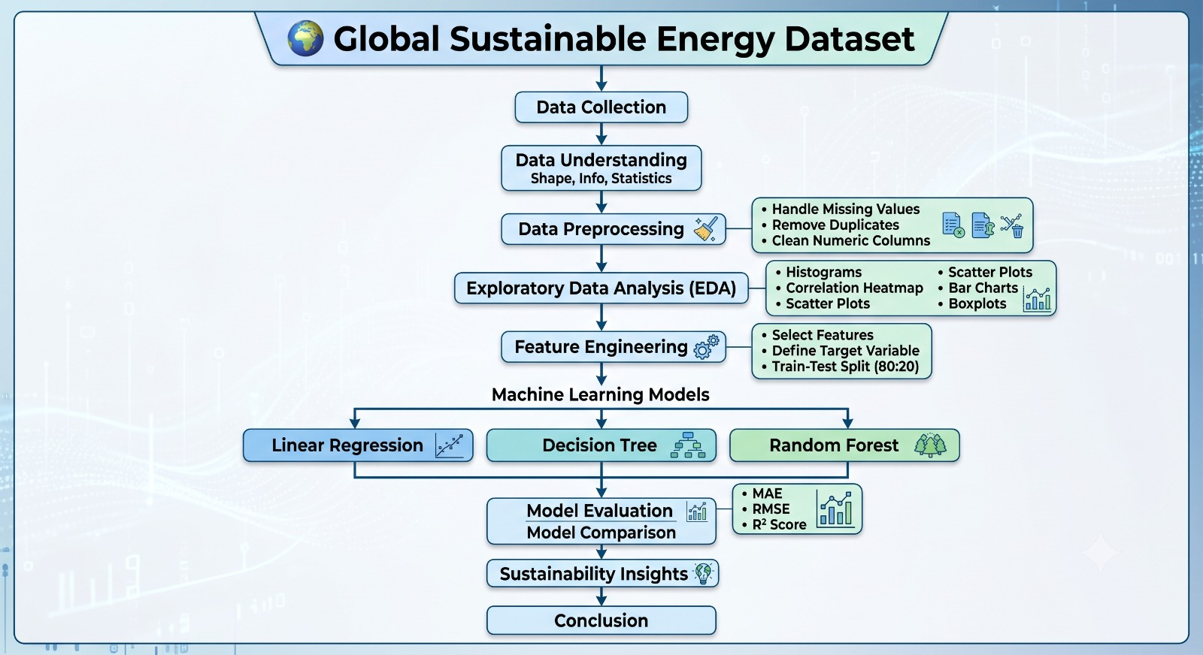
Modelling/Block Diagram/Flow of Project

Slide 8
Technology Stack
Software Used
Programming Language
- Python
Development Environment
- Jupyter Notebook
Libraries
- Pandas
- NumPy
- Matplotlib
- Seaborn
- Scikit-learn
Machine Learning
- Regression Algorithms
- Model Evaluation Metrics
Visualization
- Heatmaps
- Histograms
- Scatter Plots
- Correlation Matrix

Slide 9
Result/Outcomes
Project Results
Achievements
- Successfully loaded and preprocessed the dataset.
- Performed Exploratory Data Analysis.
- Trained Machine Learning prediction model.
- Generated renewable energy predictions.
- Evaluated model performance.
Outcomes
- Improved prediction accuracy.
- Better understanding of renewable energy trends.
- Effective data visualization.
- Reliable forecasting for sustainable planning.

Slide 10
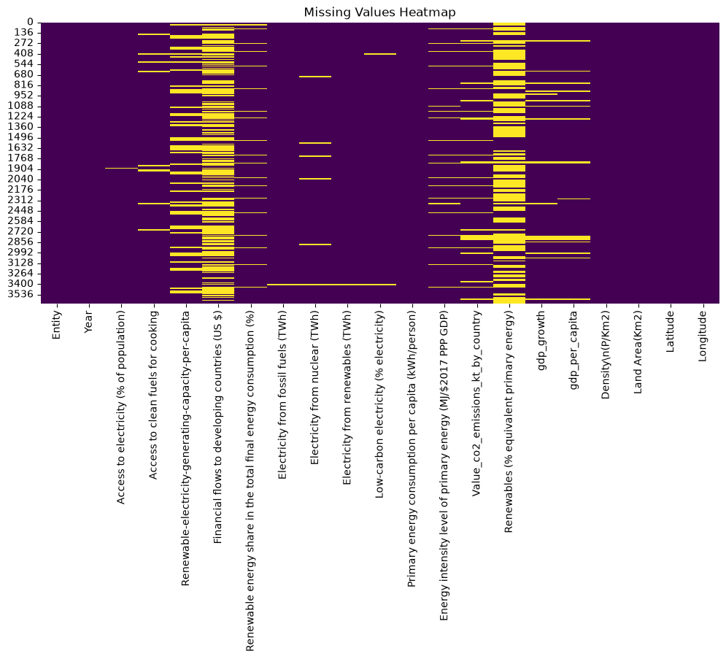

Slide 11
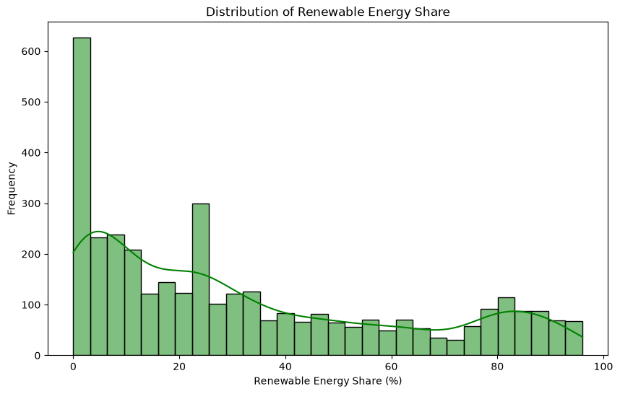

Slide 12
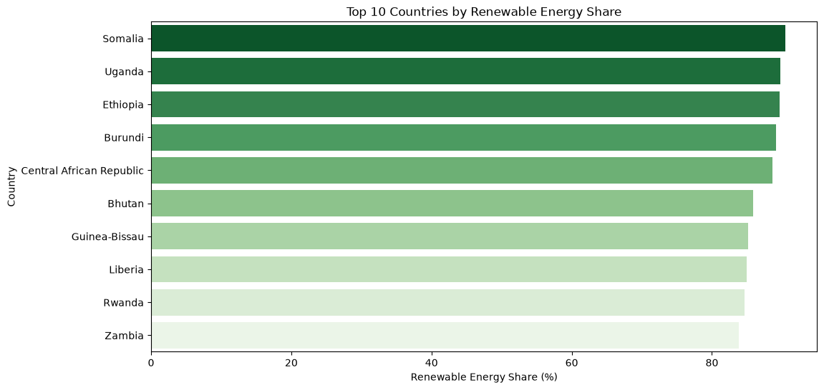

Slide 13
Conclusion
Conclusion:
- EcoAI demonstrates how Artificial Intelligence can significantly improve renewable energy forecasting through Machine Learning.
Key Highlights
- AI improves prediction accuracy.
- Supports efficient renewable energy utilization.
- Helps reduce dependence on fossil fuels.
- Encourages sustainable development.
- Provides valuable insights through data analysis.
- Supports informed decision-making for energy management.

Slide 14
Future Perspective
Future Scope
- The project can be further enhanced by integrating modern technologies
.
Future Enhancements
- Real-time weather API integration.
- Deep Learning prediction models.
- IoT-based renewable energy monitoring.
- Cloud deployment.
- Mobile and Web Dashboard.
- Smart Grid integration.
- AI-powered energy optimization.
- Multi-source renewable energy forecasting.
- Real-time visualization dashboard.

Slide 15
Thank You
Github link:
https://github.com/umang-parmar/Edunate_Project
Video (google drive link)
Notes:
GitHub Link:-

