Slide 1



Banking Management
System
-CSE202

Slide 2
Group Members
(Group 50)
Priyanshu Sharma (2023408)
Prateek Dhar (2023388)
Vansh Tyagi (2023582)
Umang Aggarwal (2023567)

Slide 3





Project Outline
01
02
Business Requirements and ER Model
Relation Model
Tables creation and Entries insertion
03
04
Sample SQl queries
and outputs
GUI implementation

Slide 4
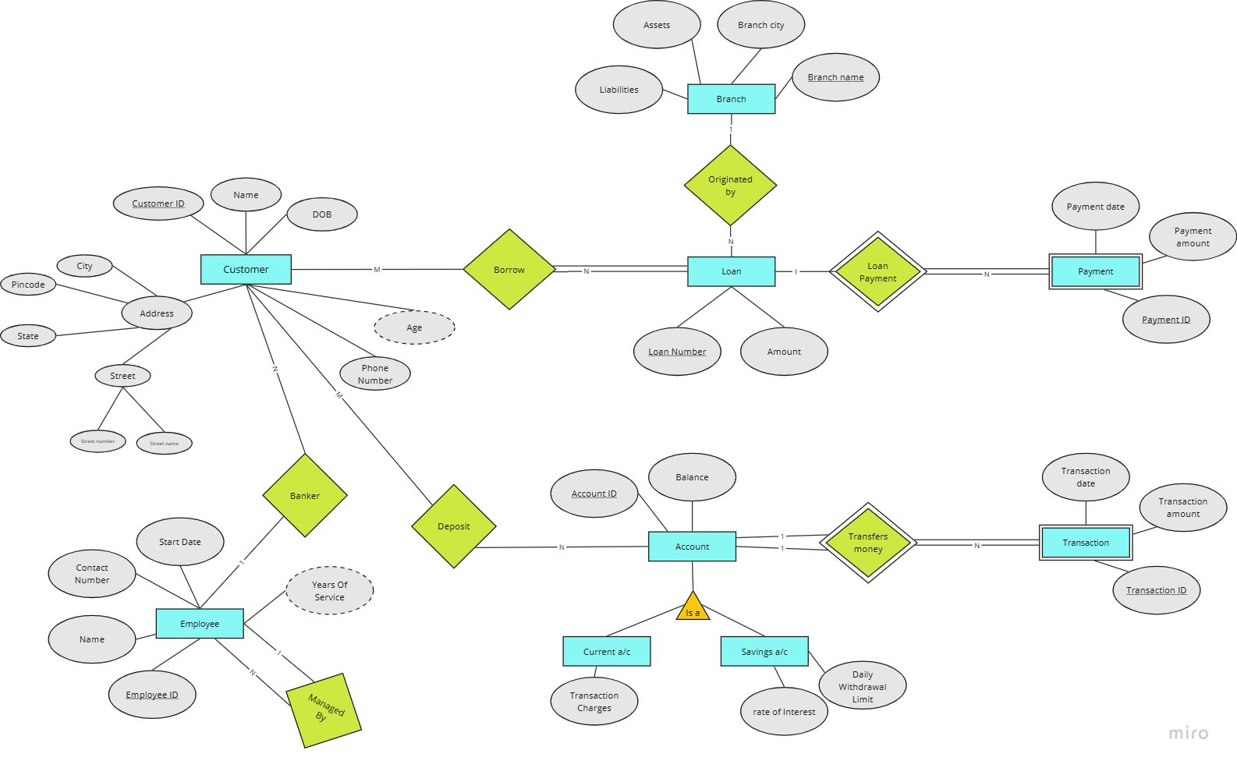
ERmodel

Slide 5

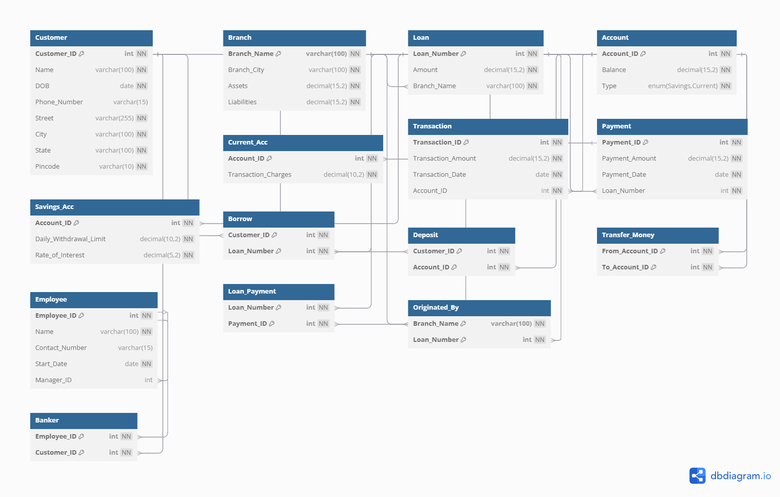
Relational Model

Slide 6

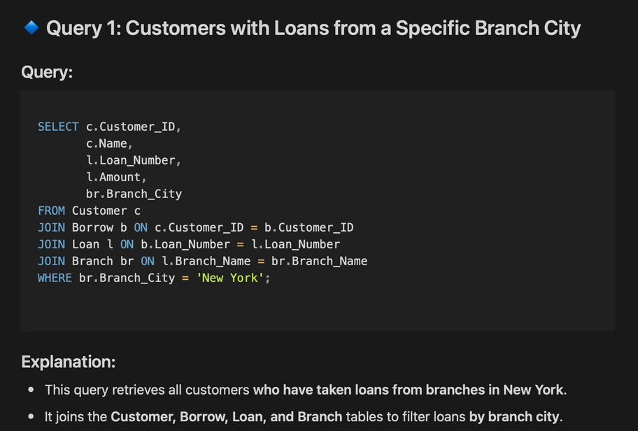
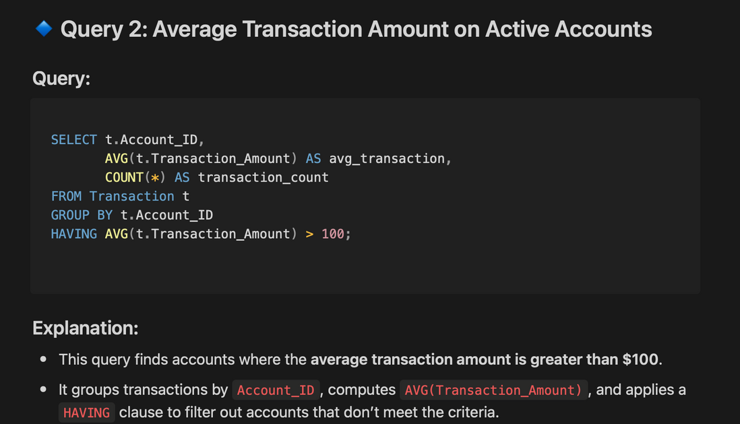
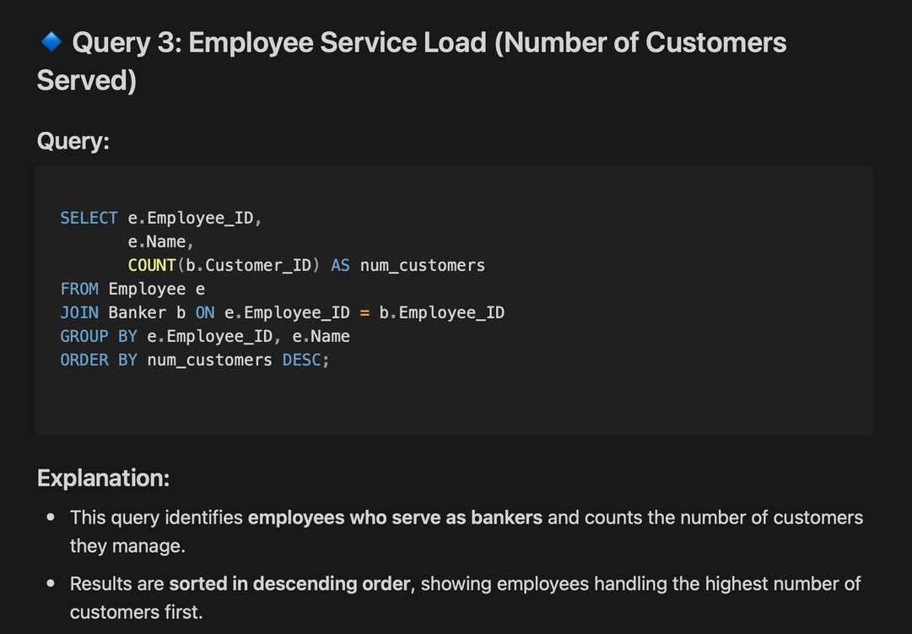

SQL Queries
‹#›
‹#›

Slide 7







GUI Implementation
The final submission involved implementing the GUI using React and CSS for the frontend and Node.js for the backend with MySQL for managing the database.

Slide 8

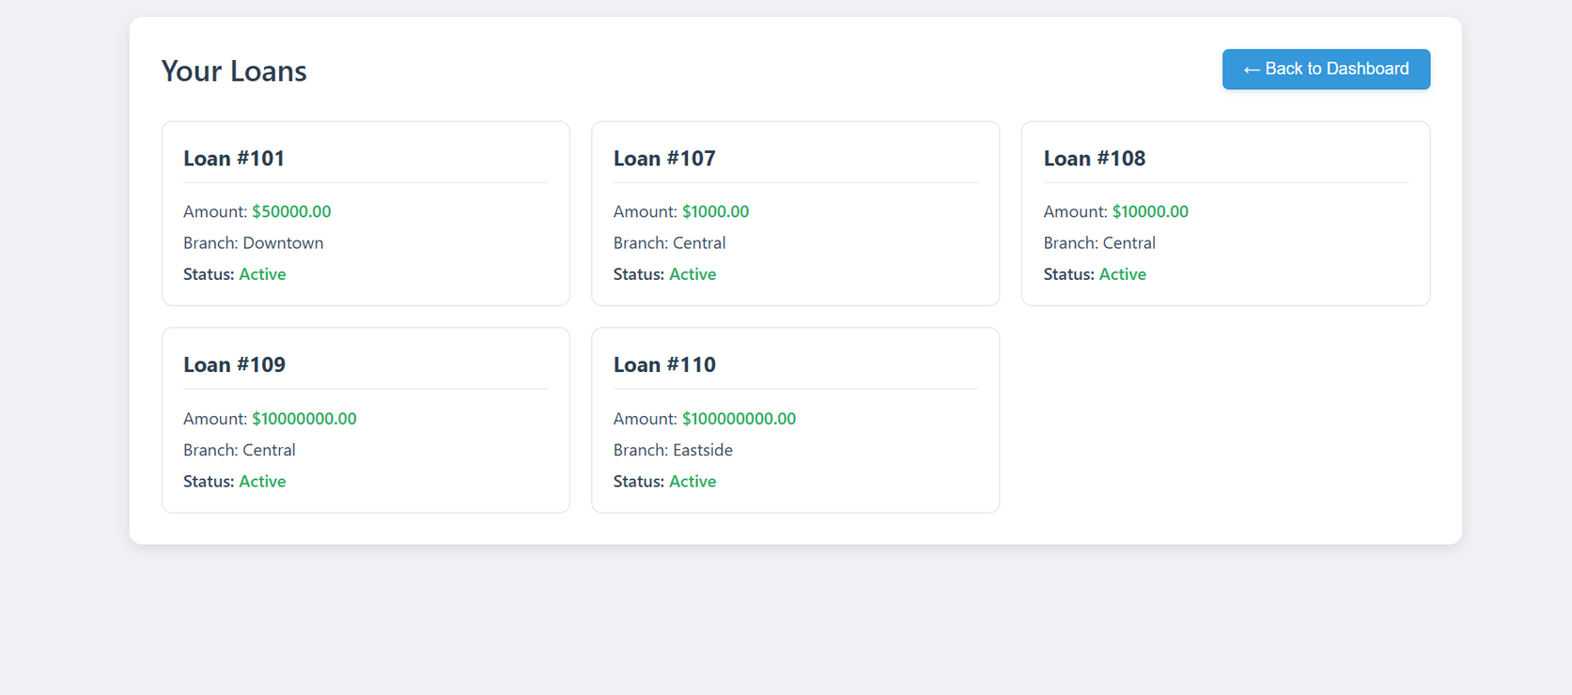
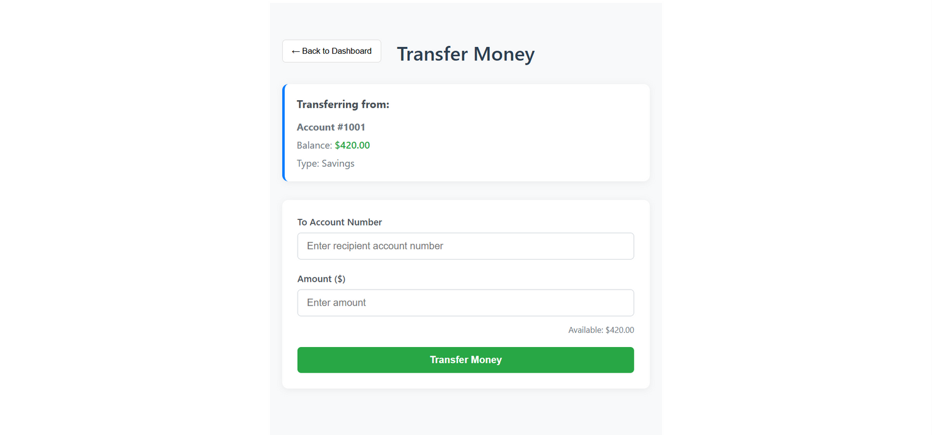
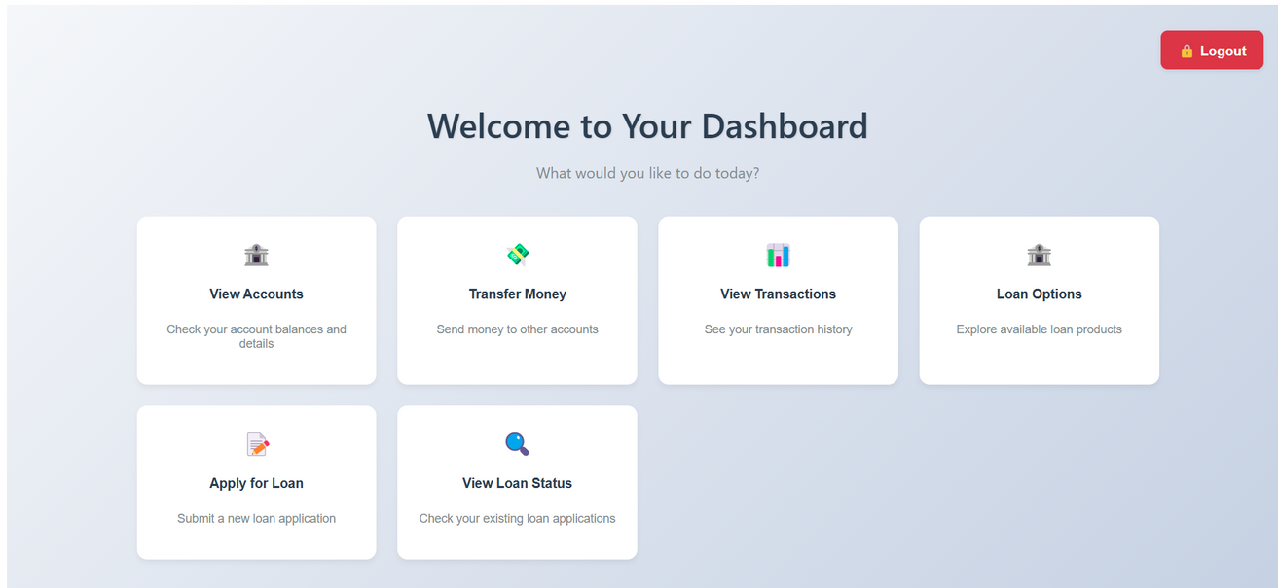

Slide 9
