Slide 1
IoT based Water Quality Assistant for Irrigation
CPG-101
Umang Sharma (101983043)
Suryansh Bhardwaj (101983044)
Prakhar Srivastava (101983045)
Mentor: Dr. Karun Verma

Slide 2
PROJECT OVERVIEW
Focuses on determining the quality of water and classifying it as good or bad for the purpose of irrigation.
Divided into three major segments
Data Collection
Treatment of water
Data analysis and Visualization
NEED ANALYSIS
Currently water quality is monitored through
Time consuming laboratory methods
Various costly sensors having low sensitivity
This delays any action and is inefficient.

Slide 3
LITERATURE SURVEY INDICES USED FOR WATER QUALITY MONITORING
Sodium Absorption Ratio
pH
Turbidity
Temperature
Chemical Oxygen Demand
Dissolved Oxygen
Salinity
Electrical Conductivity
Total Nitrogen
Biochemical Oxygen Demand
Total Phosphorus
Oxygen Reduction Potential

Slide 4
RESEARCH WORK
 | Features | Technology used | Miscellaneous
Shafi et al. | Temperature,pH, Turbidity | SVM, KNN, Deep NN | Deep NN had the highest accuracy
Zin et al. | Temperature, pH, Turbidity, Carbon Dioxide | Wireless sensor network using Zigbee, FPGA | IoT
Saravanan et al. | Turbidity, Temperature and Colour | Employed a GSM module for wireless Data Transfer | SCADA system enabled by IoT

Slide 5
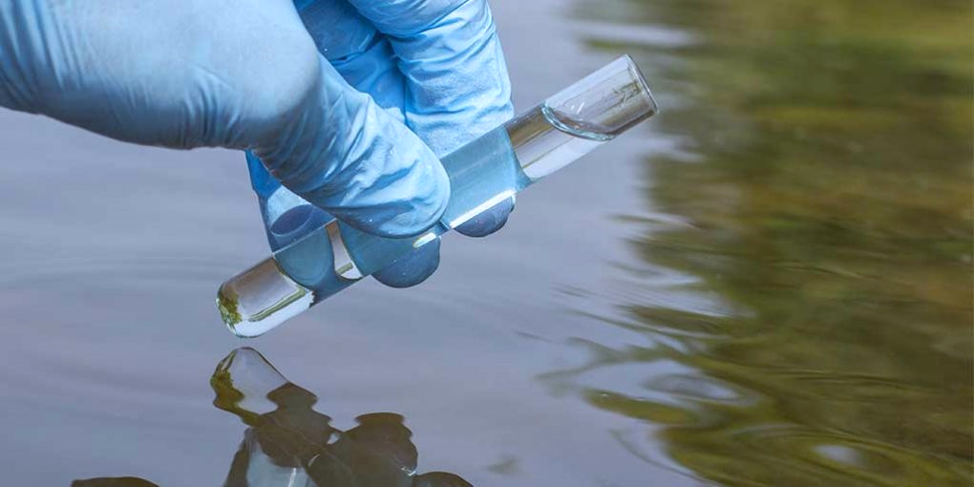
EXISTING SOLUTIONS
Smart Water Analyzer, a highly sensitive, affordable spectrum sensor for continuous online monitoring and rapid detection of microbial contamination in water.
ColiMinder technology (by VWMS) is based on direct measurement of specific metabolic (enzymatic) activity of target organisms present in the sample. The enzymatic approach directly measures the specific enzymatic activity present in the sample

Slide 6
OBJECTIVES
PROBLEM STATEMENT
Implementation of an IoT architecture
Processing and calibrating data from different sensors (SAR, pH etc.), and sending it to web portal
Perform analysis of data and classify the quality of water to generate a corresponding signal to IoT device.
The suitability of water for irrigation is determined by the total amount and type of salt present.
Soil and cropping problems develop if the total salt content increases.
Our team proposes a cost effective and scalable solution where, using machine learning models and sensors, water quality will be calculated and redirected to a treatment facility if it is unsuitable for irrigation
This will ensure minimum wastage of water and provide the crops with a constant flow of suitable irrigation water, increasing the overall yield for the farmers and in the long term will reduce the farmers dependency on fertilizers

Slide 7
ASSUMPTIONS
Location has internet access
No obstacles between the transmitters and receivers
Both the pumps are functioning well
CONSTRAINTS
Data transmission rate of LORA modules is low.
Dashboard will only function properly with regular updates on water quality.

Slide 8
Methodology
Data Collection
The field component will collect the temperature, pH value, turbidity, flow and SAR value of water .
Treatment of Water
Based on data collected, a machine learning model will determine whether the water needs to be treated or not.
Data Analysis and Visualization
Data collected will also be uploaded on an online dashbboard where it can be viewed by everyone.

Slide 9
Arduino Uno >=1
LORA modules >=2
Sensors
Requirements
Google Firebase
Reactjs/NEXTjs
Machine Learning libraries
GitHub

Slide 10
Project Outcomes
Using machine learning, the data collected will be analyzed.
A working online dashboard would be designed where the data can be uploaded and accessed by the user as and when required
The capstone project is intended to help determine if the water quality is good enough to be used for irrigation, thus, leading to increase in yield of crops quantitatively as well as qualitatively.

Slide 11
Activity | March | April | May |  | June | July |  | August | September | October |  | November
Backend
User Interface
Change of Flow(Pumps)
Sensors
ML model
Evaluation
Final Report

Slide 12
Role of each Team Member
Umang Sharma
Team Leader
Implementation of backend
Collaborating the different technologies used in the project and the hardware and sensors used
Suryansh Bhardwaj
Exploration and Implementation of the various Machine Learning algorithms that can be used and applied onto the data collected.
Prakhar Srivastava
Exploration and creation of the User Interface for the online Dashboard

Slide 13
REFERENCES
Sophia Karastogianni, Stella T. Girousi. pH: Principles and Measurement. December 2016. Available https://www.researchgate.net/publication/301702485_pH_Principles_and_Measurement
E. J. Williamson, Frank Wiersma ,L. O. Fine. A Study of the Sodium Adsorption Ratio and Residual Sodium Carbonate Concepts of Irrigation Waters as They Affect Exchangeable Sodium of Soil Under Semiarid Conditions. Available https://acsess.onlinelibrary.wiley.com/doi/abs/10.2136/sssaj1959.0361599500230004 0011x
IEEE Internet of Things Journal. Issue 6, March15,-2021.Available https://ieeexplore.ieee.org/xpl/mostRecentIssue.jsp?punumber=6488907
B. Das, P. Jain. Real-time water quality monitoring system using internet of things, in 2017 International Conference on Computer, Communications and Electronics (Comptelix), Jaipur, Rajasthan India, 1–2 July 2017. IEEE
J. Shah, An internet of things based model for smart water distribution with quality monitoring. Int. J. Innov. Res. Sci. Eng. Technol. 6(3), 3446–3451 (2017). Available http://dx.doi.org/10.15680/IJI RSET.2017.0603074
G. Bruce Wiersma (2021). Environmental Monitoring and Assessment Vol.193. Available https://www.springer.com/journal/10661

Slide 14
REFERENCES
M.C. Zin, G. Lenin, L.H.Chong, M. Prassana, Real-time water quality system in internet of things, in IOP Conference Series: Materials Science and Engineering, vol 495, no 1, p. 012021 (2019). http://dx.doi.org/10.1088/1757-899X/495/1/012021
K. Saravanan, E. Anusuya, R. Kumar, Real-time water quality monitoring using Internet of Things in SCADA. Environ. Monit. Assess. 190(9), 556 (2018). https://doi.org/10.1007/s10 661-018-6914-x
Alex Keinan , New equipment allows for sampling, testing water in real time(2017).Available https://www.foodengineeringmag.com/articles/96511-newequipment-allows-for-sampling-testing-water-in-real-time
VWM Vienna Water Monitoring Solutions. Source: www.vienna-watermonitoring.com
IEEE Wireless Communications. Issue 1, February-2021.Available https://ieeexplore.ieee.org/xpl/mostRecentIssue.jsp?punumber=77422
Ismail Butun, Nuno Pereira, Mikael Gidlund. Analysis of LoRaWAN v1.1 security: research paper (2018). Available https://www.researchgate.net/publication/325493576_Analysis_of_LoRaWAN_v11_s ecurity_research_paper

Slide 15
THANKS!
Any questions?

