Slide 1
C# Asynchronous Programming Using async and await
Created by : Umang Dobariya

Slide 2
Synchronous Programming
Synchronous Nature.
Line by Line Execution.
Execution wait for function to return.
When function takes more time.
Worst case scenario: Downloading or reading a large file.

Slide 3
Issues with Synchronous Programming
Client wants UI to be responsive.
Badly impacts the UI.
Behaviour leaves end users with bad user experience.

Slide 4
Asynchronous Programming
Parallel Programming.
Process of executing function:
1. You create the thread.
2. The thread starts executing separately.
3. An asynchronous method call (creation of a thread) will
return Immediately.
4. Main and new thread work in parallel.

Slide 5
Three Patterns :
Task based Asynchronous Programming Model
Event based Asynchronous Programming Model
Asynchronous Programming Model
Notes:
Your application shouldn't make a phone appear frozen while it's downloading data from the web.

Slide 6
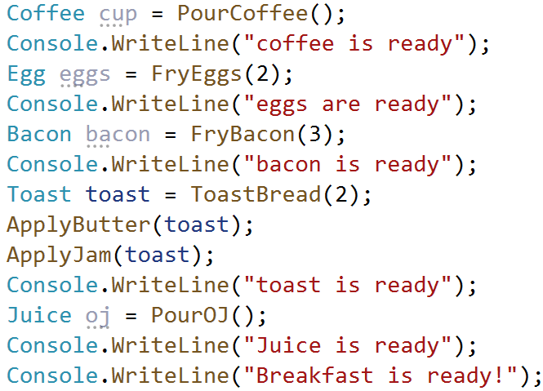
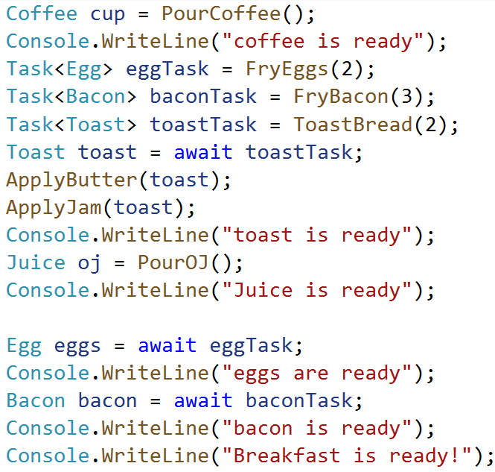
Synchronous Asynchronous

Slide 7
Synchronous Output
Asynchronous Output
coffee is ready
eggs are ready
bacon is ready
toast is ready
Juice is ready
Breakfast is ready
Elapsed Time 21.4355
coffee is ready
toast is ready
Juice is ready
eggs are ready
bacon is ready
Breakfast is ready!
Elapsed Time 16.0543

Slide 8
Before .NET 4.5

Slide 9


Asynchronous Delegates
Delegate methods are synchronous when invoked using “normal” syntax.
Delegate types are automatically equipped with BeginInvoke() and EndInvoke().
IAsyncResult Interface
BeginInvoke will always return an IAsyncResult object.
EndInvoke requires an IAsyncResult as its only parameter.

Slide 10
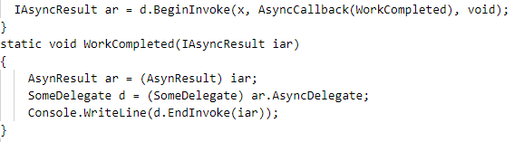
AsyncCallback will call the specified method when async call is done.
Useful for avoiding blocking of calling thread
Async Callbacks
Notes:
Walk thru code
Point some stuff out

Slide 11
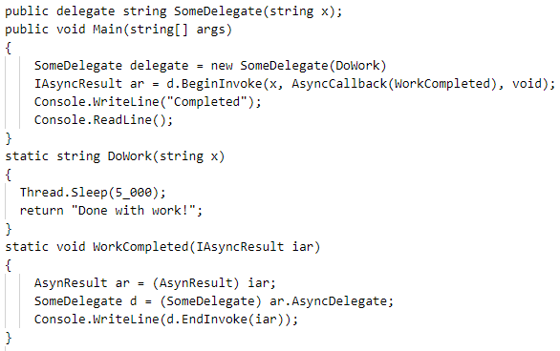
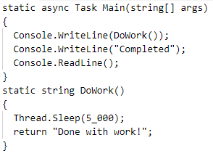
Using async delegates
Using async keyword

Slide 12
Asynchronous Calls with the Async Keyword
Notes:
3. Async and await codes, generic - Andrew

Slide 13
Async/Await VS Former Threading Procedures
For async/await keywords, compiler generates significant threading code in background for you
Mitigate burden of writing complex threading code
Uses parts of System.Threading and System.Threading.Tasks namespaces

Slide 14
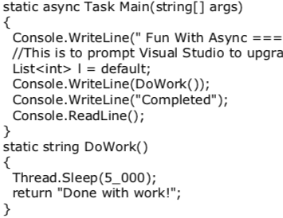
Async Keyword
async keyword assures a method, lambda expression, or anonymous method will be invoked asynchronously
CLR creates new thread of execution

Slide 15
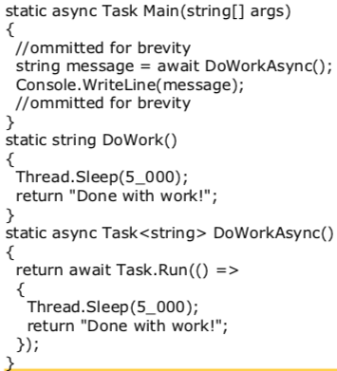
Await Keyword
await pauses current thread until task is complete
Calling thread free to operate as such
Async function without await => synchronous
Notes:
If you invoke an asynchronous method without using the await keyword, you’re doing a synchronous method call and the compiler gives you an error

Slide 16
Await Keyword (cont.)
Async functions return Task<T>
Desired return type is the underlying T
Await extracts internal return value inside Task object
Notes:
If you invoke an asynchronous method without using the await keyword, you’re doing a synchronous method call and the compiler also gives you an error

Slide 17
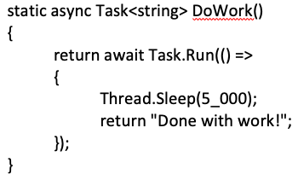
Naming Conventions
Provide method names with “Async” suffix
For example,
string message = DoWork()
Notes:
Consider, for example, if DoWorkAsync was named DoWork but still left asynchronous. If one was to write “string message = DoWork()” and the await keyword isn’t provided, the compiler gives an error because it calls the asynchronous version of DoWork(). That version returns a Task<String> object, not a string as initially intended.

Slide 18
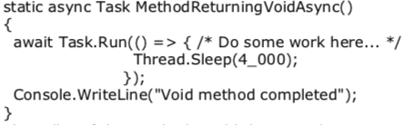
Async Methods Returning Void
Use non-generic Task class and exclude any return statements

Slide 19
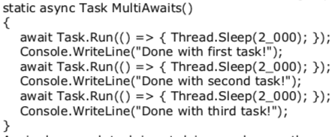
Async Methods with Multiple Awaits
Multiple await statements can be placed in a single async method

Slide 20
Calling Async Methods from Non-Async Methods
Invoke async method without await?
Call Result on method
Result is a property of Task
For void async method, call Wait() on the Task
Console.WriteLine(DoWorkAsync().Result)
MethodReturningVoidAsync().Wait()

Slide 21
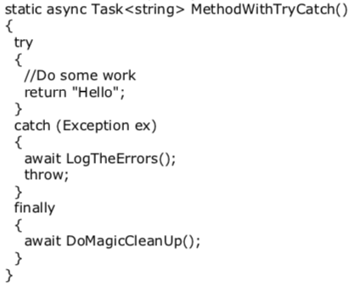
Await in catch and finally Blocks
Await calls can be placed in catch and finally blocks
Method must be async

Slide 22
Generalized Async Return Types
Before C# 7, only permissible return types were Task, Task<T>, and void
C#7 enables more variety in return types, as long as async pattern is followed
Example: ValueTask from System.Threading.Tasks.Extensions NuGet package
Notes:
Mark starts!

Slide 23
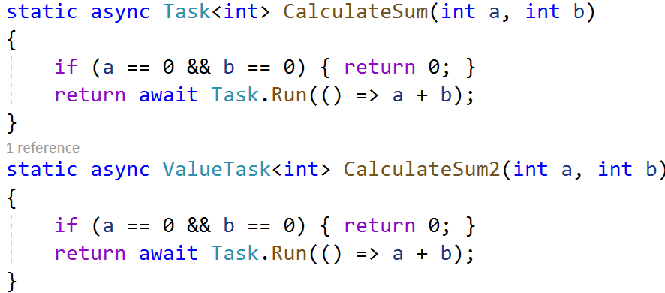
ValueTask
Similar to Task<T>
Task for value type
Notes:
Instead of allocating an object on the heap

Slide 24
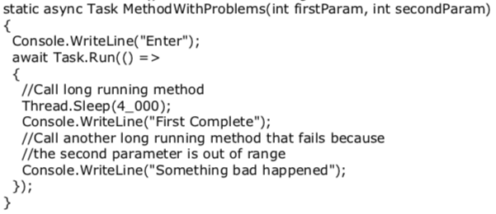
Local Functions
From C# 7.0
Can be useful to check an asynchronous function’s input data
Notes:
You should add checks to the beginning of the method. However, since the entire method runs asynchronously, there’s no guarantee the checks run before control is returned to the caller

Slide 25
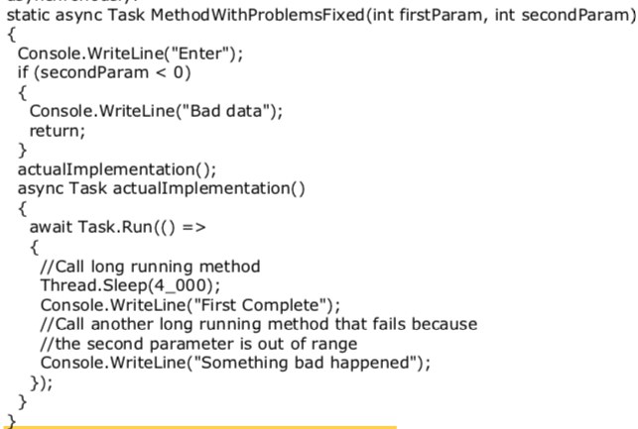
Local Functions (cont.)
Notes:
Checks done first. However, checks executed synchronously
The private function executed asynchronously

Slide 26
Asynchronous Programming in Javascript
Notes:
4. Introduce Javascript await and async : Mark

Slide 27
About Asynchronous Programming in Javascript
Javascript supports asynchronous programming through callbacks and promises.
Like C# Javascript supports the async-await syntax

Slide 28
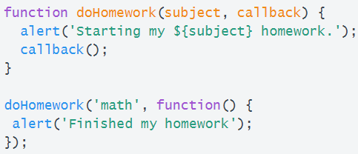
Callbacks
The original way to handle asynchronous situations in Javascript
A callback is when a function executes after another function finishes
In Javascript, functions are objects
Notes:
*code sourced from:https://codeburst.io/javascript-what-the-heck-is-a-callback-aba4da2deced

Slide 29
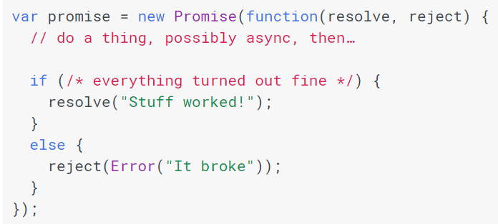
Promises
Readability and Control
Promises have four states: fulfilled, rejected,pending and settled
Helps avoid unintentional chained “callback hell” situations.
Notes:
Code sourced from:https://developers.google.com/web/fundamentals/primers/promises

Slide 30
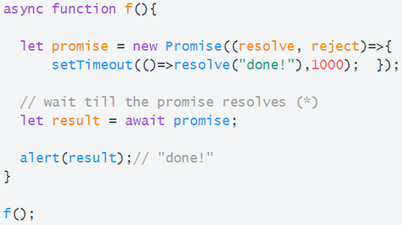
Async/Await syntax in Javascript
Most Manageable way to handle asynchronous Javascript
The latest in a series of readability improvements

Slide 31
Summary
Notes:
5. show difference and Sum up - Tracy

Slide 32
Difference between async and await in C# and Javascript
Differences | C# | Javascript
Underlying | Task | Promise
Use cases | I/O & CPU-bound tasks | I/O tasks
Multi-thread | Use Task.Run | single-threaded; Promise doesn’t help with CPU-bound tasks
Asynchronous pattern | Task-based Asynchronous Pattern | Event-based Asynchronous Pattern
Notes:
A promise is an object which can be returned synchronously from an asynchronous function.
The most notable thing is that Promises automatically unwrap and this often makes dealing with these basic async operations feel easier in JavaScript even though it has less language features and configuration to help you solve the problem.
JavaScript engine is a single threaded event-based engine. It is ideal to perform I/O intensive operations.
Javascript uses an asynchronous non-blocking model with a single-threaded event loop for its I/O interfaces.
JavaScript engine was able to handle a huge number of concurrent web requests, much more than a traditional web server using a thread pool to handle web requests, since threads are expensive and cannot be generated in great number.

Slide 33
Key Points (1/3)
Methods can be marked with the async keyword:
nonblocking manner.
multiple await contexts.
run synchronously until we see the await keyword.
Notes:
methods and lambda expression or anonymous methods
enable the method to do work in a nonblocking manner.
run synchronously until the await keyword is encountered.
can have multiple await contexts.

Slide 34
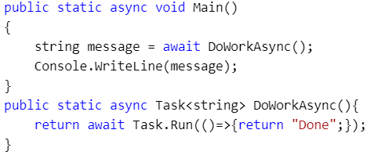
Key Points (2/3)
The await keyword:
the calling thread stop until the awaited task is complete.
hide the returned Task object from view.
Notes:
When the await expression is encountered, the calling thread is suspended until the awaited task is complete. In the meantime, control is returned to the caller of the method.
The await keyword will hide the returned Task object from view, appearing to directly return the underlying return value. Methods with no return value simply return void.

Slide 35
Key Points (3/3)
If we have stack variables, using ValueTask is more efficient than Task object.
Naming convention of async method.
Notes:
1. Task object might cause boxing and unboxing.
Task is a class. As a class, that means that any operation which needs to create one needs to allocate an object, and the more objects that are allocated, the more work the garbage collector needs to do, and the more resources we spend on it that could be spent doing other things.
ValueTask doesn’t force allocation of an object on the heap.
2. Give an example that when we didn’t add Async at the end of the method name and the user therefore forgot to add await => compile error

Slide 36
Thanks!

