Slide 2
About me

Slide 3
Problem Statement
Understand system events from various systems in Intuitive that are happening for users based on data changes, user’s actions, etc. and interpret and deliver actionable messages [Event Based]
Route the alerts, notifications to the right channels to ensure right engagement and make it cost effective as well [multi channel]
Enable product managers to configure/schedule personalized notifications at the right time [scheduled]
Ability to aggregate multiple notifications into a single one to enable mail digest to customers [batching]

Slide 4
Assumptions:
Notification service will be lowest service of the stack and will take the payload and that will have the self-sufficient data for a notification.
Each and every product will know for what events the notification needs to be sent.
Each and every service or product will have to be onboarded with notification service.
Different products may have different user bases so all the messages that are given to notification service will have all the user preferences like email only notification, do not disturb etc.
Notification service in one region will serve all traffic from all regions
Its is tier 3 service as it will not impact business.
Digest time will be same for all the messages can be made configurable as well on user level, product level etc. Priority will be same for all the mails in a digest.
In case of any business logic is needed by a product for pre processing request (business logic) then that service can add that additional module in request processor.
In case of any additional validations product level validations can be added.
APIS can be extended to support the attachments in emails. For now no support for attachments.
Support for Webhooks can be provided in order to send the notification status back to the caller.
Additional dashboards and alerting dashboard needs to be created.

Slide 5
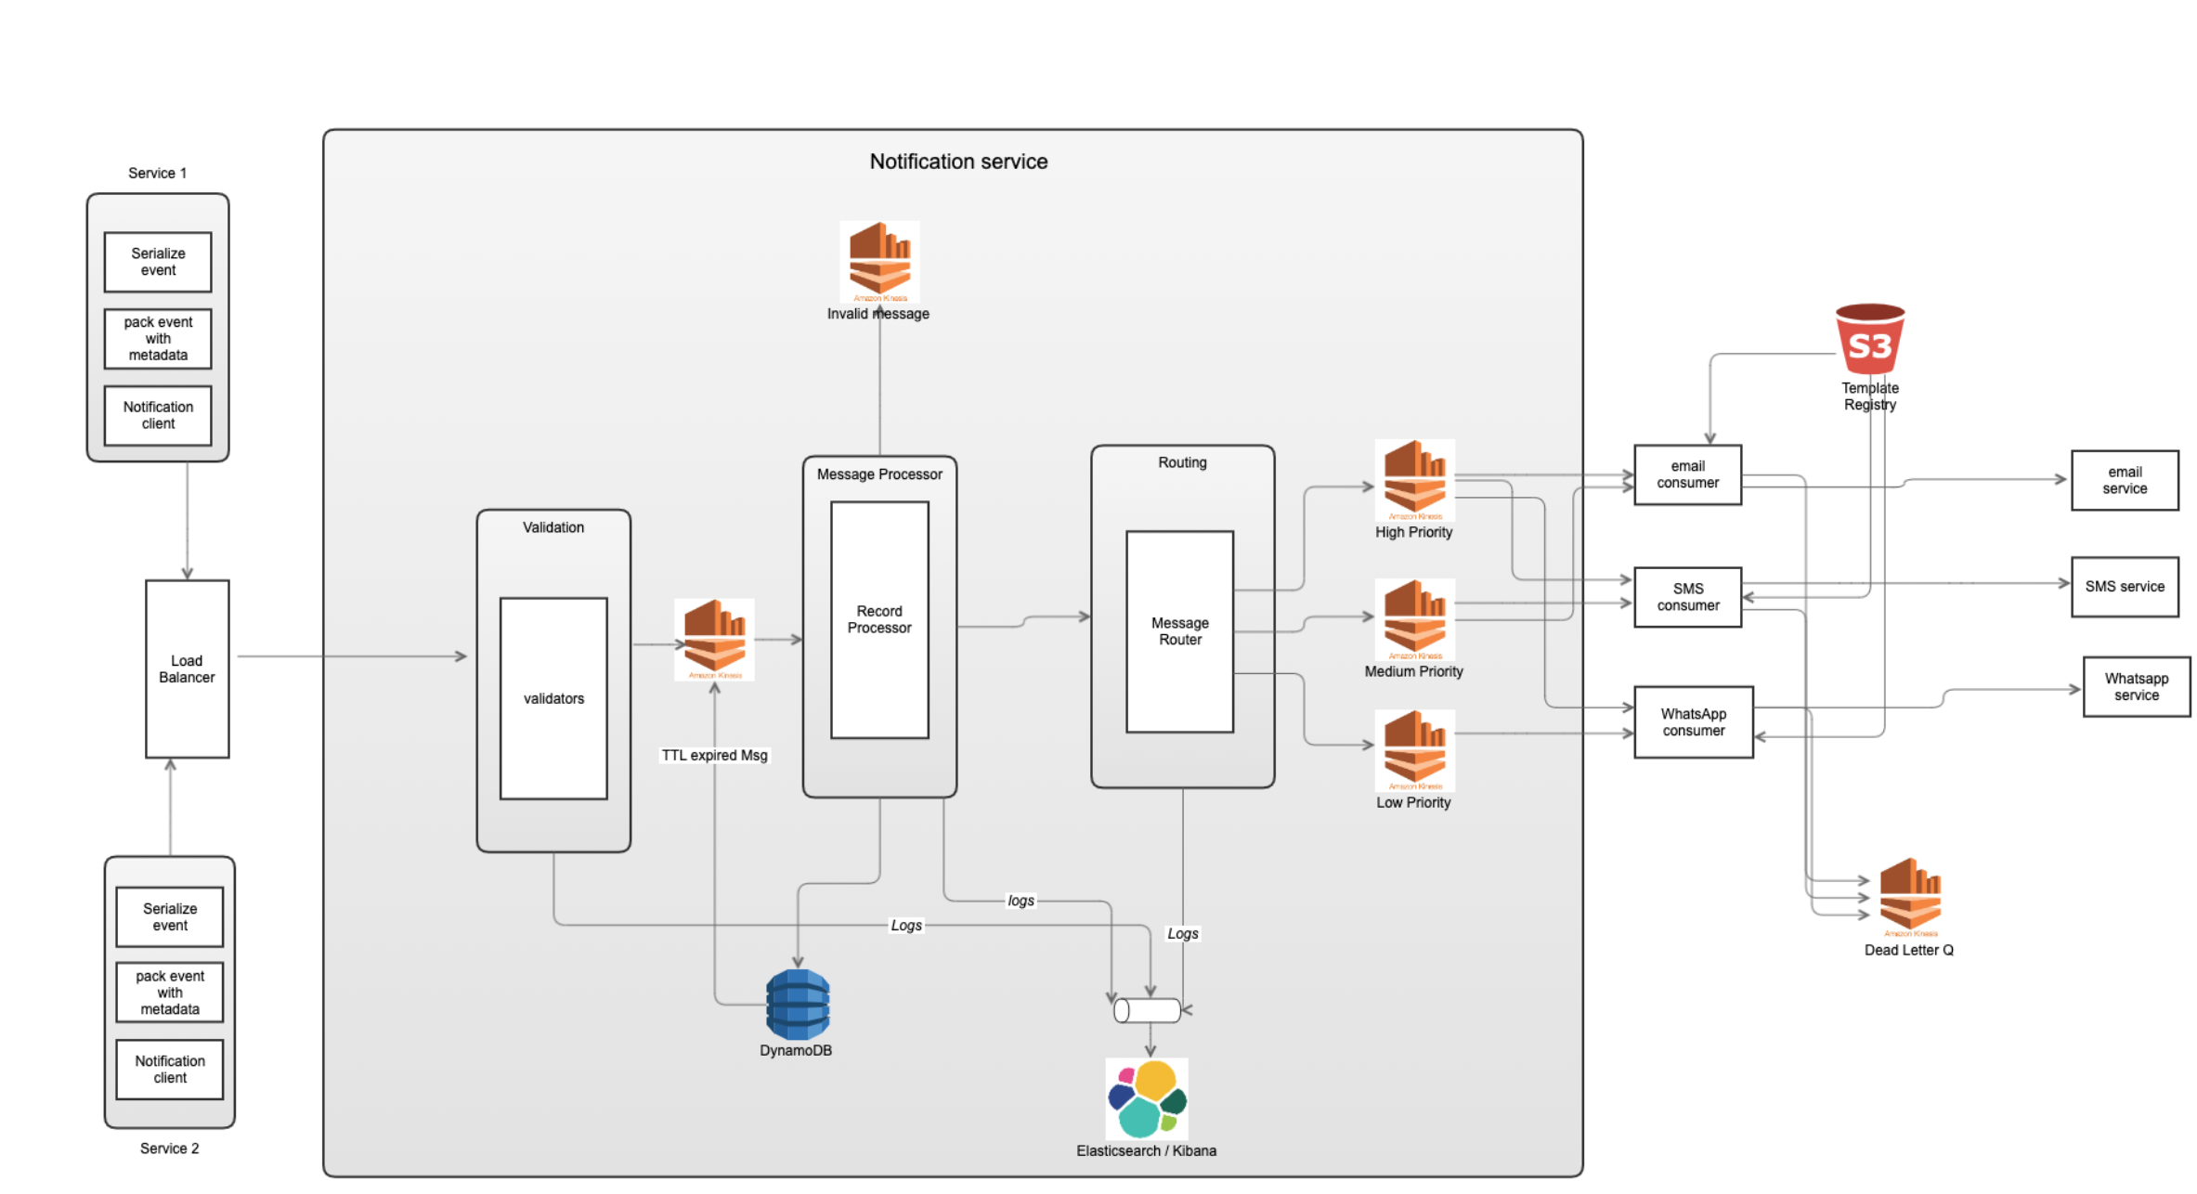
High level Design

Slide 6
Components description
Notification system has been divided into autonomous modules, each addressing a separate concern in the system:
NS-validations | Do basic sanity on the payload passed If validation is passed submit the request to request queue
NS-message-processor | Take intelligent decisions based on the payload whether to digest the message, schedule the message or apply any other message specific business logic.
NS-routing | This Module will take the responsibility of routing the message to the right channels so that appropriate actions can be taken on the message.
NS-Message-Consumers | These consumers will read the messages from the notification queues and take the appropriate actions.

Slide 7
Notification System details
Events Flow
If there is any change event for a user and user needs to be notified for it service will cook the message that will sent to the notification service.
First the change or user action is captured.
Relevant payload is created
Payload is wrapped to prepare the notification message
Notification client will be used by the service to send the notification to the Notification service
NS will validate the message received with some basic common validations and if the validation is passed the message is submitted to the notification stream.
Once the message is submitted to the stream the message processor will process each message and do the preprocessing on the message and add the message_id to each message.
Router then reads the message coming from the processor and based on some parameters will route it to the appropriate channel. In this case priority has been taken as the parameter for routing.
There will various consumers that will be consuming from the streams and will process the messages.
Each consumer will read the message and see if it needs to take any action on it or not.
If the consumer needs to take action it will process the message and use the template mentioned on the payload to prepare the content.
After preparing the content action will taken on the prepared message.
If there is any technical failure multiple attempts will be made to send the message and in case it still fails that message will be deposited in dead letter queue.

Slide 8
Digest messages flow
If the messages is digest type message will be processed as follows
Message processor will check if the message is of digest type.
The message needs to be push to the list of already existing list of messages for a email-id:
In this case email will be taken and used as the partition key for the Dynamo-DB.
The message pushed in the dynamo DB will have a TTL and in case of multiple messages the TTL of first message of the digest will be used
When the TTL expires, dynamo generates the event and removes the document from the DB and that message will be pushed to notification kinesis stream
If the message is digest type and the TTL is there and its equal or greater then the current time processor will send the message to router

Slide 9
Scheduled messages flow
If the messages is scheduled type, message will be processed as follows
Message processor will check if the message is of scheduled type.
The message needs to be push to dynamo DB with message_id as the partition key.
The message pushed in the dynamo DB will have a TTL.
When the TTL expires, dynamo generates the event and removes the document from the DB and that message will be pushed to notification kinesis stream
If the message is Scheduled type and the TTL is there and its equal or greater then the current time processor will send the message to router.

Slide 10
Steps to onboard with the Notification system
Any product can adopt this system in three easy steps:
adopt the NS client library to send the notification messages to the notification service
prepare the template for different notifications in template registry/use the existing standard templates for message content preparation
capture the events and user actions and prepare the appropriate payload to be sent to NS

Slide 11
Characteristics of service
Resiliency
Logging and Monitoring using Kibana
In case of the technical failures retry sending the notifications
As the streams are getting used so the process can be throttled
Scalability
As the service is deployed on cloud using EKS horizontal scaling can be done
Scaling criteria: Throughput, CPU usage, Memory usage
Extensible
New consumers can easily be added if needed without disrupting the whole notification system
Easy to adopt by the services.

Slide 12
API
PAYLOAD
{
"originator": "service _id", // not null
"timestamp": 1234, // not null
”message_id": "2345", // not null
"priority": "HIGH", // not null (HIGH/MEDIUM/LOW)
"is_digest": true, // can be null. If the value is not present it will taken as false.
"schedule_time": 123456, // can be null.
"message_properties": { // not null and string should be a valid json
“propert1” : “value1”,
“propert2” : “value2”,
},
"message_type": "Normal", // can be used to validate if the needed attributes are present or not
// (NORMAL, SCHEDULED/DIGEST)
"notification_modes": [
{
“mode” : “SMS”,
“Template_name” : “template_1”, // not null
“phone_numbers” : 1234567 // not null
},
{
“mode” : “WHATSAPP”,
“Template_name” : “template_1”, //not null
“phone_number” : 123456 //not null
},
{
“mode” : “EMAIL”
“Template_name” : “template_1”, //not null
“Emails: ”abc@test.com” //not null
}
]
}
Method Type POST :
URL: notification-service/v1/notifications
Responses:
204: notification request submitted
403: not authorized to send notification
400: in case of basic sanity validation failures
422: un-processable entity
500: internal server error

