Slide 1



PROJECT RATION MANAGEMENT SYSTEM
Team Leader: Vaibhav Yadav
Team Member: Umang Kumar
From NIT Delhi (CSE branch)
EVENT SALESFORCE CODATHON

Slide 2
Index
PROBLEM STATEMENT
SOLUTION PROPOSED
FLOW CHART
ABOUT DEVELOPMENT
1.PROGRAMMING LANGUAGE USED
2.FRAMEWORK USED
IMPLEMENTAION
PROBLEM FACED
FUTURE WORK
REFERENCES
DEMO

Slide 3

Problem Statement
In the past, many ration distribution frauds of crores are disclosed and few are yet to be disclosed to the public. Currently, the ration distribution system works on Public Distribution System(PDS) which has been manipulated many times by corrupt people which cost the thousand of hundred poor people their monthly wages.
During ration collection, people are seen standing in a large queue to get the ration as early as possible before it gets out.
As most of the frauds are done by/or through distributors, a change in the administration powers is necessary.
Most of the time the ration left per Centre get wasted or illegally sold by the distributor.

Slide 4
Solution PROPOSED
To prevent fraud we need to protect the user data from an intruder for that we need to design an algorithm that will protect user data, store it in a ration card chip, and pass it through an encryption algorithm to prevent the intruder from accessing it by any mean.
To prevent the crowd gathering, an appointed date and time will be given to every customer based on their last date of issue of Ration so that the cycle does not exceed 30-31 days.
The Distributor accessibility must be limited and have no access to user data. The working of the ration holders must be tracked.
By the record of the ration left per month per ration distributer center so that the amount of ration left at the various ration center store at one place,and the collected amount of ration is used whenever need arises like in covid, government has to distribute free ration to the public,in the states where the natural disaster come frequently.

Slide 5
GOVERNMENT
RATION MANAGENT WEBSITE
USER(PEOPLE WHO TAKE RATION)
DISTRIBUTOR
APPOINTMENT
MARK ATTENDENCE
VIEW RATION TAKKEN RECORD
KEEP RECORD OF RATION STOCK

Slide 6
About Development
Programming Language Used
1.HTML
2.CSS
3.Java script
Framework used
1.Bootstrap

Slide 7
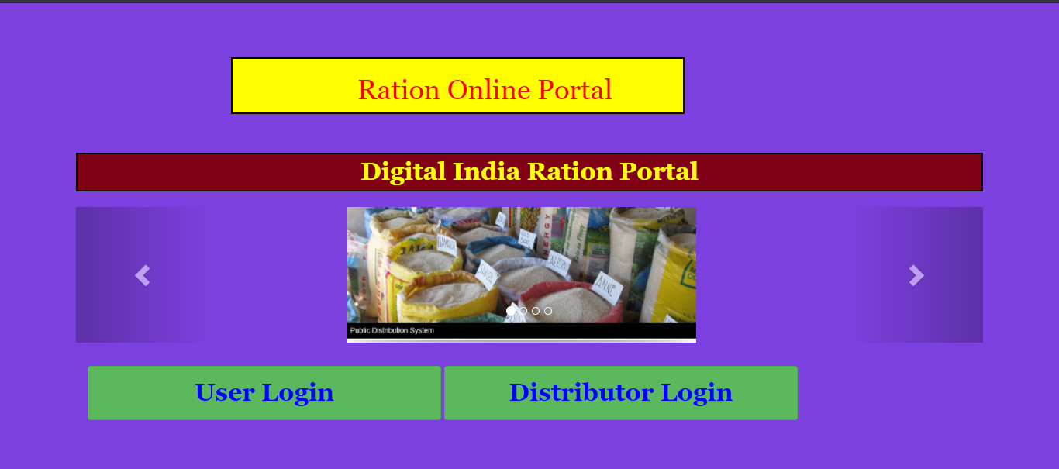
IMPLEMENTAION
MAIN MENU
1.When any one open the Ration management website
The two option occurs to the user.
a.First one is for people who take the ration the is
User login
b.Second one is for the distributor to mark attenedence,
Keep the record of ration etc.

Slide 8
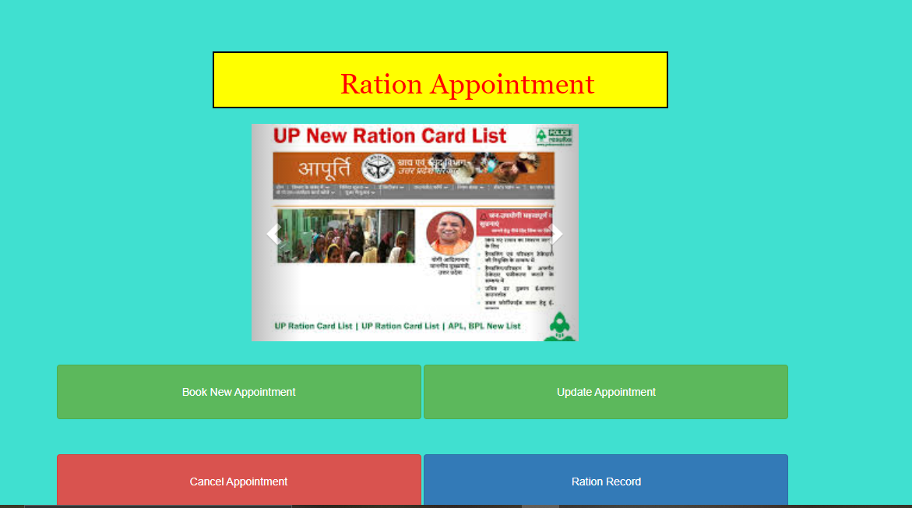
User appointment page
Ration Appointment Date Page:
This page provided different funtionality to the user to modify or get the appointment according to their convenience date.
In this times of covid, gathering of people could be very dangerous for many peoples. To prevent the gathering appointment system is designed. This is efficient and a good approach as it will decrease delay and every thing will happen in well organize and secure way.

Slide 9
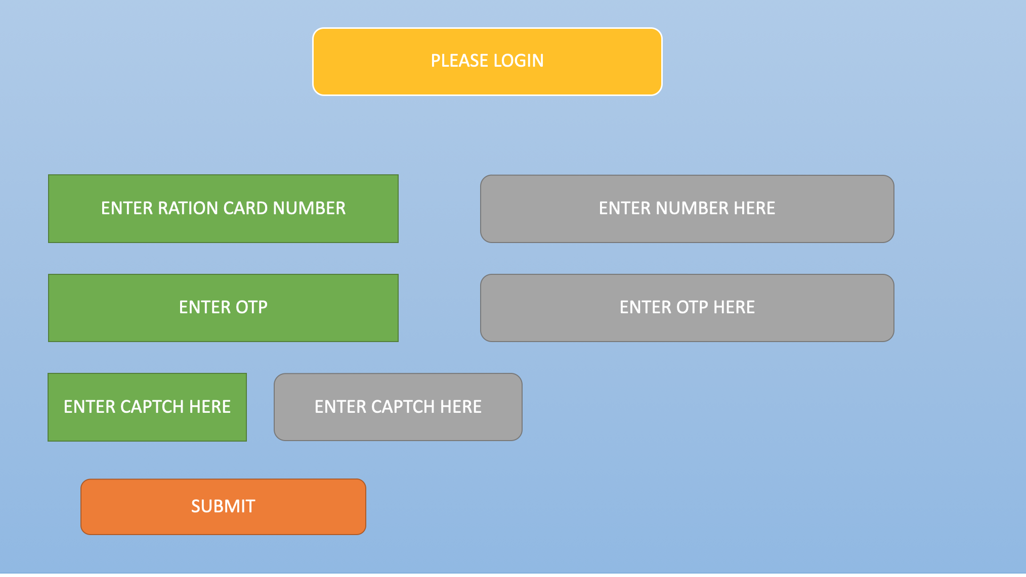

Slide 10
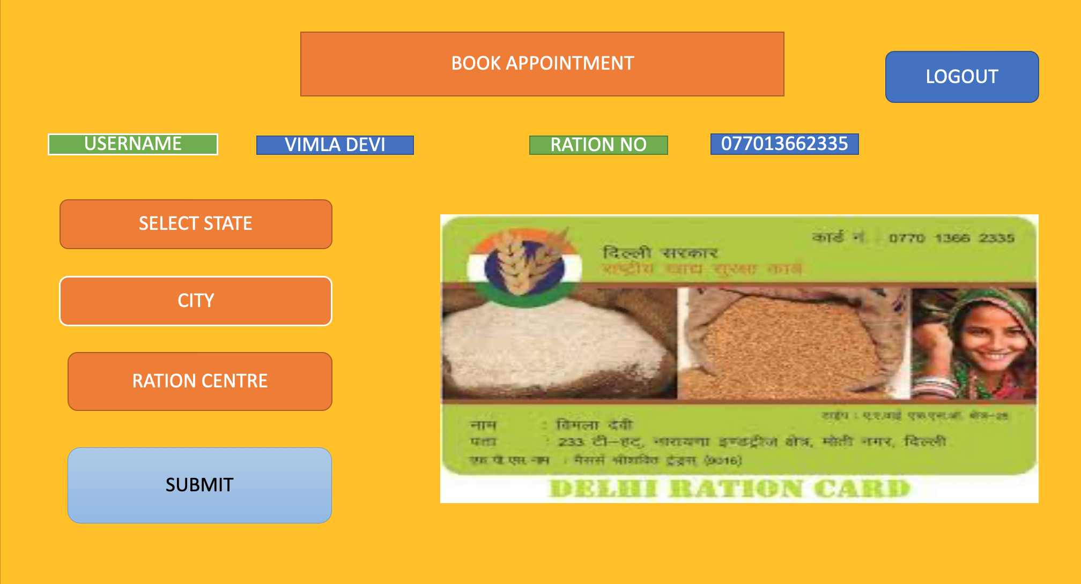

Slide 11
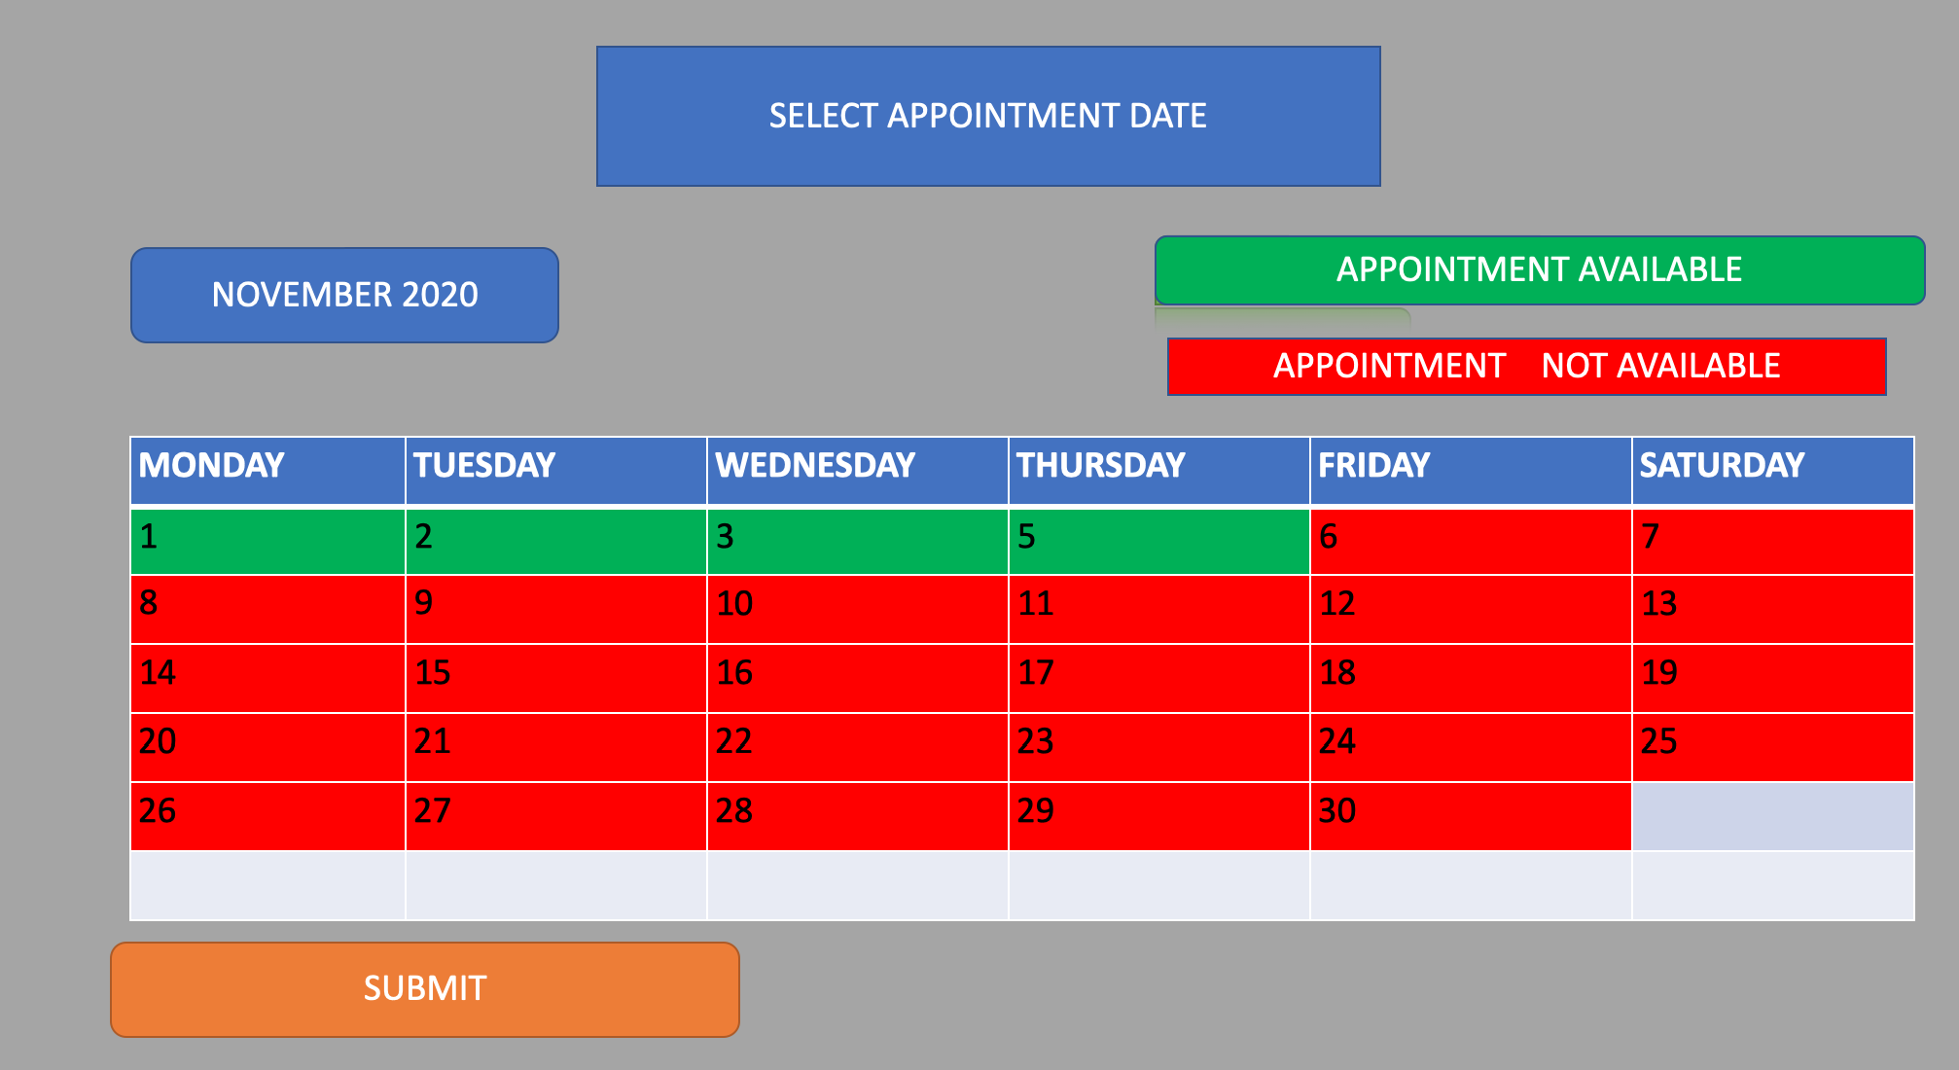

Slide 12
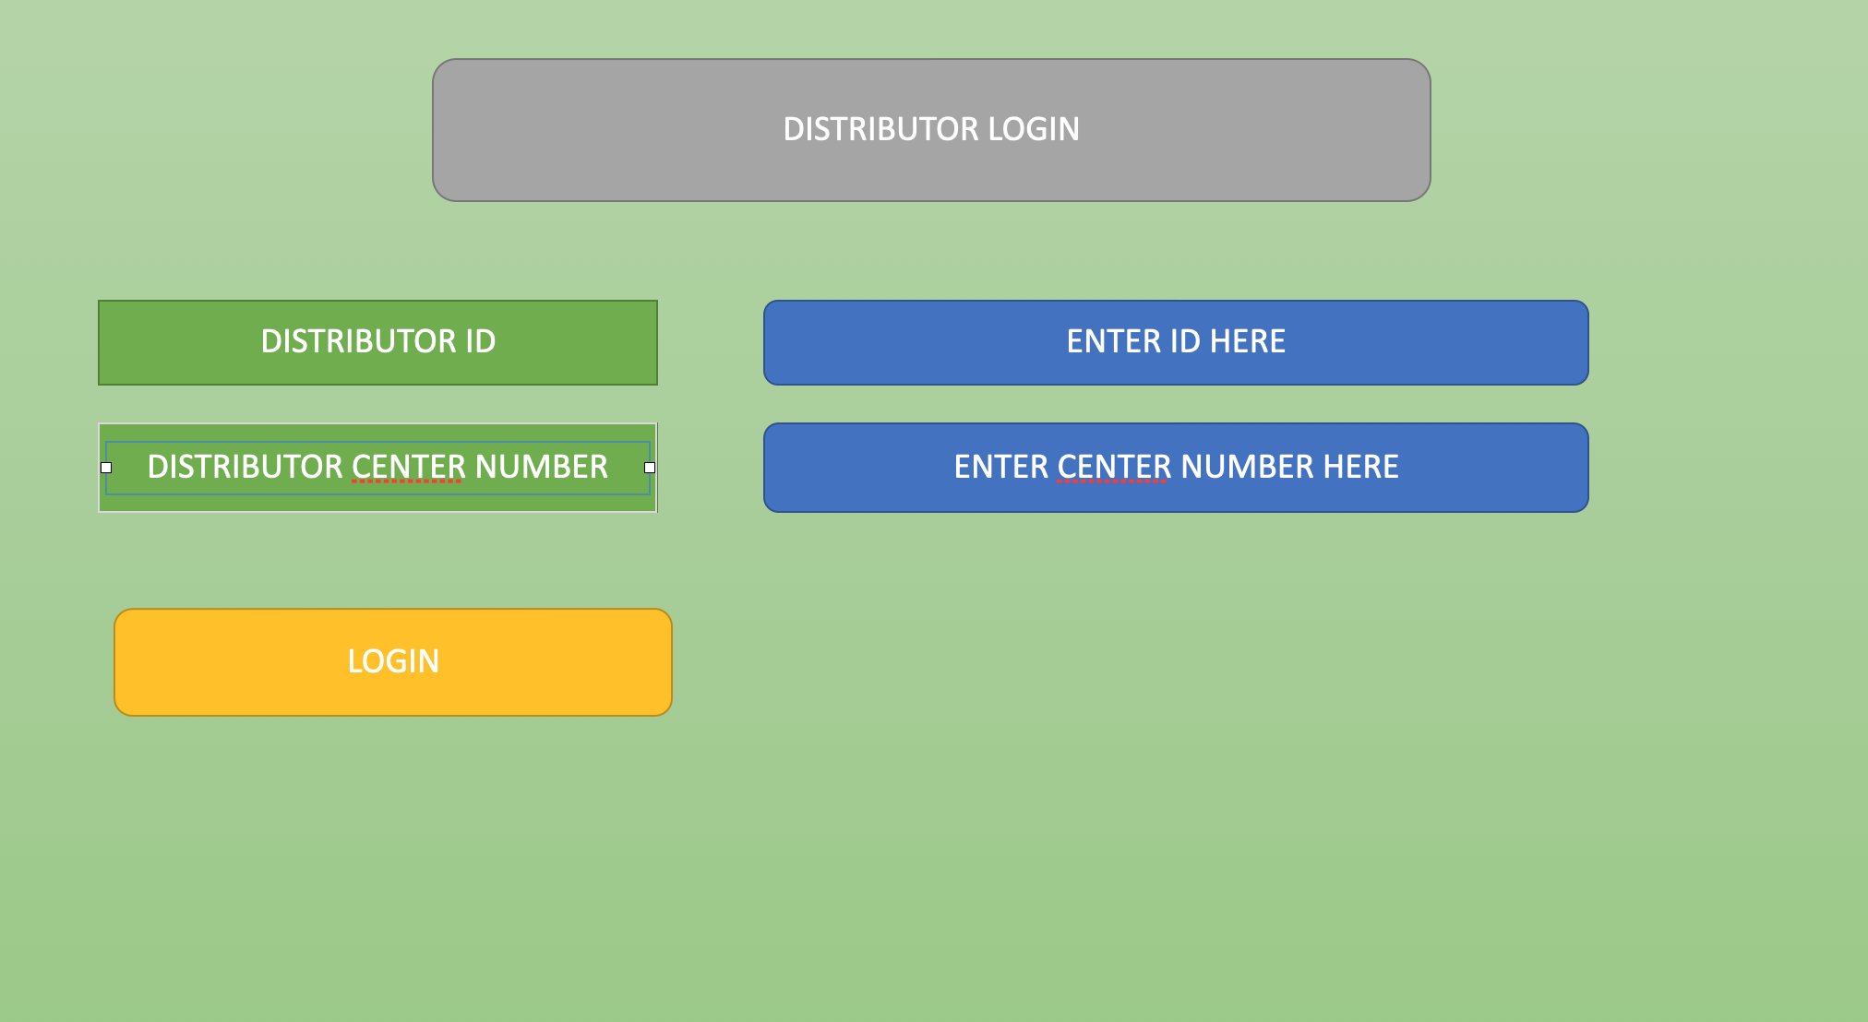

Slide 13
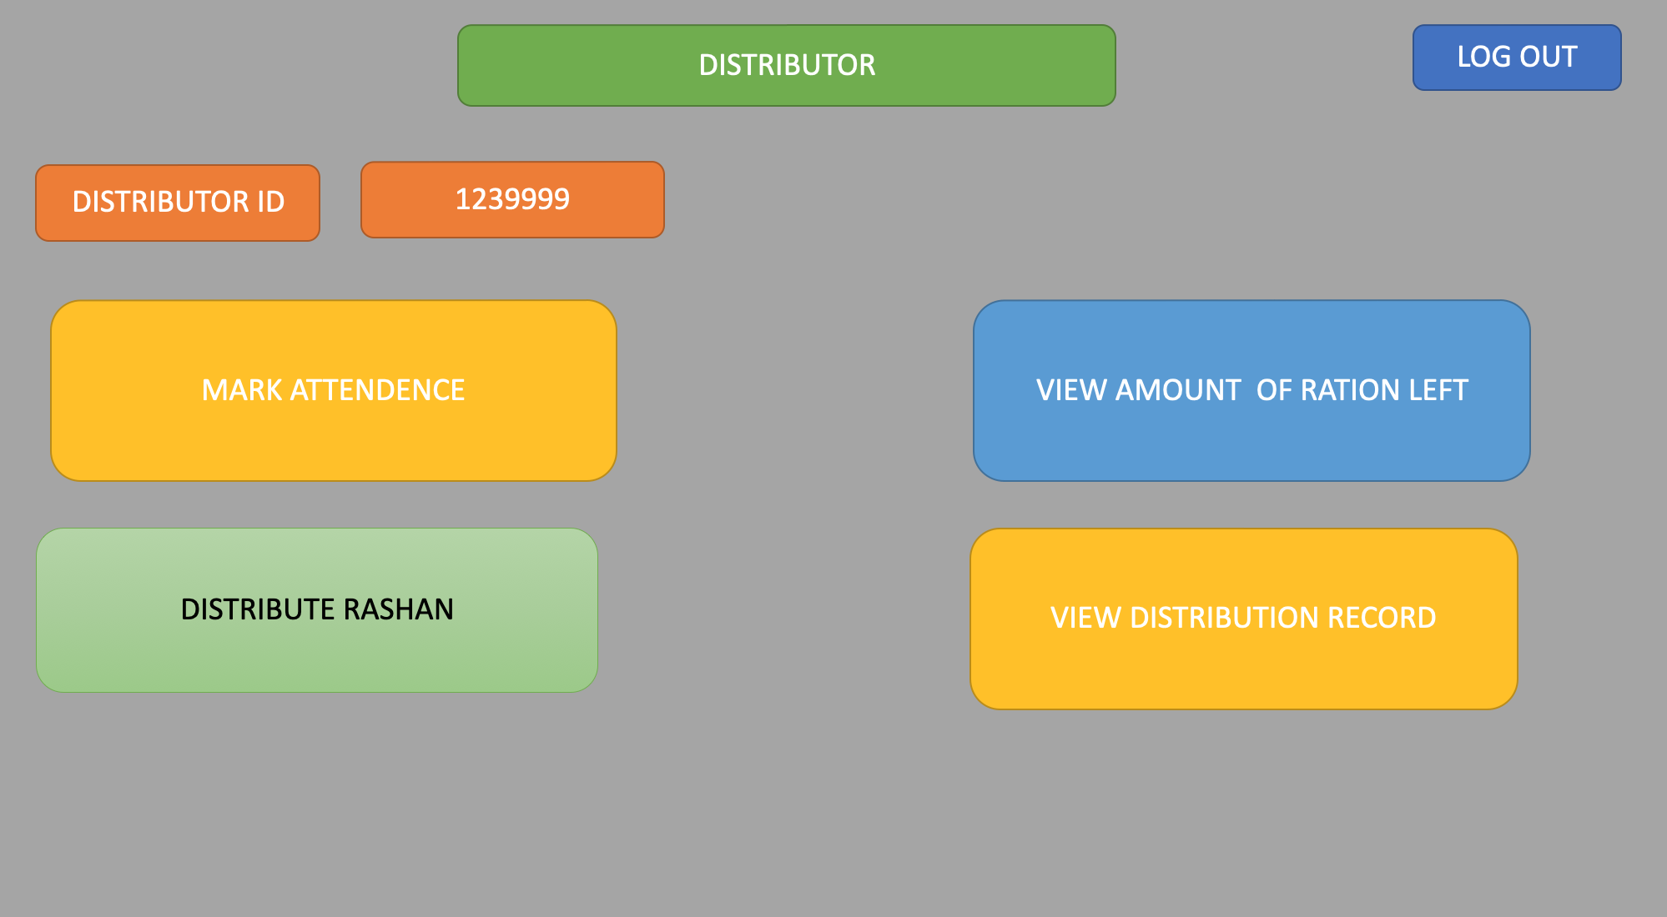

Slide 14
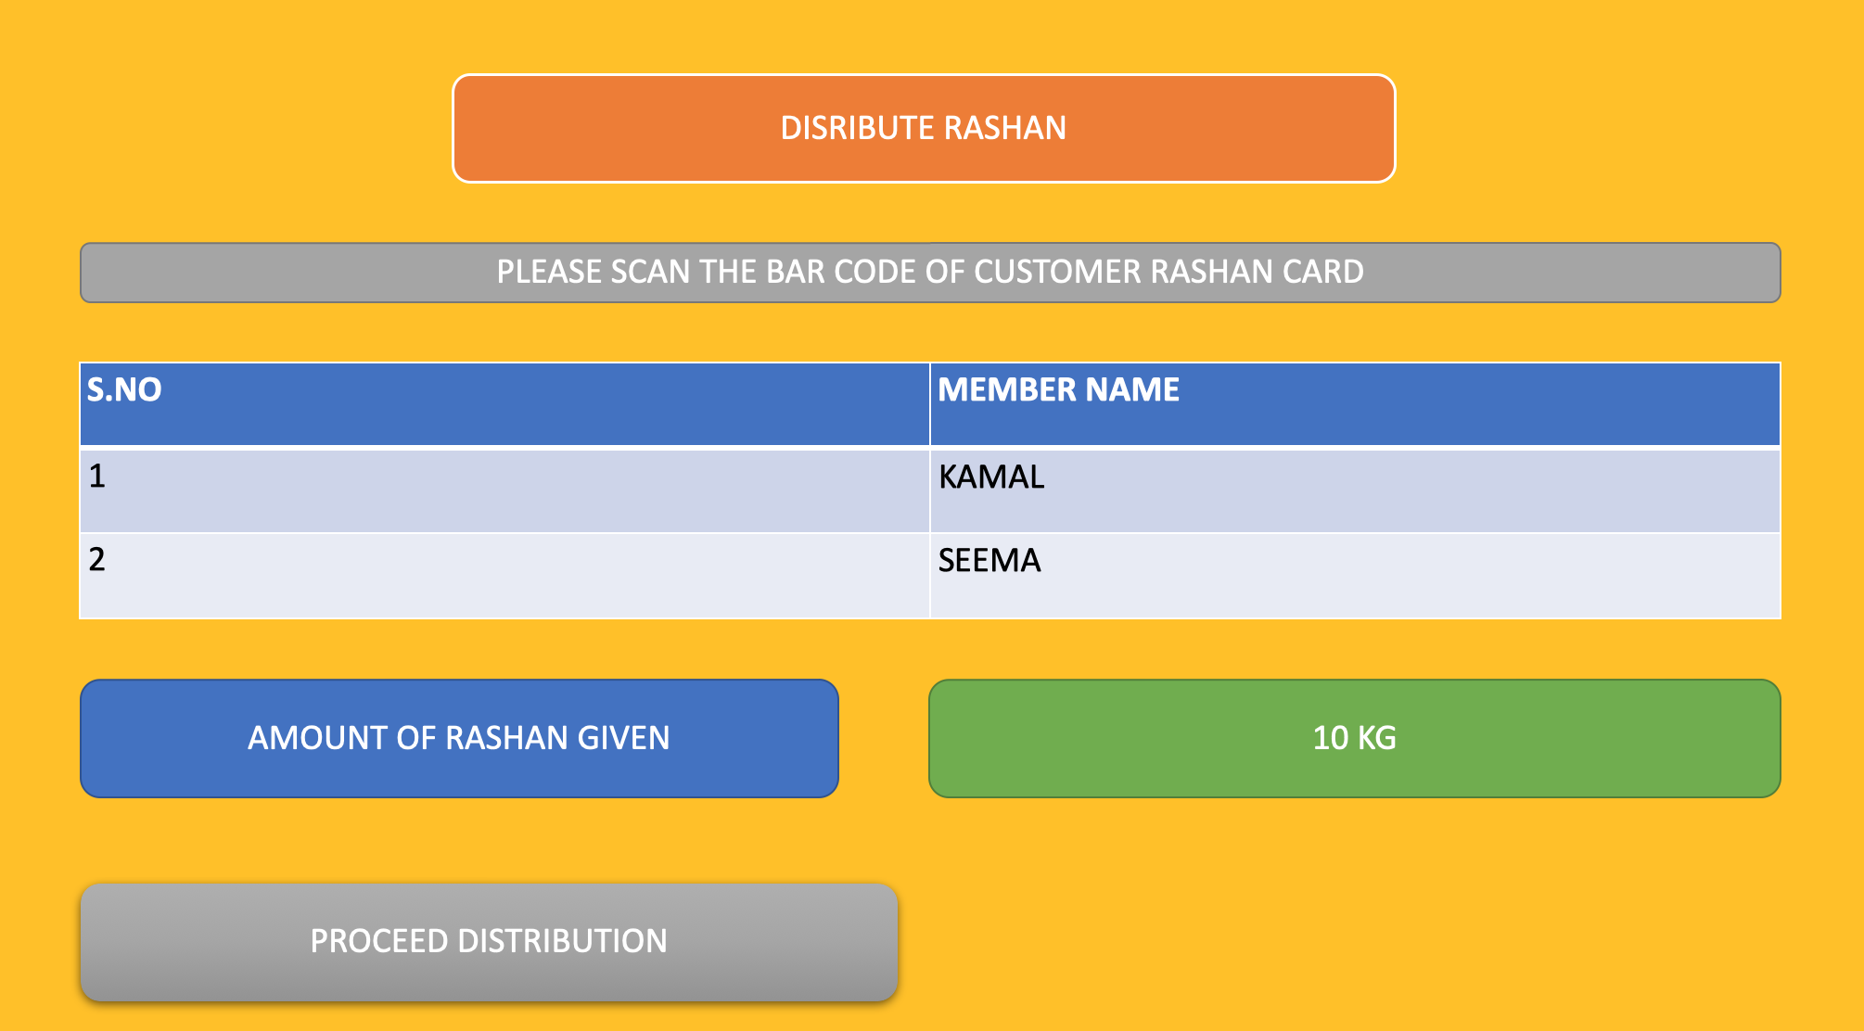

Slide 15
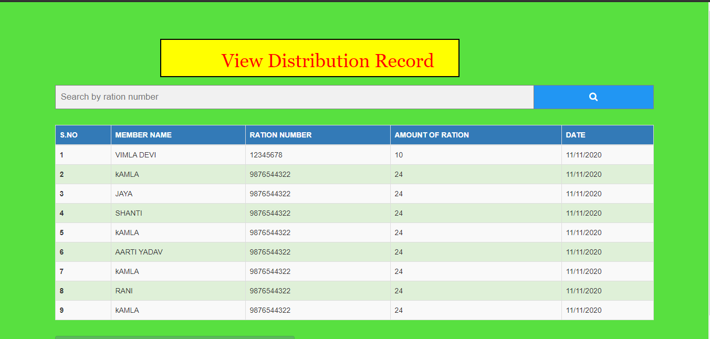
DISTRIBUTION RECORD

Slide 16
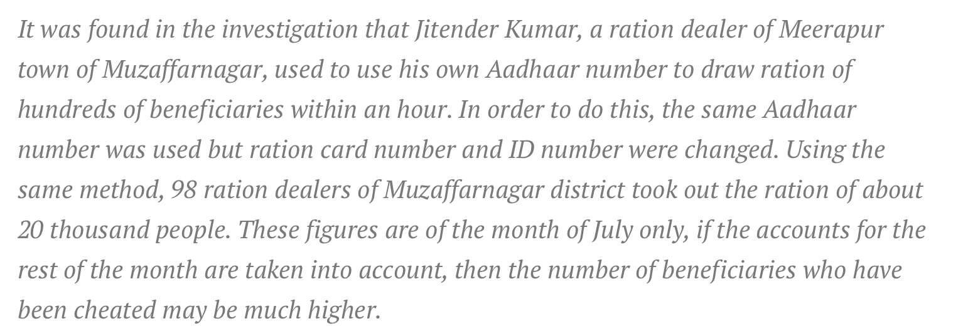
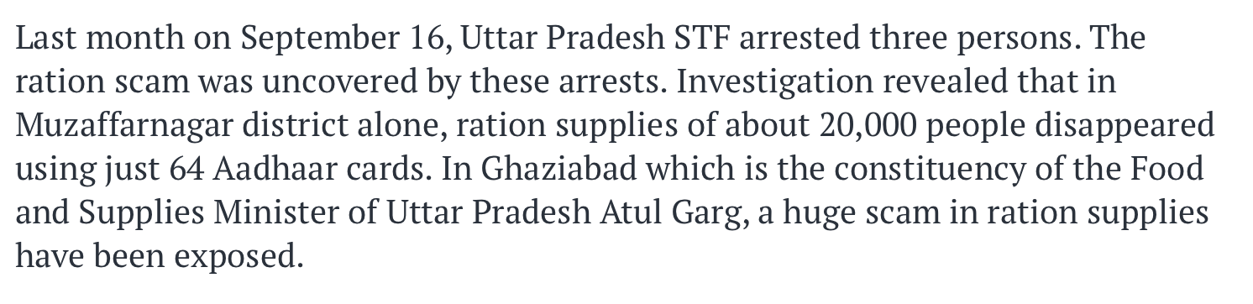
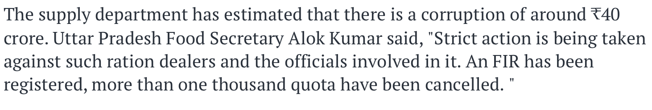
SECURITY SOLUTION
Usually the frauds are comminted by using the Ration card details i.e. Ration card number and ID no. so to prevent any fraudulent we need to limit the access to these things.
Algorithm:
Every ration card will have a unique ID which will be use to identify the ration card and to update user details ONLY.
For transaction different id's will be used which will be stored in ration card chip which will return a hash value which will be sended to manager department from the distributor computer.
Assuming a computer expert is hired to access the information, so we need to hide the information a ration card is returning which will be used used to verify the identity and transaction of ration.

Slide 17
EXCESS RATION MANAGEMENT
RATION CENTEER 1
RATION CENTER 8
RATION CENTER 2
CENTRAL STORE
RATION CENTER 3
RATION CENTER 7
RATION CENTER 6
RATION CENTER 4
RATION CENTER 5

Slide 18
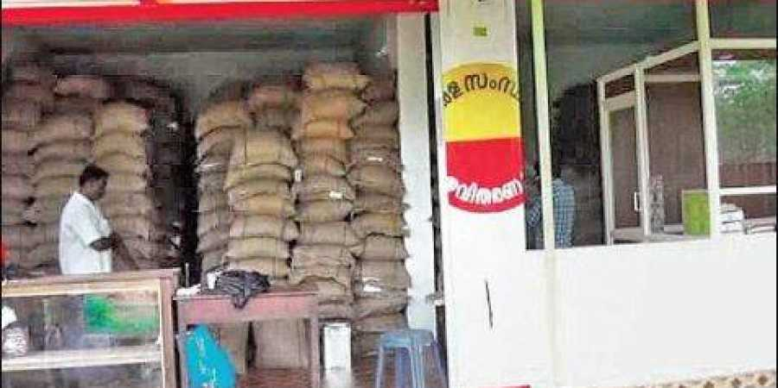
EXCESS RATION MANAGEMENT
By using the sorting algorithms we can search the center which produce the
large amount of undistributed ration per month,and we can put some constraint that if the center produce more than this amount then the services of that center review by the government.
Saving the storage cost

Slide 19
Problem Faced
->We faced problem in making the web carrousel and also the problem is to make it dynamic as well but after exploring we are able to find it solution by using the bootstrap framework.
Following are the predefine classes that help us to build the web carousel.
id="carousel"
class="carousel slide"
data-ride="carousel“
->Another problem we faced in building the calendar for appointment and we also need to enter the color to particular date field so that user can recognize which date is available. This also solved by using table in bootstrap and using the CSS we give color to the particular date column.

Slide 20
FUTURE WORK
Using different complex function we want to made our website dynamic and user friendly.
In this way it benefit both government and people and save money as well as precious time of people.
We will use mysql as database in our website and use optimized algorithm for increasing the efficiency of Ration management website.

Slide 21
REFERENCES USED
https://getbootstrap.com/
https://www.w3schools.com/html/

Slide 22
DEMO

