Slide 1
eDeals
all the best deals in one place!

Slide 2
Authors
Bharath Krishnan
Rifat Hasan
Umang Mehta

Slide 3
Significance
To get the best deals on any product in one place
Helps users save time
Includes leading online retailers like Amazon, Bestbuy, etc.
User can have a track of the deals that were used

Slide 4
Technical Information
The project uses a relational database which will gather data from different web sources
The project is a restful web service using JPA and JSON using Jackson-Jersey implementation.
The project uses MySQL as database and HTML, Java and Javascript

Slide 5
System Actors
User
Searches for deals for the product required
Is presented with a list of deals for the product searched. User can filter products based on requirements
User chooses the preferred deal and proceeds to the corresponding site

Slide 6
System Actors
Admin
Admin will provide the interface to the user for searching best deals
Admin will create and provide ads on the eDeal site

Slide 7
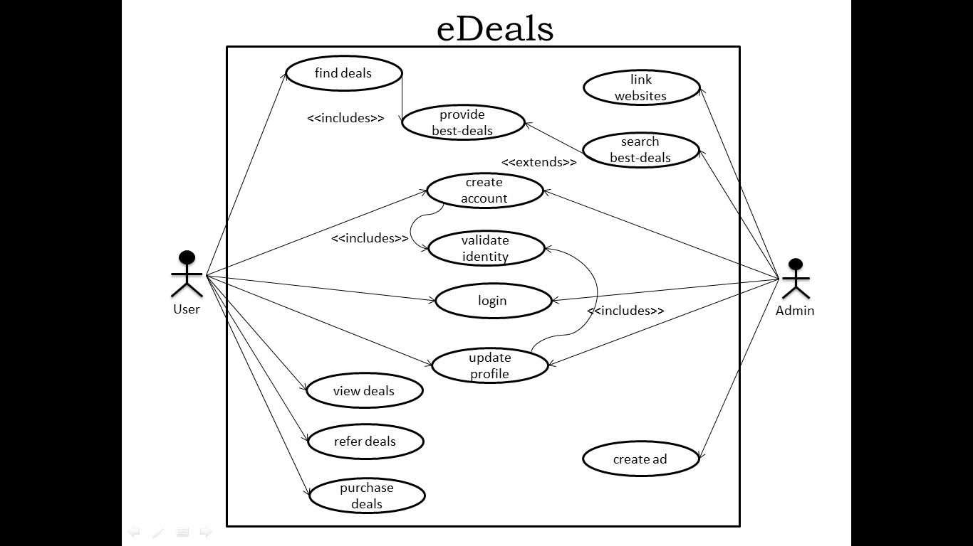
Use Case Diagram

Slide 8
Use Case – Find Deals
findDeals
Description: User will enter product name and search for the best deal based on his requirement and system availability.
Precondition: User should be on eDeals website/application.
Step by step:
User enters the particular product which he requires in search box.
System provides the deals that are relevant to the product
System recommends the best deal.
User can filter the deals based product attributes.
System provides the deal based on user requirement

Slide 9
Use Case – Create Account
createAccount
Description: User creates an Account to find the Best deal by entering his first name, last name, date of birth, telephone number, shipping address and email address
Precondition: User should have opened the eDeals site
Step by step:
User opens the eDeals site
User keys in his first name, last name, date of birth, telephone number and email address to create an account
System redirects the user to the eDeals website and logs the user into the system and activates the account.

Slide 10
Use Case – View Deals
viewDeals
Description: User will view the deals with details provided by the system.
Precondition:
System should provide the deals based on user requirement.
User should have an account and must be logged into the system.
Step by step:
User will view the deals based on his requirement.
User can choose any of the provided deals to view in detail given by the system
System will provide all the details relevant to that particular deal along with the offer that the system provides on the original deal

Slide 11
Use Case – Link Websites
linkWebsites
Description: The system finds the deals according to the user’s requirements and provides the user with a link to view the deals.
Precondition:
User should have opened the eDeals website
User should have searched for a product
Product should be a valid one.
Step by step:
User searches for a product.
System provides various deals that would redirect to different websites

Slide 12
Use Case – Search Best Deals
searchBestDeals
Description: The system will search the best deals for the products.
Precondition: The system must have linked the web services to search best deals
Step by step:
System links the web services.
System searches the best deals from the linked web services.
Post Condition: The search should be filtered by the users search criteria

Slide 13
Use Case – Provide Best Deals
provideBestDeals
Description: The system will provide the best deals for the product based on user requirement and also provide a link where the user can have discount using eDeals site.
Precondition: User should have provided the searching criteria by finding deals
Step by step:
System gets the user search criteria when user tries to find deals.
System links that search with web services.
System gets data from the web and provides it in the eDeal site

Slide 14
Use Case – Create Ads
createAd
Description: The Admin Creates Ad’s to attract user attention on the website.
Step by Step:
Admin selects the appropriate Ad’s Based on the popularity of product.
Admin posts the Ad’s on the Website

Slide 15
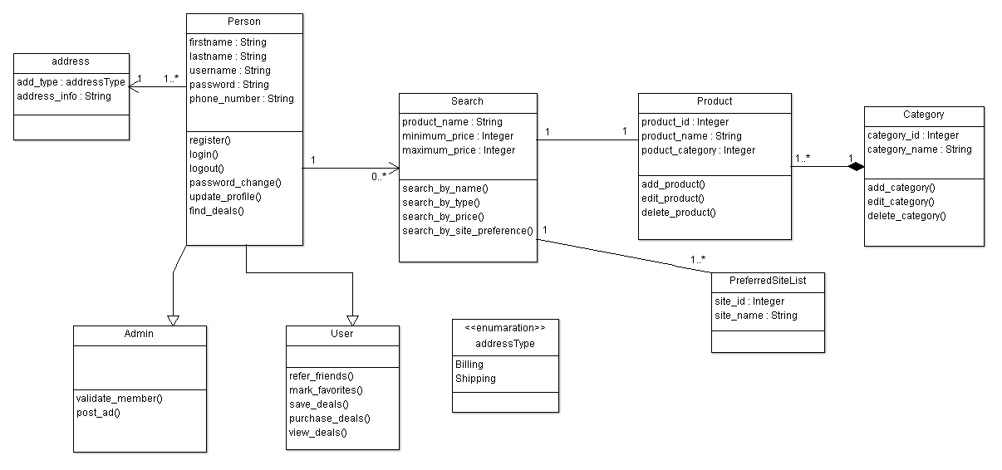
Class Diagram

Slide 16
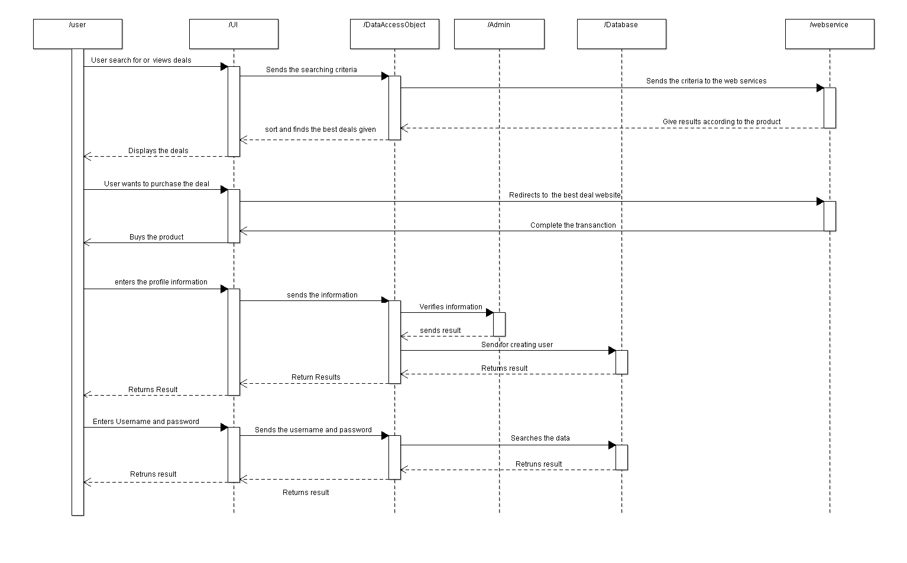
User Sequence Diagram

Slide 17
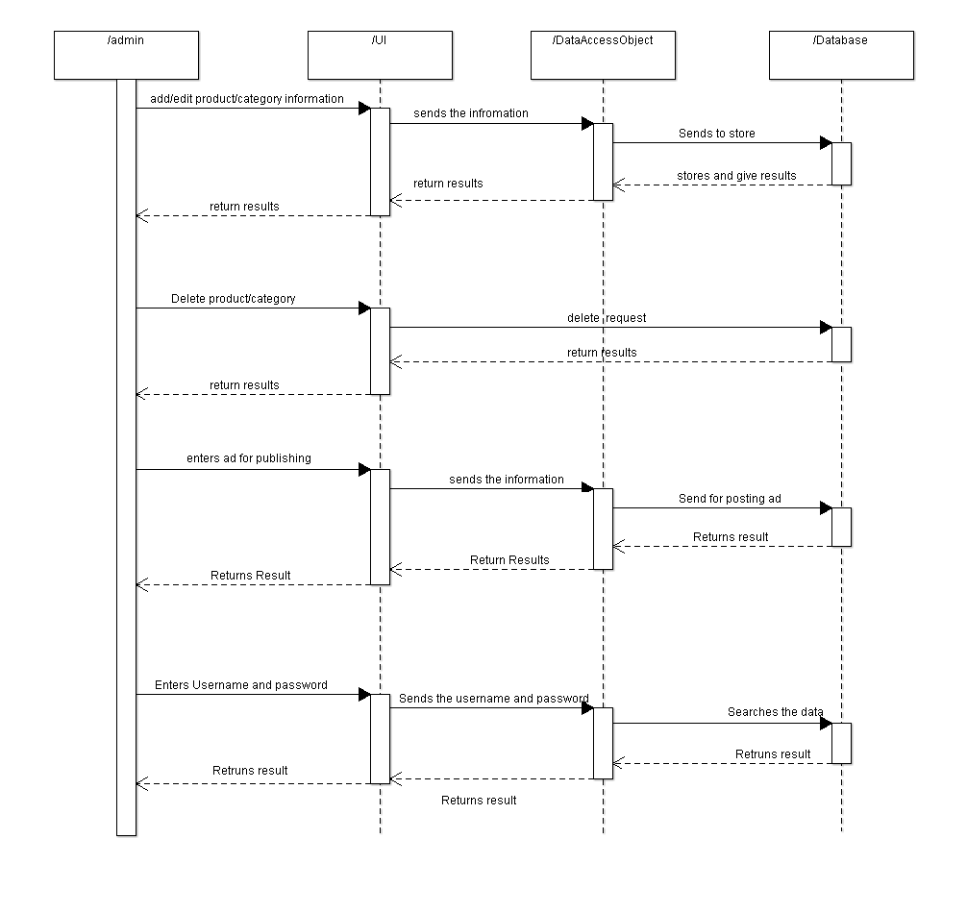
Admin Sequence Diagram

Slide 18
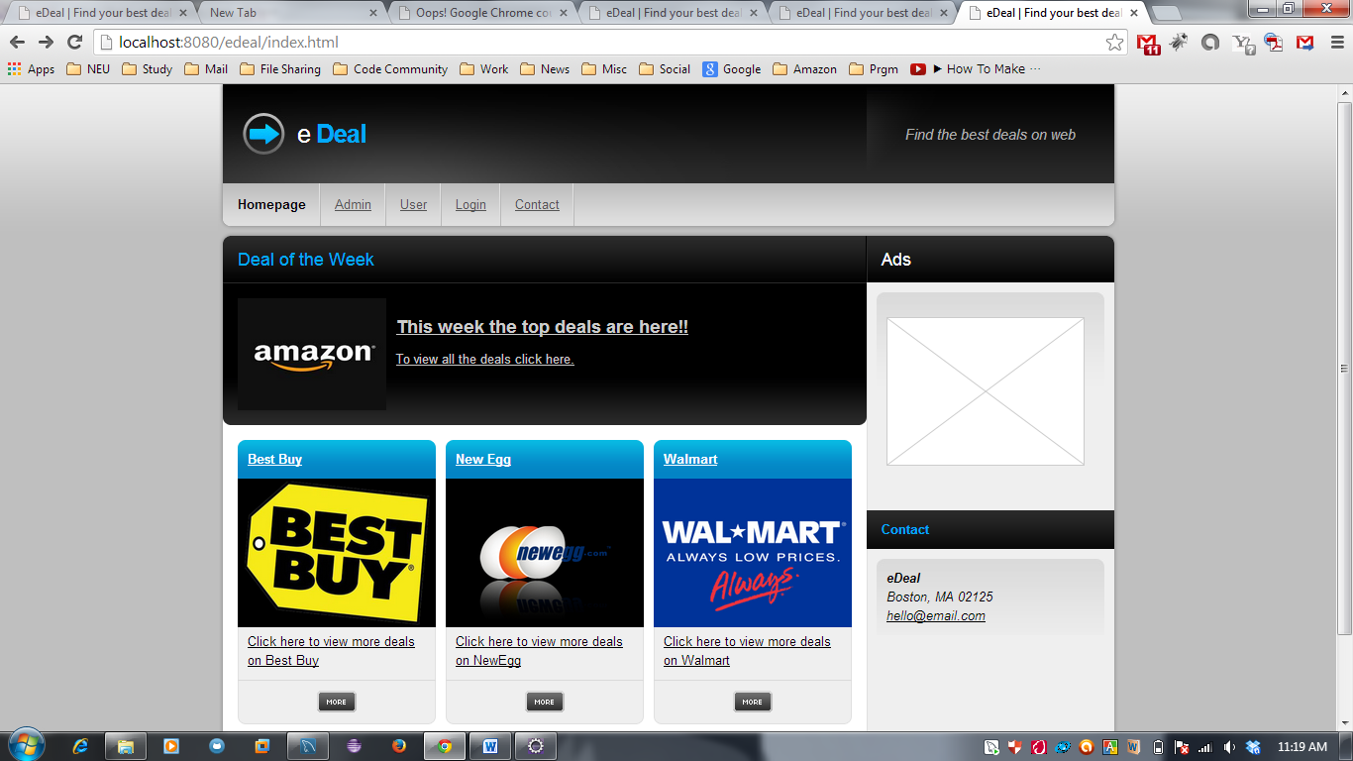

Slide 19
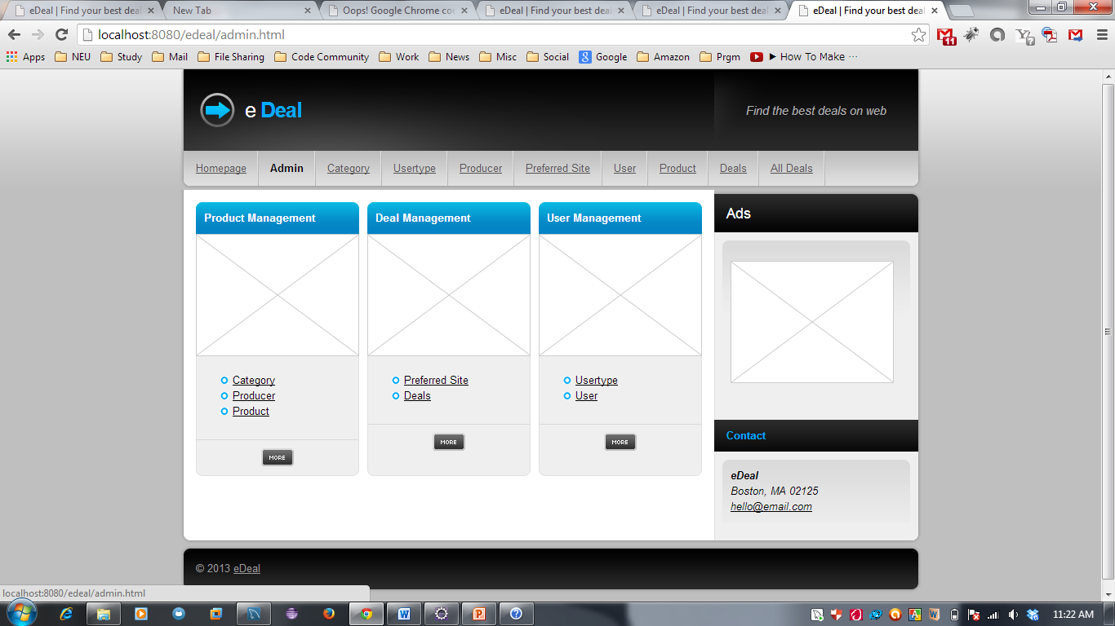

Slide 20
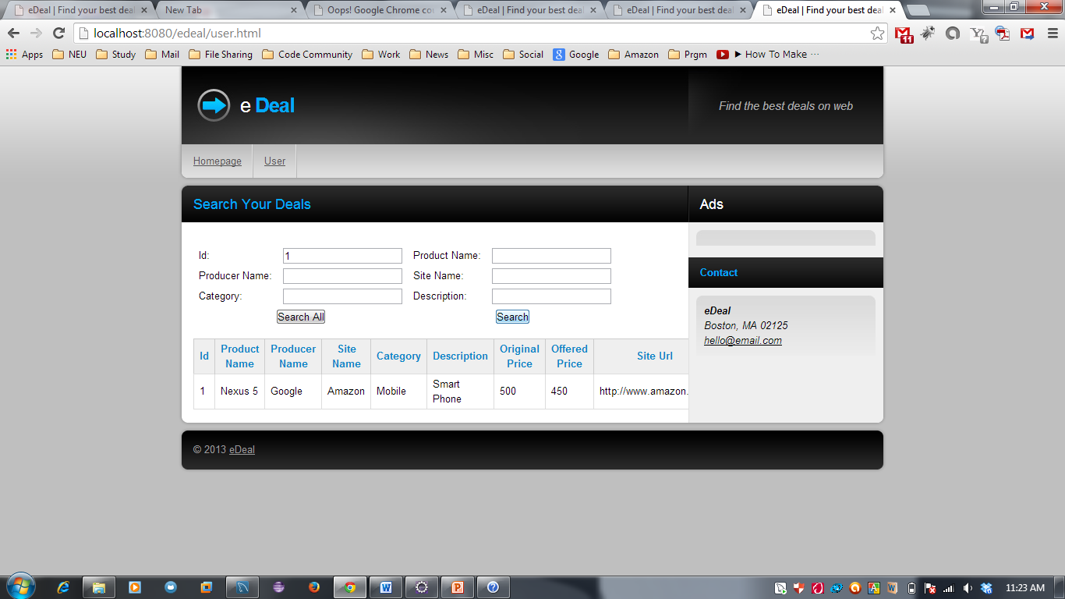

Slide 21
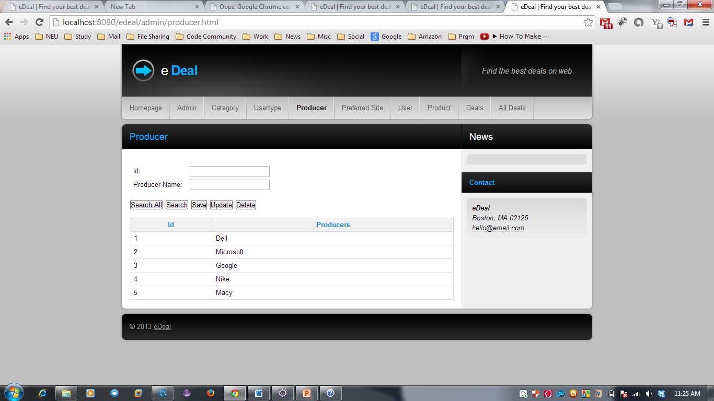

Slide 22
THANK YOU !

