Slide 1
Designing Driver Onboarding Module
Umang Agrawal
MTS3 @ VMware

Slide 2
Requirements and Goals of the System
Functional Requirements
Drivers should be able to sign up and enter profile information.
Drivers should be able to trigger onboarding process.
Admins should be able to approve/decline the pending driver applications.
Drivers should be able to toggle their availability once approved.
Non-functional Requirements
Our service needs to be highly available.
Consistency can take a hit
The system should be highly reliable
Not in scope: Uploading and storing of verification documents, API security measures

Slide 3
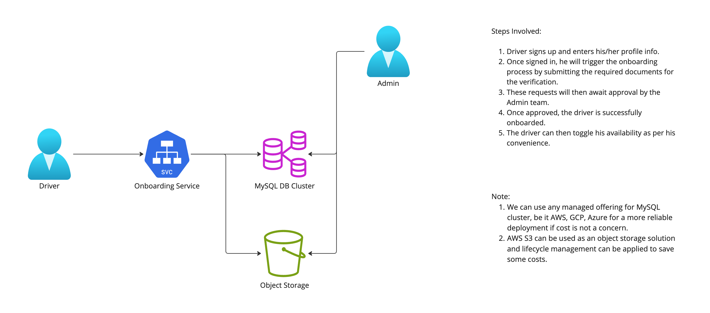
High Level Design

Slide 4
Design Choices
MySQL cluster for storing driver related info along with encrypted passwords.
Both reads and writes are light for this requirement. There won’t be much writes to the DB as it is rare to have many drivers onboarding at the same time.
Best choice for storing and querying structured data.
Stateful set can be used to deploy a MySQL cluster with Master Slave configurations. Read replicas can be adjusted as per load requirement.
AWS S3 for storing documents uploaded by the driver for verification.
Using Bucket Storage Lifecycle to save on costs

Slide 5
Low Level Design
GET, POST /api/v1/drivers
GET /api/v1/drivers/<email_id>
GET, POST /api/v1/drivers/<email_id>/availability
POST /api/v1/drivers/<email_id>/onboard
GET /api/v1/approvals
POST /api/v1/approvals/<email_id>

Slide 6
Major Kubernetes Manifests Used
Deployment
Onboarding service
Note: Replicas can be chosen as per requirement
Stateful Set
MySQL Cluster
Can be replaced by managed services like AWS RDS
Secret
To store sensitive info
Note: Can be replaced by managed services like Vault(by Hashicorp), AWS Secrets manager, etc.

Slide 7
Phase 2 Enhancements
Pagination in API Response
Caching
RBAC Middleware
Using SSL/TLS to encrypt a connection to a DB instance
Kubernetes deployment using Helm
Using Runway/Concourse and Gitops for CI/CD pipeline
Collecting app logs using Fluentd
Prometheus/Grafana Dashboarding for App performance monitoring and raising alerts

Slide 8
Thank You

