Slide 1
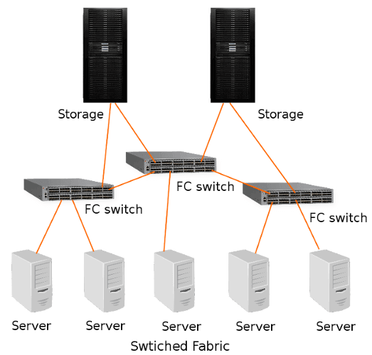
FABRIC TOPOLOGY GENERATOR

Slide 2

PROBLEM TO SOLVE
Prepare a quick Topology Diagram of your testbed to use in emails or chats.
Share your Topology with your team while sharing setups.
Attaching the Topology Diagrams in Bug Description for easy understanding of the Testbed.

Slide 3
TECH STACK USED
Github
Python

Slide 4
DOWNLOADING ANACONDA
Go to link : https://www.anaconda.com/products/individual
Download 64-Bit Graphical Installer based on your OS.
It will come with the latest version of Python.

Slide 5
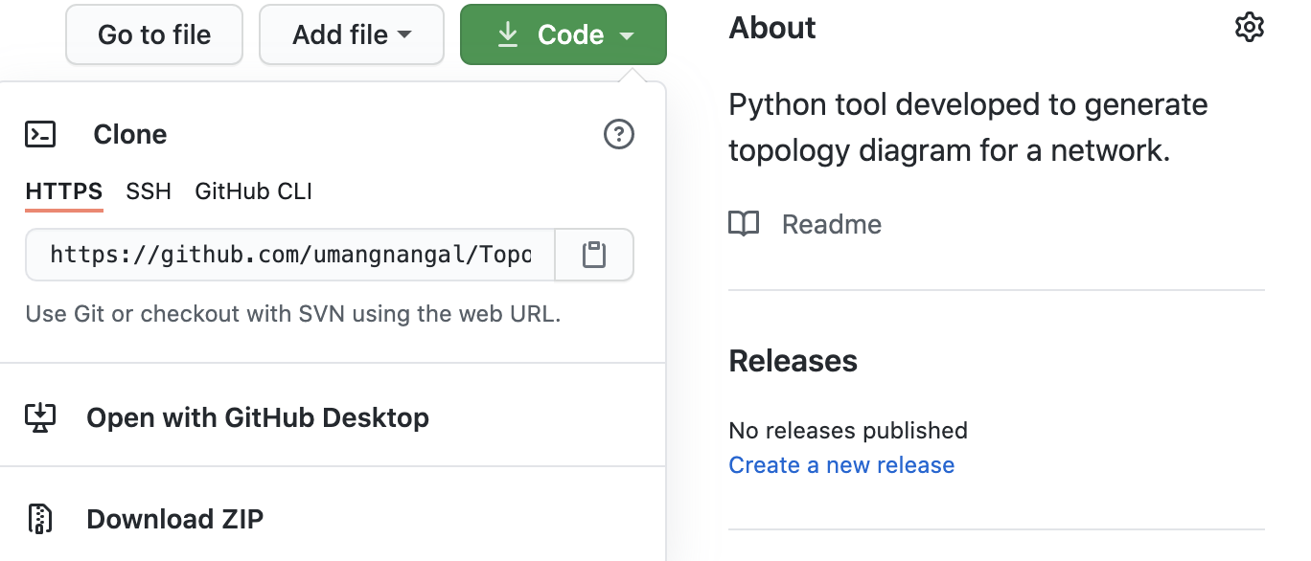
WORKING WITH GITHUB
Download GitHub Desktop for better experience.
https://desktop.github.com/
Visit the link given below :
https://github.com/umangnangal/Topology_Generator.git
Use the ‘Open with GitHub Desktop’ option

Slide 6

USING ANACONDA
Use conda to create a new virtual environment with latest python version installed.
conda create --name <name> python
Activate the newly created virtual environment.
conda activate <name>
Install the additional packages required for tool to run.
pip install -r requirements.txt

Slide 7

DEMO

Slide 8
CONTRIBUTING TO THE PROJECT
Raise bugs or enhancements
Fix issues IN the code.
Add more features to the tool

Slide 9

THANK YOU

