Slide 1

Text File Compression And Decompression Using Huffman Coding
ACB 522: Algorithms in Computational Biology
Sarvani Gupta (MT23252)
Mimansha Das(MT23233)
Umang Sharma(MT23239)

Slide 2
Huffman Algorithm
The Huffman Algorithm, devised by David A. Huffman in 1952, is a method for lossless data compression.
Its primary objective is to encode characters from the input data into variable-length codes, where more frequently occurring characters are assigned shorter codes.
the “prefix rule” is used which makes sure that the algorithm only generates uniquely decodable codes

Slide 3
How Huffman algorithm works?
Frequency Analysis: The algorithm begins by analyzing the frequency of each character in the input data.
Build Huffman Tree: Using the character frequencies, a binary tree called the Huffman tree is constructed.
Generate Huffman Codes: Traversing the Huffman tree assigns shorter codes to more frequent characters and longer codes to less frequent ones.
Encoding: The input data is then replaced with its corresponding Huffman codes for compression.
Decoding: To decompress, the encoded data is decoded by traversing the Huffman tree.

Slide 4
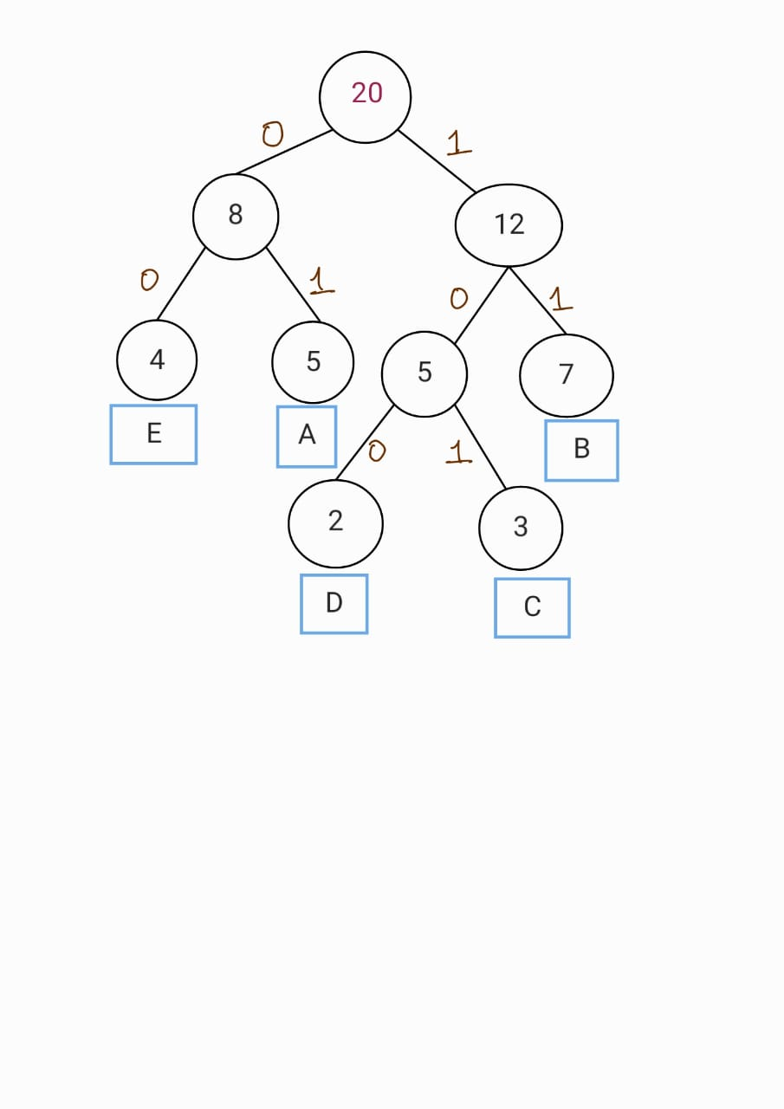
Example of Huffman Algorithm
Example- “ABBCDBCCDAABBEEEBEAB”
4

Slide 5
Character | Frequency | Code
A | 4 | 01
B | 7 | 11
C | 3 | 101
D | 2 | 100
E | 4 | 00

Slide 6
Toward a Better Compression for DNA Sequences Using Huffman Encoding
This research paper explores the potential of using Huffman encoding, a data compression technique, to improve the compression ratio of DNA sequences.
It describes various methods of DNA sequence compression such as Standard Huffman coding, Unbalanced Huffman Tree and Multiple Huffman Coding.
Standard Huffman Coding(SHT):uses a combination of run-length encoding (RLE) and Huffman coding with a focus on identifying frequently occurring substrings.
Unbalanced Huffman Tree (UHT): It aims to achieve better compression compared to the standard Huffman Tree (SHT) for DNA data. UHT forces the resulting Huffman tree to be unbalanced. This approach aims to guarantee the encoding of three out of the four DNA bases using only two bits each, with the remaining base using three bits.
Multiple Huffman Coding(MSHT/MUHT): The DNA sequence is split into smaller chunks using markers or partitions.

Slide 7
Standard Huffman Coding VS Multiple Huffman Coding
SHT
MSHT
Treats the entire data sequence as a whole.
Analyzes the frequency of symbols across the entire data set.
Builds a single Huffman tree based on these symbol frequencies.
Assigns shorter codes to more frequent symbols in the final compressed data.
Divides the data sequence into smaller segments.
Analyzes the frequency of symbols within each segment independently.
Builds a separate Huffman tree for each segment based on the local symbol frequencies.
Assigns shorter codes to frequent symbols within each segment, potentially capturing local patterns missed by SHT.

Slide 8
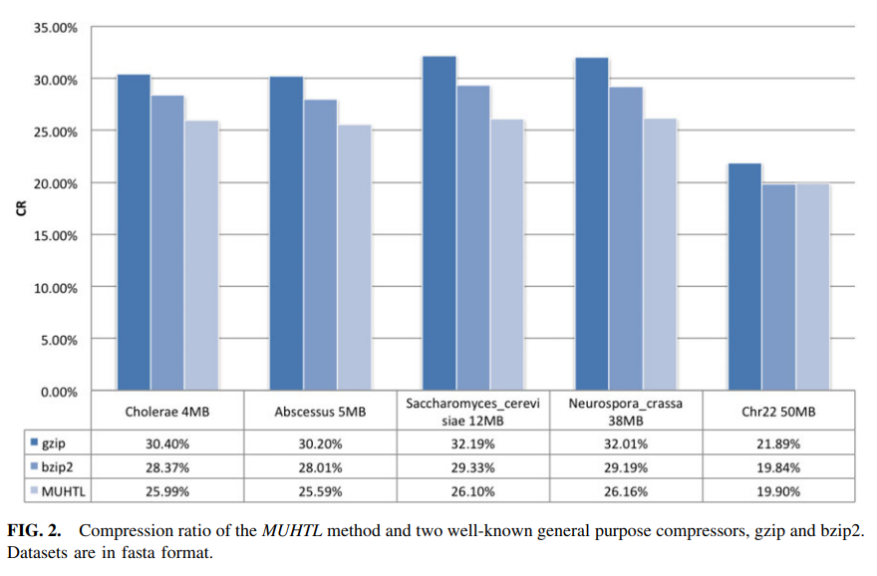
MULTIPLE HUFFMAN ENCODING VS OTHER COMPRESSION TOOLS

Slide 9
Workflow of code:
Structs and Classes:
Tree struct defines a node in the Huffman tree. It stores the frequency of a character and pointers to its left and right children.
TreeComparator is a function used to compare two Tree nodes based on their frequencies. It's used in the priority queue to ensure that the node with the lowest frequency is at the front.
Building the Huffman Tree:
The buildHuffmanTree function takes a frequency table (a vector of pairs mapping characters to their frequencies) and constructs a Huffman tree.
It uses a priority queue (huffqueue) to keep track of intermediate trees. It repeatedly pops the two lowest frequency trees, combines them into a new tree, and pushes it back into the queue until only one tree remains.

Slide 10
Encoding: The traverseHuffmanTree function recursively traverses the Huffman tree to generate codewords for each character. It appends "0" for a left branch and "1" for a right branch.
compressFile reads the input file, constructs the Huffman tree, generates codewords, and writes the compressed data to an output file along with a header containing information needed for decompression.
Decoding: readHeader reads the header from the compressed file, extracting the Huffman codes and the number of padded bits.
getDecodedBuffer decodes the compressed bitstring back to the original characters using the Huffman codes.
decompressFile reads the compressed file, extracts the Huffman codes from the header, and writes the decompressed data to an output file.
Main Function: The main function takes command-line arguments for input and output file paths. If no arguments are provided, it uses default file paths.
It compresses the input file, then decompresses the compressed file back to its original form.

Slide 11
Time Complexity = O(n Log n)
Space Complexity = O(n + m)
N = number of unique character in the input file
M = size of the compressed data

Slide 12
Huffman algorithm v/s BWT
Aspect | Huffman Algorithm | Burrows Wheeler Transform
Algorithm type | Dictionary-based compression | Permutation based transformation
Compression efficiency | Assigns shorter codes to more frequent characters | Rearranges data to group similar characters
Complexity | O(n log n) | O(n ^2 log n)
Applications | File compression,image compression,multimedia compression | Preprocessing steps in compression algorithm

Slide 13
File Compression Software: Brands like WinZip, WinRAR, and 7-Zip employ Huffman coding along with other compression techniques to reduce file sizes efficiently.
JPEG Image Compression: Companies like Adobe (creator of Photoshop) and various camera manufacturers integrate JPEG compression, which includes Huffman coding, into their products.
MPEG Video Compression: This is employed by companies involved in video streaming, broadcasting, and multimedia software development, including industry leaders like Netflix, YouTube, and Adobe
Network Protocols: Companies involved in network infrastructure, telecommunications, and internet services, such as Cisco, Huawei, and Google, may implement Huffman coding within their protocol designs.
Data Storage Systems: Companies like Oracle, IBM, and Amazon (with its AWS services) may utilize Huffman coding or similar techniques to optimize data storage and retrieval.

Slide 14
In computational biology,
DNA Sequence Compression
Biological Data Storage
Sequence Alignment
Genome Assembly
Data Transmission and Communication

Slide 15
References:
https://www.researchgate.net/publication/304395425_Huffman_coding
https://www.geeksforgeeks.org/text-file-compression-and-decompression-using-huffman-coding/
https://www.ncbi.nlm.nih.gov/pmc/articles/PMC5372760/pdf/cmb.2016.0151.pdf

Slide 16
Thank you!

