Slide 1
IPRC
Light Weight Hexacopter for Surveillance Applications
Student Name | Reg. No.
19L31A0407 | MD. K. M. Thakksim
19L31A0412 | P. Apuroop kumar
19L31A0427 | U. R. V. Bharadwaj
19L31A04F1 | Y. Sai Kamalesh
External Mentor: Mr. S. K. V. Satish
Project Mentor: Mr. P. Tirumala Rao
DEPARTMENT OF ECE

Slide 2
IPRC
Light Weight Hexacopter for Surveillance Applications
Student Name | Reg. No.
19L31A0428 | Sk. Shoaib
19L31A04D7 | S. Chandra Shekhar
19L31A04E0 | P. Sri kamal
19L31A04E9 | S. L. Manohari
External Mentor: Mr. S. K. V. Satish
Project Mentor: Mrs. P. Mamatha Devi
DEPARTMENT OF ECE

Slide 3
IPRC
Light Weight Hexacopter for Surveillance Applications
Student Name | Reg. No.
19L31A04H1 | Ch. Dinesh
19L31A04H5 | U. Maonj
19L31A04I4 | V. S. M. Pavan
19L31A04O1 | P. Akshitha
External Mentor: Mr. S. K. V. Satish
Project Mentor: Mrs. A. Usha Rani
DEPARTMENT OF ECE

Slide 4
Contents
IPRC
Abstract
Motivations
Hardware Components
Software
Block Diagram
Working Principle
Circuit Diagram
Working Proof
Conclusion

Slide 5
Abstract
IPRC
Monitoring and surveillance activities with a security focus while using an aerial vehicle is known as aerial security.
Aerial Vehicles can aid in monitoring areas from a bird’s eye view. A Remotely Piloted Hexacopter is one such vehicle.
Hexacopters equipped with powerful enough cameras can assist security personnel in monitoring remote locations.
Using such surveillance drones to record videos of densely populated areas and performing image recognition processes is performed by this drone.

Slide 6
Motivation
IPRC
This project created a platform to learn about the unmanned aerial vehicles such as the quadcopter and hexacopter.
This expands the scope of the Electronics Engineering to include the control and the understanding of the mathematical components.
It also opens the possibilities to broaden the understanding and application of control systems, stabilization, artificial Intelligence and computer Image processing as it applies to the quadcopter.

Slide 7
Hardware Components
Hardware Components
IPRC
Motors
Electronic Speed Controller (ESC)
Flight controller Boards
Propellers
Radio Transmitter
Battery
Power Distribution Cables
Camera
Landing Gear

Slide 8
Drones
IPRC
Drones are more formally known as unmanned aerial vehicles (UAVs) or unmanned aircraft systems.
They look like helicopters or reconnaissance aircraft and, without a doubt, one of their strengths is the many different applications for which they can be used.

Slide 9
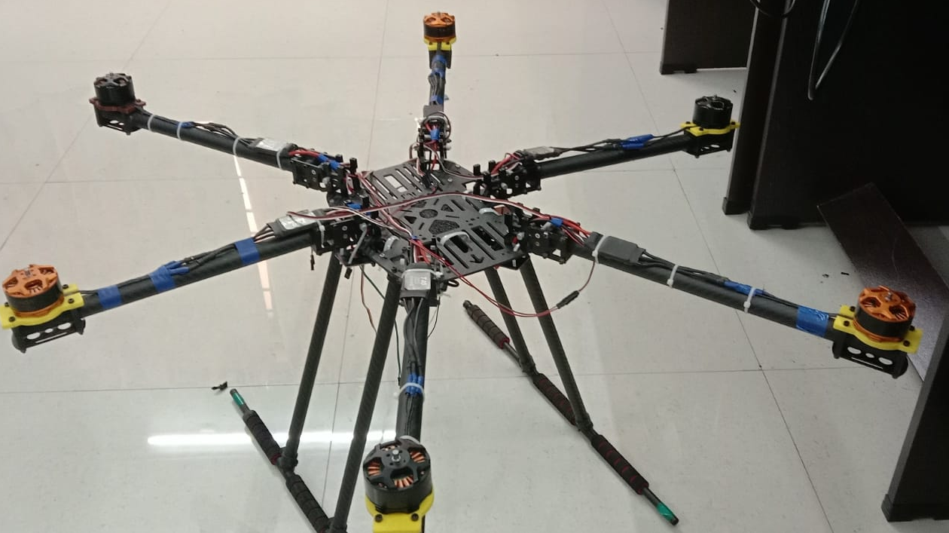
Hexa Copter
IPRC
A small remote-controlled aircraft like a helicopter, with six blades that go around on top, used especially to photograph things from the air.
The hexacopter has the potential for other capabilities such as autonomous flying, object tracking, and it can capture aerial data needed for many of the Vision Lab's research projects.
Fig. Hexacopter

Slide 10
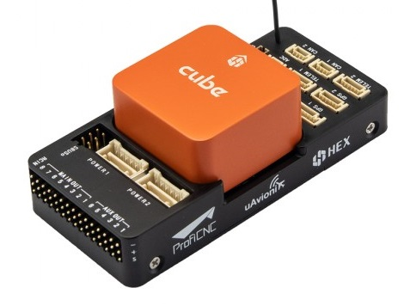
Flight Controller
IPRC
The flight controller is the brain of a drone. A small box filled with intelligent electronics and software, which monitors and controls everything the drone does. Flight controllers vary in sizes and complexity.
The Flight Controller oversees the safety of flight control operations by reviewing flight data and flight control systems.
Fig. Cube Orange Flight Controller

Slide 11
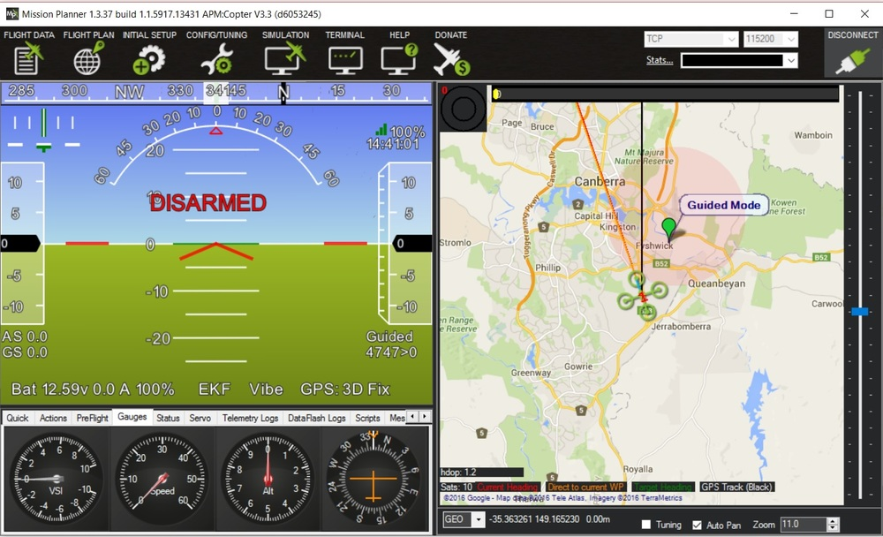
Ardupilot SW
IPRC
ArduPilot is an open source,unmanned vehicle Autopilot Software,capable of controlling autonomous:
Multirotor drones
Fixed-wing and VTOL aircraft
Helicopters
Ground rovers
Boats
Submarines
Antenna trackers
Fig. Ardupilot Software

Slide 12
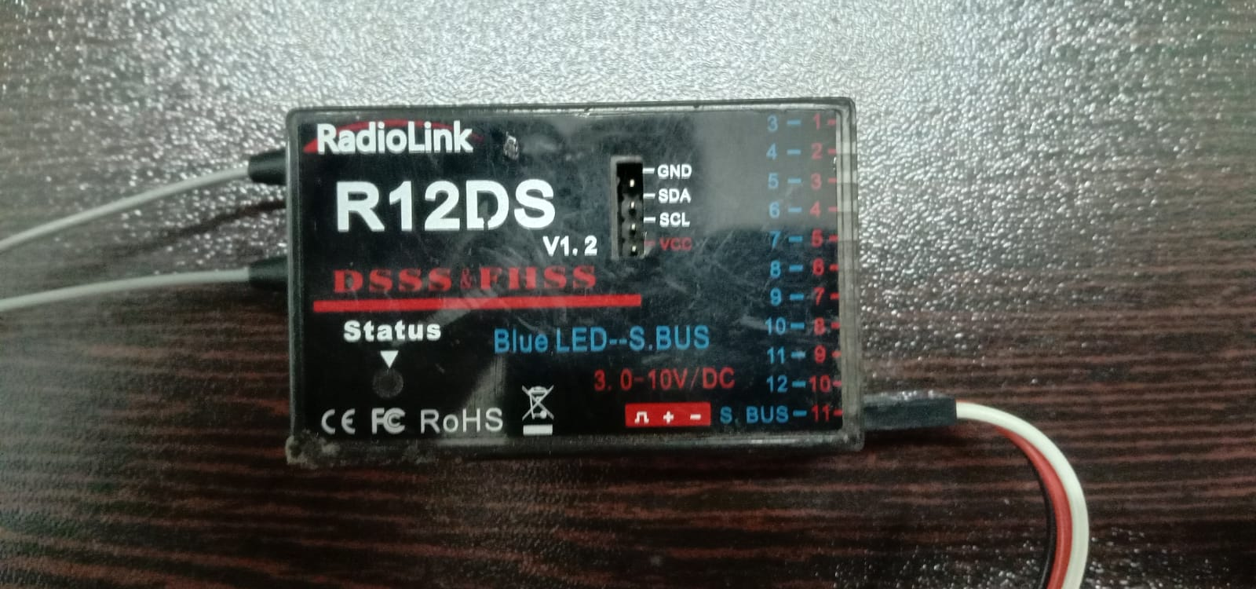
Radio Recevier
IPRC
In radio communications,a radio receiver,also known as a receiver ,a wireless,or simply a radio,is an electronic device that receives radio waves and converts the information carried by them to a usable form
The receiver uses electronic filters to separate the desired radio frequency signal from all the other signals picked up by the antenna, an electronic amplifier to increase the power of the signal for further processing
Fig. Radio Receiver

Slide 13
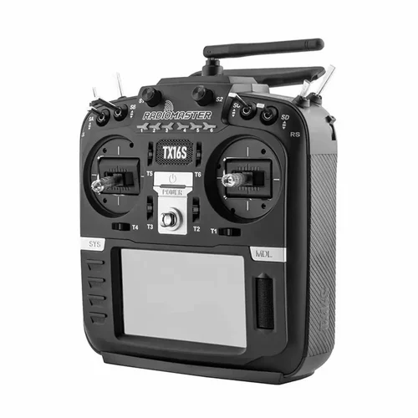
Radio Transmitter
IPRC
A transmitter is an electronic device used in telecommunications to produce radio waves in order to transmit or send data with the aid of an antenna
The transmitter is able to generate a radio frequency alternating current that is then applied to the antenna which,in turn,radiates this as radio waves
Fig. Radio Transmitter

Slide 14
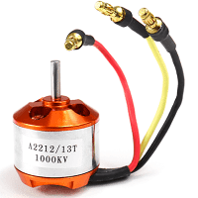
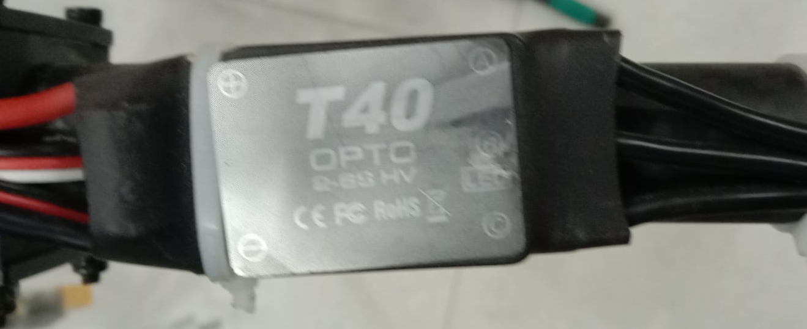
BLDC Motors & ESC
IPRC
A brushless DC motor (also known as a BLDC motor or BL motor) is an electronically commuted DC motor which does not have brushes.
The operation of a bldc is based on the simple force interaction between the permanent magnet and the electromagnet.
ESC is an electronic circuit used to change the speed of an electric motor
A signal from the flight controller causes the ESC to raise or lower the voltage to the motor as required, thus changing the speed of the propeller.
Fig. BLDC motor
Fig. ESC

Slide 15
Propellor & Battery
IPRC
Propellers are devices that transform rotary motion into linear thrust. Drone propellers provide lift for the aircraft by spinning and creating an airflow, which results in a pressure difference between the top and bottom surfaces of the propeller.
Drone propeller blades are constructed from plastic or carbon fiber. Plastic propellers are cheaper and more flexible, allowing them to absorb impact better.
Batteries used in drones are lithium polymer (LiPo) batteries. LiPo batteries are composed of a lithium-based cathode and anode separated by a polymer electrolyte.
because they offer the advantage of high energy density in relation to their size and weight, with a higher voltage per cell, so they can power the drone's on-board systems with fewer cells than other rechargeables.

Slide 16
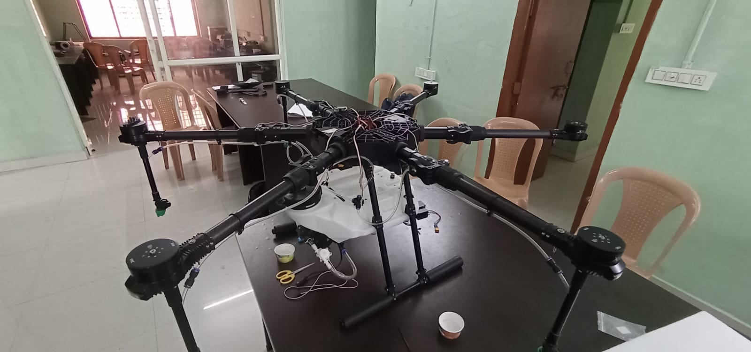
Drone Frame
IPRC
The drone frame has two main parts: the body and the arms.
A Hexacopter configuration is used for greater stability during flight and offers great maneuvrability.
However, the increase in motors also
causes increase in power consumption
and decrease in flight duration.
Drone Frames should be designed to be light weight and durable for longer flight times.
Fig. Hexacopter Frame

Slide 17
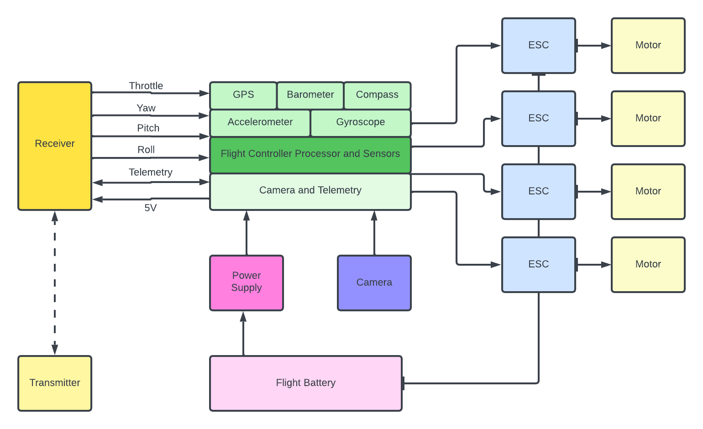
Block Diagram
IPRC

Slide 18
Working Principle
IPRC
The Drone achieves stable flight after all the mandatory pre flight checks.
The drone can move with the pilot inputs or autonomously using the GPS coordinates assigned and go through a fixed course.
During flight, the drone can use an FPV camera to transmit live video or a GoPro to record the video.
After the flight the video can then be used for Image Recognition activities.

Slide 19
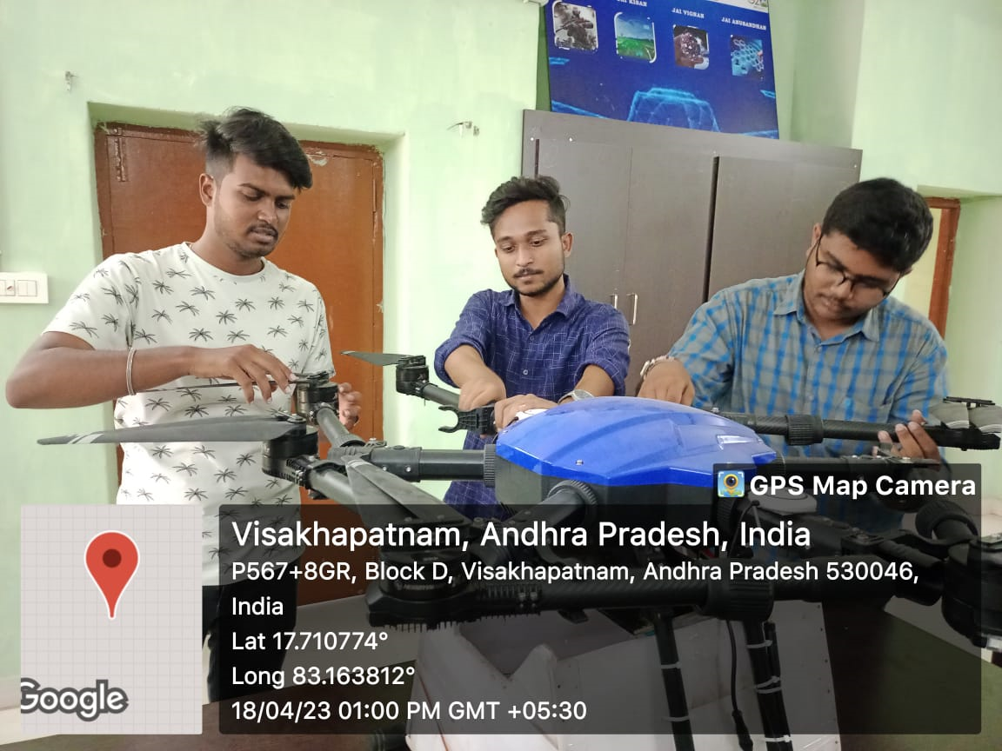
Geo Tag Photo
IPRC

Slide 20
Conclusion
IPRC
A Drone that can fly either manually or autonomously and record video of the flight is constructed.
The drone can be used for live video transmitting or

Slide 21
IPRC
THANK YOU

