Slide 1
ORDER SERVICE API
Developed by
Umaparvathi

Slide 2
Scope
This service is limited to receiving the order information from external source/user
This service is limited to update the order information in the database.
This service is limited to publish created order message to broker.
Purpose of Application
To receive order data, stores the same in Database and publish order message to broker.
Technical Components
This service is developed in Python which can run within the containers.
Python 3.9.11
Docker, Docker-compose
MySQL
RabbitMQ
Data Flow
The service receives order message from user or service, gather all required information regarding the order from two endpoints and saves the order information to database. The service then publishes create order message to the broker.

Slide 3
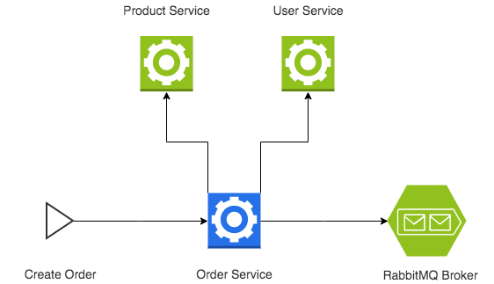

Technical Architecture

