Slide 1

FACE RECOGNITION BASED ATTENDANCE SYSTEM N.SUNIL ( 209E1A05F4 ) N.VAASAVII ( 209E1A05E7 ) N.PAVANI ( 209E1A05E8 ) P.THARUN TEJ ( 209E1A05G8 ) S.UMAPATHI ( 20381A0513 ) BATCH No : 06 UNDER THE ESTEEMED GUIDANCE OF Mr. J. Sankar Babu, M.Tech, Assistant Professor DEPARTMENT OF COMPUTER SCIENCE AND ENGINEERING SRI VENKATESWARA ENGINEERING COLLEGE Karakambadi Road, Opp. LIC Training Center, Tirupati-517507

Slide 2
FACE RECOGNITION BASED ATTENDANCE SYSTEM

Slide 3
CONTENTS
ABSTRACT
INTRODUCTION
ANALYSIS
SOFTWARE REQUIREMENTS SPECIFICATION
DESIGN WITH UML DIAGRAMS
IMPLEMENTATION
TESTING
CONCLUSION
FUTURE ENHANCEMENT
REFERENCES

Slide 4
ABSTRACT
A face recognition-based attendance system automates attendance tracking by identifying individuals through facial features ,eliminating the need for manual recording. It employs computer vision algorithms to detect and match faces against a database, providing accurate and efficient attendance management. This system enhances security, reduces administrative burden, and offers real-time monitoring of attendance data, fostering a streamlined and reliable approach to attendance tracking in various settings.

Slide 5
INTRODUCTION
Traditional attendance tracking methods often rely on manual processes such as paper-based sign-in sheets or card-swiping systems, which are prone to errors and time-consuming.
Face recognition technology offers a modern solution by utilizing computer vision algorithms to automatically recognize and authenticate individuals based on their facial features
This system works by capturing an image of the person's face, extracting unique facial features, and comparing them against a database of known faces to determine identity.
By eliminating the need for physical cards or manual entries, face recognition-based attendance systems streamline the attendance process, saving time for both employees and administrators.
Moreover, these systems enhance security by reducing the likelihood of buddy punching or fraudulent attendance, while also providing real-time tracking and analytics for better attendance management.

Slide 6
EXISTING SYSTEM:
Manual attendance systems typically involve the use of paper-based sign-in sheets or time cards where individuals physically record their presence by writing their name, time in, and time out.
These systems require manual data entry and verification by administrators, making them prone to errors, inaccuracies, and time-consuming administrative tasks such as data sorting and processing.
DRAWBACKS:
Prone to human error
Time-consuming
Lack of real-time tracking
Susceptible to buddy punching
Difficulty in data management and analysis

Slide 7
PROPOSED SYSTEM:
Implement a robust face recognition algorithm for accurate identification.
Integrate the system with a user-friendly interface for seamless attendance management.
ADVANTAGES:
High accuracy can be achieved
Less time consumption

Slide 8
SOFTWARE REQUIREMENTS SPECIFICATION
Hardware System Configuration:
Processor - I3 (min)
RAM - 4GB (min)
Hard Disk - 160GB
Software System Configuration:
Operating System : Windows (any version)
Software : python 3.12

Slide 9
ARCHITECTURE
Start
Capture Image of Face
Extract Facial Features
Compare Features with Database
Is there a Match?
Mark Attendance
Reject Access/Attendance
Stop
Fig : Architecture of Face Recognition Based Attendance System.

Slide 10
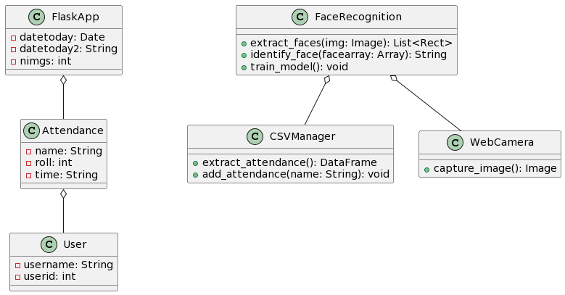
Class Diagram
Class diagram is a type of static structure diagram that represents the fundamental architecture of the system.
Fig : Class Diagram

Slide 11
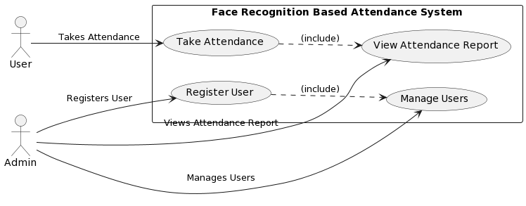
Usecase Diagram
Use cases are a set of actions, services and functions that the system needs to perform.
Fig : Usecase Diagram

Slide 12
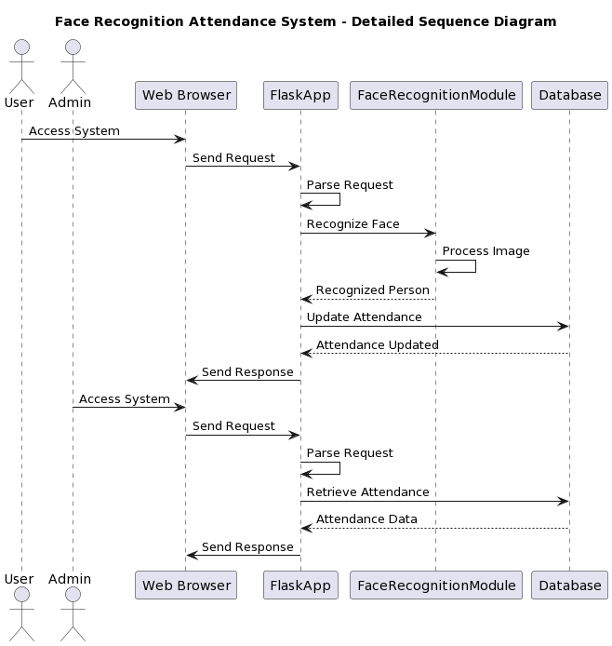
Sequence Diagram
Sequence diagrams describe interactions among classes in terms of exchange of messages over time.
Fig : Sequence Diagram
12

Slide 13
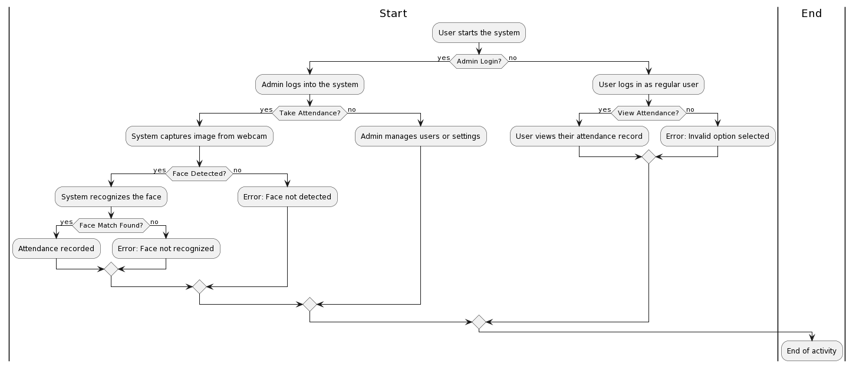
Activity Diagram
Activity diagram is basically a flow chart to represent the flow from one activity to another activity.
Fig : Activity Diagram
13

Slide 14
IMPLEMENTATION
14

Slide 15
The project implementation contains the following steps:
Step 1: Set Up Development Environment
1. Install Python and required libraries: Python, Flask, OpenCV, scikit-learn, Pandas.
2. Set up a development environment using your preferred text editor or IDE.
Step 2: Design Database Schema
1. Design a database schema to store user information and attendance records.
2. Choose a database system (e.g., SQLite, MySQL) and create the necessary tables.
Step 3: Collect Training Data
1. Collect a dataset of facial images for training the face recognition model.
2. Ensure diversity in the dataset to account for variations in lighting, pose, and facial expressions.

Slide 16
Step 4: Train Face Recognition Model
1. Preprocess the training data (e.g., face detection, normalization).
2. Train a face recognition model using machine learning algorithms like K-nearest neighbors or deep learning frameworks like TensorFlow or PyTorch.
3. Evaluate the model's performance using validation data and fine-tune as necessary.
Step 5: Develop Flask Web Application
1. Create Flask routes for various functionalities (e.g., user registration, attendance tracking).
2. Implement user interfaces using HTML templates.
3. Handle form submissions and user interactions using Flask request objects.
4. Integrate face recognition functionality into the Flask application.

Slide 17
Step 6: Implement User Registration and Management
1. Create routes for user registration, login, and profile management.
2. Implement functionality to capture user images for registration and update user information in the database.
Step 7: Implement Attendance Tracking
1. Design routes and functionality for capturing attendance data.
2. Integrate face recognition functionality to identify users during attendance capture.
3. Update attendance records in the database with timestamps and user information.

Slide 18
Step 8: Deployment
1. Deploy the Flask application to a web server (e.g., Heroku, AWS, DigitalOcean).
2. Configure the server environment and database settings for production use.
3. Monitor system performance and handle any issues that arise.
Haar Cascade algorithm:
This involves Four Stages that include:
Haar Features Calculation
Integral Images Creation
Adaboost Usage
Cascading Classifiers Implementation

Slide 19
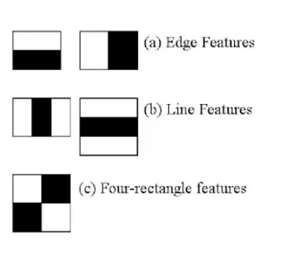
Haar Features Calculation:
Gathering the Haar features is the first stage. Haar features are nothing but a calculation that happens on adjacent regions at a certain location in a separate detecting window. The calculation mainly includes adding the pixel intensities in every region and between the sum differences calculation.

Slide 20
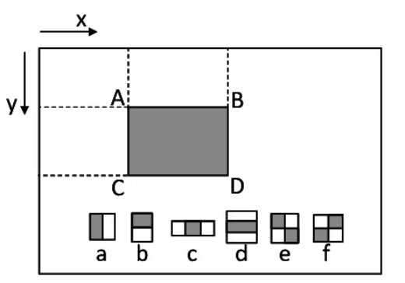
2. Integral Image Creation: Creating Integral Images reduces the calculation. Instead of calculating at every pixel, it creates the sub-rectangles, and the array references those sub-rectangles and calculates the Haar Features.

Slide 21
3. Adaboost Training:
The "weak classifiers" are combined by Adaboost Training to produce a "strong classifier" that the object detection method can use. This essentially consists of selecting useful features and teaching classifiers how to use them.
By moving a window across the input image and computing the Haar characteristics for each part of the image, weak learners are created. This distinction stands in contrast to a threshold that can be trained to tell objects apart from non-objects. These are "weak classifiers," but an accurate strong classifier needs many Haar properties In the final step, weak learners might be combined with strong learners.

Slide 22
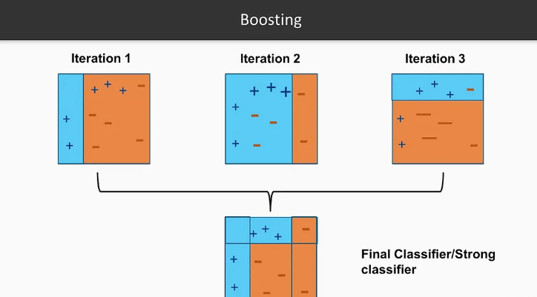

Slide 23
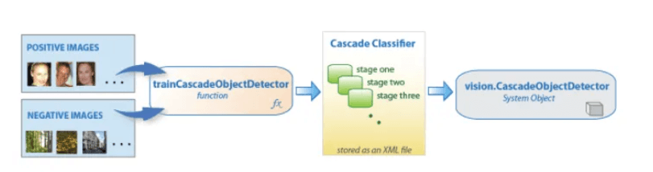
4. Cascading Classifiers Implementation:
Every sage at this point is actually a group of inexperienced students. Boosting trains weak learners, resulting in a highly accurate classifier from the average prediction of all weak learners. It depends based upon the prediction. The classifier decides for indication of an object that was found positive or moved to the next region, i.e., negative. Because most windows do not contain anything of interest, stages are created to reject negative samples as quickly as feasible. Because classifying an object as a non-object would significantly hurt your object detection system, having a low false negative rate is crucial.

Slide 24
TESTING
Test case id | Test Scenario | Test Steps | Prerequisites | Test Data | Expected Result | Actual Result | Test Status
#FDA001 | To add an user to the data using User name, Userid, images | Enter User name and User id and click add new user | User data | Username,User id | When the user submits the user data, data should be store in database successfully | As Expected | Pass
#FDA002 | To Take attendance on the system using webcam by clicking on take attendance | Click on take attendance | User Data | Face recognition | To recognize the face and store it into database | As Expected | Pass

Slide 25
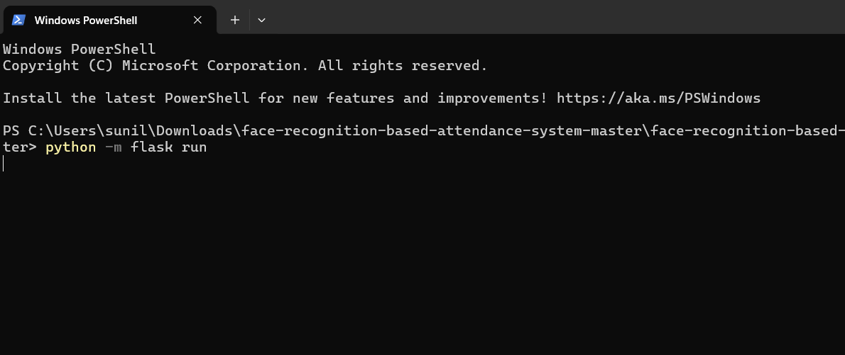
The following slides show the working of the algorithm:
The below slide represents the command to run the flask file in command line interface.

Slide 26
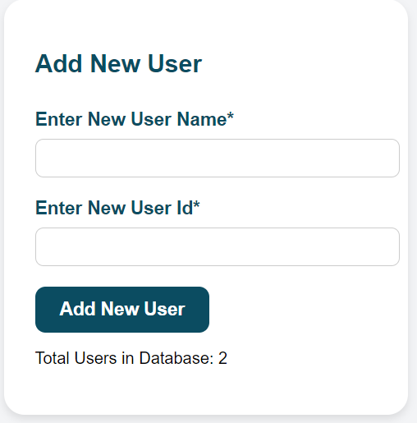
The below slide represents the entry of an user into database.

Slide 27
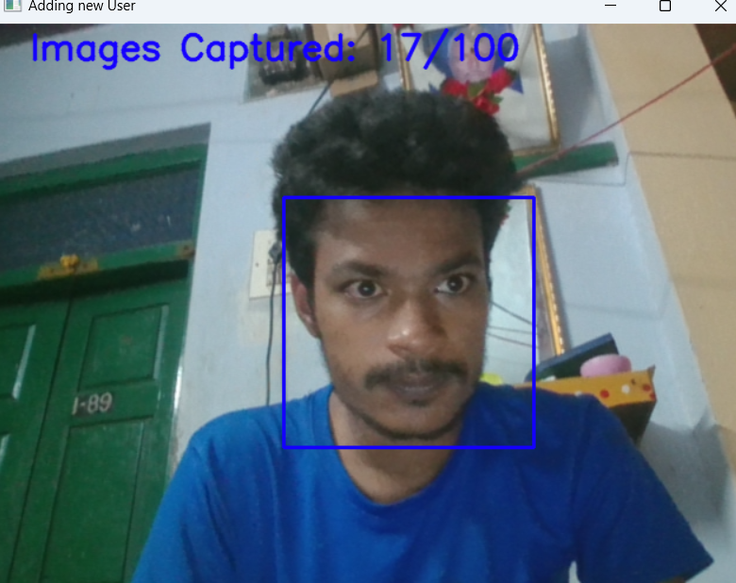
The below slide represents the entry of an user images into database.

Slide 28
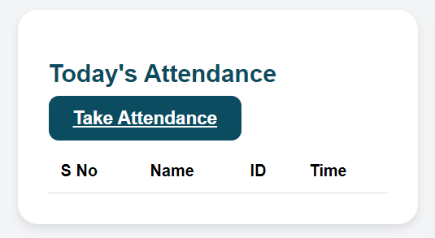
The below slide represents the way to take the attendance and track it.

Slide 29
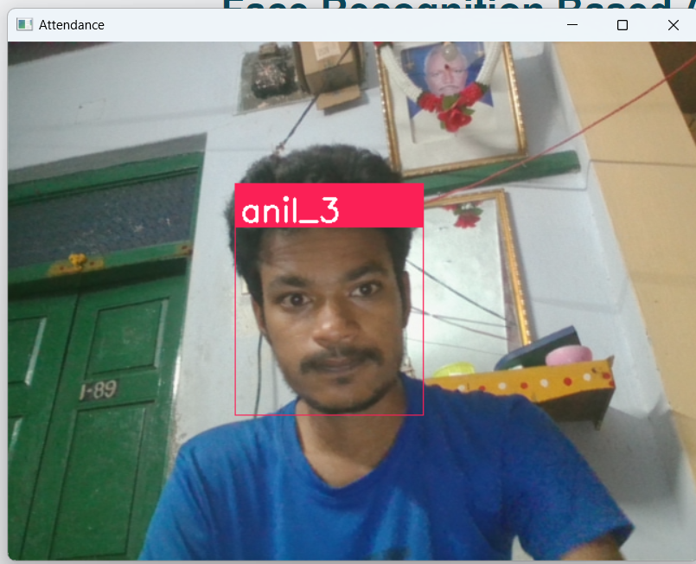
The below slide represents the tracking of attendance through webcam.

Slide 30
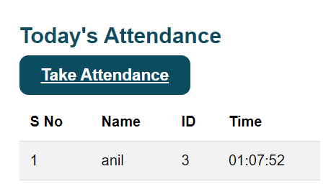

The below slide represents how the attendance is being stored into databases.

Slide 31
CONCLUSION
Face recognition-based attendance systems offer a modern and efficient solution to traditional manual methods, significantly reducing errors and administrative burden. By leveraging advanced computer vision algorithms, these systems provide accurate and real-time attendance tracking while enhancing security measures. Their ability to streamline processes and automate tasks not only saves time but also improves overall productivity and data management. As technology continues to advance, integrating face recognition into attendance systems represents a forward-thinking approach that aligns with the demands of modern workplaces

Slide 32
FUTURE ENHANCEMENT
face recognition-based attendance systems could involve integrating machine learning algorithms to improve accuracy and adaptability over time. Additionally, incorporating multi-modal biometric authentication methods such as iris recognition or voice recognition could enhance security and reliability. Cloud-based storage and processing can enable scalability and remote access, facilitating seamless implementation across various environments. Furthermore, incorporating privacy-preserving techniques such as differential privacy or federated learning can address concerns regarding data privacy and security, ensuring compliance with evolving regulations.

Slide 33
REFERENCES
Here are the book references without descriptions:
1. "Flask Web Development: Developing Web Applications with Python" by Miguel Grinberg
2. "Programming Computer Vision with Python: Tools and algorithms for analyzing images" by Jan Erik Solem
3. "Hands-On Machine Learning with Scikit-Learn, Keras, and TensorFlow: Concepts, Tools, and Techniques to Build Intelligent Systems" by Aurélien Géron
5. "OpenCV 4 with Python Blueprints: Build creative computer vision projects with the power of OpenCV and Python" by Gabriel Garrido Calvo, Prateek Joshi
6. "Biometrics: Advanced Identity Verification: The Complete Guide" by John D. Woodward Jr., Nicholas M. Orlans, Peter T. Higgins

Slide 34
THANK YOU

