Slide 1



Serverless Computing
Senthil Kumar Palanisamy

Slide 2
Evolution of Serverless Computing

Slide 3

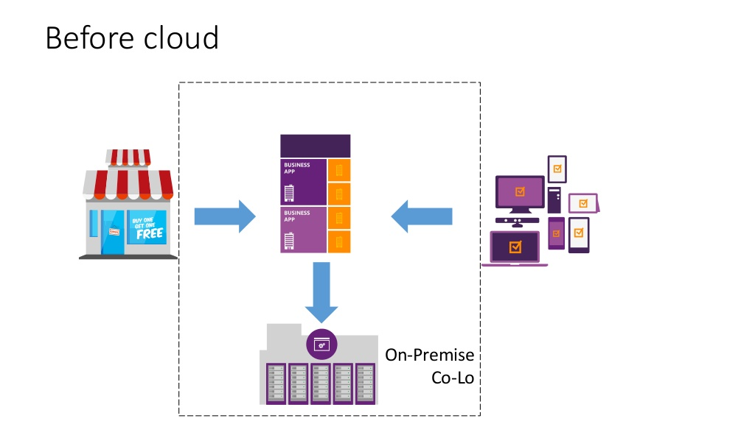

Slide 4
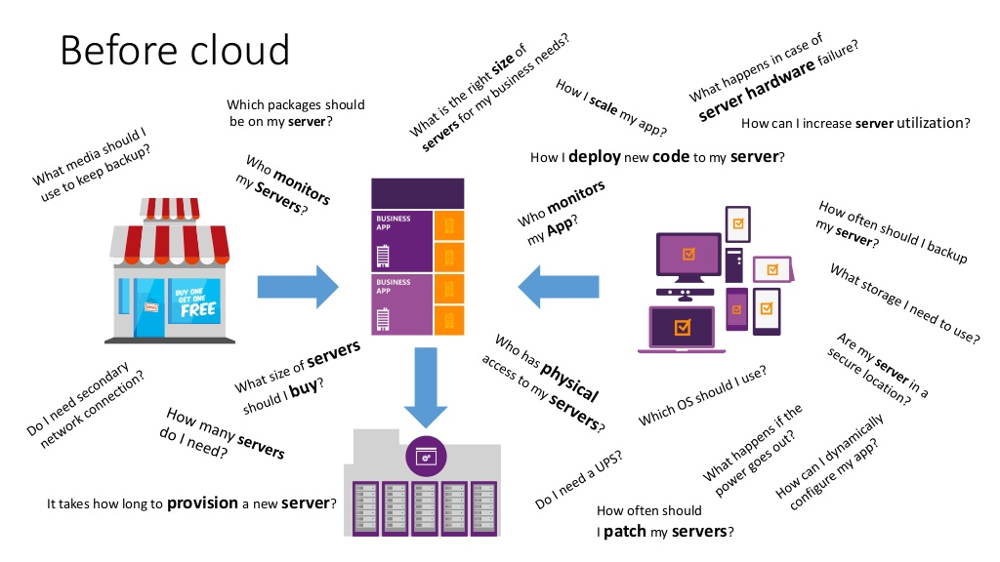

Slide 5
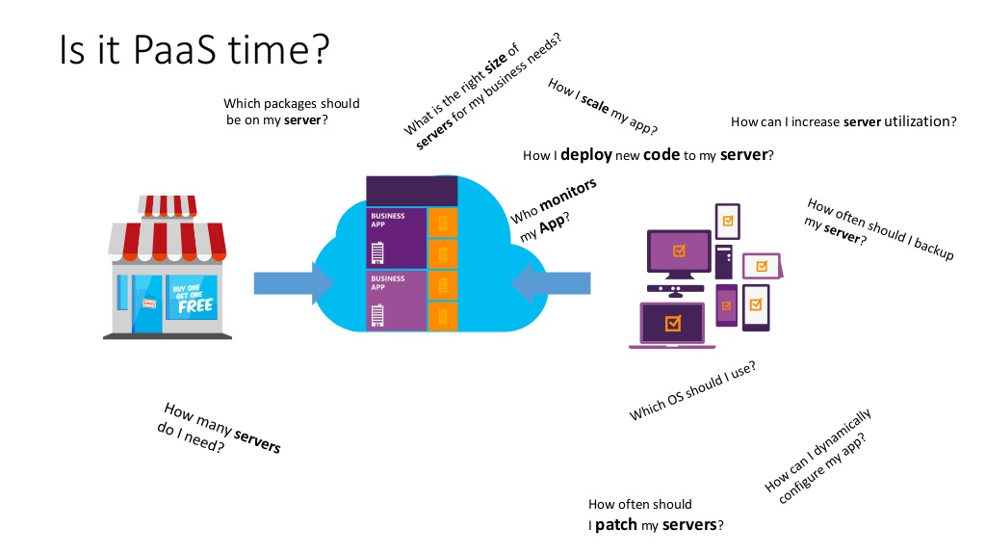

Slide 6
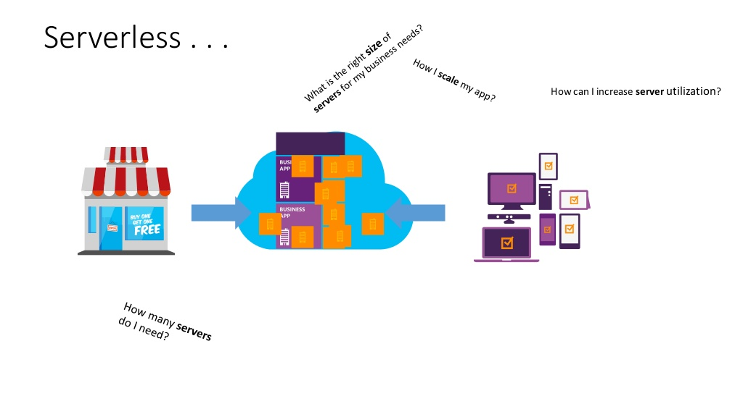

Slide 7
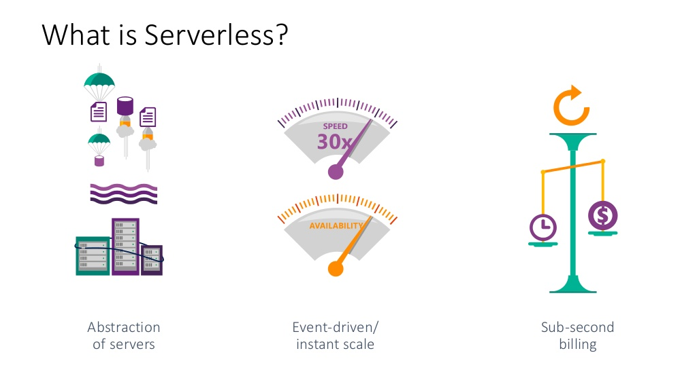

Slide 8
Serverless Computing (FaaS)
Function as a Service (Azure Functions)
Platform to develop, run, and manage application
Without the complexity of building and maintaining the infrastructure
Similar Technologies
AWS Lambda
Google Cloud Functions
Open Whisk (IBM)

Slide 9
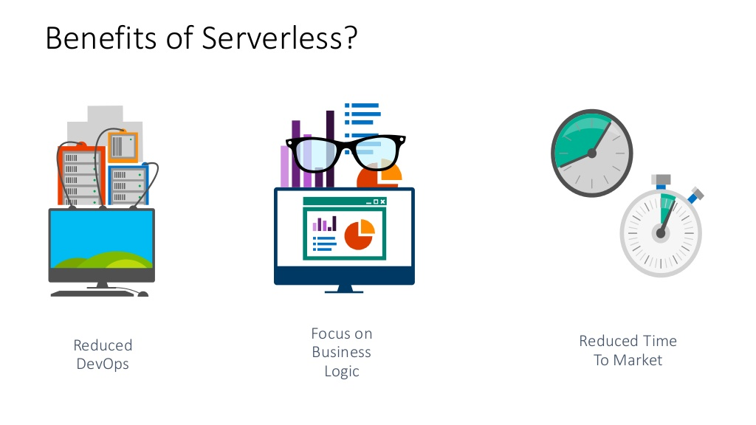

Slide 10
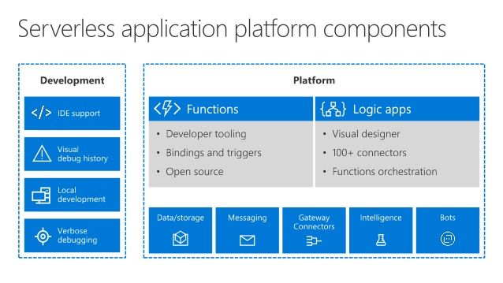

Slide 11
Serverless Apps Lifecycle
Design
Develop
Deploy
Monitor

Slide 12
Azure Serverless Apps Design
Distributed Architecture
Design stateless and ASync solutions to enable scaling.
Connect with other Azure Services via triggers and bindings.
Use Logic Apps to orchestrate workflows
Use managed connectors to abstract calls to cloud and on-premises services.
Cloud DevOps
Design for automation. Use ARM templates.
Design DevOps for the cloud: safe deployment with test/development and production environment separation and test on the target platform.
Monitor the running apps with App Insights and tune for best experience.

Slide 13
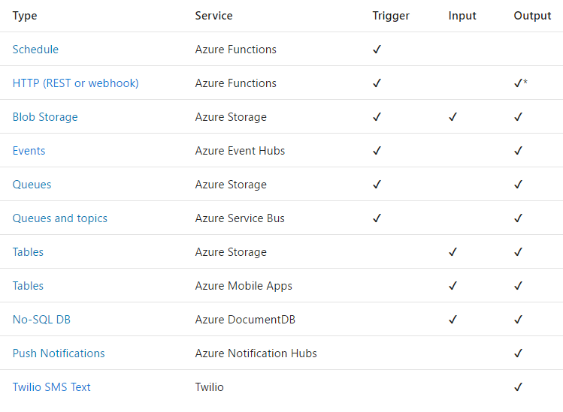
Triggers and Bindings
Triggers
and
Bindings

Slide 14
Use Bindings in Your Code
function.json
public static class OrderHandler
{
[FunctionName("OrderWebhook")]
public static async Task<HttpResponseMessage> Run(
[HttpTrigger] HttpRequestMessage req,
[Queue("aievents1", Connection = "AiStorageConnection")] IAsyncCollector<String> eventOutput,
TraceWriter log)
{
log.Info($"Webhook was triggered!");
string jsonContent = await req.Content.ReadAsStringAsync();
dynamic data = JsonConvert.DeserializeObject(jsonContent);
await eventOutput.AddAsync(
JsonConvert.SerializeObject(GetLogData(data)));
int orderId = PlaceOrder(data);
return req.CreateResponse(HttpStatusCode.OK,
new {orderNumber = orderId });
}
. . .
}
"bindings": [
{
"type": "httpTrigger",
"direction": "in",
"webHookType": "genericJson",
"name": "req"
},
{
"type": "http",
"direction": "out",
"name": "res"
},
{
"type": "queue",
"name": "eventOutput",
"queueName": "aievents1",
"connection":"AiStorageConnection",
"direction": "out"
}
]

Slide 15
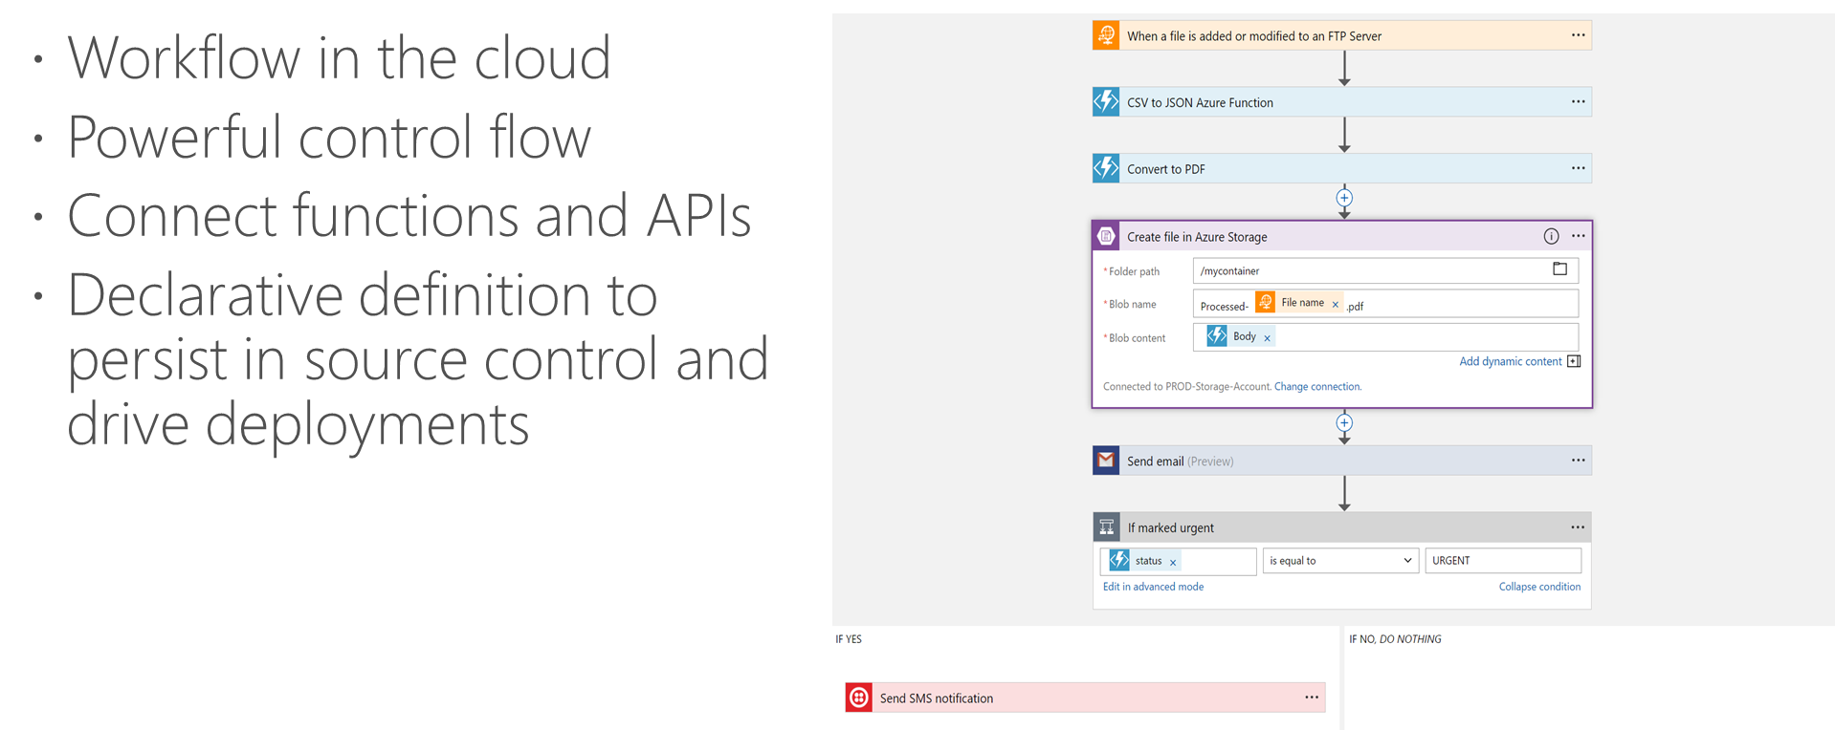
Logic Apps Workflow Designer

Slide 16
Logic Apps
SaaS
appFigures
Asana
Azure API Management
Azure App Services
Azure Automation
Azure Cognitive Face API
Azure Cognitive LUIS
Azure Cognitive Text Analytics
Azure Cognitive Vision
Azure Data Lake Store
Azure Document DB
Azure Event Hub
Azure Functions
Azure Machine Learning
Azure Resource Manager
Azure Service Bus
Azure SQL
Azure Storage Blob
Azure Storage Queues
Basecamp
Bing Search
BitBucket
Bitly
Blogger
Box
Buffer
Campfire
Chatter
Common Data Service
Disqus
DocuSign
Dropbox
Dynamics AX Online
Dynamics CRM Online
Dynamics CRM Service Bus
Dynamics Financials
Dynamics Operations
Easy Redmine
Eventbrite
Facebook
FreshBooks
Freshdesk
GitHub
Gmail
Google Calendar
Google Contacts
Google Drive
Google Sheets
Google Tasks
GoTo Meeting
GoTo Training
GoTo Webinar
Harvest
HelloSign
Infusionsoft
JIRA
Insightly
Instagram
Instapaper
MailChimp
Mandrill
Medium
Microsoft Project Online
Microsoft Translator
MSN Weather
Muhimbi PDF
Office 365
Office 365 Users
Office 365 Video
OneDrive
OneDrive for Business
OneNote
Outlook.com
Outlook Tasks
PagerDuty
Pinterest
Pipedrive
Pivotal Tracker
Power BI
Project Online
Redmine
Salesforce
Salesforce Chatter
SendGrid
SharePoint Online
Slack
SmartSheet
SparkPost
Stripe
Survey Monkey
Todoist
Toodledo
Trello
Twilio
Twitter
Typeform
UserVoice
VS Team Services
Webmerge
Wordpress
Wunderlist
Yammer
YouTube
Zendesk
Protocols/Native
HTTP, HTTPS
HTTP Webhook
FTP, SFTP
SMTP
RSS
Compose, Query, Parse JSON
Wait
Terminate
Workflow
Cloud APIs and platform
Supports over 125 built-in connectors
Scales to meet your needs
Enables rapid development
Extends with custom APIs and Functions
API connections
Authenticate once and reuse
XML and EDI
XML Validation
Transform XML (+Mapper)
Flat File Encode
Flat File Decode
X12
EDIFACT
AS2
Integration Account Artifact Lookup
Hybrid
BizTalk Server
File System
IBM DB2
Informix
Oracle DB
SharePoint Server
SQL Server
SAP
Websphere MQ

Slide 17
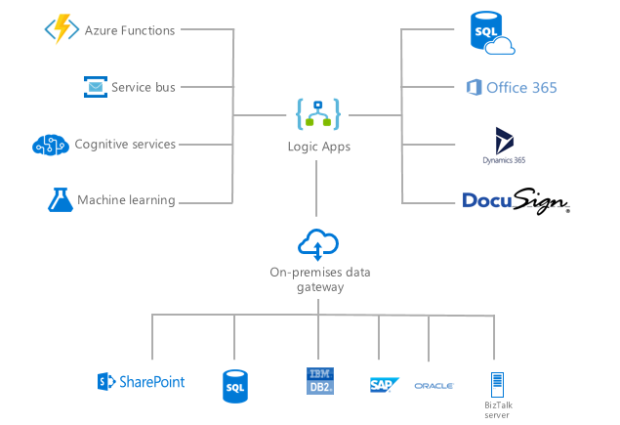
Logic Apps Connect Everything

Slide 18
Develop
Design
Develop
Deploy
Monitor

Slide 19
Local Development Tooling Options
Azure Functions Core Tools
Provides the entire Functions runtime
Trigger off of Azure events and debug locally
JavaScript
Use Visual Studio Code or any Node debugger
C#
Use Visual Studio 2015 or 2017
Use class libraries with attributes in Visual Studio 2017

Slide 20
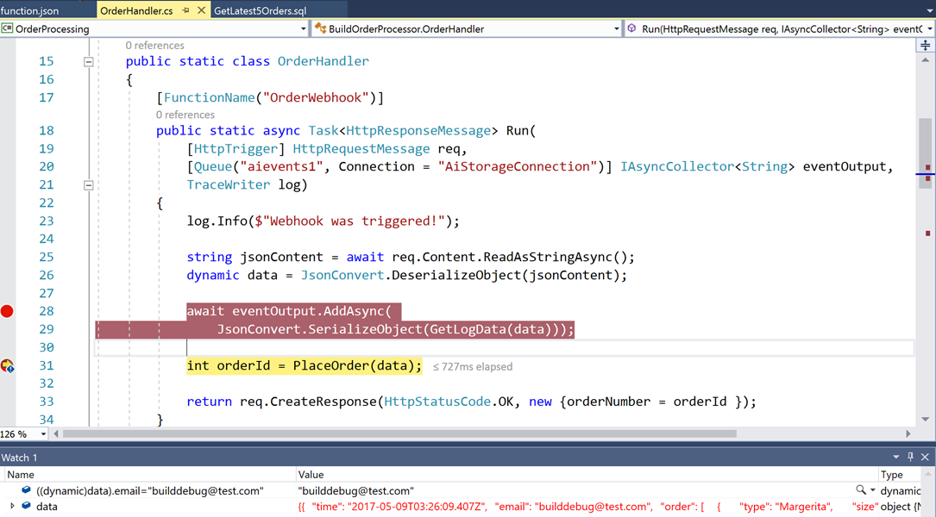
C# and Visual Studio
Based on class libraries
Get the full power of IntelliSense, unit testing, and local debugging
Use Web Jobs attributes to define triggers and bindings
Learn more at https://aka.ms/vs2017functiontools

Slide 21
Deploy
Design
Develop
Deploy
Monitor

Slide 22
Deployment Options
Resource deployment
Azure Resource Manager (i.e. ARM)
Content deployment
Visual Studio
Azure CLI (Logic App)
Azure Functions Core Tools (Function App)
CI/CD
https://www.visualstudio.com/en-us/docs/build/get-started/aspnet-4-ci-cd-azure-automatic
Safe deployment practices
Use Azure Functions deployment slots for environment separation and swap deployments

Slide 23
Monitor
Design
Develop
Deploy
Monitor

Slide 24
Key Scenarios for Monitoring
Alert
Monitor
Learn
Optimize

Slide 25
Extensible Application Performance Management (APM)
Rich data: Metrics, Traces, Exception tracking, Dependencies, Page Views, User data, custom events
Easy to use graph/alerts, powerful analytics portal, integration with PowerBI and other analytics services

Slide 26
Azure Functions Runtime
Developer experience
Same consistent Programming Model
Same Azure Functions portal
Publish directly from Visual Studio tooling
Leverage triggers: timer trigger and new SQL Service Broker trigger
Administrator features
Take advantage of Azure Functions on premises
Workers can run in spare compute – i.e. desktops left on overnight within orgs
Only provision two types of roles
Management Role – Hosts Portal, Publishing Endpoint and
Worker Role – Runs Function in Windows Server Containers

Slide 27
Summary
Azure offers a comprehensive Serverless Application Platform
Azure Functions bindings and local DevEx optimize time to market
Azure Logic Apps provide orchestration and integration with 125+ connectors
Try Azure Functions : http://aka.ms/TryFunctions
Join the Azure Functions Community https://aka.ms/func-github

Slide 28
Questions ?

