Slide 1

LLM-Driven Visa Application Processing in Embassy-Absent Regions aided by VFS Global
Umar Farooq Khan - x22179780 Intelligent Agents and Process Automation - NCI

Slide 2

Introduction
Migrating between countries can bring positive changes to one's life.
Challenging yet rewarding.
Third-party facilitators like VFS Global assist in visa processing
VFS Global streamlines the visa application process.

Slide 3
Agenda
Intro
Old and New proposed System
Analysis
Coding Implementations (For the main cumbersome task)
Statistics (Cost, Productivity, Implementation cost, Error rates)

Slide 4
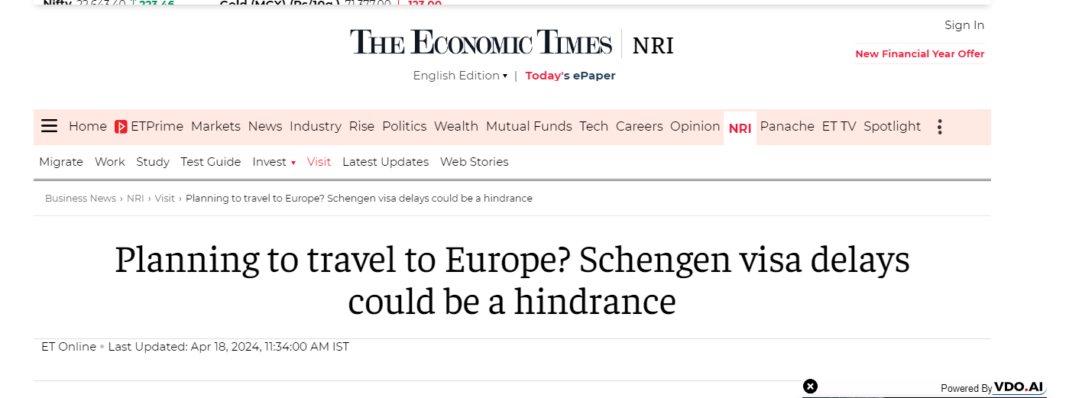
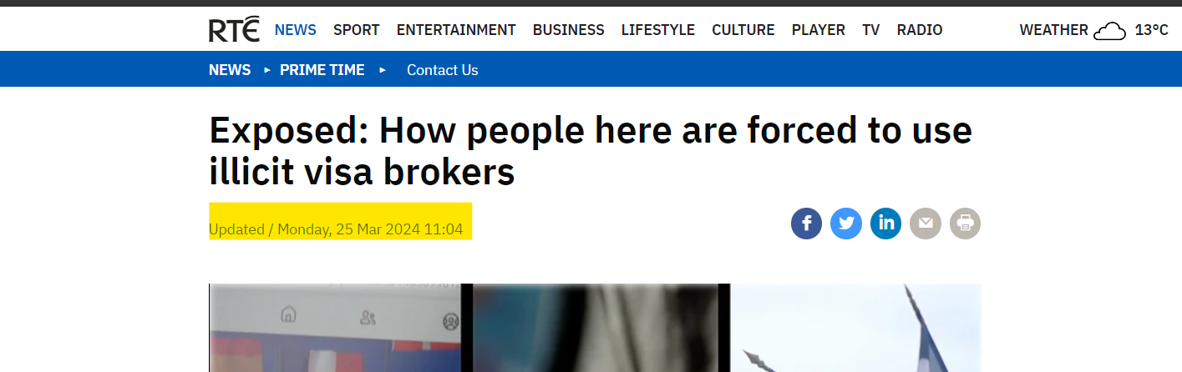
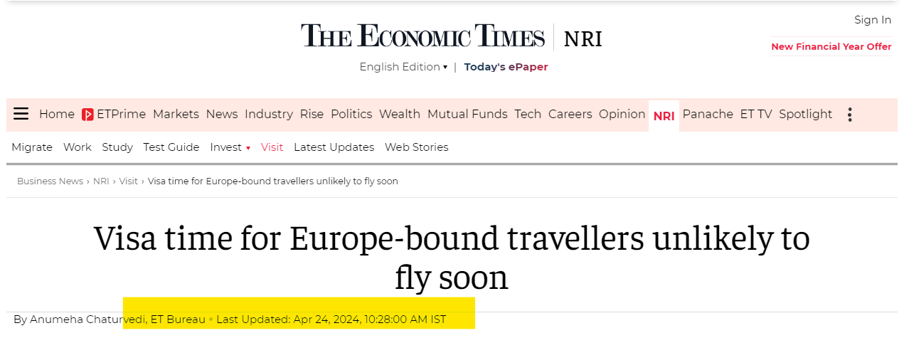

Slide 5
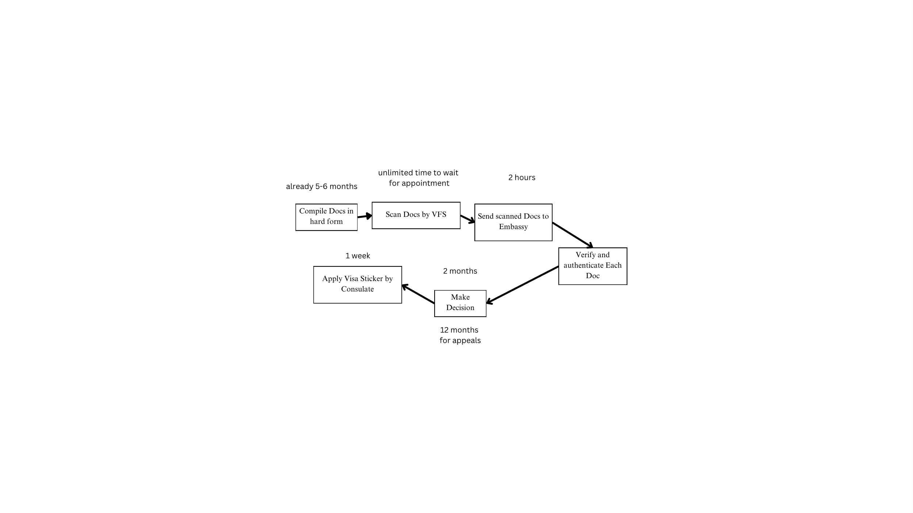
Current Visa Application System
Total 1 year Process of Student Visa and Spouse Visa along with Appeals

Slide 6

Current processes has turnaround time of 60-80 days.
Appeals have 1+ year
VFS Global takes approximately 80-90 minutes/appointment.
Alone scanning takes 30-40minutes.
Personally experienced 90-120 minutes of appointment, cause scanning was not done properly. Technical Error.
Each Visa Officer (VO) handles 19 manual cumbersome tasks, (each task takes 1 week)

Slide 7
6 applications per day are processed currently by VFS
0.5 decisions per month by embassy
Visa Fee 60-100€
Assumptions:
1) Salary paid(ideally) = €100*80days*8 hour =€64,000
2) 10k app/mo if you implement our VFS automated system by VFS
Losing €67millon/mo/10k applications, loss reaches to €1billion only 15 appeals%

Slide 8
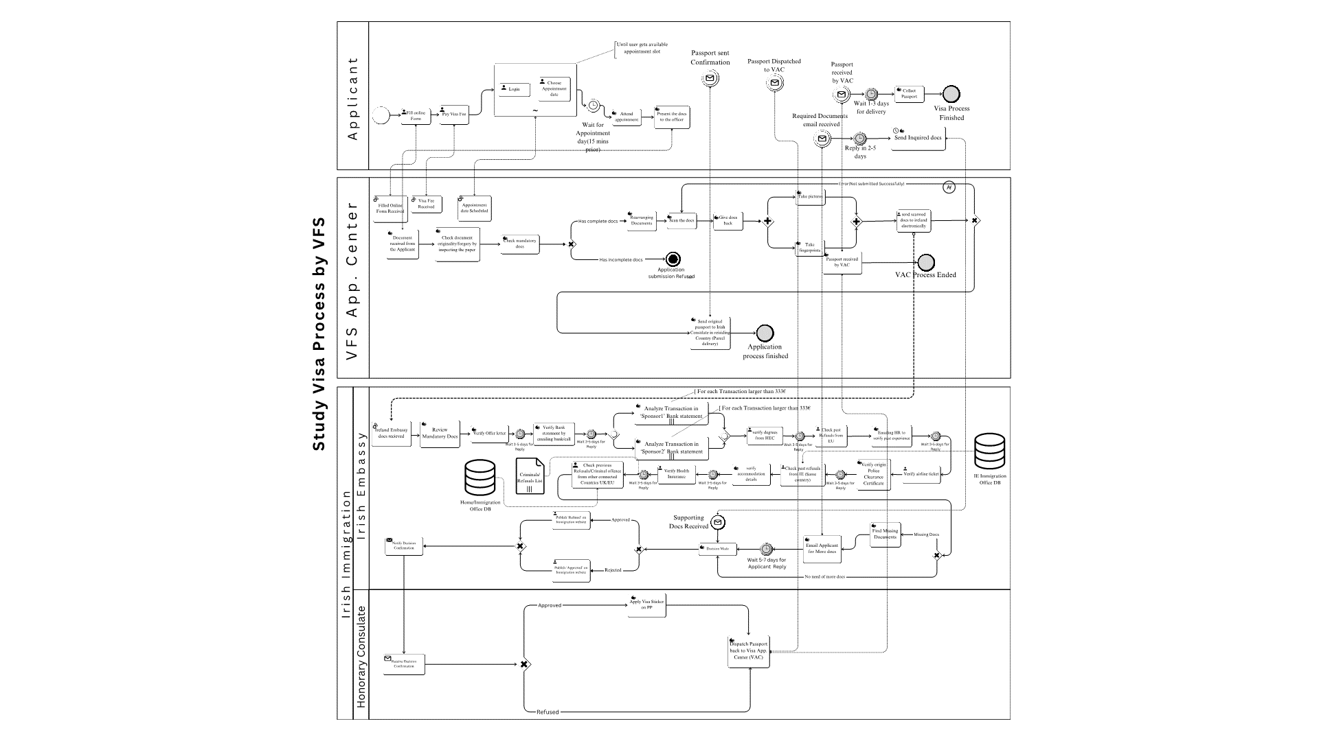

Slide 9
Goal is to automate both systems and Embassy Traditional System
VFS improvement = A new useful Feature
Embassy Improvement = Use of Large Language Model to find inconsistencies in docs, finding sentiments after automating tasks.
AI based live calling
Automated Emailing

Slide 10
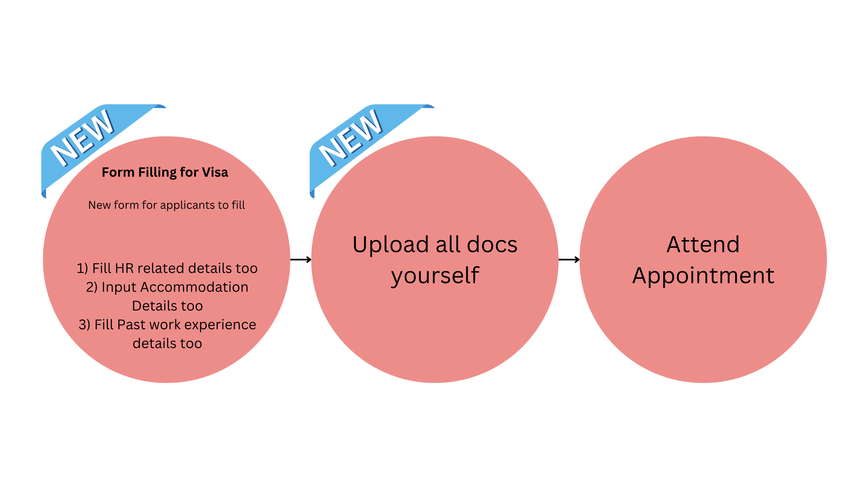
New Proposed System For VFS

Slide 11
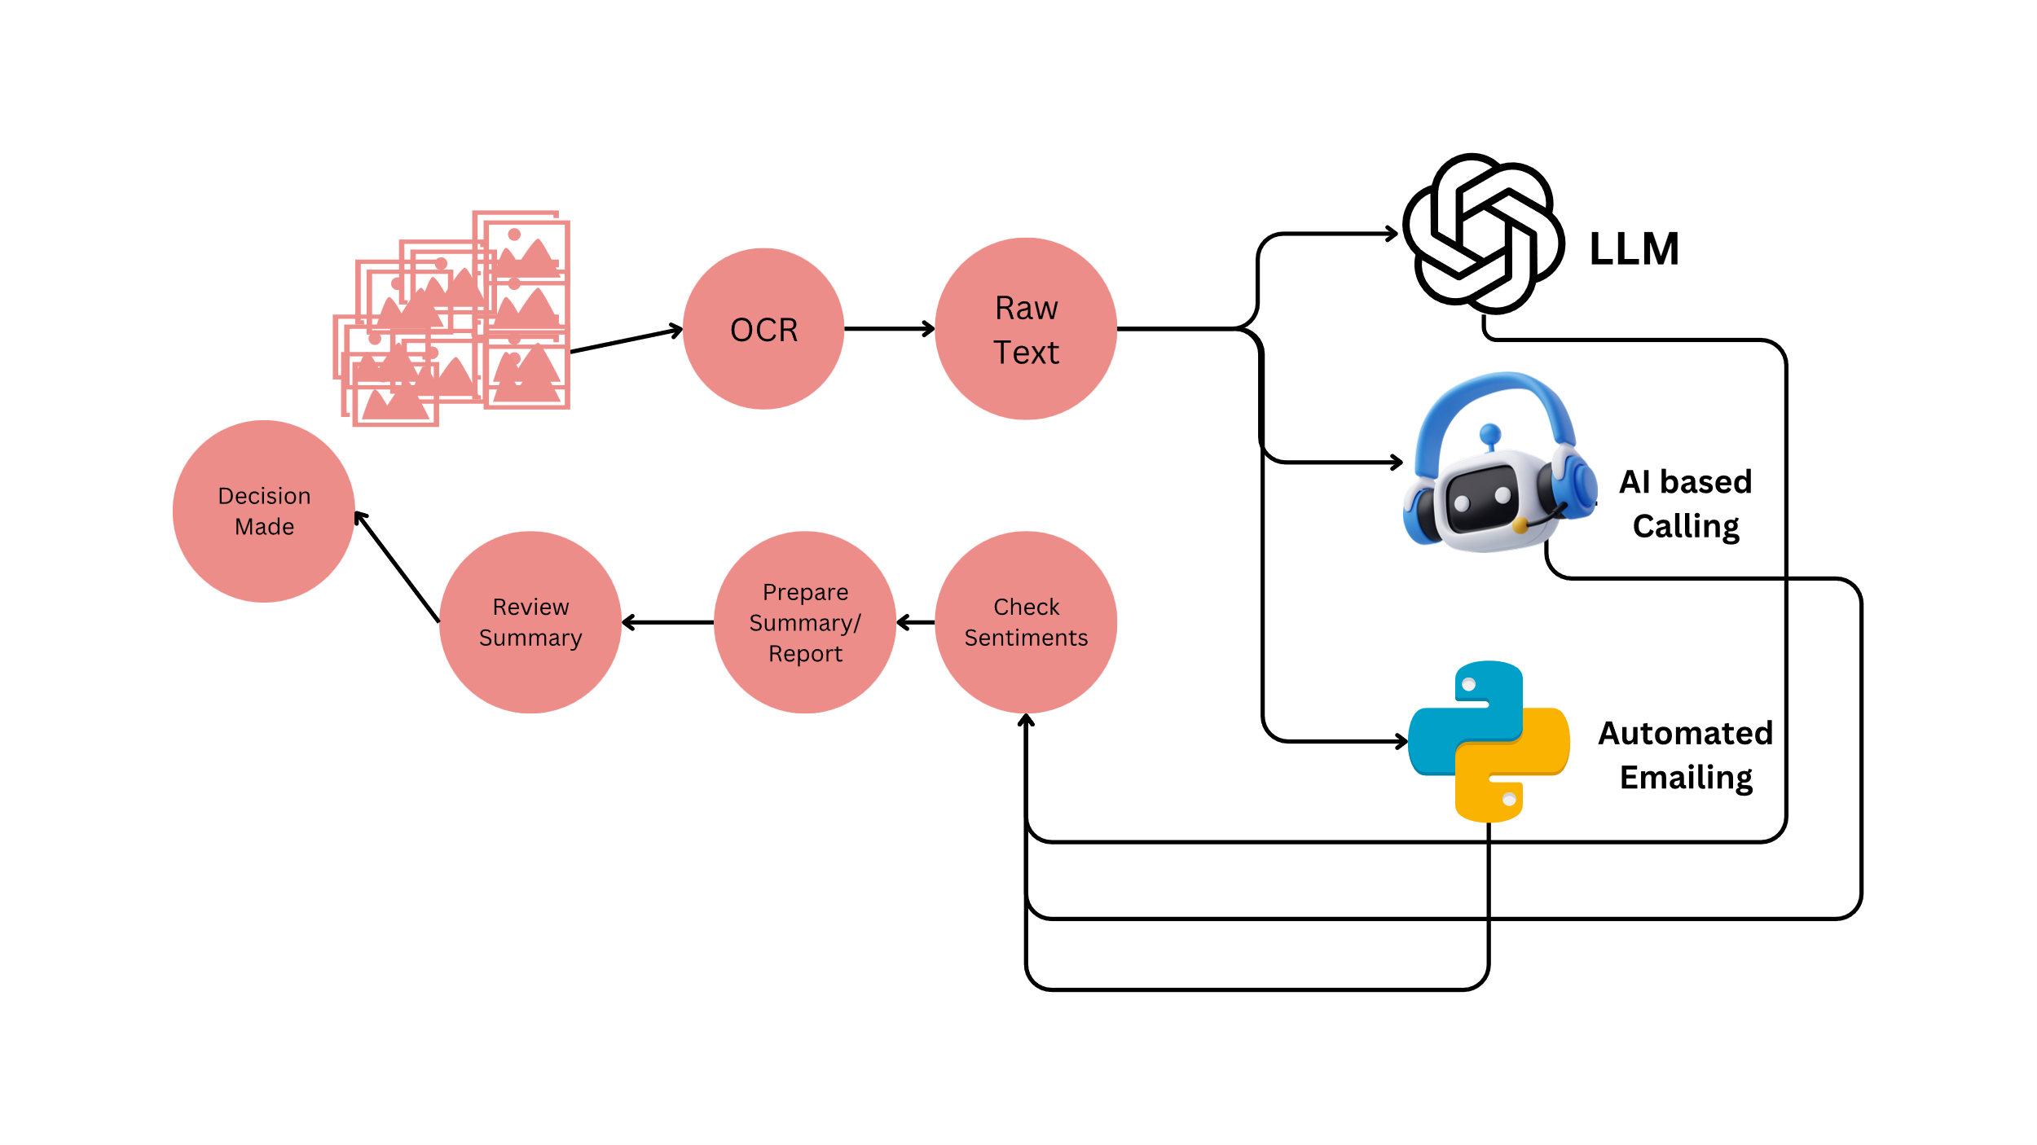
Proposed System for Embassy Decision Making Process

Slide 12
Generated Summary in structured Form
Document | Verification Method | Verification Result
Sponsor Bank Statement Minimum Requirement | LLM | Positive
Sponsor Bank Statement Cross checked with proofs attached | LLM | Negative
Applicant Bank Statement Cross checked with proofs attached | LLM | Positive
Work Experience | Emailing | Negative
Offer Letter | AI call | Positive
Provided Proof of Funds | LLM | Positive
Provided Source of Funds | LLM | Positive
Accommodation Details | AI call | Positive
Degrees | API | Positive

Slide 13

Generated Summary in Natural Language
Document Forgery
Certainly, here are the documents that did not yield a positive response during verification:
Sponsor Bank Statement Cross checked with proofs attached.
Work Experience: As the Job duration is not what the applicant claimed. (He said Feb to August but instead it was confirmed that he worked July to August)
That's the only document listed in the provided information that did not receive a positive response during verification.

Slide 14

Coding Implementation

Slide 15
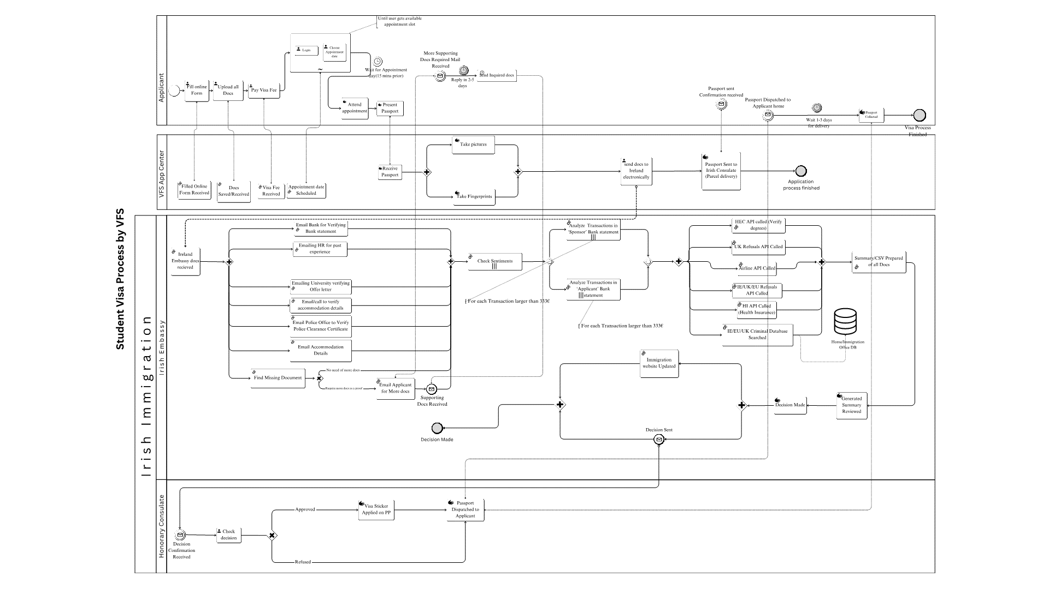

Slide 16
Improvement by # of tasks
Pools | Task Type | Before Improvement | After Improvement | Percentage Improvement
Applicant | Manual Task | 4 | 2 | 50%
 | User Task | 4 | 6 | 50%
 | Service Task | 0 | 0 | N/A (No change)
VFS | Manual Task | 9 | 4 | 55.56%
 | User Task | 1 | 1 | 0% (No change)
 | Service Task | 3 | 4 | 33.33%
Embassy | Manual Task | 17 | 1 | 94.12%
 | User Task | 1 | 1 | 0% (No change)
 | Service Task | 1 | 19 | 94.74%

Slide 17
Cost, Error, Productivity Analysis
For Embassy: 640 hours --> 40 hours. = 93.7%
Losing €67millon/mo/10k applications, loss reaches to €1billion on appeals
Loss before: from €1billion ---> 67m (because of visa fee is so small)
Loss Decreased by 97%, saving ~€1b per month
For VFS: 90minutes --> 10minutes = 88%
6 --> 48 applications per day = 88%
Profit 1100€ to ~100k€ per day =8990% (They were already in profit as they charge in dollars and pay salaries in local currencies)

Slide 18
Errors Analysis
No increase in errors, because at the end VO takes decision himself after reviewing report. System just increase the processing speed by pointing out inconsistencies
Advantageous when you dont need to spend time again on appeals.

Slide 19
Cost of Implementation & Recurring
Per application processed = 3 LLM api calls needed =0.0225€
2 Live calling cost =3minutes* 0.08$ per minute (BlandAI)
Total cost = 0.26€
Per application processed = 640 hours*100 = 64,000€
Cost saved =~64,000 (100%)
No recurring cost for VFS
One time cost for Embassy: 50,000-100,000€
One time cost for VFS: 10,000€

Slide 20
Conclusion
LLM works best in raw text and can works best for Sentiment analysis.
We can also apply in house trained ML models and compare the accuracy and error rate more in depth.

