Slide 1
Personal Loan
Umar Khayam

Slide 2
Problem Statement
Thera Bank marketing strategy
Target customer
Reduce marketing budget
Notes:
Thera Bank seeks to enhance its marketing strategies to convert its current savings and checking account holders into personal loan clients. This initiative follows a successful campaign that achieved a conversion rate of over 9%, encouraging the bank to target customers more effectively and increase conversions within a limited budget.
They want to increase profitability and customer engagement without significantly raising operational costs.

Slide 3
Dataset
Features | Description
Age | Customer's age
Experience | Years of professional experience
Income | Annual income of the customer
Zip Code | Home Address ZIP code.
Family | Family size of the customer
CCAvg | Mean spending on credit cards per month
Education | Education Level. 1 Undergraduate /2 Graduate /3 (Advanced/Professional)
Mortgage | Value of house mortgage if any
Personal Loan | Did this customer accept the personal loan offered in the last campaign?
Notes:
This has encouraged the retail marketing department to devise campaigns with better target marketing to increase the success ratio with minimal budget.

Slide 4
Dataset (Cont..)
Features | Description
Security Accounts | Does the customer have a securities account with the bank?
CD Account | Does the customer have a certificate of deposit (CD) account with the bank?
Online | Does the customer use internet banking facilities?
Credit Card | Does the customer use a credit card?
Notes:
This has encouraged the retail marketing department to devise campaigns with better target marketing to increase the success ratio with minimal budget.

Slide 5
Dataset (Cont..)
Missing values nor duplicates
Outliers
Inconsistency

Slide 6
Exploratory Data Analysis (EDA)
Age and experience
Income and CCavg
CD Accounts
Income
Education
Mortgage

Slide 7
1. Age and experience
Highly correlated
Does not impact on personal loan

Slide 8
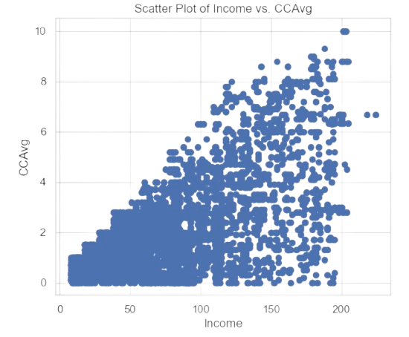
2. Income and CCavg
Fig 1: Income and CCavg

Slide 9
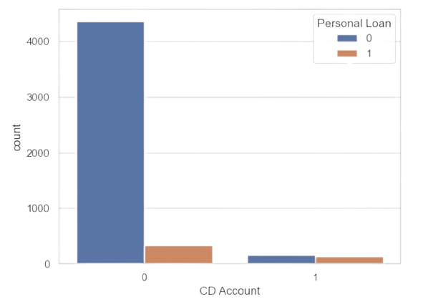
3. CD Account
Fig 2: CD account and personal loan

Slide 10
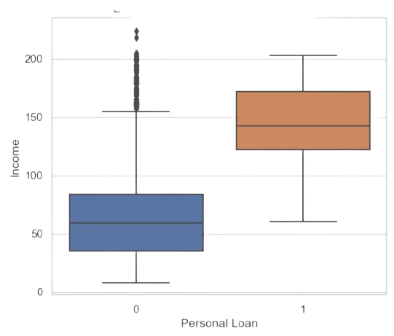
4. Income
Fig 3: Income and personal loan

Slide 11
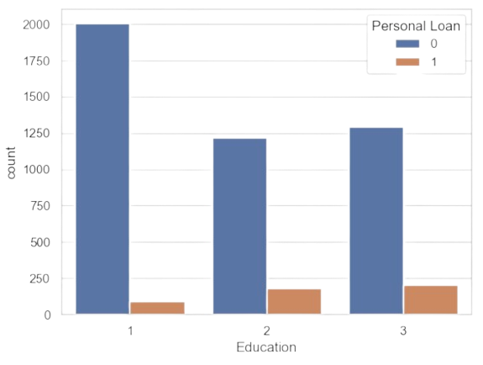
5. Education
Fig 4: Education and personal loan

Slide 12
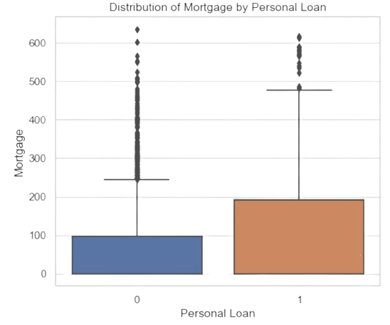
6. Mortgage
Fig 5: Mortgage and personal loan

Slide 13
Feature Selection
EDA
Feature importance

Slide 14
Model Fitting
Logistic Regression
Decision Tree

Slide 15
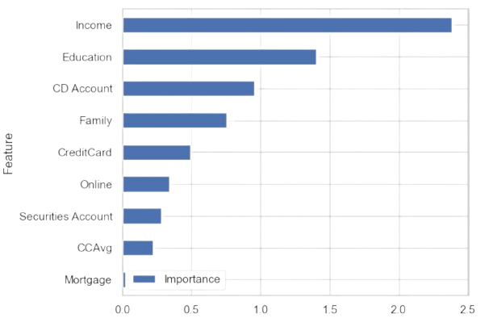
Logistic Regression
Percision 0.8
Recall 0.6
Scalling the data
Fig 6: Scalled feature importance

Slide 16
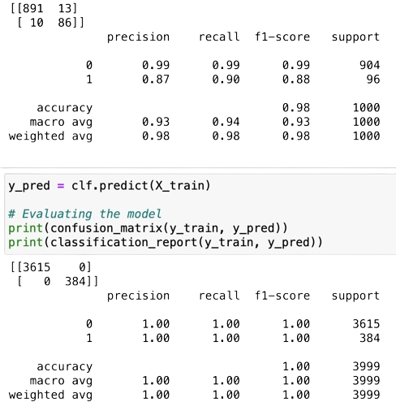
Decision Tree
Fig 7: Percision and recall of DT

Slide 17
Resampling and Cross-Validation
SMOTE oversampling
Stratified cross-validation

Slide 18
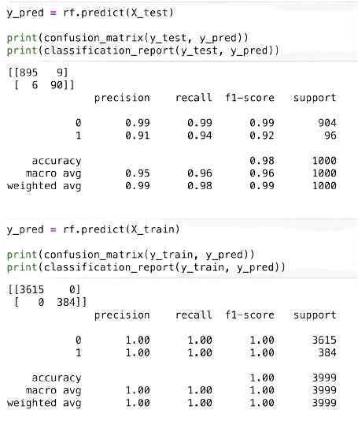
Random Forest
Fig 8: Percision and recall of RF

