Slide 2
Other Considerations for the Model
Qualitative variables
Extension of the Linear Model
Potential problems

Slide 3
Qualitative Predictors
Predictors with two levels
Gender (male/female), employed (yes/no), etc.
Predictors with more than two levels
Operating system (Windows/Mac/Linux), Geographic region (east /west/south/north), etc.
Person ID | Region (Original) | North | South | East | West
1 | North | 1 | 0 | 0 | 0
2 | South | 0 | 1 | 0 | 0
3 | East | 0 | 0 | 1 | 0
4 | West | 0 | 0 | 0 | 1
Table presents information for the person from each region

Slide 4
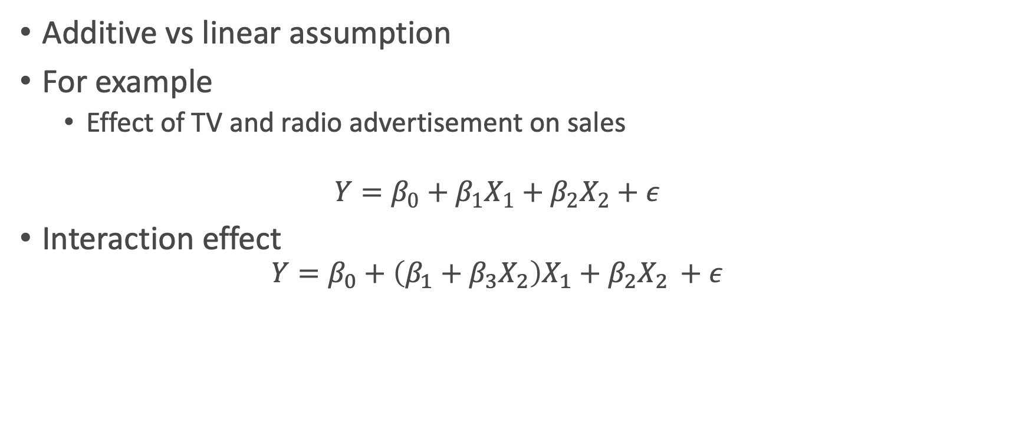
Extensions of Linear Model
Additive vs linear assumption
For example
Effect of TV and radio advertisement on sales
$$Y=β_{0}+β_{1}X_{1}+β_{2}X_{2}+ε$$
Interaction effect
$$Y=β_{0}+\left(β_{1}+β_{3}X_{2}\right)X_{1}+β_{2}X_{2 }+ε$$

Slide 5
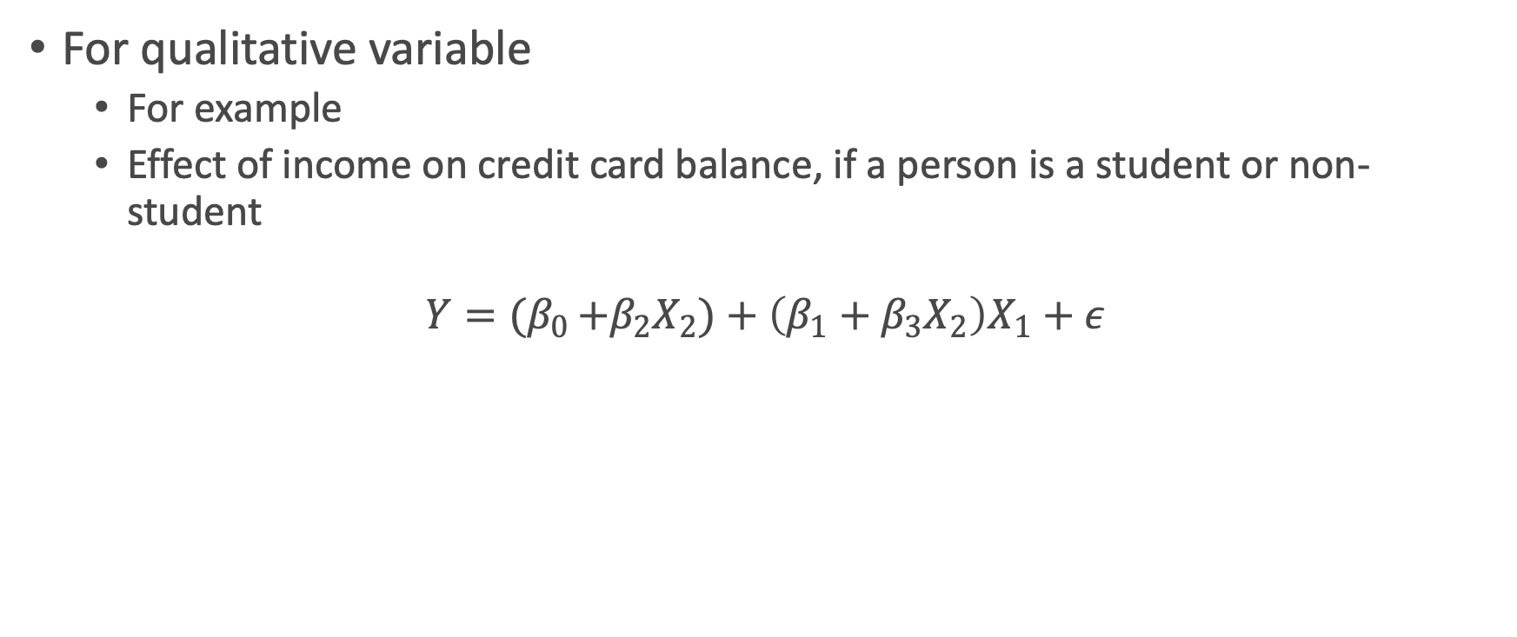
Extensions of Linear Model
For qualitative variable
For example
Effect of income on credit card balance, if a person is a student or non-student
$$Y={(β}_{0 }+β_{2}X_{2})+\left(β_{1}+β_{3}X_{2}\right)X_{1}+ε$$

Slide 6
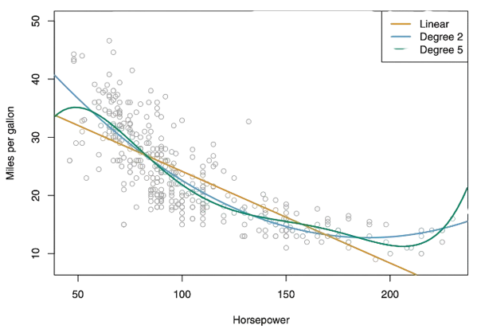
Non-Linear Relationship
Polynomial Regression for modeling non-linear
Different types of model fit for the dataset

Slide 7
Potential Problems
When fitting the model many problems can occur
Non-linearity of the response predictor relationships
Correlation of error terms
Non-constant variance of error terms.
Outliers
High-leverage points
Collinearity

Slide 8
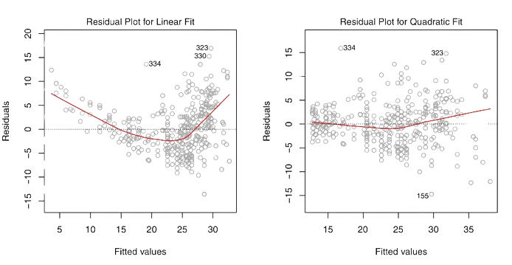

1. Non-Linearity
The residual Plot, for linear model its $e_{i}$ versus $x_{i}$
For non-linear $e_{i}$ versus${\hat{y}}_{i}$
$$e_{i}=y_{i}−{\hat{y}}_{i}$$
Residual plot for the linear and non-linear model

Slide 9

Non-Linearity
If there is non-linearity we can use
Log X
$\sqrt{x}$
$x^{2}$ etc.

Slide 10
2. Correlation of Error Terms
When errors are not correlated
The standard error for the coefficient is reliable
Confidence interval is trusted
P values are valid
Correlation occurs in the time series data

Slide 11
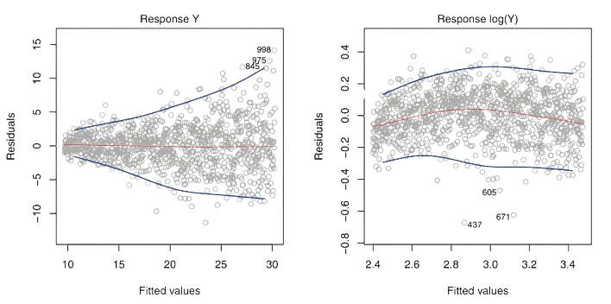
3. Non Constant Variance of Error Terms
The variance of error increases with the value of the response
The variance of error between residual and fitted values

Slide 12
4. Outliers
The points where the observed value is far from the predicted
Outliers can cause invalid fitted line
Just remove the outliers, but it can indicate other factors

Slide 13
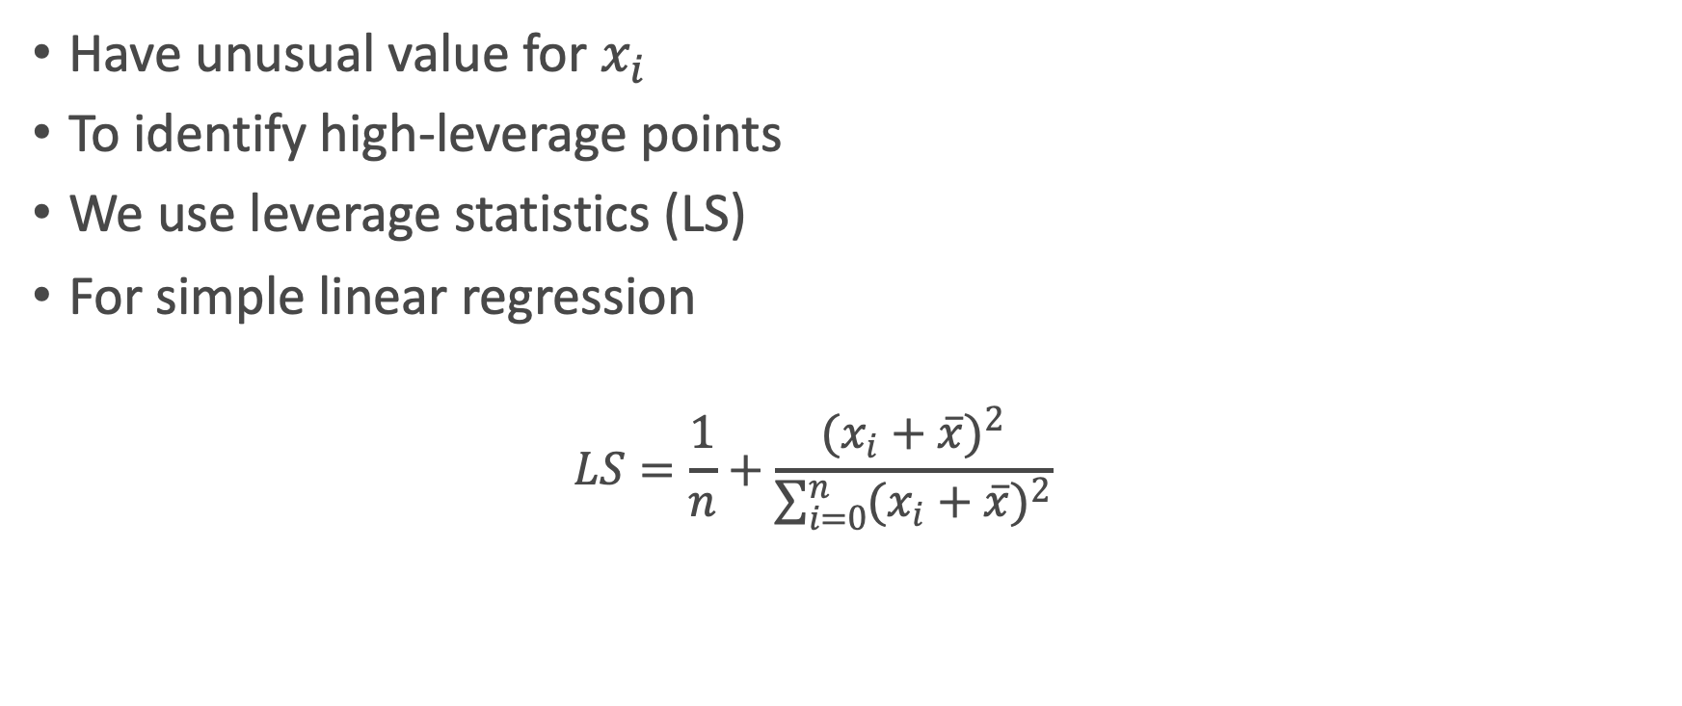
5. High Leverage Points
Have unusual value for $x_{i}$
To identify high-leverage points
We use leverage statistics (LS)
For simple linear regression
$$LS=\frac{1}{n}+\frac{(x_{i}+{\overline{x})}^{2}}{\sum_{i=0}^{n}{(x_{i}+\overline{x})^{2}}}$$

Slide 14

High Leverage Points
Always between $\frac{1}{n}$ and 1.
Average LS always = $\frac{(p+1)}{n}$.
If exceed the average, then high levearge

Slide 15
6. Collinearity
Two or more predictors are closely related
Less reliable statistical test
Difficult to find individual effects on response
To check collinearity
Correlation matrix
Variance inflation factor

Slide 16
K-Nearest Neighbors
Non parametric approch
Find the value of k
Bias variance tradeoff

Slide 17
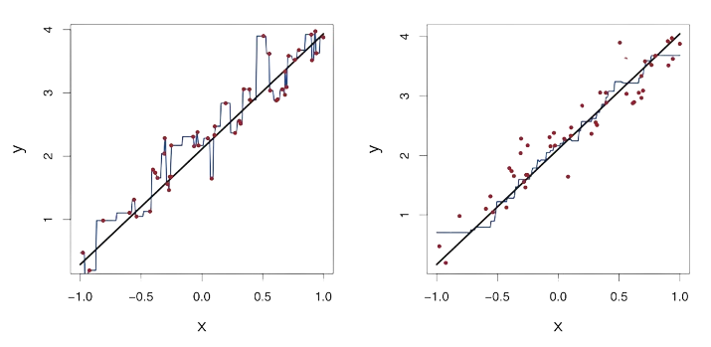
K-Nearest Neighbors
The parametric approach will outperform if the estimated form is true
Display the relation between x and y for linear regression and KNN

Slide 18
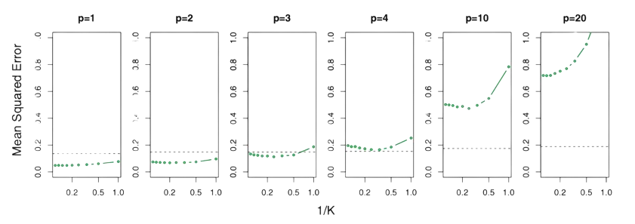
K-Nearest Neighbors
KNN is better for predictors <= 4
Perform worse if greater
KNN MSE (green line) against linear regression (dotted line)

