Slide 1
Computer Organization and Architecture
Introduction

Slide 2
Computer Organization and Architecture
There is no clear distinction between matters related to computer organization and matters relevant to computer architecture

Slide 3
Architecture & Organization
Architecture is those attributes visible to the programmer
Instruction set, number of bits used for data representation, I/O mechanisms, addressing techniques.
e.g. Is there a multiply instruction?
How do I design a computer?
Organization is how features are implemented
Control signals, interfaces, memory technology.
e.g. Is there a hardware multiply unit or is it done by repeated addition?
How does a Computer Work?
All Intel x86 family share the same basic architecture
All IBM System/370 family share the same basic architecture
But
Organization differs between different versions

Slide 4
Introduction
A computer system is made up from
hardware
Software
Firmware
Hardware is the physical medium, for example:
circuit boards
processors
keyboard
Software is a computer program, for example:
an operating system
an editor
a compiler
a Fortran 90 program

Slide 5
Introduction
Firmware is a combination of software and hardware
Computer chips that have data or programs recorded on them are firmware
ROMs (read-only memory)
PROMs (programmable read-only memory)
EPROMs (erasable programmable read-only memory)
Firmware means microcode
Microcode is generic word for representing certain functions in programming. These functions have special status and special representation.

Slide 6
Introduction
Principle of Equivalence of Hardware and Software:
Anything that can be done with software can also be done with hardware, and anything that can be done with hardware can also be done with software.
.

Slide 7
Structure & Function
Structure is the way in which components relate to each other
Function is the operation of individual components as part of the structure

Slide 8
Function
All computer functions are:
Data processing
Data storage
Data movement
Control

Slide 9
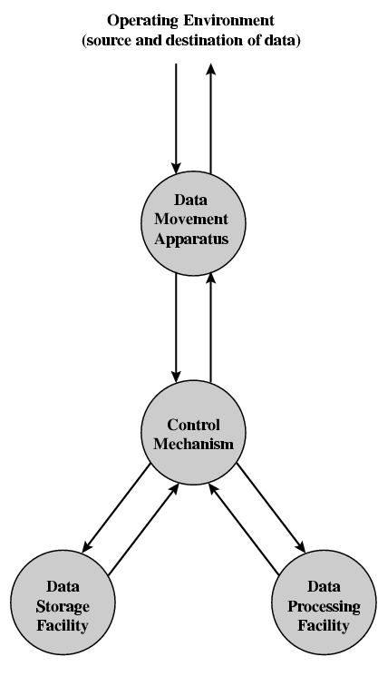
Functional view

Slide 10
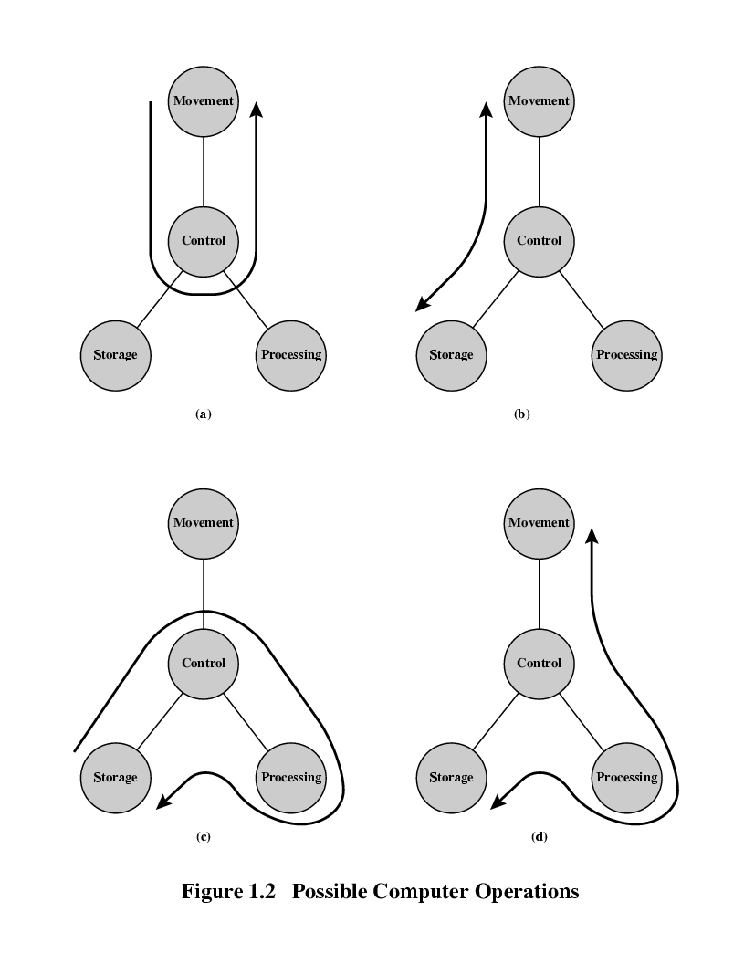
Operations (1) Data movement

Slide 11
Operations (2) Storage

Slide 12
Operation (3) Processing from/to storage

Slide 13
Operation (4) Processing from storage to I/O

Slide 14
Structure - Top Level
Peripherals
Computer
Central
Processing
Unit
Main
Memory
Computer
Systems
Interconnection
Input
Output
Communication
lines

Slide 15
Structure - The CPU
CPU
Computer
Arithmetic
and
Login Unit
I/O
Registers
System
Bus
CPU
Internal CPU
Interconnection
Memory
Control
Unit

Slide 16
Structure - The Control Unit
Control Unit
CPU
ALU
Sequencing
Login
Internal
Bus
Control
Unit
Control Unit
Registers and
Decoders
Registers
Control
Memory

Slide 17
Components of a Computer System
Control – logic that controls fetching/execution of instructions
Memory – area where instructions/data are stored
Input/Output – external interaction with computer
Address bus
C o n t r o l
Memory
Data bus
Input/Output devices

Slide 18
Components of a Computer System
Control, Memory , Input/Output
The three major components are connected by
an address bus which provides the address for the memory location to be addressed for read and write
a data bus which transfer data
from CPU or I/O to the memory and
from the memory to the CPU or I/O
a control bus which consists of
many control signals to control the overall system operations
many status data from the memory and I/0 devices

Slide 19
Processor Integration
Early computers had many separate chips for the different portions of a computer system
Registers
ALU
Control
Memory

Slide 20
Microprocessors
Data Bus
CPU (ALU + Reg + control)
Address Bus
Memory
I/O
Devices
Control Bus
First microprocessors placed control, registers, arithmetic logic unit in one integrated circuit (one chip).

Slide 21
Modern μProcessors
Modern microprocessors (general purpose μProcessors) also integrate memory onchip for faster access. External memory and I/O components still required. Memory integrated on the microprocessor is called cache memory.
Data Bus
CPU
Address Bus
Registers, ALU, Fetch, Exe Logic, Bus logic, Cache Memory
Memory
I/O
Devices
Control Bus

Slide 22
Microprocessor
Microprocessor is an electronic circuit that functions as the central processing unit (CPU) of a computer, providing computational control. Microprocessors are also used in other advanced electronic systems, such as computer printers, automobiles, and jet airliners.
Modern microprocessors incorporate transistors, in addition to other components such as resistors, diodes, capacitors, and wires, all packed into an area about the size of a postage stamp.

Slide 23
Microcontrollers
Microcontrollers integrate all of the components (control, memory, I/O) of a computer system into one integrated circuit. Microcontrollers are intended to be single chip solutions for systems requiring low to moderate processing power.
Microcontroller

Slide 24
Microprocessor vs. Microcontroller
Microprocessor
CPU is stand-alone, RAM, ROM, I/O, timer are separate
designer can decide on the amount of ROM, RAM and I/O ports.
expansive
versatility
general-purpose
Microcontroller
CPU, RAM, ROM, I/O and timer are all on a single chip
fix amount of on-chip ROM, RAM, I/O ports
for applications in which cost, power and space are critical
single-purpose

Slide 25
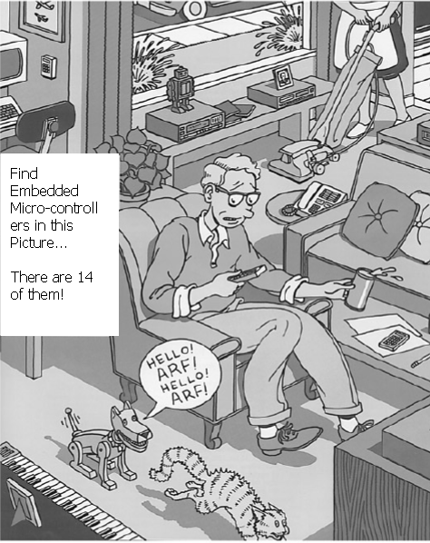

Slide 26
Computer Systems
A history

Slide 27
ENIAC
Electronic Numerical Integrator And Computer
University of Pennsylvania
Trajectory tables for weapons
Started 1943 and Finished 1946
Too late for war effort
Used until 1955
Decimal (not binary)
18,000 vacuum tubes
30 tons
15,000 square feet
140 kW power consumption
5,000 additions per second

Slide 28
von Neumann/Turing
Stored Program concept
Main memory storing programs and data
ALU operating on binary data
Control unit interpreting instructions from memory and executing
Input and output equipment operated by control unit
Completed 1952

Slide 29
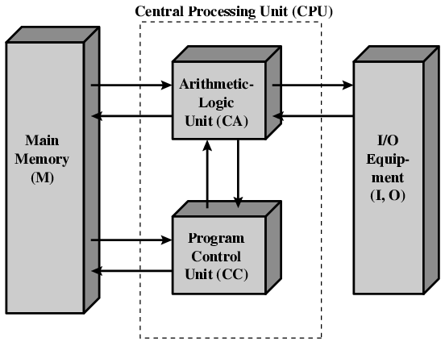
Structure of von Neumann machine

Slide 30
Commercial Computers
1947 - Eckert-Mauchly Computer Corporation
UNIVAC I (Universal Automatic Computer)
US Bureau of Census 1950 calculations
Became part of Sperry-Rand Corporation
Late 1950s - UNIVAC II
Faster
More memory

Slide 31
IBM
Punched-card processing equipment
1953 - the 701
IBM’s first stored program computer
Scientific calculations
1955 - the 702
Business applications
Lead to 700/7000 series

Slide 32
Transistors
Replaced vacuum tubes
Smaller
Cheaper
Less heat dissipation
Solid State device
Made from Silicon (Sand)
Invented 1947 at Bell Labs
William Shockley et al.

Slide 33
Transistor Based Computers
Second generation machines
IBM 7000
DEC - 1957
Produced PDP-1

Slide 34
Microelectronics
Literally - “small electronics”
A computer is made up of gates, memory cells and interconnections
These can be manufactured on a semiconductor
e.g. silicon wafer

Slide 35
Generations of Computer
Vacuum tube - 1946-1957
Transistor - 1958-1964
Small scale integration - 1965 on
Up to 100 devices on a chip
Medium scale integration - to 1971
100-3,000 devices on a chip
Large scale integration - 1971-1977
3,000 - 100,000 devices on a chip
Very large scale integration - 1978 to date
100,000 - 100,000,000 devices on a chip
Ultra large scale integration
Over 100,000,000 devices on a chip

Slide 36
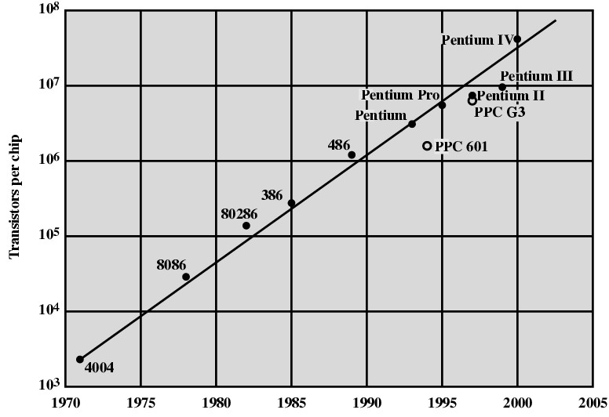
Growth in CPU Transistor Count

Slide 37
IBM 360 series
1964
First planned “family” of computers
Similar or identical instruction sets
Similar or identical O/S
Increasing speed
Increasing number of I/O ports (i.e. more terminals)
Increased memory size
Increased cost
Multiplexed switch structure

Slide 38
DEC PDP-8
1964
First minicomputer
Did not need air conditioned room
Small enough to sit on a lab bench
$16,000
$100k+ for IBM 360
BUS STRUCTURE

Slide 39
DEC - PDP-8 Bus Structure
Console
Controller
Main Memory
I/O
Module
I/O
Module
CPU
OMNIBUS

Slide 40
Semiconductor Memory
1970
Fairchild
Size of a single core
i.e. 1 bit of magnetic core storage
Holds 256 bits
Non-destructive read
Much faster than core

Slide 41
Intel
1971 - 4004
First microprocessor
All CPU components on a single chip
4 bit
Followed in 1972 by 8008
8 bit
Both designed for specific applications
1974 - 8080
Intel’s first general purpose microprocessor

Slide 42
Speeding it up
Pipelining
On board cache
On board L1 & L2 cache
Branch prediction
Data flow analysis
Speculative execution

Slide 43
Pentium Evolution (1)
8080
first general purpose microprocessor
8 bit data path
Used in first personal computer – Altair
8086
much more powerful
16 bit
instruction cache, prefetch few instructions
8088 (8 bit external bus) used in first IBM PC
80286
16 Mbyte memory addressable
up from 1Mb
80386
32 bit
Support for multitasking

Slide 44
Pentium Evolution (2)
80486
sophisticated powerful cache and instruction pipelining
built in maths co-processor
Pentium
Superscalar
Multiple instructions executed in parallel
Pentium Pro
Increased superscalar organization
Aggressive register renaming
branch prediction
data flow analysis
speculative execution

Slide 45
Pentium Evolution (3)
Pentium II
MMX technology
graphics, video & audio processing
Pentium III
Additional floating point instructions for 3D graphics
Pentium 4
Note Arabic rather than Roman numerals
Further floating point and multimedia enhancements
Itanium
64 bit

