Slide 1
Computer Organization and Architecture
System Buses

Slide 2
Program Concept
Hardwired systems are inflexible
General purpose hardware can do different tasks, given correct control signals
Instead of re-wiring, supply a new set of control signals
Programs
Sequence of steps
For each step, an arithmetic or logical operation is done
For each operation, a different set of control signals is needed

Slide 3
Function of Control Unit
For each operation a unique code is provided
e.g. ADD, MOVE
A hardware segment accepts the code and issues the control signals

Slide 4
Components
The Control Unit and the Arithmetic and Logic Unit constitute(create) the Central Processing Unit
Data and instructions need to get into the system and results out
Input/output
Temporary storage of code and results is needed
Main memory

Slide 5
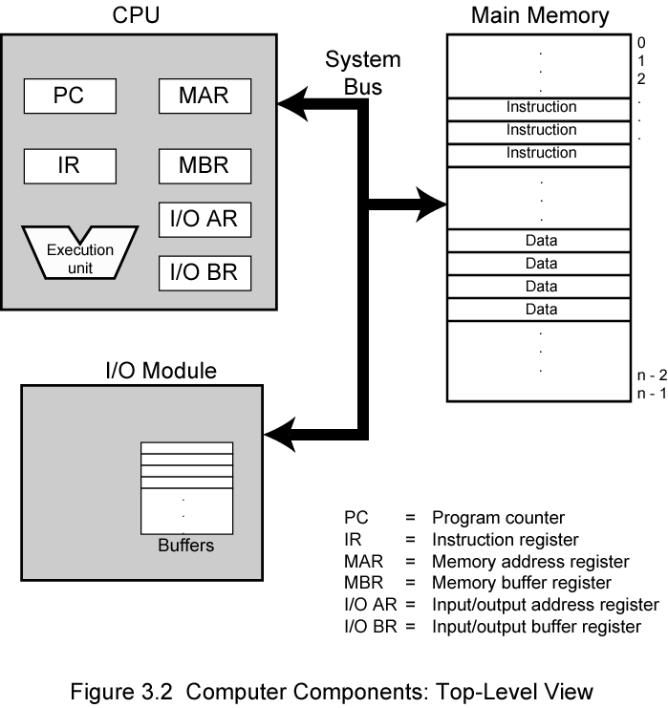
Interactions among Computer Components: Top Level View

Slide 6
Interactions among Computer Components
Memory Address Register (MAR) – specifies address for next read or write
Memory Buffer Register (MBR) – contains data to be written into or receives data read from memory
I/O address register (I/O AR) - specifies a particular I/O device
I/O buffer register (I/O BR) - used for exchange of data between an I/O module and CPU (or memory)
Memory module - a set of locations
with sequentially numbered addresses
each holds a binary number that can be either an instruction or data

Slide 7
Execute Cycle
Program Execution

Slide 8
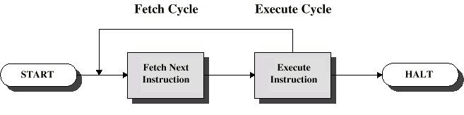
Instruction Cycle
Two steps:
Fetch
Execute

Slide 9
Fetch Cycle
Program Counter (PC) holds address of next instruction to fetch
Processor fetches instruction from memory location pointed to by PC
Increment PC
Unless told otherwise
Instruction loaded into Instruction Register (IR)
Processor interprets instruction and performs required actions

Slide 10
Execute Cycle
Processor-memory
data transfer between CPU and main memory
Processor I/O
Data transfer between CPU and I/O module
Data processing
Some arithmetic or logical operation on data
Control
Alteration of sequence of operations
e.g. jump
Combination of above

Slide 11
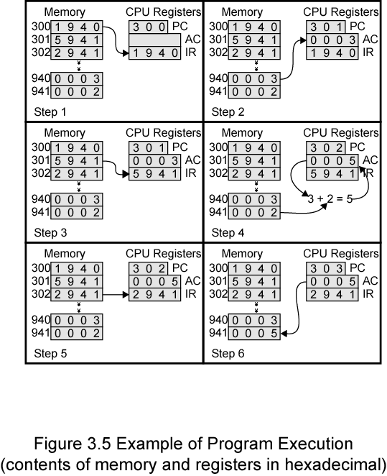

Slide 12
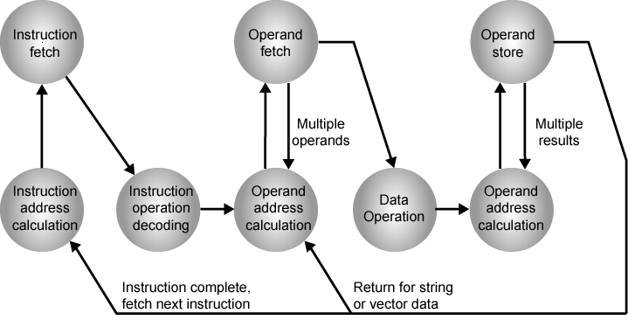
Instruction Cycle State Diagram

Slide 13
Interrupts
Changing Program Flow

Slide 14
Interrupts
Mechanism by which other modules (e.g. I/O) may interrupt normal sequence of processing
Program - as a result of program execution
e.g. overflow, division by zero
Timer
Generated by internal processor timer
Used in pre-emptive multi-tasking
I/O - to signal completion of I/O or error
from I/O controller
Hardware failure
e.g. memory parity error, power failure

Slide 15
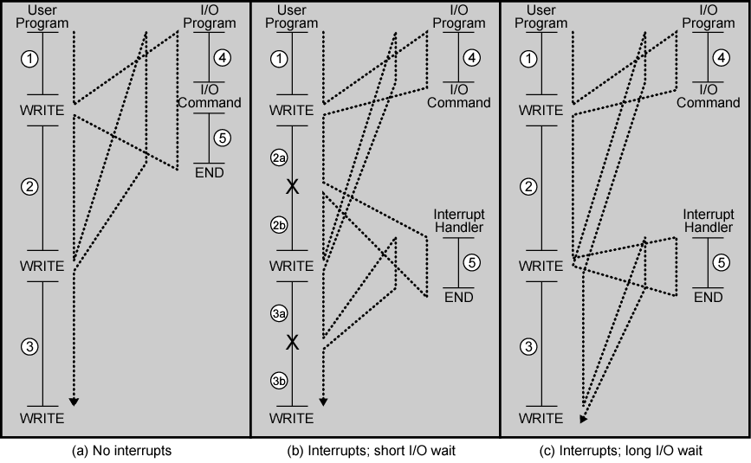
Program Flow Control

Slide 16
Interrupt Cycle
Added to instruction cycle
Processor checks for interrupt
Indicated by an interrupt signal
If no interrupt, fetch next instruction
If interrupt pending:
Suspend(hang) execution of current program
Save context
Set PC to start address of interrupt handler routine
Process interrupt
Restore context and continue interrupted program

Slide 17
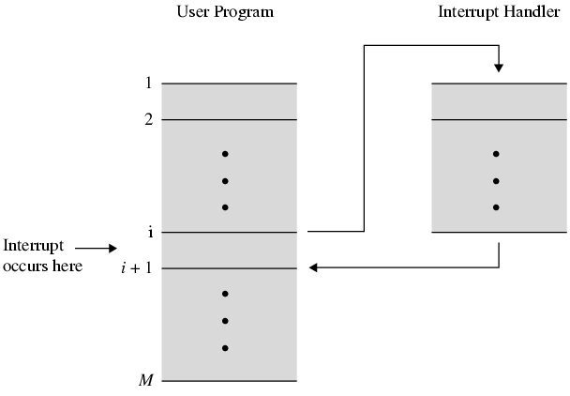
Transfer of Control via Interrupts

Slide 18
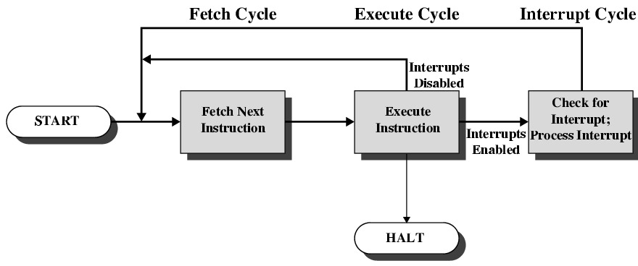
Instruction Cycle with Interrupts

Slide 19
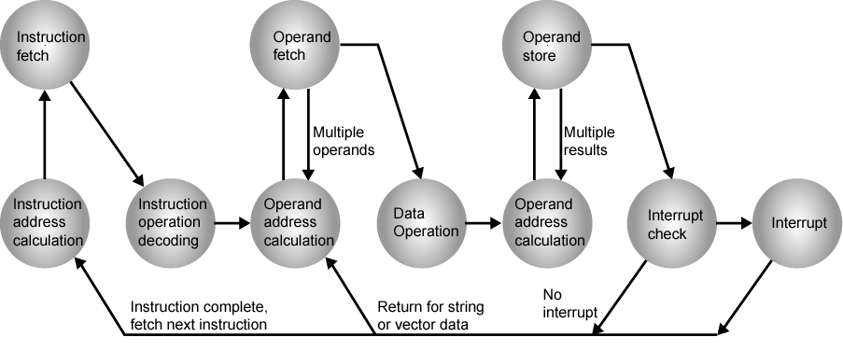
Instruction Cycle (with Interrupts) - State Diagram

Slide 20
Multiple Interrupts
Two approaches can be taken to dealing with multiple interrupts
Disable interrupts
Processor will ignore further interrupts whilst processing one interrupt
Interrupts remain pending and are checked after first interrupt has been processed
Interrupts handled in sequence as they occur
Define priorities
Low priority interrupts can be interrupted by higher priority interrupts
When higher priority interrupt has been processed, processor returns to previous interrupt
The drawback to the preceding approach is that it doesn’t take into account relative priority or time-critical needs.

Slide 21
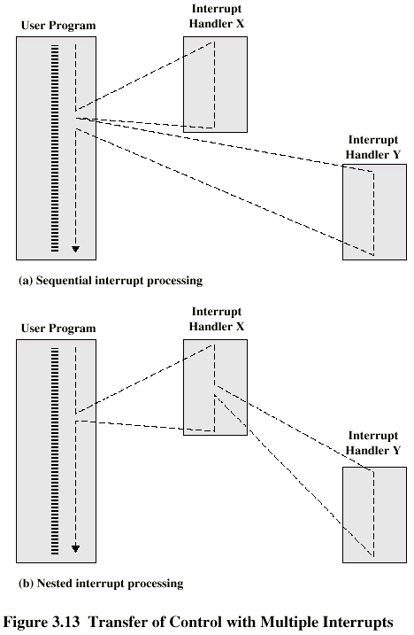
Multiple Interrupts - Sequential

Slide 22
Multiple Interrupts – Nested

Slide 23
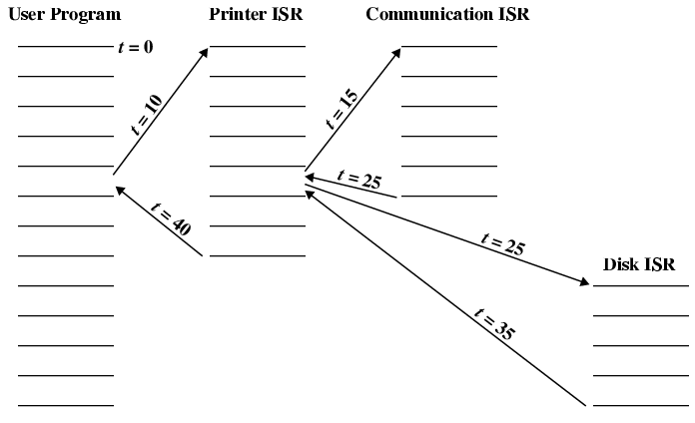
Time Sequence of Multiple Interrupts

Slide 24
Busses
Connecting Components

Slide 25
Connecting
The collection of paths connecting the various modules of a computer (CPU, memory, I/O) is called the interconnection structure.
All the units must be connected
Different type of connection for different type of unit
Memory
Input/output
CPU

Slide 26
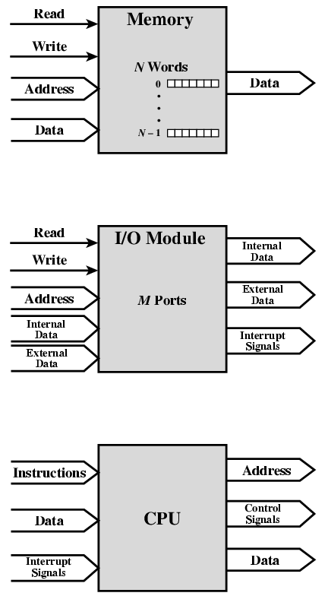
Computer Modules
Address
Data Read
Data Write
Interrupt Signals

Slide 27
Computer Modules
It must support the following types of transfers:
Memory to CPU – the processor read an instruction or a unit of data from memory.
CPU to Memory – the processor writes a unit of data to memory.
I/O to CPU – the processor read data from an I/O devices via an I/O module.
CPU to I/O – the processor sends data to the I/O devices.
I/O to or from Memory – For these two cases, an I/O module is allowed to exchange data directly with memory, without going through the processor, using Direct Memory Access (DMA)

Slide 28
Memory Connection
Receives and sends data
Receives addresses (of locations)
Receives control signals
Read
Write
Timing

Slide 29
Input/Output Connection(1)
Similar to memory from computer’s viewpoint
Output
Receive data from computer
Send data to peripheral
Input
Receive data from peripheral
Send data to computer

Slide 30
Input/Output Connection(2)
Receive control signals from computer
Send control signals to peripherals
e.g. spin disk
Receive addresses from computer
e.g. port number to identify peripheral
Send interrupt signals (control)
External data line is used to communicate between I/O module and peripherals
Internal data line is used to communicate between I/O module and CPU/Memory

Slide 31
CPU Connection
Reads instruction and data
Writes out data (after processing)
Sends control signals to other units
Receives (& acts on) interrupts

Slide 32
Buses
There are a number of possible interconnection systems
Single and multiple BUS structures are most common
e.g. Control/Address/Data bus (PC)
e.g. Unibus (DEC-PDP)

Slide 33
What is a Bus?
A communication pathway connecting two or more devices
Characteristics
It is a shared transmission medium.
Must only be used by one device at a time
When used to connect major computer components (CPU, memory, I/O) is called a system bus.
Usually broadcast
Often grouped
A number of channels in one bus
e.g. 32 bit data bus is 32 separate single bit channels
Power lines may not be shown

Slide 34
Data Bus
Carries data
Remember that there is no difference between “data” and “instruction” at this level
Width is a key determinant of performance
8, 16, 32, 64 bit

Slide 35
Address bus
Identify the source or destination of data
e.g. CPU needs to read an instruction (data) from a given location in memory
Bus width determines maximum memory capacity of system
e.g. 8080 has 16 bit address bus giving 64k address space

Slide 36
Control Bus/Line
Control access to and use of the data and address lines. Typical control lines include:
Memory Read and Memory Write
I/O Read and I/O Write
Transfer ACK
Bus Request and Bus Grant
Interrupt Request and Interrupt ACK
Clock
Reset

Slide 37
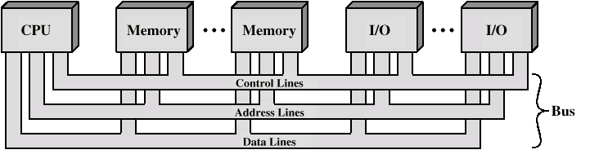
Bus Interconnection Scheme

Slide 38
Big and Yellow?
What do buses look like?
Parallel lines on circuit boards
Ribbon cables
Strip connectors on mother boards
e.g. PCI
Sets of wires

Slide 39
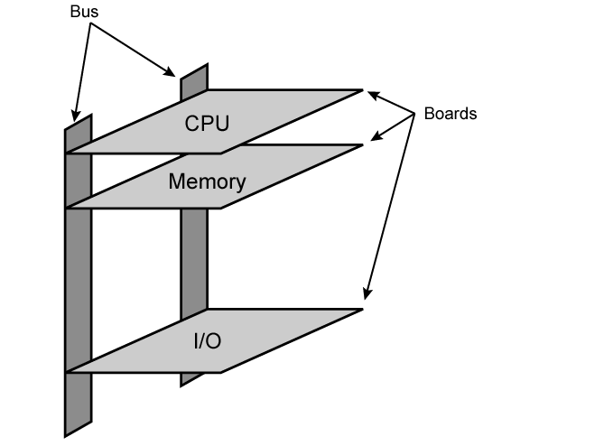
Physical Realization of Bus Architecture

Slide 40
Single Bus Problems
A great number of devices on a bus will cause performance to suffer
Propagation delay - the time it takes for devices to coordinate the use of the bus
The bus may become a bottleneck as the aggregate data transfer demand approaches the capacity of the bus (in available transfer cycles/second)
Most systems use multiple buses to overcome these problems

Slide 41
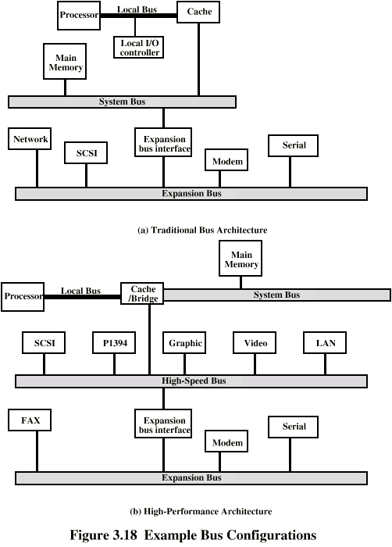
Traditional (with cache)

Slide 42
Traditional Hierarchical Bus Architecture
Use of a cache structure insulates CPU from frequent accesses to main memory
Main memory can be moved off local bus to a system bus
Expansion bus interface
buffers data transfers between system bus and I/O controllers on expansion bus
insulates memory-to-processor traffic from I/O traffic

Slide 43
High Performance Bus

Slide 44
High-performance Hierarchical Bus Architecture
Traditional hierarchical bus breaks down as higher and higher performance is seen in the I/O devices
Incorporates a high-speed bus
specifically designed to support high-capacity I/O devices
brings high-demand devices into closer integration with the processor and at the same time is independent of the processor
Changes in processor architecture do not affect the high-speed bus, and vice versa
Sometimes known as a mezzanine architecture

Slide 45
Bus Types
Dedicated - a line is permanently assigned either to one function or to a physical subset of computer components
Multiplexed
Time multiplexing - using the same lines for multiple purposes (different purposes at different times)
Uses fewer lines, saving space and cost
BUT more complex circuitry required in each module
BUT potential reduction in performance
Physical dedication - the use of multiple buses, each of which connects to only a subset of modules, with an adapter module to connect buses and resolve contention at the higher level.

Slide 46
Bus Types
Dedicated
Separate data & address lines
Multiplexed
Shared lines
Address valid or data valid control line
Advantage - fewer lines
Disadvantages
More complex control
Ultimate performance

Slide 47
Bus Arbitration
More than one module controlling the bus
e.g. CPU and DMA controller
Only one module may control bus at one time
Arbitration may be centralised or distributed

Slide 48
Centralised or Distributed Arbitration
Centralised
Single hardware device controlling bus access
Bus Controller
Arbiter
May be part of CPU or separate
Distributed
Each module may claim the bus
Control logic on all modules

Slide 49
Method of Arbitration
Determining who can use the bus at a particular time
Centralized - a single hardware device called the bus controller or arbiter allocates time on the bus
Distributed - each module contains access control logic and the modules act together to share the bus
Both methods designate one device (either CPU or an I/O module) as master, which may initiate a data transfer with some other device, which acts as a slave.

Slide 50
Timing
Control Action w.r.t Time Signal

Slide 51
Timing
Co-ordination of events on bus
Synchronous
Events determined by clock signals
Control Bus includes clock line
A single 1-0 is a bus cycle
All devices can read clock line
Usually sync on leading edge
Usually a single cycle for an event

Slide 52
Synchronous Timing
Control Bus includes clock line.
Clock transmits a regular sequence of alternating 1’s and 0’s of equal duration
A single 1-0 transmission is referred to as a clock cycle or bus cycle
All other devices on the bus can read the clock line, and all events start at the beginning of a clock cycle

Slide 53
Asynchronous Timing
The occurrence of one event on a bus follows and depends on the occurrence of a previous event
Allows system to take advantage of advances in device performance by having a mixture of slow and fast devices, using older and newer technology, sharing the same bus
BUT harder to implement and test than synchronous timing

Slide 54
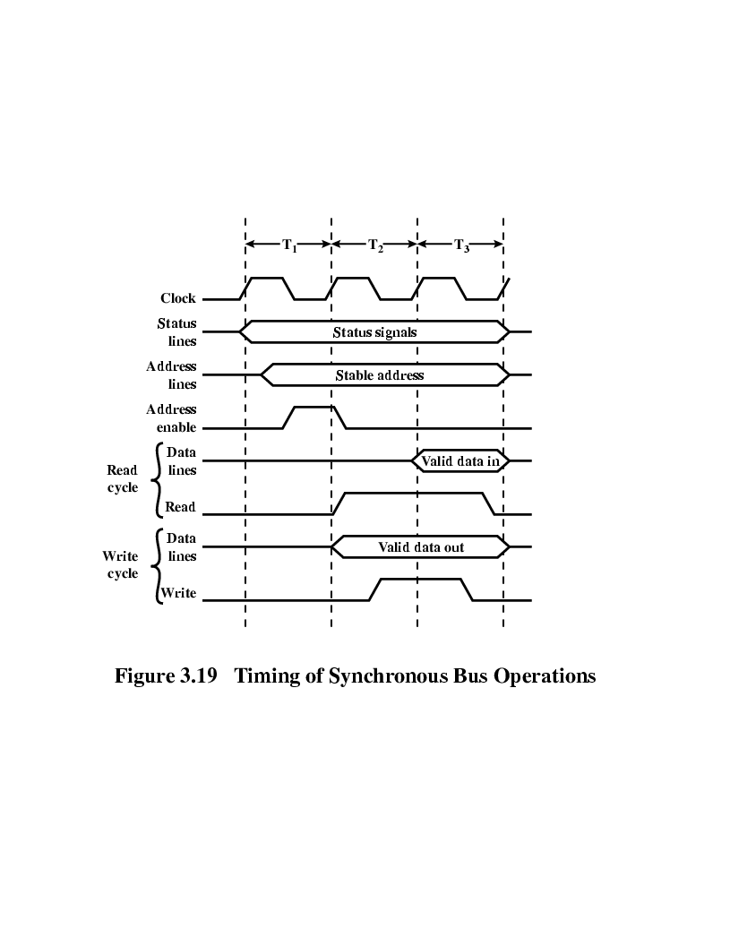
Synchronous Timing Diagram (Read)
Control Signals
Address
Data Read
Step 1
Step 2
Step 3
Step 4
Step 6
Step 5

Slide 55
Synchronous Timing Diagram (Write)
Control Signals
Address
Data Write
Step 1
Step 2
Step 3
Step 4
Step 5
Step 6

Slide 56
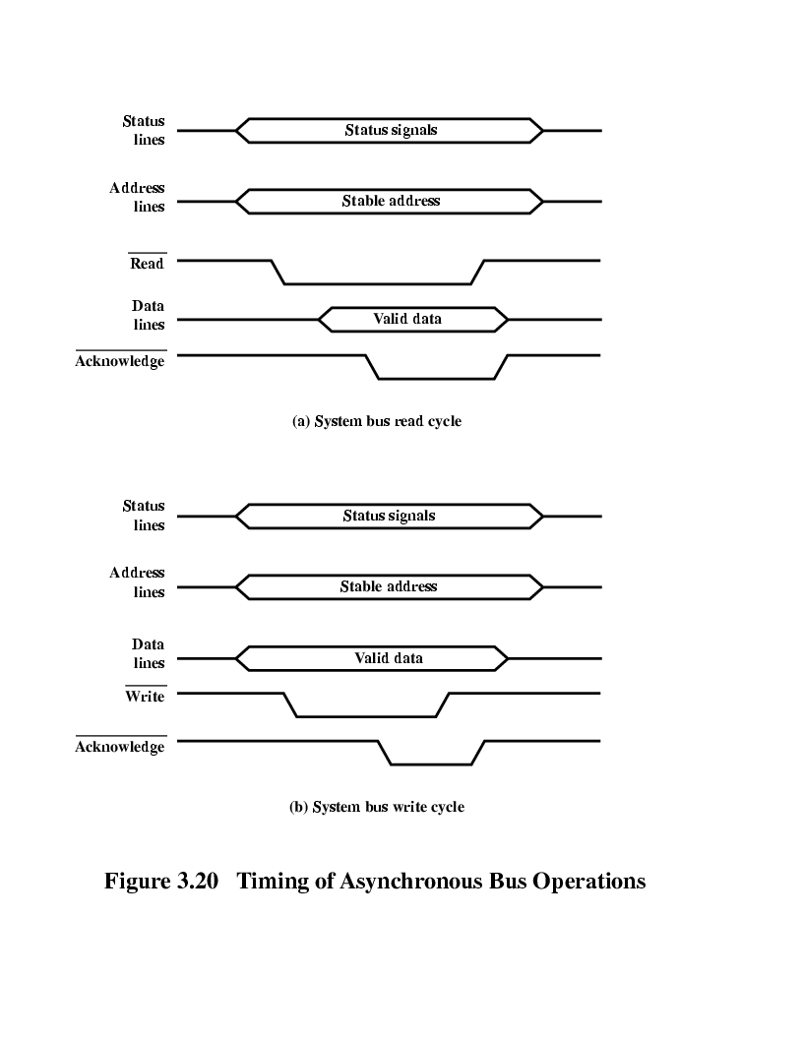
Asynchronous Timing – Read Diagram
Step 1
Step 2
Step 3
Step 4
Step 5
Control Signals
Address
Data Read

Slide 57
Asynchronous Timing – Write Diagram
Step 1
Step 2
Step 3
Step 4
Step 5
Control Signals
Address
Data Write

