Slide 1
Cache Memory
Structure and Function

Slide 2
Cache Memory
A cache ( pronounced KASH) is a component that transparently stores data so that future requests for that data can be served faster.
Analogous(similar) to …
Weapons and Food cache
Ladies hand bag
A students journal (notes)
Cache Hit
If requested data is contained in the cache (cache hit), this request can be served by simply reading the cache, which is comparatively faster.
Cache Miss
Otherwise the data has to be fetched from its original storage location, which is comparatively slower.
Efficiency
Cache hits > Cache Miss

Slide 3
Characteristics
Location
Capacity
Unit of transfer
Access method
Performance
Physical type
Physical characteristics
Organisation

Slide 4
Location
CPU
Internal (main)
External (secondary)

Slide 5
Capacity
Word size
The natural unit of organisation
typically equal to the number of bits used to represent a number and to the instruction length.
Number of words
or Bytes
Number of Words - has to do with the number of addressable units (which are typically words, but are sometimes bytes, regardless of word size). For addresses of length A (in bits), the number of addressable units is 2^A.

Slide 6
Unit of Transfer
Internal
Usually governed by data bus width
External
Usually a block which is much larger than a word
Addressable unit
Smallest location which can be uniquely addressed
Word internally
Cluster on M$ disks

Slide 7
Access Methods (for all memory devices)
Sequential
Start at the beginning and read through in order
Access time depends on location of data and previous location
e.g. tape
Direct
Individual blocks have unique address
Access is by jumping to vicinity(nearby area) plus sequential search
Access time depends on location and previous location
e.g. disk

Slide 8
Access Methods (for all memory devices)
Random
Individual addresses identify locations exactly
Access time is independent of location or previous access
e.g. RAM
Associative
Data is located by a comparison with contents of a portion of the store
Access time is independent of location or previous access
e.g. cache

Slide 9
Organization
The physical arrangement of bits to form words.
Obvious arrangement not always used
Ex. Characters vs. Integers vs. Floating Point Numbers

Slide 10
Memory Hierarchy
Registers
In CPU
Internal or Main memory
May include one or more levels of cache
“RAM”
External memory
Backing store

Slide 11
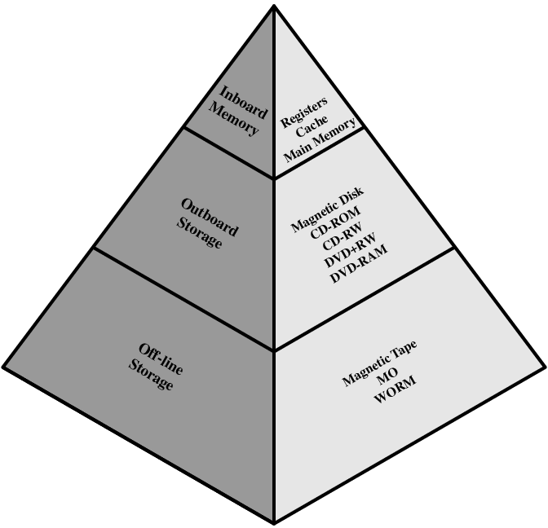
Memory Hierarchy - Diagram

Slide 12
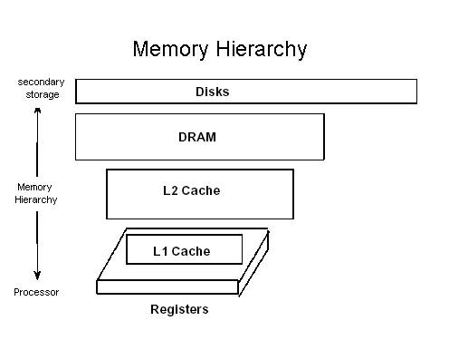
Hierarchy List
Registers
L1 Cache
L2 Cache
Main memory
Disk cache
Disk
Optical
Tape

Slide 13
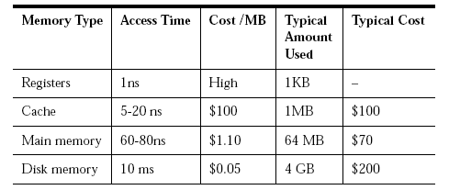
Access Times

Slide 14
Cache Levels
Due to increasing gap between CPU and main Memory, small memory called L1 cache is inserted.
L1 caches can be accessed almost as fast as the registers, typically in 1 or 2 clock cycle
Due to even more increasing gap between CPU and main memory, Additional cache: L2 cache is inserted between L1 cache and main memory
Some high performance systems also include additional L3 cache which sits between L2 and main memory
The cache is placed both physically closer and logically closer to the CPU than the main memory.

Slide 15
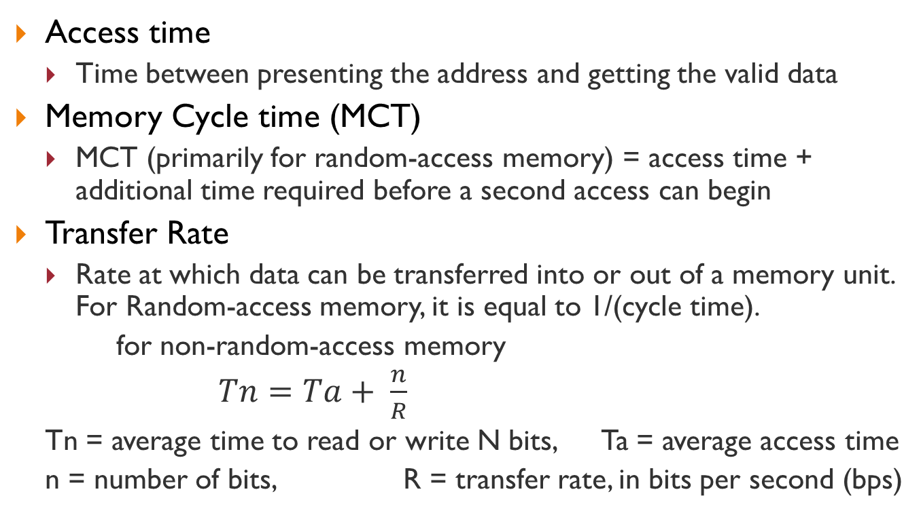
Performance
Access time
Time between presenting the address and getting the valid data
Memory Cycle time (MCT)
MCT (primarily for random-access memory) = access time + additional time required before a second access can begin
Transfer Rate
Rate at which data can be transferred into or out of a memory unit. For Random-access memory, it is equal to 1/(cycle time).
for non-random-access memory
$Tn=Ta+ \frac{n}{R}$
Tn = average time to read or write N bits, Ta = average access time
n = number of bits, R = transfer rate, in bits per second (bps)

Slide 16
Physical Types
Semiconductor
RAM
Magnetic
Disk & Tape
Optical
CD & DVD
Others
Bubble
Hologram

Slide 17
Physical Characteristics
Decay - decline in quality
Volatility - information decays or is lost when power is lost
Erasable - removable
Power consumption
non-volatile - information remains without deterioration until changed -- no electrical power needed
non-erasable
information cannot be altered with a normal memory access cycle
As a practical matter, must be non-volatile

Slide 18
The Bottom Line
How much?
Capacity
How fast?
Time is money
How expensive?
Cost
There are trade-offs between the 3 key characteristics of memory (cost, capacity, and access time) which yield the following relationships:
Smaller access time -> greater cost per bit
Greater capacity -> smaller cost per bit
Greater capacity -> greater access time

Slide 19
So you want fast?
It is possible to build a computer which uses only static RAM (see later)
This would be very fast
This would need no cache
How can you cache cache?
This would cost a very large amount

Slide 20
Locality of Reference
During the course of the execution of a program, memory references tend to cluster
e.g. loops

Slide 21
Why is cache memory needed?
When a program references a memory location, it is likely to reference that same memory location again soon.
A memory location that is near a recently referenced location is more likely to be referenced then a memory location that is farther away.
A small but fast cache memory, in which the contents of the most commonly accessed locations are maintained, can be placed between the CPU and the main memory.
When a program executes, the cache memory is searched first.

Slide 22
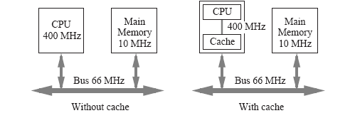
Why is cache memory fast?
Faster electronics used
A cache memory has fewer locations than a main memory, which reduces the access time
The cache is placed both physically closer and logically closer the CPU than the main memory
The cache-less computer (In Fig) usually needs a few bus cycles to synchronize the CPU with the bus.
A cache memory can be positioned closer to the CPU.

Slide 23
Cache Structure and Operation
Cache Memory

Slide 24
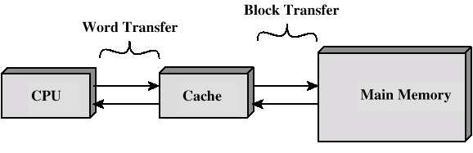
Cache
Small amount of fast memory
Sits between normal main memory and CPU
May be located on CPU chip or module

Slide 25
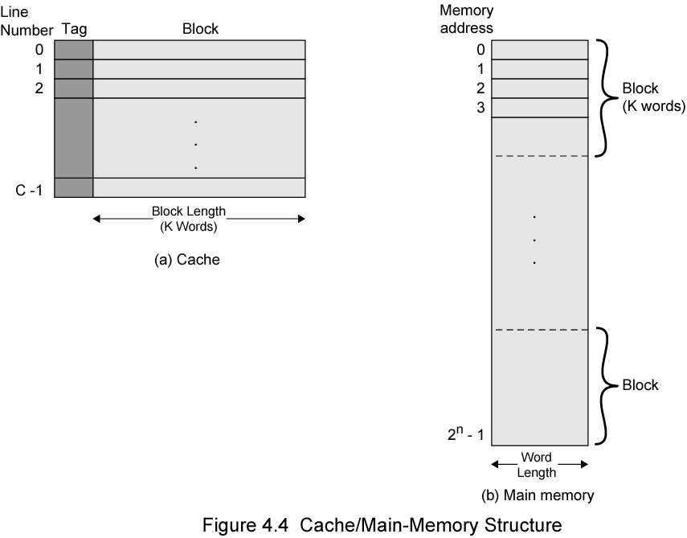
Cache/Main Memory Structure

Slide 26
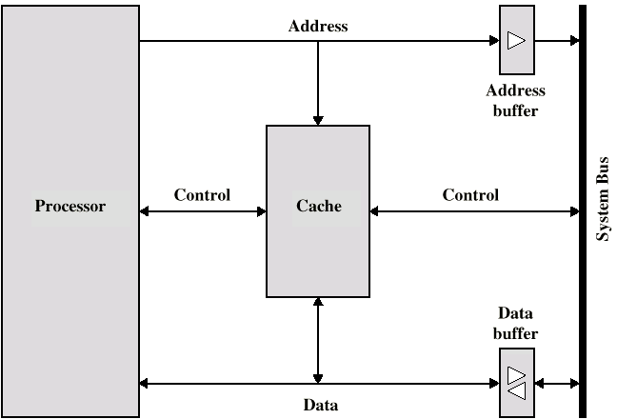
Typical Cache Organization

Slide 27
Cache Operation
Hits and Miss

Slide 28
Cache operation - overview
CPU requests contents of memory location
Check cache for this data
If present, get from cache (fast)
If not present, read required block from main memory to cache
Then deliver from cache to CPU
Cache includes tags to identify which block of main memory is in each cache slot

Slide 29
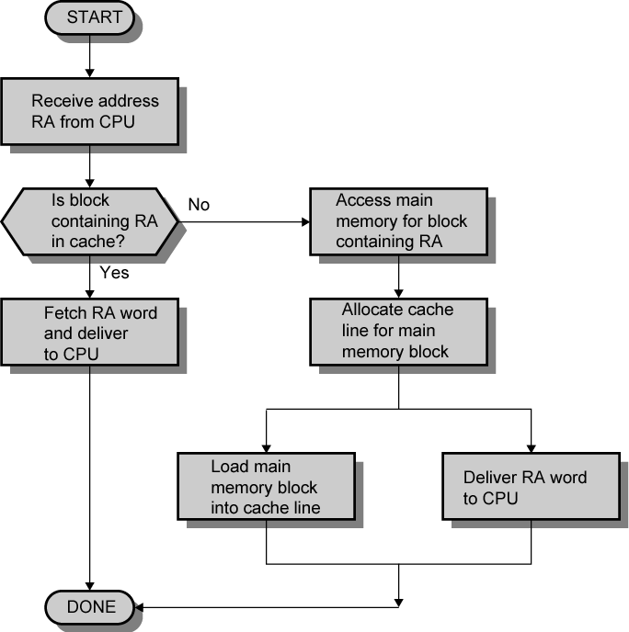
Cache Read Operation - Flowchart

