Slide 1
Cache Memory
Cache Design

Slide 2
Cache Design
Size
Mapping Function
Replacement Algorithm
Write Policy
Block Size
Number of Caches

Slide 3
Size does matter
Cost
More cache is expensive
Speed
More cache is faster (up to a point)
Checking cache for data takes time

Slide 4
Mapping
Cache Memory

Slide 5
Mapping Function
Cache of 64 kByte
Cache block of 4 bytes
i.e. cache is 16k (2¹⁴) lines of 4 bytes
16 MBytes main memory
24 bit address of RAM
(2²⁴=16M)

Slide 6
Direct Mapping
Cache Mapping

Slide 7
Direct Mapping
Each block of main memory maps to only one cache line
i.e. if a block is in cache, it must be in one specific place
Address is in two parts
Least Significant w bits identify unique word
Most Significant s bits specify one memory block
The MSBs are split into a cache line field r and a tag of s-r (most significant)

Slide 8
Direct Mapping Address Structure
Tag s-r
Line or Slot r
Word w
8
14
2
24 bit address
2 bit word identifier (4 byte block)
22 bit block identifier
8 bit tag (=22-14)
14 bit slot or line
No two blocks in the same line have the same Tag field
Uniqueness on the basis of 8 bit tag
Check contents of cache by finding line and checking Tag

Slide 9
Direct Mapping Cache Line Table
Cache line Main Memory blocks held
0 0, m, 2m, 3m…2^{s}-m
1 1,m+1, 2m+1…2^{s}-m+1
m-1 m-1, 2m-1,3m-1…2^{s}-1

Slide 10
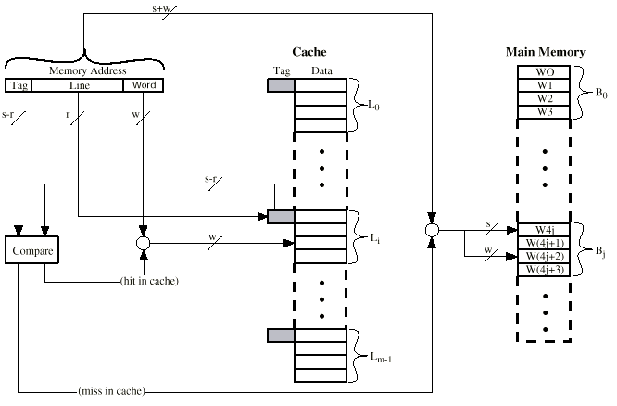
Direct Mapping Cache Organization

Slide 11
Direct Mapping Summary
Address length = (s + w) bits
22+2 = 24bits
Number of addressable units = 2^{s+w} words or bytes
Block size = line size = 2^{w} words or bytes
Number of blocks in main memory = 2^{s}
Number of lines in cache = m = 2^{r}
Size of tag = (s – r) bits
22-14=8

Slide 12
Direct Mapping pros & cons
Simple
Inexpensive
Fixed location for given block
If a program accesses 2 blocks that map to the same line repeatedly, cache misses are very high

Slide 13
Direct Mapping
Advantages
The tag memory is much smaller than in associative mapped cache.
No need for an extensive search, since the slot field is used to direct the comparison to a single field.
Disadvantages
Every memory reference may potentially result in a miss if cache belongs to same group

Slide 14
Associative Mapping
Cache Mapping

Slide 15
Associative Mapping
A main memory block can load into any line of cache
Direct had only ONE line for a block
Direct mapping is underutilized as compared to associative mapping
Memory address is interpreted as tag and word
Tag uniquely identifies block of memory
22 bit Tag as compared to 8 bit tag in direct mapping
Searching is faster in direct as compared to associative

Slide 16
Associative Mapping Address Structure
Word
2 bit
Tag 22 bit
22 bit tag stored with each 32 bit block of data
Compare tag field with tag entry in cache to check for hit
Least significant 2 bits of address identify which 16 bit word is required from 32 bit data block

Slide 17
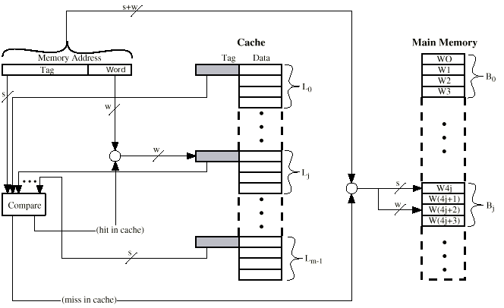
Fully Associative Cache Organization

Slide 18
Associative Mapping Summary
Address length = (s + w) bits
22+2 = 24 bits
Number of addressable units = 2^{s+w} words or bytes
Block size = line size = 2^{w} words or bytes
Number of blocks in main memory = 2^{s}
Number of lines in cache = undetermined
No r bits
Size of tag = s bits = 22 bits

Slide 19
Associative Mapping
Advantages
Any main memory block can be placed into any cache slot.
Regardless of how irregular the data and program references are, if a slot is available for the block, it can be stored in the cache.
Disadvantages
Considerable hardware overhead needed for cache bookkeeping.
There must be a mechanism for searching the tag memory in parallel.

Slide 20
Set Associative Mapping
Cache Mapping

Slide 21
Set Associative Mapping
Hybrid of direct and associative
Cache is divided into a number of sets
Each set contains a number of lines
A given block maps to any line in a given set
Direct mapped one block to exactly one line
Associative mapped one block to any line
e.g. Block B can be in any line of set i
e.g. 2 lines per set
2 way associative mapping
A given block can be in one of 2 lines in only one set

Slide 22
Set Associative Mapping Example
13 bit set number
Block number in main memory is modulo 2¹³
000000, 00A000, 00B000, 00C000 … map to same set

Slide 23
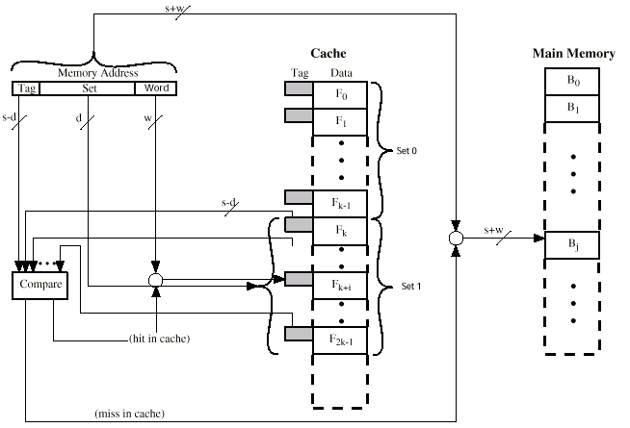
Two Way Set Associative Cache Organization

Slide 24
Set Associative Mapping Address Structure
Word
2 bit
Tag 9 bit
Set 13 bit
Use set field to determine cache set to look in
Compare tag field to see if we have a hit

Slide 25
Set Associative Mapping Summary
Address length = (s + w) bits
22+2 = 24 bits
Number of addressable units = 2^{s+w} words or bytes
Block size = line size = 2^{w} words or bytes
Number of lines in set = k
2 for two-way set associative mapping
Number of sets = v = 2^{d}
Number of lines in cache = kv
Size of tag = (s – d) bits
22-13=9

Slide 26
Set Associative Mapping
Hybrid of associative and Direct
Better search time than associative but worse than direct
Better hit ratio than direct but worse than associative

Slide 27
Replacement Algorithms
Cache Memory

Slide 28
Replacement
When a cache miss occurs, new line is to be brought in cache.
The line is preferably written in an empty location
If the cache is full for associative or the set is full for set-associative then a line must be recovered
Select a line for replacement – VICTIM
Read the block from cache and write in RAM
Write the new block in cache line

Slide 29
Replacement Algorithms (1) Direct mapping
No choice of victim
Victim is already known
Each block only maps to one line
Replace that line

Slide 30
Replacement Algorithms (2) Associative & Set Associative
Better selection of victim
Hardware implemented algorithm (speed)
Least Recently used (LRU)
e.g. in 2 way set associative
Which of the 2 block is LRU?
First in first out (FIFO)
replace block that has been in cache longest
Least frequently used
replace block which has had fewest hits
Create a histogram
Random

Slide 31
Writing Policies
Cache Memory

Slide 32
Write Policy
Must not overwrite a cache block unless main memory is up to date
Multiple CPUs may have individual caches
I/O may address main memory directly

Slide 33
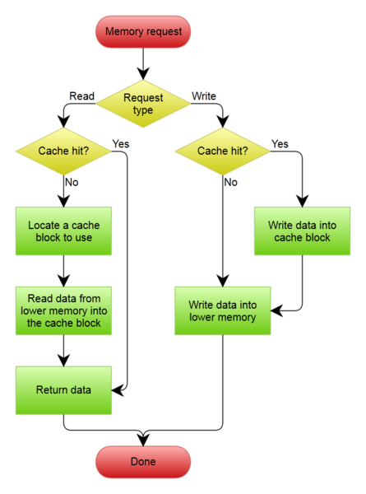
Write through
All writes go to main memory as well as cache
Multiple CPUs can monitor main memory traffic to keep local (to CPU) cache up to date
Lots of traffic
Slows down writes

Slide 34
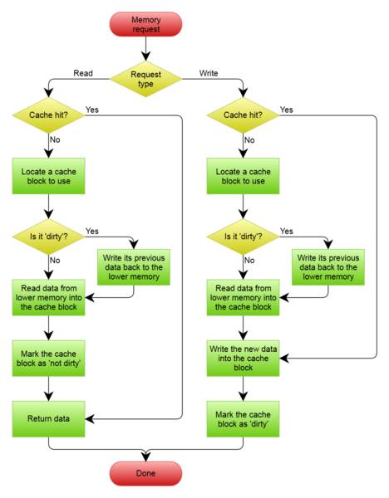
Write back
Updates initially made in cache only
Update bit for cache slot is set when update occurs
If block is to be replaced, write to main memory only if update bit is set
Other caches get out of sync
I/O must access main memory through cache

Slide 35
Cache Coherency
Coherent Data

Slide 36
Cache Coherency
The synchronization of data in multiple caches such that reading a memory location via any cache will return the most recent data written to that location via any (other) cache.
Some parallel processors do not cache accesses to shared memory to avoid the issue of cache coherency.
If caches are used with shared memory then some system is required to detect when data in one processor's cache should be discarded or replaced because another processor has updated that memory location. Several such schemes have been devised.

Slide 37
Cache Performance
Which is Better?

Slide 38
Cache Performance
As to which cache read or write policies are best, there is no simple answer. The organization of a cache is optimized for each computer architecture and the mix of programs that the computer executes.

