Slide 1
Cache Memory
Pentium Cache

Slide 2
Pentium 4 Cache
80386 – no on chip cache
80486 – 8k using 16 byte lines and four way set associative organization
Pentium (all versions) – two on chip L1 caches
Data & instructions
Pentium 4 – L1 caches
8k bytes
64 byte lines
four way set associative
L2 cache
Feeding both L1 caches
256k
128 byte lines
8 way set associative

Slide 3
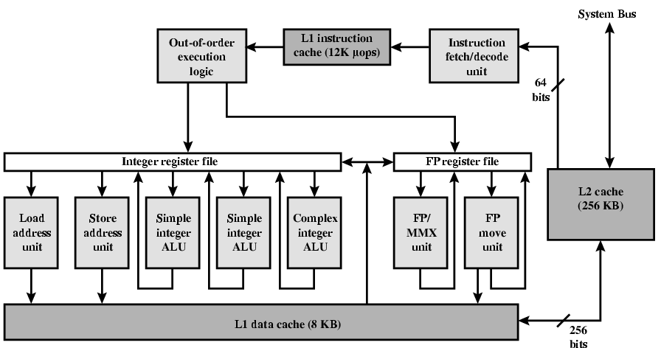
Pentium 4 Diagram (Simplified)

Slide 4
Pentium 4 Core Processor
Fetch/Decode Unit
Fetches instructions from L2 cache
Decode into micro-ops
Store micro-ops in L1 cache
Out of order execution logic
Schedules micro-ops
Based on data dependence and resources
May speculatively execute
Execution units
Execute micro-ops
Data from L1 cache
Results in registers
Memory subsystem
L2 cache and systems bus

Slide 5
Pentium 4 Design Reasoning
Decodes instructions into RISC like micro-ops before L1 cache
Micro-ops fixed length
Superscalar pipelining and scheduling
Pentium instructions long & complex
Performance improved by separating decoding from scheduling & pipelining
(More later – ch14)
Data cache is write back
Can be configured to write through
L1 cache controlled by 2 bits in register
CD = cache disable
NW = not write through
2 instructions to invalidate (flush) cache and write back then invalidate

Slide 6
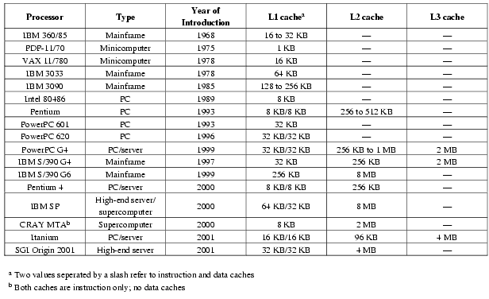
Comparison of Cache Sizes

