Slide 1
Internal Memory
ROM and RAM

Slide 2
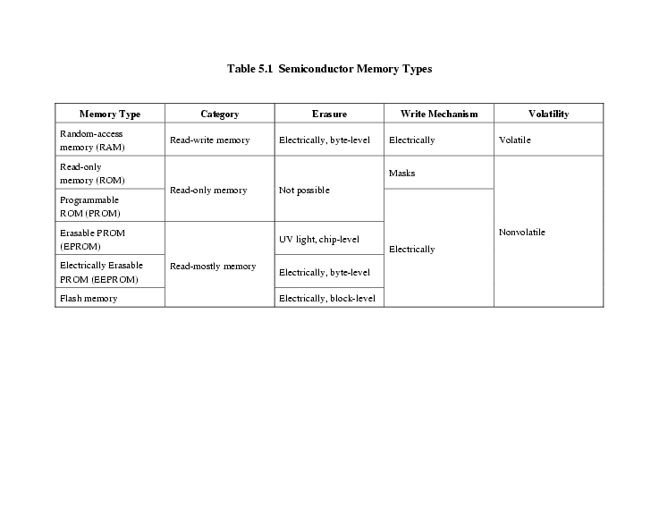
Semiconductor Memory Types

Slide 3
Semiconductor Memory
RAM
Misnamed as all semiconductor memory is random access
Read/Write
Volatile
Temporary storage
Static or dynamic

Slide 4
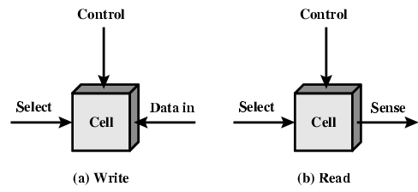
Memory Cell Operation
Address
Control
Data

Slide 5
Dynamic RAM - DRAM
Bits stored as charge in capacitors
Charges leak
Need refreshing even when powered
Simpler construction
Smaller per bit
Less expensive
Need refresh circuits
Slower
Main memory
Essentially analogue
Level of charge determines value

Slide 6
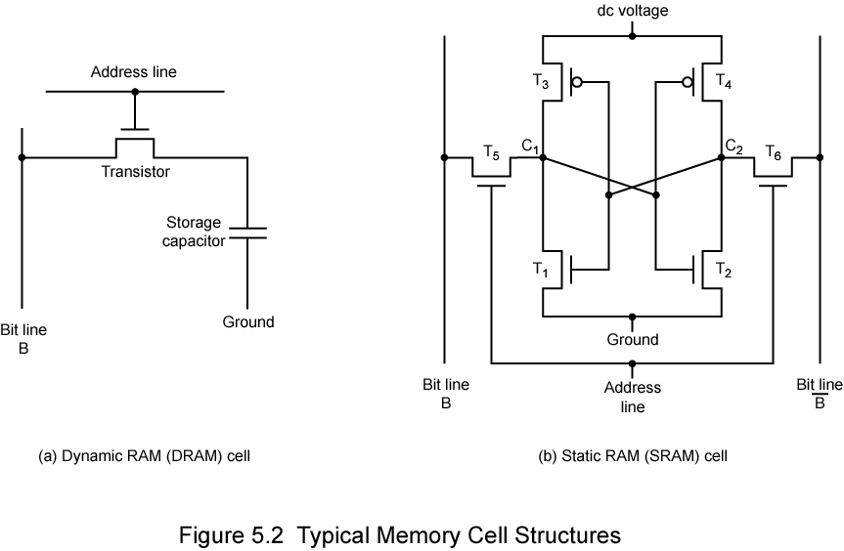
Dynamic RAM Structure
Items | Count
Transistor | 1
Capacitor | 1

Slide 7
Dynamic RAM Structure - READ
Address
Data

Slide 8
Dynamic RAM Structure - WRITE
Address
Data

Slide 9
DRAM Operation
Address line active when bit read or written
Transistor switch closed (current flows)
Write
Voltage to bit line
High for 1 low for 0
Then signal address line
Transfers charge to capacitor
Read
Address line selected
transistor turns on
Charge from capacitor fed via bit line to sense amplifier
Compares with reference value to determine 0 or 1
Capacitor charge must be restored

Slide 10
Static RAM - SRAM
Bits stored as on/off switches
No charges to leak
No refreshing needed when powered
More complex construction
Larger per bit
More expensive
Does not need refresh circuits
Faster
Cache
Digital
Uses flip-flops

Slide 11
Static RAM Structure
Items | Count
Transistor | 6
Capacitor | NIL

Slide 12
Static RAM Operation
Transistor arrangement gives stable logic state
State 1
C₁ high, C₂ low
T₁ T₄ off, T₂ T₃ on
State 0
C₂ high, C₁ low
T₂ T₃ off, T₁ T₄ on
Address line transistors T₅ T₆ is switch
Write – apply value to B & complement to B
Read – value is on line B

Slide 13
SRAM v DRAM
Both volatile
Power needed to preserve data
Dynamic cell
Simpler to build, smaller
More dense
Less expensive
Needs refresh
Larger memory units
Static
Faster
Cache

Slide 14
Read Only Memory (ROM)
Permanent storage
Nonvolatile
Microprogramming or microcode
Library subroutines
Systems programs (BIOS)
Function tables

Slide 15
Types of ROM
Written during manufacture
Very expensive for small runs
Programmable (once)
PROM
Needs special equipment to program
Read “mostly”
Erasable Programmable (EPROM)
Erased by UV
Electrically Erasable (EEPROM)
Takes much longer to write than read
Flash memory
Erase whole memory electrically

Slide 16
Organisation in detail
A 16 Mbit chip can be organised as 1M of 16 bit words
A bit per chip system has 16 lots of 1Mbit chip with bit 1 of each word in chip 1 and so on
A 16 Mbit chip can be organised as a 2048 x 2048 x 4 bit array
Reduces number of address pins
Multiplex row address and column address
11 pins to address (2¹¹=2048)
Adding one more pin doubles range of values so x4 capacity

Slide 17
Organization
2048 x 2048
1 Mbit

Slide 18
Refreshing
Refresh circuit included on chip
Disable chip
Count through rows
Read & Write back
Takes time
Slows down apparent performance

Slide 19
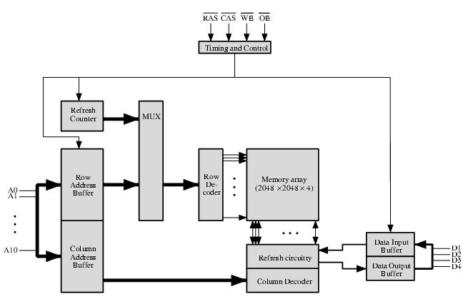
Typical 16 Mb DRAM (4M x 4)

Slide 20
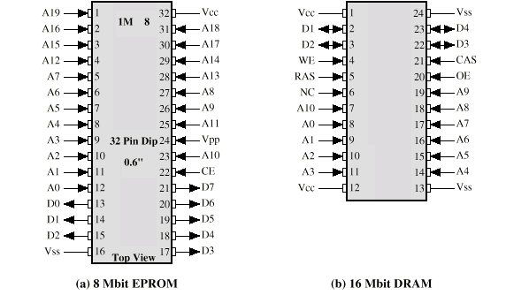
Packaging

Slide 21
Error Correction
Hard Failure
Permanent defect
Soft Error
Random, non-destructive
No permanent damage to memory
Detected using Hamming error correcting code

Slide 22
Advanced DRAM Organization
Basic DRAM same since first RAM chips
Enhanced DRAM
Contains small SRAM as well
SRAM holds last line read (c.f. Cache!)
Cache DRAM
Larger SRAM component
Use as cache or serial buffer

Slide 23
Synchronous DRAM (SDRAM)
Access is synchronized with an external clock
Address is presented to RAM
RAM finds data (CPU waits in conventional DRAM)
Since SDRAM moves data in time with system clock, CPU knows when data will be ready
CPU does not have to wait, it can do something else
Burst mode allows SDRAM to set up stream of data and fire it out in block

Slide 24
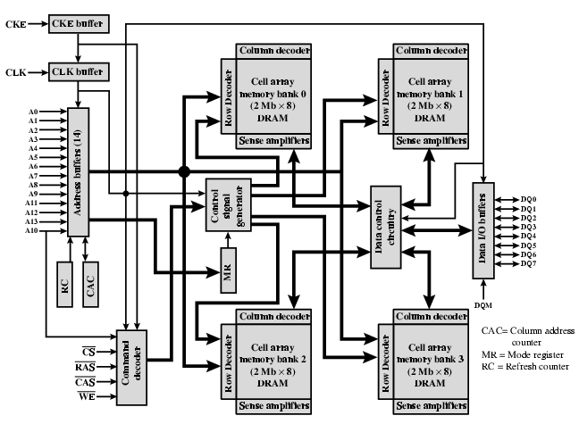
SDRAM

Slide 25
DDR SDRAM
SDRAM can only send data once per clock
Double-data-rate SDRAM can send data twice per clock cycle
Rising edge and falling edge

