Slide 1
External Memory
Magnetic storage and Optical Storage

Slide 2
External Memory
Used for data persistency
  High capacity
  Low access speed
  Low cost

Slide 3
Types of External Memory
Magnetic Disk
  RAID
  Removable
Optical
  CD-ROM
  CD-Recordable (CD-R)
  CD-R/W
  DVD
Magnetic Tape

Slide 4
Magnetic Storage
Hard Disk, Floppy Disks

Slide 5
Magnetic Disk
Disk substrate coated with magnetisable material (iron oxide…rust)
Substrate used to be aluminium
Now glass
  Improved surface uniformity
    Increases reliability
  Reduction in surface defects
    Reduced read/write errors
  Lower flight heights
  Better stiffness
  Better shock/damage resistance

Slide 6
Head
Recording & retrieval via conductive coil called a head
May be single read/write head or separate ones
During read/write, head is stationary, platter rotates

Slide 7
Write Mechanisms
Write
  Current through coil produces magnetic field
  Pulses sent to head
  Magnetic pattern recorded on surface below

Slide 8
Read Mechanisms
Read (traditional)
  Magnetic field moving relative to coil produces current
  Coil is the same for read and write
Read (contemporary)
  Separate read head, close to write head
  Partially shielded magneto resistive (MR) sensor
  Electrical resistance depends on direction of magnetic field
  High frequency operation
    Higher storage density and speed

Slide 9
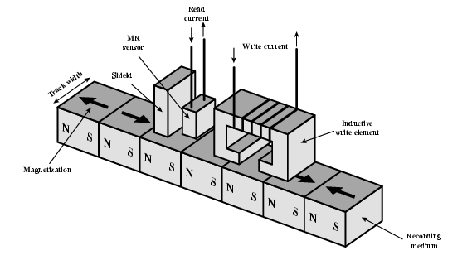
Inductive Write MR Read

Slide 10
Data Organization and Formatting
Concentric rings or tracks
  Gaps between tracks
  Reduce gap to increase capacity
  Same number of bits per track (variable packing density)
  Constant angular velocity
Tracks divided into sectors
Minimum block size is one sector
May have more than one sector per block

Slide 11
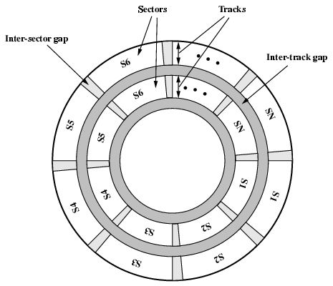
Disk Data Layout

Slide 12
Disk Velocity
Bit near centre of rotating disk passes fixed point slower than bit on outside of disk
Increase spacing between bits in different tracks
Rotate disk at constant angular velocity (CAV)
  Gives pie shaped sectors and concentric tracks
  Individual tracks and sectors addressable
  Move head to given track and wait for given sector
  Waste of space on outer tracks
    Lower data density

Slide 13
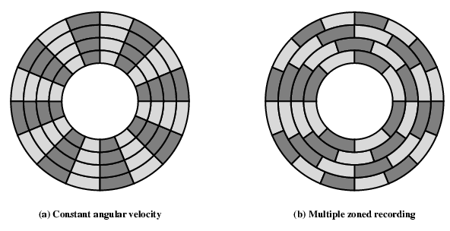
Disk Layout Methods Diagram

Slide 14
Finding Sectors
Must be able to identify start of track and sector
Format disk
  Additional information not available to user
  Marks tracks and sectors

Slide 15
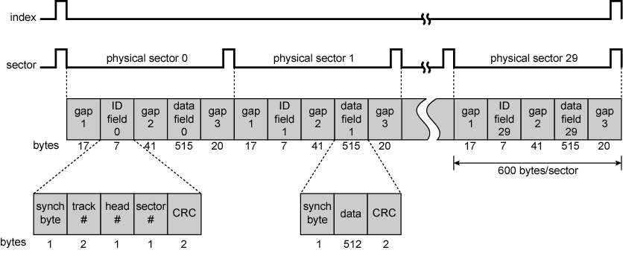
Winchester Disk Format - Seagate ST506

Slide 16
Characteristics
Fixed (rare) or movable head
Removable or fixed
Single or double (usually) sided
Single or multiple platter
Head mechanism
  Contact (Floppy)
  Fixed gap
  Flying (Winchester)

Slide 17
Fixed/Movable Head Disk
Fixed head
  One read write head per track
  Heads mounted on fixed ridged arm
Movable head
  One read write head per side
  Mounted on a movable arm

Slide 18
Removable or Not
Removable disk
  Can be removed from drive and replaced with another disk
  Provides unlimited storage capacity
  Easy data transfer between systems
Nonremovable disk
  Permanently mounted in the drive

Slide 19
Multiple Platter
One head per side
Heads are joined and aligned
Aligned tracks on each platter form cylinders
Data is striped by cylinder
  reduces head movement
  Increases speed (transfer rate)

Slide 20
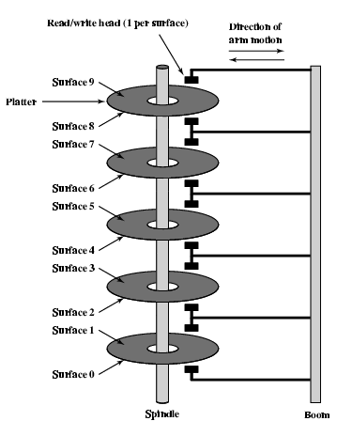
Multiple Platters

Slide 21
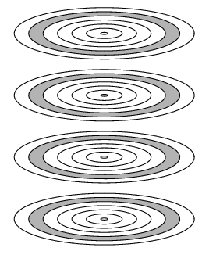
Tracks and Cylinders

Slide 22
Floppy Disk
8”, 5.25”, 3.5”
Small capacity
  Up to 1.44 Mbyte (2.88M never popular)
Slow
Universal
Cheap
Obsolete? --- YES

Slide 23
Removable Hard Disk
ZIP
  Cheap
  Very common
  Only 100M
JAZ
  Not cheap
  1G
L-120 (a: drive)
  Also reads 3.5” floppy
  Becoming more popular?
All obsoleted by CD-R and CD-R/W? -- YES

Slide 24
Speed
Seek time
  Moving head to correct track
(Rotational) latency
  Waiting for data to rotate under head
Access time = Seek + Latency
Transfer rate

Slide 25
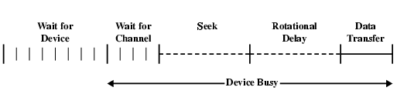
Timing of Disk I/O Transfer

Slide 26
Optical Storage
CD, DVD, Blu-ray

Slide 27
Optical Storage CD-ROM
Originally for audio
650Mbytes giving over 70 minutes audio
Polycarbonate coated with highly reflective coat, usually aluminium
Data stored as pits
Read by reflecting laser
  It is optical as the read/write mechanism is optical
  Photons are not stored....
Constant packing density
Constant linear velocity

Slide 28
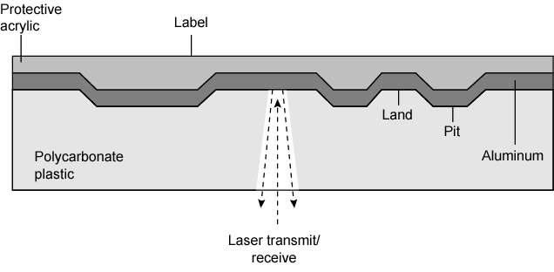
CD Operation

Slide 29
CD-ROM Drive Speeds
Audio is single speed
  Constant linier velocity
  1.2 ms⁻¹
  Track (spiral) is 5.27km long
  Gives 4391 seconds = 73.2 minutes
Other speeds are quoted as multiples
e.g. 24x
Quoted figure is maximum drive can achieve

Slide 30
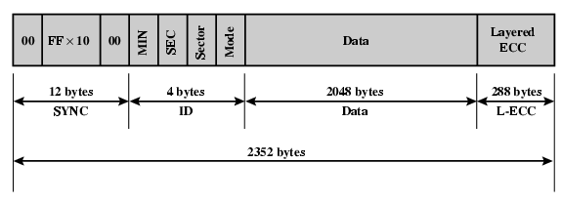
CD-ROM Format
Mode 0=blank data field
Mode 1=2048 byte data+error correction
Mode 2=2336 byte data

Slide 31
Random Access on CD-ROM
Difficult
Move head to rough position
Set correct speed
Read address
Adjust to required location

Slide 32
CD-ROM for & against
Large capacity
  Use lots of CDs
Easy to mass produce
Removable
Robust
Expensive for small runs
Slow
Read only

Slide 33
Other Optical Storage
CD-Recordable (CD-R)
  WORM
    Write once read many
  Now affordable
  Compatible with CD-ROM drives
CD-RW
  Erasable
  Getting cheaper
  Mostly CD-ROM drive compatible
  Phase change
    Material has two different reflectivity in different phase states

Slide 34
DVD
Digital Video Disk
  Used to indicate a player for movies
    Only plays video disks
Digital Versatile Disk
  Used to indicate a computer drive
    Will read computer disks and play video disks

Slide 35
DVD - technology
Multi-layer
Very high capacity (4.7G per layer)
Full length movie on single disk
  Using MPEG compression
Movies carry regional coding
Players only play correct region films
Can be “fixed”

Slide 36
DVD – Writable
Loads of trouble with standards
Compatibility issue
  First generation DVD drives may not read first generation DVD-W disks
  First generation DVD drives may not read CD-RW disks

Slide 37
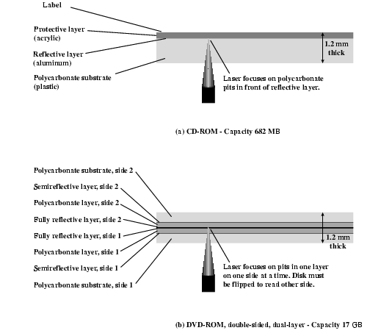
CD and DVD

Slide 38
Blu-ray Disc
High density, optical
The plastic disc is 120 mm in diameter and 1.2 mm thick, the same size as DVDs and CDs
Blu-ray Discs contain 25 GB per layer, with dual layer discs (50 GB) being the norm for feature-length video discs.
The major application of Blu-ray Discs is as a medium for video material such as feature films.

Slide 39
Tape Drives
Magnetic tapes

Slide 40
Magnetic Tape
Serial access
Slow
Very cheap
Backup and archive

Slide 41
Digital Audio Tape (DAT)
Uses rotating head (like video)
High capacity on small tape
  4Gbyte uncompressed
  8Gbyte compressed
Backup of PC/network servers

