Slide 1
Representations
Instr: Dr. Arif Raza
Source: Course Slides, HCI by Dr. Kamran Sedig
Department of Computer Science,
The University of Western Ontario, Canada

Slide 2
Representations
Representations and their different forms
Their role and power
Types and dimensions
Visual representations
Encoding techniques

Slide 3
Broad definition of representations
Using and combining different notational systems to encode information, along with rules for the interpretation of the notational system
Text
Color
Symbols
Lines Etc.

Slide 4
Ingredients
A representational system has two ingredients
represented world
  that which is represented
representing world
  a composite of symbols representing something in the external world
A representation combines elements according
to some syntactic rules (conforming to the rules of syntax) to convey meaning

Slide 5
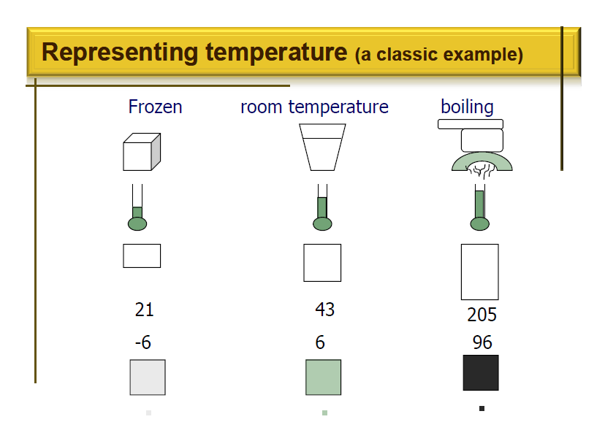

Slide 6
Representing temperature
Top row depicts water
  Frozen, room temperature, boiling
Next two rows
  Analog representations
Next two rows
  Numerical temperature notations
Last two rows
  Gray scale notation

Slide 7
Representing temperature
In each representation, the representing world loses information about the represented world
Depicting the numerical value of temperature
  Information about situation lost
  Shape of ice cube, size of glass of water, etc.
  Less and less fidelity (conformity), but more and more condense (abbreviate)

Slide 8
Forms of representations
Information can be represented in different forms
  A representation can be a sound, object, movement, gesture, mark, or an event
A form is a notation together with an interpretation of it
  The more abstract a notation becomes, the more information should be given about how it should be interpreted
Generally, the more abstract, the more condense and powerful

Slide 9
Forms of representations
Some notations
  Algebras, alphabets, animations, architectural
  drawings, programming languages, diagrams, flow
  charts, graphs, logical formalisms, mathematical
  formalisms, mechanical models, musical notations,
  punctuation systems, …

Slide 10
Static vs. interactive
Static
  are constant and don’t change
  e.g., representation of number “2” on this slide
  usually conveys syntax, structure, and surface semantics
Interactive / dynamic
  added temporal dimension
  may change form
  usually conveys deeper semantics, process, events, motion

Slide 11
Depictive vs. descriptive representations
Depictive / Analogical
  make use of icons or signs whose meanings are supposed to be conveyed through their visual form
  e.g., photographs, maps, drawings
Descriptive / Propositional
  make use of notational symbols whose meanings are supposed to be conveyed through conventions and rules
  are language-like and more abstract
  e.g., humans languages, formal systems of mathematics, computer languages

Slide 12
Internal vs. external
Internal
  refers to cognitive mental representation of users
External
  refers to representations by an external medium, e.g., computer screen

Slide 13
Representations as mental interfaces
Reps. can stand for a concept, event, object, or an idea and be connected to it
  through this connection, the representation and what it represents are perceived to have unity of meaning
    meanings can be simple, highly abstract, or with great interiority(inside)
  therefore, representations can act as mental interfaces
    i.e, we think using representations and through representations

Slide 14
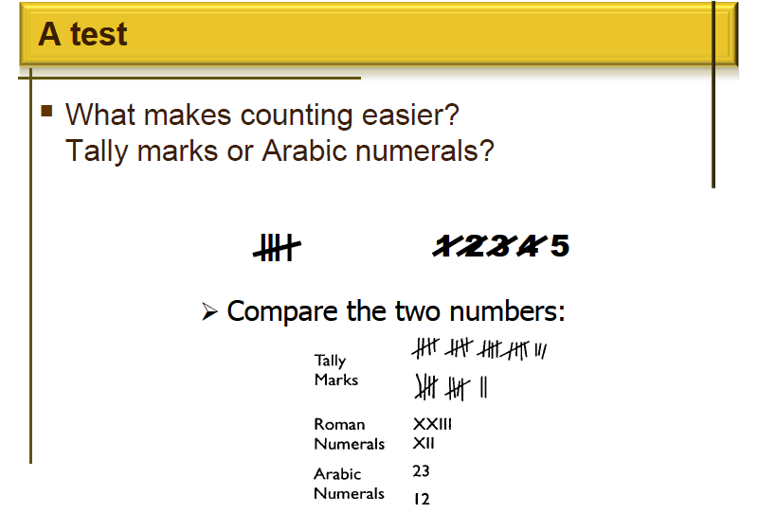

Slide 15
Principle
Tally marks are additive
  more difficult to read, but their size is proportional to the size of the number and can act like a visual graph
Arabic numerals are substitutive
  easier to read, but difficult to know the size based on the representation
Lesson
changes in representation often provide tradeoffs
one aspect of a task gets easier while another aspect can get more difficult

Slide 16
Role of representations
Representations play a central role in
cognition, communication, and hence design of HCI tools

Slide 17
Power of representations
The power of the unaided mind is highly
overrated (overestimated)
  memory, thought and reasoning are constrained(controlled) without external representational aids
    E.g, calculator, paper and pencil, books

Slide 18
Alternative representations
Two representations may be equivalent
informationally, but not computationally
  Graphs vs. equations
Different representations are stored differently
in the mind
Multiple, alternative representations may have
a synergistic (working together) mental effect

Slide 19
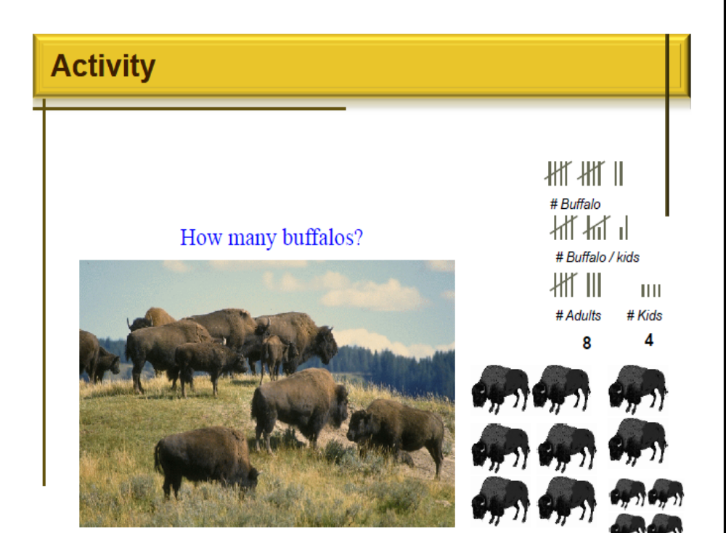

Slide 20
Appropriate representations
Allow people to find relevant information easily
  information may be present but difficult to find as in the case of the buffalos
Capture important, critical features of the
represented world
  deliberately ignoring the irrelevant

Slide 21
Dimensions of a representation
Must be appropriate / usable for
Content
  Eg, What is good to represent numbers?
Task
  Eg, If task is calculation, how should numbers be represented?
Users
  What representations support cognitive abilities and needs of its users

Slide 22
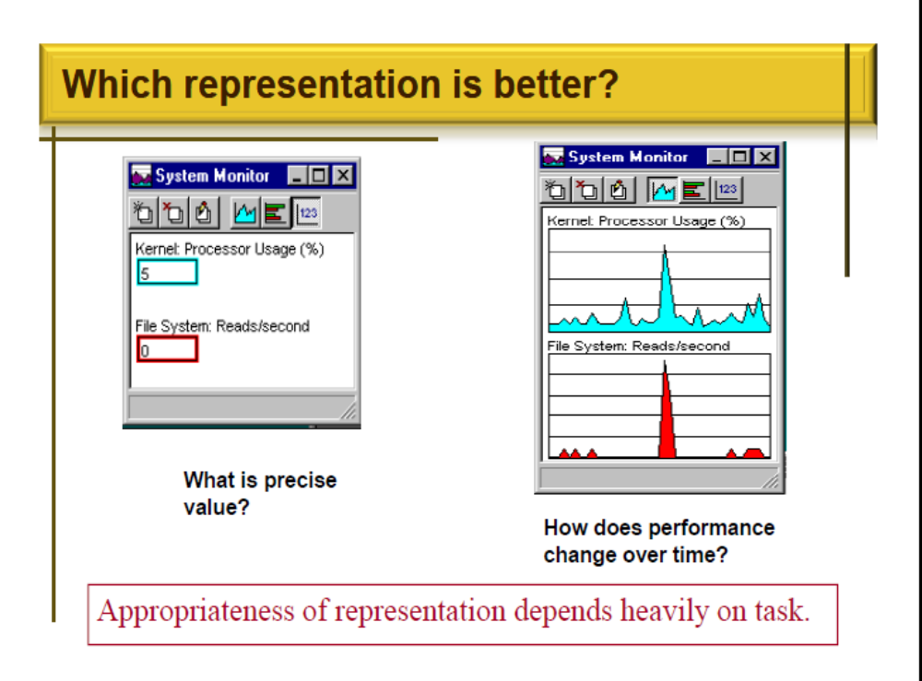

Slide 23
Why do representations matter?
2 major tasks for users of many information
displays
  finding relevant information easily and quickly
  interpreting and computing desired conclusions

Slide 24
Representations and cognitive effort
Representations can be
Reflective
  Requiring a lot of comparisons and cognitive effort to find elements and relationships and interpret their meaning
Experiential
  Easily perceived and interpreted

Slide 25
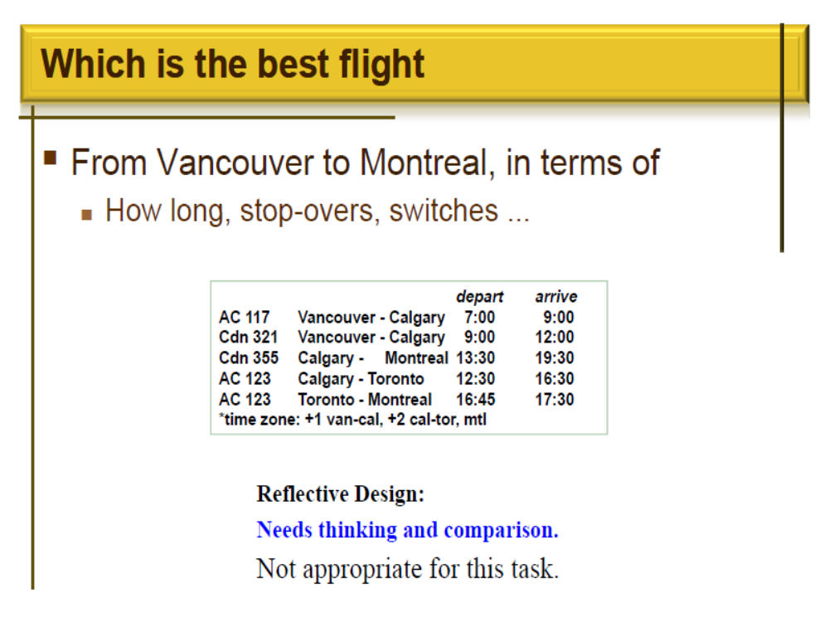

Slide 26
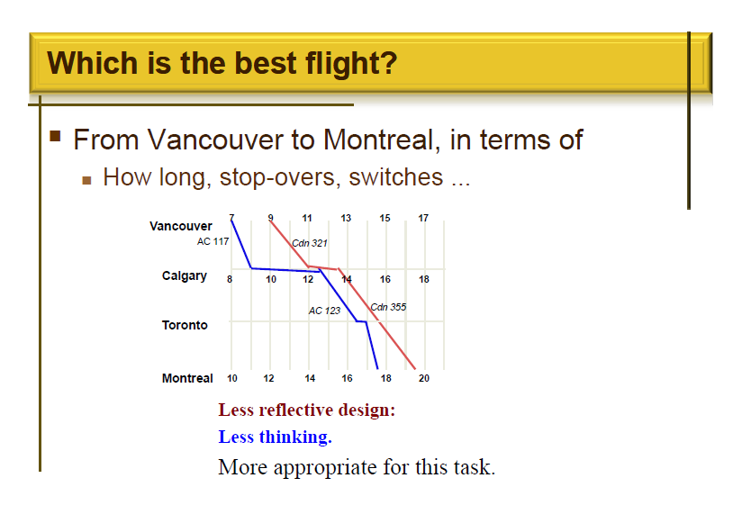

Slide 27
Some encoding techniques
Symbolic
Learnt by convention
Size, length, height
  Bigger - more important ; should be noticed
  Good for comparing
  Good for getting a qualitative feeling about info.
Multidimensional icons
  Packing lots into small space
Color
  Scales can provide a quick perceptual view of info.

Slide 28
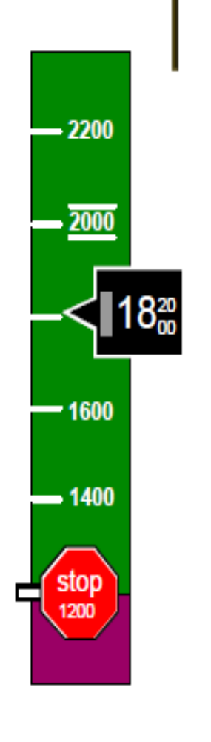
Encoding example: color
A cockpit altimeter
  Binary color indicator
    Green and purple
  Conventional height indicator
  Qualitative and quantitative indications of altitude

Slide 29
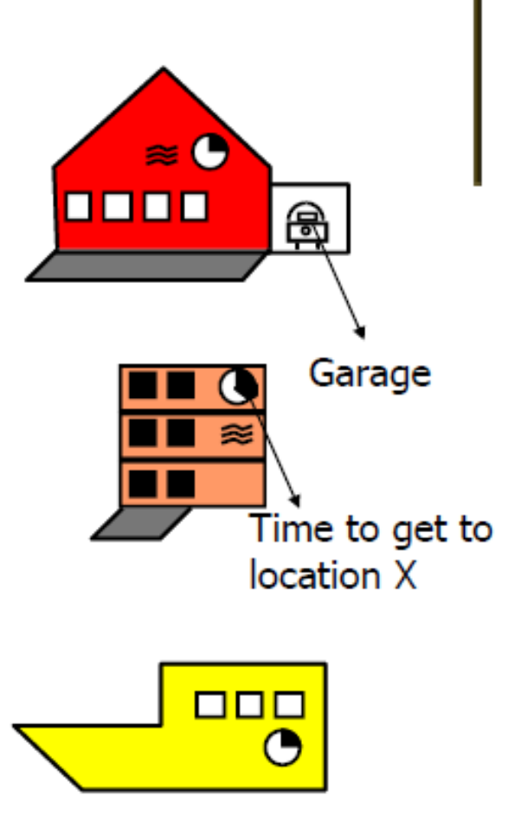
Encoding by multidimensional
icons
Shape: categorical
variable (house, flat, …)
Windows: # of rooms
Black/white: condition of room
Front parallelogram: size of yard
Much easier to process than text.

Slide 30
Summary
Representations play a central role in
cognition, decision making, communication,
learning, interface design
  Crucial to be aware of tradeoffs of different encoding techniques
Awareness of the task and how representation might be used is crucial(vital)

Slide 31
Summary
A representation is a visual structure upon which selected information is mapped
  Eg reps: graphs, tables, maps, diagrams, icons
Representations are made of encodings
  Eg: maps contain color, text, numbers, areas, lines, shapes, symbols, etc.

Slide 32
Summary: Last Word
Collection of representations create the
interface
External representations are the face of
software
Face of software is what users see
and interact with!

