Slide 1
Ch 6 –Transfers and Metaphors
CSE 476 - HCI

Slide 2
Transfer: Two levels
Transfer in HCI takes place at two levels
1. high, conceptual level
eg, how an application works
“This word processor is similar to the other one.”
2. low, detailed level
eg, how to cut and paste
“It’s just ctrl-X, ctrl-V; like the other one.”

Slide 3
Transfer: Three Types
There are 3 types of transfer:
1) Negative transfer
2) Zero transfer
3) Positive transfer

Slide 4
Negative Transfer
Previous knowledge conflicts with the new situation
E.g., quitting a Microsoft Windows application may not be like most other MS applications
Usually gets resolved after some period of
making mistakes
Can be troublesome, wasteful
Mistakes can make user feel stupid

Slide 5
Zero Transfer
User does not see any similarity between the
current situation or object and anything they
know from before
eg, knowing SQL does not readily transfer to MS Word
May be a desired effect when you design
something totally novel

Slide 6
Positive Transfer
Previous knowledge transfers to and supports the new situation
E.g., the overall concept of using one relational database vs. another
E.g., how menus are used across MS applications
May be desirable if you want users to know how to use an application quickly: transfer of usability across applications and platforms

Slide 7

Transfer
Which type of transfer?
negative
zero
positive

Slide 8
Fitts’ law
The time required to move to a target is a function of the target size and distance to the target
When designing systems that involve pointing, make sure that controls are near or large, especially when rapid movements and accuracy are important
E.g., design of car/plane dashboards

Slide 9
Hick’s law
The time it takes to make a decision increases as the number of alternatives increases
E.g. Menus
  The time for a user to select an item from a simple software menu increases with the number of items
Device settings
  The time for a person to make simple decisions about adjustments on a device increases with the number of controls

Slide 10
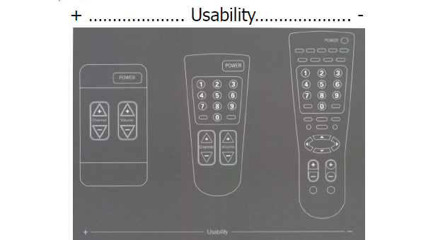
Flexibility-usability tradeoff?
As the flexibility of a system increases, its usability decreases

Slide 11
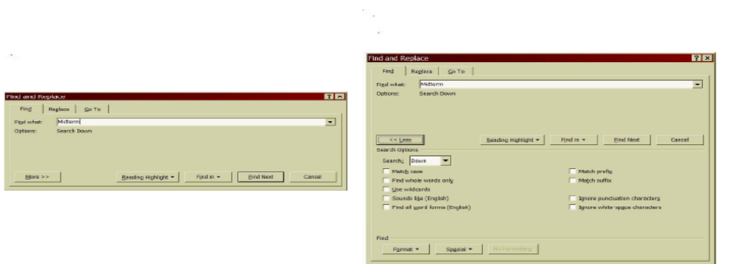
Progressive disclosure?
A strategy for managing information complexity in which only necessary or requested information is displayed at any given time

Slide 12
Causality?
The thing that happens right after an action is interpreted by people to be caused by that action
False causality
simultaneous effect
  starting up an unfamiliar application just as computer crashes causes “superstitious” behaviors
invisible effect
  command with no apparent result often re-entered repeatedly
  eg, mouse click to raise menu on unresponsive system

Slide 13
Metaphors
What is a metaphor?
One thing is conceived representing another

Slide 14
What is a metaphor?
The transference of the relation between one set of objects to another set for the purpose of brief explanation (Webster’s)
“A metaphor is an invisible web of terms and associations that underlies the way we speak and think about a concept.”

Slide 15
Metaphors we live by
Lakoff & Johnson : “...the way we think, what we experience, and what we do every day is very much a matter of metaphor.''
How do we think about arguing?
“argument is war”
  Defend and attack a position
  Criticisms right on target
  An indefensible argument
  Strategies to attack weak points of an argument and destroy their position

Slide 16
Function of metaphors
“Metaphors function as natural models, allowing us to take our knowledge of the familiar, concrete objects and experiences and use it to give more structure to more abstract concepts.”
How do we use metaphors when designing interfaces?

Slide 17
Computer as metaphor
Computer can stand for a number of things depending on how they are portrayed
  tool / appliance
    getting user’s tasks done
  person
    interaction, communication, sharing
  media
    channel / path for communication…
  Vehicle
    getting to where the user wants to go

Slide 18
Metaphors in computers
Became popular with graphical user interface of Xerox Star
Metaphoric use of desktop items
  E.g., folders, documents
  Not a real desktop
Later on, everyone started using metaphors
  notebooks, buildings, cities, cards
Knowledge about elements and their relations to each other is mapped onto elements and their relations in the unfamiliar HCI domain

Slide 19
HCI and metaphors
Almost all aspects of a computer system are based on metaphors
objects on the screen
  windows, menus, buttons, palettes, pointers, icons
types of interactions performed
  direct manipulation, command-based, gesture
system response
  scrolling a document up/down/right/left
names given to commands
  cut, paste, copy, move, pipe
internal models of the computer
  memory (linear, pointers, links, …), I/O

Slide 20
Metaphors and conceptual models
Metaphors are closely linked to conceptual models
  humans think metaphorically
  metaphor implies a model
  model cannot easily be understood without a metaphor

Slide 21
How do metaphors help?
Metaphors
  Do not reduce absolute complexity
  But, they do reduce complexity relatively

Slide 22
2 kinds of metaphors
1. Familiarizing metaphors
  uses familiar objects and actions to help create a corresponding model on the computer
  facilitates transfer of existing knowledge to application
eg, desktop metaphor
  objects: documents, folders
  actions: opening a document; moving a document to a folder
easier to learn initially

Slide 23
2 kinds of metaphors – contd…
2) Transporting metaphors
  provides a new way of thinking / model in the computer environment
  eg, spreadsheet (active table cells which did not exist before)
  used in financial, scientific, graphic, … applications
  more difficult to learn initially, but may make it easier for designers to expand

Slide 24
Composite metaphors
Mixing two or more metaphors
eg, desktop interfaces such as MS Windows
  Metaphors combined together
  Desktop: files, folders
  accessory tools: calendar, clipboard
  direct manipulation: pointing at objects and selecting them
Complementary metaphors dividing up interface function at a single level
eg, integrated office system such as MS Office
  separate metaphor for each constituent application
  spreadsheets, text editing, decision support

Slide 25
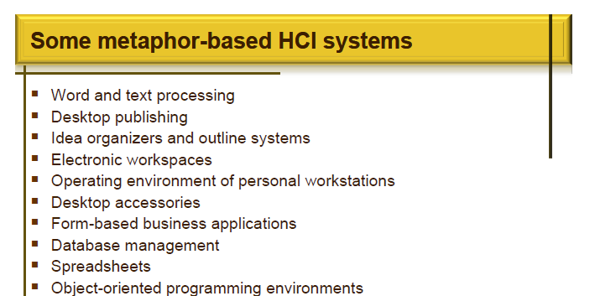

Slide 26
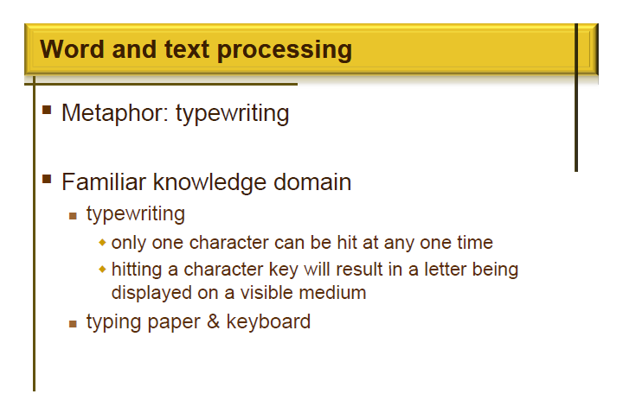

Slide 27
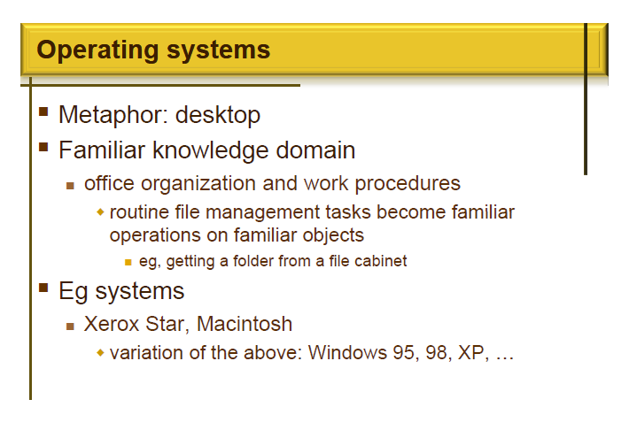

Slide 28
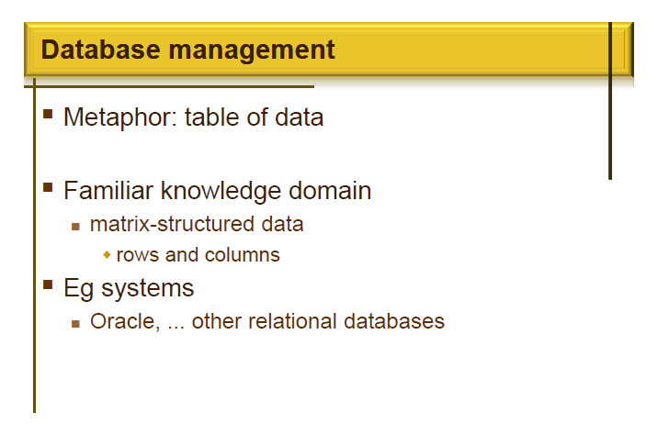

Slide 29
Metaphor & inconsistency with real world
Usefulness of metaphors depends on how well they allow users to understand and predict system behavior
not on how “literally” they copy real world

Slide 30
Two ways to address inconsistency
1) consciously known to user
  color mixing in electronic drawing/paint programs
  novice fine-arts users resist using the system
  adapt after they become conscious of how computer operates
2) of no consequence to user’s activity
  electronic pencil tool in paint programs
  real world: artists turn pencil at various angles to get different width and shading effects;
  computer: “pencil” can be assigned a near-infinite variety of width and characteristics

Slide 31
Question
In the real world, when documents age, they become yellowish
If you were to use a color as metaphor to signify age of documents, what would you do?

Slide 32
Metaphors and color coding
“age of document” metaphor
real world: documents fade to yellow over time
computer:
  new: white
  older: progressive saturation of yellow
  doesn’t work
Problem
  oldest item (deep yellow) leaps out of screen and dominates white

Slide 33
Metaphors and color coding
Alternative
  progress from yellow to duller shades of brown
Lesson
  exact replication of real-world metaphor does not always work
use metaphor to help develop ideas but be careful that it does not end up confusing users

Slide 34
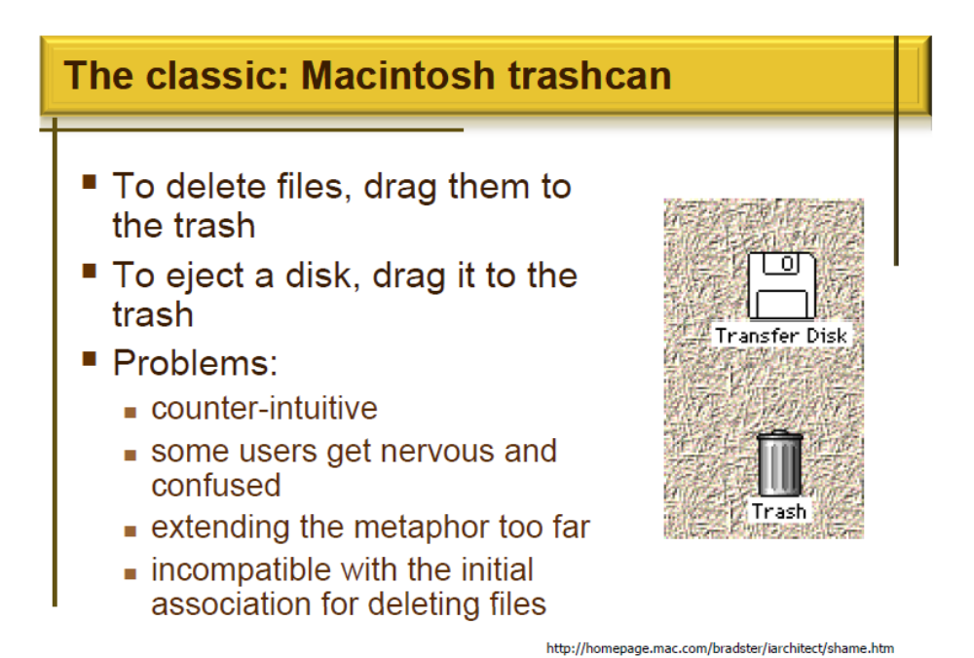

Slide 35
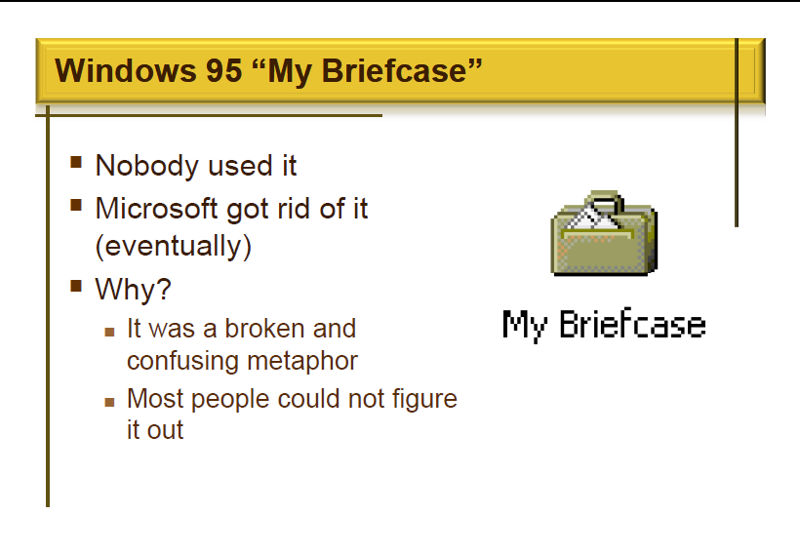

Slide 36
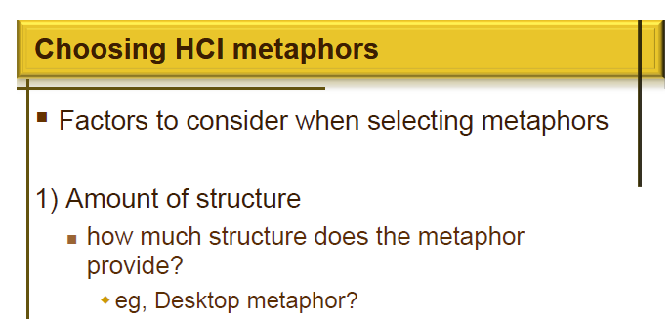

Slide 37
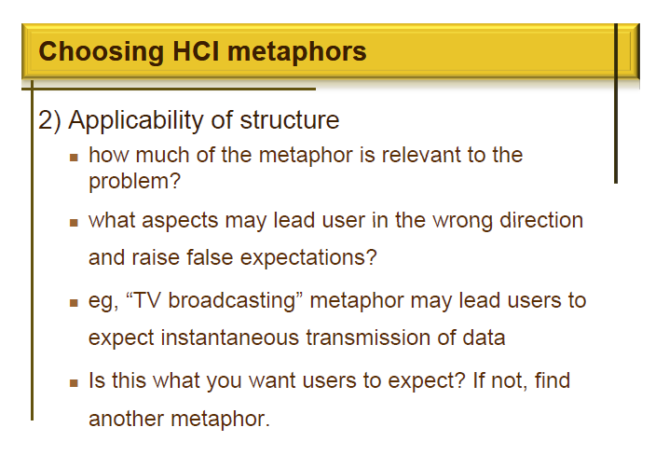

Slide 38
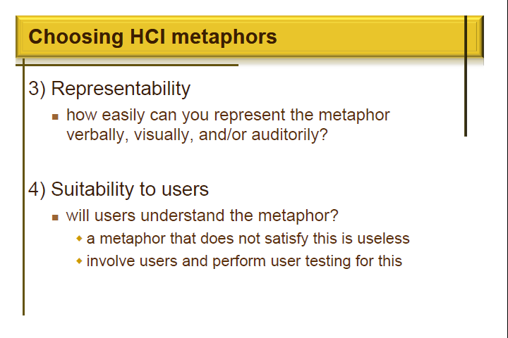

Slide 39
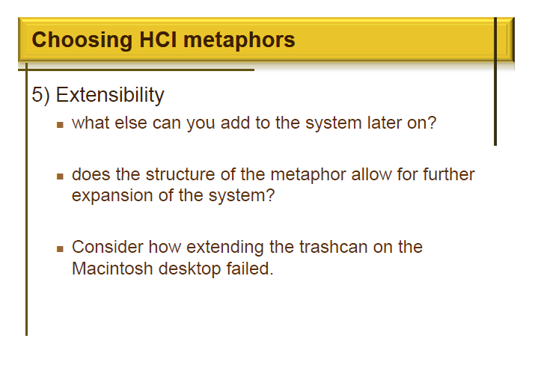

Slide 40
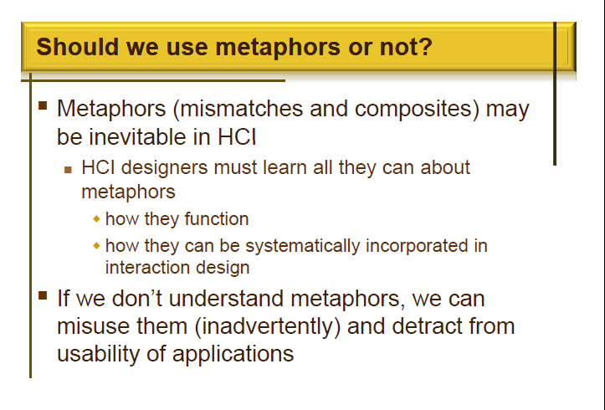

Slide 41
