Slide 1
Chapter-2
PACT
Instr: Dr. Arif Raza
Ref: Designing Interactive Systems: A Comprehensive Guide to HCI and Interaction Design, 2/E, David Benyon, Addison-Wesley, 2010

Slide 2
Aim
The aim of this chapter is to get familiar with our framework for interaction design, PACT.
It stands for People, Activities, Contexts, Technologies, the four components that need to be brought together when designing interactive systems.

Slide 3
Key Points
Designers need to understand the people who will use their systems and products.
They need to understand the activities that people want to undertake and the contexts in which those activities take place.
Designers also need to know about the features of interactive technologies and how to approach designing interactive systems.
Doing a PACT analysis is an effective way of understanding and designing interactive systems.

Slide 4
People
The key features of people that interaction designers need to think about.

Slide 5
Physical differences
Physical differences need to be considered.
People have different personalities and cognitive skills and preferences.
Ergonomics is the study of the relationships between people and technologies.

Slide 6
Physical differences – contd…
Variability in the five senses-
Color blindness affects about 8% of western males
In Europe there are around 3 million wheelchair users
Short sightedness and
long sightedness
affect many
Many
people
are hearing
impaired

Slide 7
Psychological differences
Two main ideas are important,
  individual differences and
  mental models

Slide 8
Psychological (individual) differences
Language Differences
e.g. tick and cross
Spatial Ability
basic cognitive abilities
Recognition vs Memorization

Slide 9
Psychological differences – contd…
The Myers-Brigg site is a good source of material http://www.myersbriggs.org/.
There are thousands of web sites offering personality tests, e.g. http://www.testsonthenet.com/index_new.htm

Slide 10
Psychological differences – mental models
The understanding and knowledge that we possess of something is referred to as a ‘mental model’.
They are also called conceptual models
Understanding is absolutely central to interaction design and it is worth spending time to think about the ideas.
We have, services, processes, products such as a central heating system, a central locking system on a car. It is all down to your mental model.

Slide 11
Think about your mental models of everyday objects and things.
a central locking
system on a car
mental models of structures
Where is LMS
link on
mims web site?
How does a tap work?
How does anything work?

Slide 12
Usage Differences
Novice Users
Expert Users
Discretionary
users
Homogeneous
Group
Heterogenous
group
Designing websites
Vs
A company’s intranet

Slide 13
Activities
There are many characteristics that an activity may possess.
Main features are
  Temporal Aspects
  Cooperation
  Complexity
  Safety Critical
  The nature of the content

Slide 14
Activities - Temporal Aspects
Temporal Aspects cover how regular or infrequent activities are.
Something that happens everyday have a different design from something that happens once a year.
Using cell phone vs changing its battery
Frequent task should be easy to do, infrequent task should be easy to learn how to do.

Slide 15
Activities - Temporal Aspects
Single, or
Continuous set of actions
or
with interruption
Normal working
vs
peak/time pressure
Response Time

Slide 16
Activities - Cooperation
This is about whether activities can be carried out alone or
Working with others is essential.
Issues of awareness of others and communication and coordination become important.

Slide 17
Activities - Complexity
Well defined tasks need different designs from more vague tasks.
A well defined task can be accomplished with a simple step by step design.
A vague activity means people have to be able to browse around, see different information, move things around and so on.

Slide 18
Activities - Safety Critical
Mistakes could result
in some harm
Injury or a
serious accident
Vital to foresee
what may happen

Slide 19
Activities - The nature of the content
Data Requirements of the activity
  Large alphabetical data
  Numeric data or
  A Video
Media to be used
  Requirements of a simple two tone display of numeric data vs a full motion multimedia display

Slide 20
Contexts
The three main aspects of context
  social,
  organizational and
  physical.

Slide 21
Contexts – physical environment
Sun shining on
an ATM display
Noisy, cold / hot
Geographically remote

Slide 22
Contexts – Social context
Supportive environment:
Help available
Social norms
Privacy issues

Slide 23
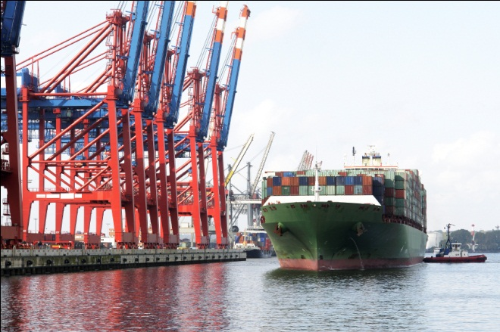


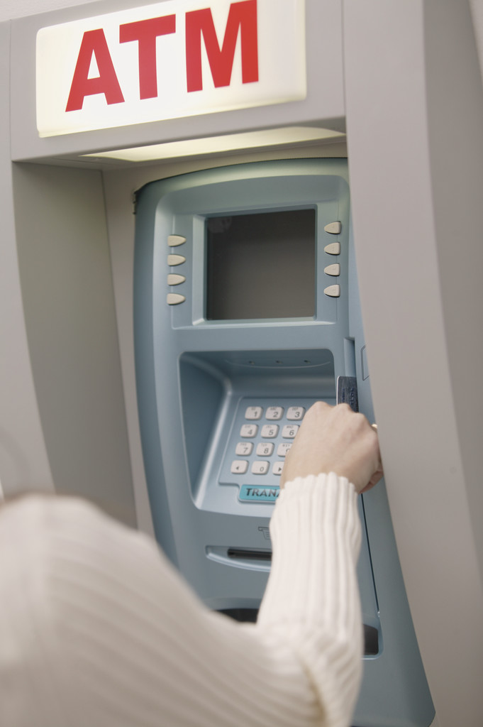
Contexts – Organizational context

Slide 24
Technologies
Aim
To introduce the main technological components of interactive systems design.

Slide 25
Technologies
There is both an abstract side to this section and a concrete side.
For concrete examples of technologies go to an electronics on-line shop such as http://www.engadget.com which has reviews and descriptions of all manner of technologies.

Slide 26
Technologies – contd…
For the more abstract aspects think about
  Input – entering data, instructing the device
  Output – displaying content in an appropriate fashion
  Communication – between devices, linking devices together. Talk about different layers of communication and different communication protocols
  Content – what is the form of the content, and what information is it meant to convey?

Slide 27
PACT analysis, design method
PACT analysis is a first human-centered design method.
By considering all the various characteristics of the people, the activities they are doing, the contexts in which they take place and the technologies that are available, you can begin to understand a domain in terms of interaction design and begin to form solutions.

Slide 28
PACT analysis, design method
The designer need to scope out the variety of Ps, As, Cs and Ts that are possible.
This can be done through
  Brainstorming
  Observations
  Interviews
  Workshops

Slide 29
PACT analysis, design method
The results can be written as ‘Scenarios of Use’
The designer should look for trade-offs between different combinations of PACT and their effects.

Slide 30
PACT analysis
For People
Group of stakeholders who might never use the system
Physical, Psychological and Social Differences
All the stakeholders to be considered , not just the end-users

Slide 31
PACT analysis
For Activities
Cooperative features and the nature of data
Complexity – Focused or vague, simple or difficult
Temporal Aspects (Frequency, continuous or interruptible)

Slide 32
PACT analysis
For Contexts
Organizational Settings
Physical
Social

Slide 33
PACT analysis
For Technologies
Communication and content
Input
output

Slide 34
PACT analysis - Case study
To design/develop a system for a university department to access their laboratories.

Slide 35
PACT analysis, Case study
People
People in wheelchairs and with color blindness need to be considered
All these people are well educated and understand things such as swipe cards, passwords etc.
Students, instructors and technicians
visitors and frequent users
-Other stake holders e.g. cleaning staff and security personnel

Slide 36
PACT analysis, Case study
Activities
Overall purpose – To enter some form of security clearance and to open the door.
Temporal Aspects –Well Defined Activity
Frequent with peak at the start of each lab session.
Data – Numeric or Alphanumeric code
Activity does not require cooperation with others
Security is important but not a safety critical activity.

Slide 37
PACT analysis, Case study
For Contexts
Organizational Settings : primarily security context
Physical :
Activity takes place indoors
Social: It may happen in a crowd
Or It may happen at night or on a holiday

Slide 38
PACT analysis, Case study
For Technologies
Output: needs to be clearly visible whether the entered data has been accepted or not.
Door to open if the process is successful
Communication : with a central db to validate
Input : A small amount of data has to be entered quickly.
Must be obvious for visitors and infrequent users

Slide 39
Human Centered Interactive Systems Design
Five Activities
Understanding – where designers observe and analyze the information / problem
Abstracting - where designers focus on the main elements of a problem
Structuring - where designers consider the relationships b/w the elements and people
Representing – how the structure can be represented
Detailing – concerned with colours, movements, etc.
G.C. Smith and P. Tabor (1996)

Slide 40
Activities in Interactive System Design
Prototyping and
Envisionment
Requirements
Evaluation
Star Life Cycle, Hix and Hartson, 1993
Conceptual Design
Physical Design

Slide 41
Activities in Interactive System Design
Evaluation is central to designing interactive systems. Everything gets evaluated at every step.
The activities can happen in any order.

Slide 42
Requirements
Requirements are concerned with:
  What the system has to do
  What it has to be like
  How it has to fit with other things

Slide 43
Requirements – contd…
Functional Requirements – What the system should be able to do and what are functional constraints
Non-Functional Requirements : define how a system is supposed to be
Reqs are generated through discussions with stakeholders

Slide 44
Conceptual Design
Conceptual Design is concerned with:
  Designing a system in abstract
  What information and functions are needed
  Deciding what someone will have to know to use the system

Slide 45
Conceptual Design– Techniques
Modelling – Use Case Models
Entity Relationship models
State machines

Slide 46
Physical Design
Physical Design is concerned with:
  How things are going to work
  The look and feel of the product
  Structuring interactions into logical sequences
Physical design takes abstract representation and translates it into concrete design

Slide 47
Physical Design
Defines knowledge, tasks and activities that people will be required to do
Defines HW and SW requirements

Slide 48
Physical Design - Components
Operational Design
Representational Design
Design of Interactions

Slide 49
Operational Design
Operational Design is concerned with:
  How everything works
  How content is structured and stored
  Focusing on:
    Processes
    Movements
    Flow of things
Events are occurrences that cause, or trigger some other functions (from outside or inside)

Slide 50
Representational Design
Fixing on colours, shapes, sizes and information layout.
Style and
Aesthetics
Attitudes and Feelings of people

Slide 51
Interaction Design
Interaction Design is concerned with:
  Allocation of functions to human beings or to technology
  Sequencing of the interactions

Slide 52
Prototyping and Envisionment
Prototyping and Envisionment is concerned with:
  Finding appropriate media to render(reduce) design ideas for:
    The process
    The audience
    The resources available
    The questions that the prototype is helping to answer
  Sketches, Cardboard mock-ups, pictorial forms etc are some of the examples.

Slide 53
Evaluation
Every design activity is followed by evaluation
Designer checking through to ensure completion and correctness of design
List of requirements
High level design
Functional Prototype

