Slide 1
LECTURE 01
FIRST DAY HAND OUT

Slide 2
NUMERICAL METHODS

Slide 3
An Introduction

Slide 4
What Are Numerical Methods?
Techniques by which mathematical problems are formulated so that they can be solved with arithmetic operations {+,-,*,/} that can then be performed by a computer. Algorithms are used to obtain numerical solutions of a mathematical problem.
Numerical Methods involves the study, development , and analysis of algorithm for obtaining solutions to various mathematical problems.

Slide 5
DETAIL INFORMATIONS
Pre Requisites :-Calculus, Programming
Course Code :-MATH- 352
Credits :- 2+1 Hours
Instructor :- Gp Capt Umar Farooq(R)
Email :-umar_mcs@yahoo.com
Schedule and RV
Training Program-Spring Semester 2012
Office Hours (STI)
Training Program-Spring Semester 2012
Marks Distribution
10% assignments, 10% quizzes, 30% mid-term exam, 50% final exam

Slide 6
RECOMMEMDED BOOKS
TEXT BOOKS
Numerical Methods Using MATLAB , (Fourth Edition)
by John H Mathews
Numerical Methods by: DrV.N..Vedamurthy
&
Dr V.S. Niyengar
REFRENCE BOOKS
Numerical Analysis
by R.Gupta.
Numerical Mathematics
by Jerome C.R. Li

Slide 7
OBJECTIVES OF THE COURSE
The primary goal is to provide an engineer with a basic knowledge of numerical methods. The numerical techniques learned in this course enable students to work with mathematical models of technology and systems. Homework and projects in other courses require the mathematical and numerical skills obtained in MTH- 352. MATLAB is the software environment used for implementation and application of these numerical methods.

Slide 8
Outlines of the Course
Error Analysis
Taylor Theorem
Solution of nonlinear Equations
Interpolation
Least Squares curve fitting
Numerical Differentiation
Numerical Integration
Solution of ordinary differential equations

Slide 9
Numerical Methods
Why do we need them?
1. No analytical solution exists.
2. An analytical solution is difficult to obtain
or not practical.

Slide 10
Why You Need to Learn Numerical Methods?
Numerical methods are extremely powerful problem-solving tool
During your career, you may often need to use commercial computer programs (canned programs) that involve numerical methods. You need to know the basic theory of numerical methods in order to be a better user.
You will often encounter problems that cannot be solved by existing canned programs; you must write your own program of numerical methods.

Slide 11
Why You Need to Learn Numerical Methods?
4.Numerical methods are an efficient vehicle for learning to use computers.
5.Numerical methods provide a good opportunity for you to reinforce your understanding of mathematics.
You need that in your life as an engineer or a scientist.

Slide 12
LIST OF PRACTICALS
Difference Table
Newton forward difference Interpolation
Newton Backward Difference Interpolation
Interpolation using Lagrange formula
Derivative using Newton Forward difference formula
Derivatives using Newton back ward
Difference formula
Numerical Integration by using Trapozoidal Rule
Numerical Integration by using Simpson’s 1/3 Rule

Slide 13
LIST OF PRACTICALS
Numerical Integration by using Simpson’s 3/8 l Rule
Differential Equations by Euler’s Method
Differential Equations by Euler’s modified Method
Differential Equations by Runge-Kutta Method
Non Linear Equations by Bisection Method
Non Linear Equations by Secant Method
Non Linear Equations by Raphson Method
Non Linear Equations by Method of false position

Slide 14
BRIEF OF TOPICS

Slide 15
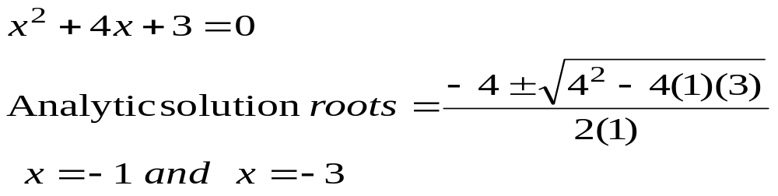
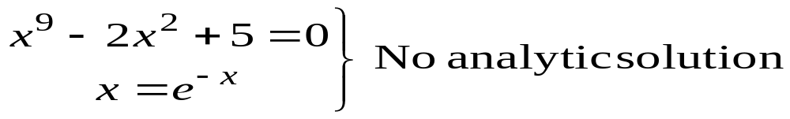
Solution of Nonlinear Equations
Some simple equations can be solved analytically
Many other equations have no analytical solution

Slide 16
Methods for solving Nonlinear Equations
Bisection Method
Newton-Raphson Method
Secant Method

Slide 17
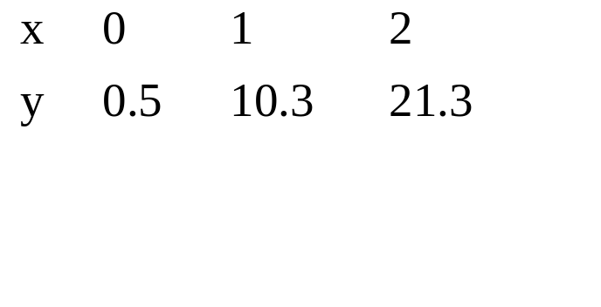
Curve Fitting
Given a set of data
Select a curve that best fit the data. One choice is find the curve so that the sum of the square of the error is minimized.

Slide 18

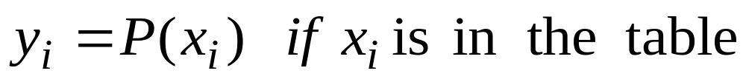
Interpolation
Given a set of data
find a polynomial P(x) whose graph passes through all tabulated points.

Slide 19
Methods for Curve Fitting
Least Squares
  Linear Regression
  Nonlinear least Squares Problems
Interpolation
  Newton polynomial interpolation
  Lagrange interpolation
  Cubic Spline
  Bezier Curves

Slide 20
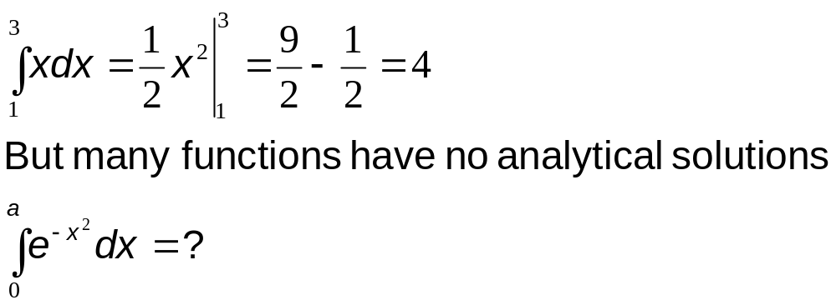
Integration
Some functions can be integrated analytically

Slide 21
Methods for Numerical Integration
Upper and Lower Sums
Trapezoid Method
Romberg Method
Gauss Quadrature

Slide 22
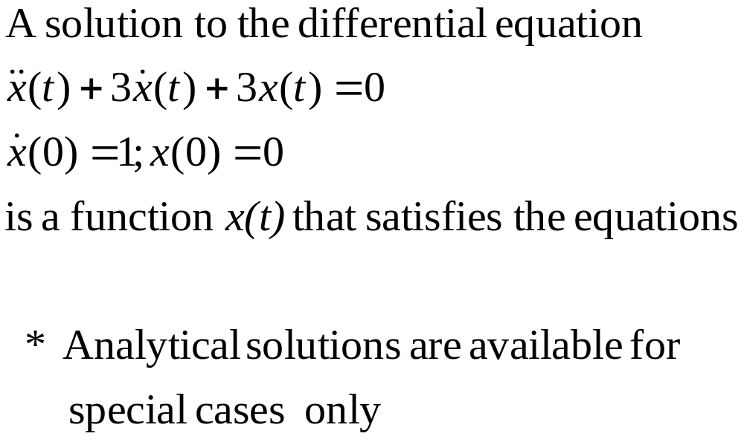
Solution of Ordinary Differential Equations

