Slide 1
LECTURE # 2

Slide 2
ERROR ANALYSIS

Slide 3
Why measure errors?
1) To determine the accuracy of numerical results.
2) To develop stopping criteria for iterative algorithms.

Slide 4
Error Definitions
True Error can be computed if the true value is known

Slide 5
Notation
We say the estimate is correct to n decimal digits if
We say the estimate is correct to n decimal digits rounded if

Slide 6
Example—True Error
The derivative,
of a function
can be
approximated by the equation,
If
and
a) Find the approximate value of
b) True value of
c) True error for part (a)

Slide 7
Example (cont.)
Solution:
a) For
and

Slide 8
Example (cont.)
Solution:
b) The exact value of
can be found by using
our knowledge of differential calculus.
So the true value of
is
True error is calculated as
True Value – Approximate Value

Slide 9
Example—Relative True Error
Following from the previous example for true error,
find the relative true error for
at
with
From the previous example,
Relative True Error is defined as
as a percentage,

Slide 10
Approximate Error
What can be done if true values are not known or are very difficult to obtain?
Approximate error is defined as the difference between the present approximation and the previous approximation.

Slide 11
Error Definitions
Estimated Error When the true value is not known

Slide 12
Example—Approximate Error
For
at
find the following,
a)
using
b)
using
c) approximate error for the value of
for part b)
Solution:
a) For
and

Slide 13
Example (cont.)
Solution: (cont.)
b) For
and

Slide 14
Example (cont.)
Solution: (cont.)
c) So the approximate error,
is
Present Approximation – Previous Approximation

Slide 15
Relative Approximate Error
Defined as the ratio between the approximate error and the present approximation.
Approximate Error
Relative Approximate Error (
) =
Present Approximation

Slide 16
Example—Relative Approximate Error
For
at
, find the relative approximate
error using values from
and
Solution:
From Example 3, the approximate value of
using
and
using
Present Approximation – Previous Approximation

Slide 17
Types Error
Truncation Error
This refers to errors introduced when a more complicated mathematical expression is replaced with a more elementary formula.
Truncation errors are those that result from using an approximation in place of an exact mathematical procedure.
Round-off Error
A computer’s representation of real numbers is limited to the fixed precision of the mantissa. True values are sometimes not stored exactly by a computer’s representation. This is called round-off error
Round-off error is due to the fact that computers can only represent quantities with a finite number of digits.

Slide 18
Example of Truncation Error
Taking only a few terms of a Maclaurin series to
approximate
If only 3 terms are used,

Slide 19
Significant Digits
Significant digits are those digits that can be used with confidence.

Slide 20
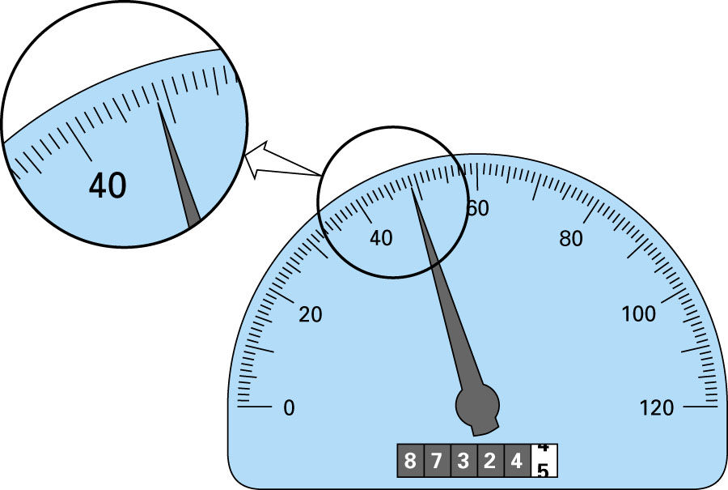
48.9

Slide 21
SIGNIFICANT DIGITS

