Slide 1
LECTURE # 3

Slide 2
Number Representation and Computer Accuracy
Number Representation
Normalized Floating Point Representation
Rounding and Chopping

Slide 3
Representing Real Numbers
You are familiar with the decimal system
Decimal System Base =10 , Digits(0,1,…9)
Standard Representations

Slide 4
Fractional Binary Numbers
2^{i}
2^{i–1}
4
• • •
2
1
b_{i}
b_{i–1}
• • •
b₂
b₁
b₀
.
b_{–1}
b_{–2}
b_{–3}
• • •
b_{–j}
1/2
1/4
• • •
1/8
2^{–j}
Representation
Bits to right of “binary point” represent fractional powers of 2
Represents rational number:

Slide 5
Frac. Binary Number Examples
Value Representation
5-3/4 101.11₂
2-7/8 10.111₂
63/64 0.111111₂
Observations
Divide by 2 by shifting right
Multiply by 2 by shifting left
Numbers of form 0.111111…₂ just below 1.0
1/2 + 1/4 + 1/8 + … + 1/2^{i} + … → 1.0
Use notation 1.0 – ε

Slide 6
Representable Numbers
Limitation
Can only exactly represent numbers of the form x/2^{k}
Other numbers have repeating bit representations
Value Representation
1/3 0.0101010101[01]…₂
1/5 0.001100110011[0011]…₂
1/10 0.0001100110011[0011]…₂

Slide 7
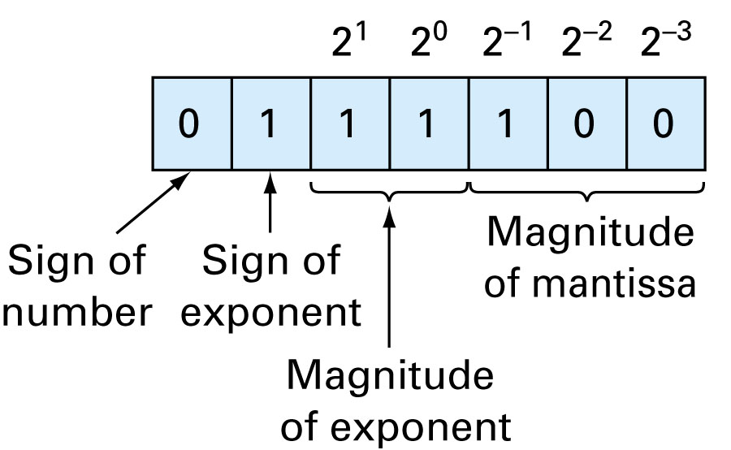
7-Bit Representation (sign: 1 bit, Mantissa 3bits,exponent 3 bits)

Slide 8
Example
9 bit-hypothetical word
the first bit is used for the sign of the number,
the second bit for the sign of the exponent,
the next four bits for the mantissa, and
the next three bits for the exponent
We have the representation as
0 | 0 | 1 | 0 | 1 | 1 | 1 | 0 | 1
mantissa
exponent
Sign of the number
Sign of the exponent

Slide 9
Representation
Hypothetical Machine (using 6 bits to rep number)
Mantissa 3 bits exponent 2 bit sign 1 bit
Possible machine numbers
.25 .3125 .375 .4375 .5 .625 .75 .875
1 1.25 1.5 1.75

Slide 10
Representation
Gap near zero

Slide 11
Mantissa | Exponent
 | n= -3 | n= -2 | n= -1 | n=0 | n=1 | n=2 | n=3
0.1000 | .0625 | .125 | .25 | .5 | 1 | 2 | 4
.1001 | .0703125 | .140625 | .28125 | .5625 | 1.125 | 2.25 | 4.5
.1010 | .078125 | .15625 | .3125 | .625 | 1.25 | 2.5 | 5
.1011 | .0859375 | .171875 | .34375 | .6875 | 1.375 | 2.75 | 5.5
.1100 | .09375 | .1875 | .375 | .75 | 1.5 | 3 | 6
.1101 | .1015625 | .203125 | .40625 | .8125 | 1.625 | 3.25 | 6.5
.1110 | .109375 | .21875 | .4375 | .875 | 1.75 | 3.5 | 7
.1111 | .1171875 | .234375 | .46875 | .9375 | 1.875 | 3.75 | 7.5

Slide 12
Machine Epsilon
Defined as the measure of accuracy and found by difference between 1 and the next number that can be represented
Notes:
THG picture

Slide 13
Remarks
Numbers that can be exactly represented are called machine numbers
Difference between machine numbers is not uniform
sum of machine numbers is not necessarily a machine number
0.25 + .3125 =0.5625 (not a machine number)

Slide 14
IEEE 754 STANDARDS

Slide 15
Floating Point Representation
Numerical Form
(-1)^{s} M 2E
Sign bit s determines whether number is negative or positive
Significand M normally a fractional value in range [1.0,2.0).
Exponent E weights value by power of two
Encoding
MSB is sign bit
exp field encodes E
mantissa field encodes M
s
exp
mantissa

Slide 16
Floating Point Precisions
s
exp
mantissa
Encoding
MSB is sign bit
exp field encodes E
Mantissa field encodes M
Sizes
Single precision: 8 exp bits, 23 mantissa bits
32 bits total
Double precision: 11 exp bits, 52 mantissa
bits
64 bits total

Slide 17
IEEE-754 Format Single Precision
32 bits for single precision
0 | 0 | 0 | 0 | 0 | 0 | 0 | 0 | 0 | 0 | 0 | 0 | 0 | 0 | 0 | 0 | 0 | 0 | 0 | 0 | 0 | 0 | 0 | 0 | 0 | 0 | 0 | 0 | 0 | 0 | 0 | 0
Sign
(s)
Biased
Exponent (e’)
Mantissa (m)
17

Slide 18
Example
1 | 1 | 0 | 1 | 0 | 0 | 0 | 1 | 0 | 1 | 0 | 1 | 0 | 0 | 0 | 0 | 0 | 0 | 0 | 0 | 0 | 0 | 0 | 0 | 0 | 0 | 0 | 0 | 0 | 0 | 0 | 0
Sign
(s)
Biased
Exponent (e’)
Mantissa (m)
18

Slide 19
“Normalized” Numeric Values
Condition
exp ≠ 000…0 and exp ≠ 111…1
Exponent coded as biased value
E = Exp – Bias
Exp : unsigned value denoted by exp
Bias : Bias value
Single precision: 127 (Exp: 1…254, E: -126…127)
Double precision: 1023 (Exp: 1…2046, E: -1022…1023)
Significand coded with implied leading 1
M = 1.xxx…x₂
xxx…x: bits of fraction
Minimum when 000…0 (M = 1.0)
Maximum when 111…1 (M = 2.0 – ε)
Get extra leading bit for “free”

Slide 20
Normalized Encoding Example
Value
Float F = 15213.0;
15213₁₀ = 11101101101101₂ = 1.1101101101101₂ X 2¹³
Significand
M = 1.1101101101101₂
frac = 11011011011010000000000₂
Exponent
E = 13
Bias = 127
Exp = 140 = 10001100₂

Slide 21
Rounding and Chopping
Rounding: Replace the number by the nearest machine number
Chopping: Throw all extra digits

