Slide 1
Taylor Theorem
Taylor Theorem
Examples
Reading assignment: Chapter 4

Slide 2
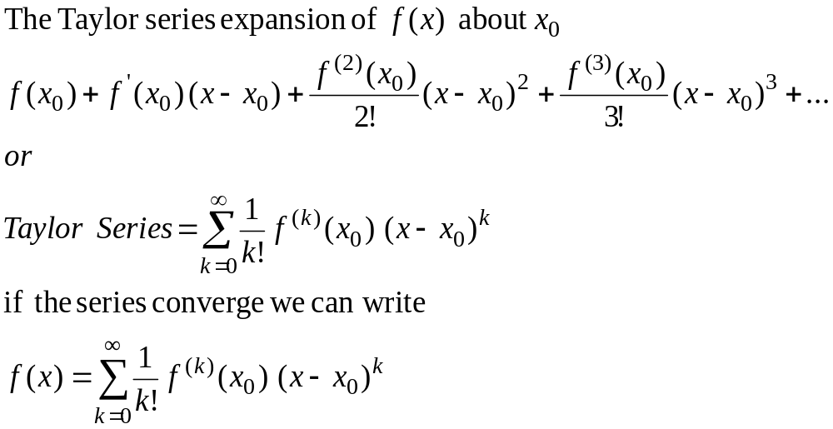
Taylor Series

Slide 3
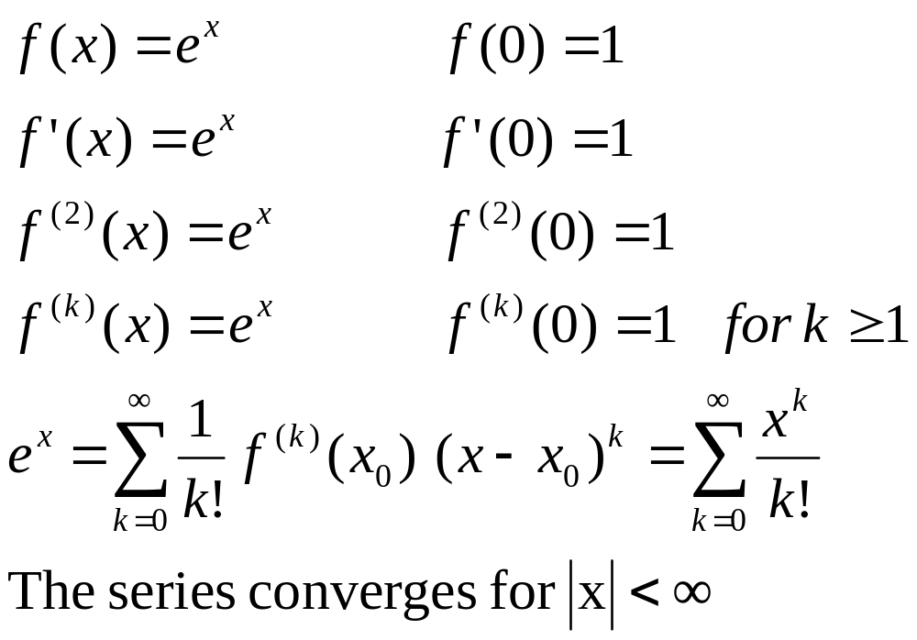
Taylor Series
Example 1

Slide 4
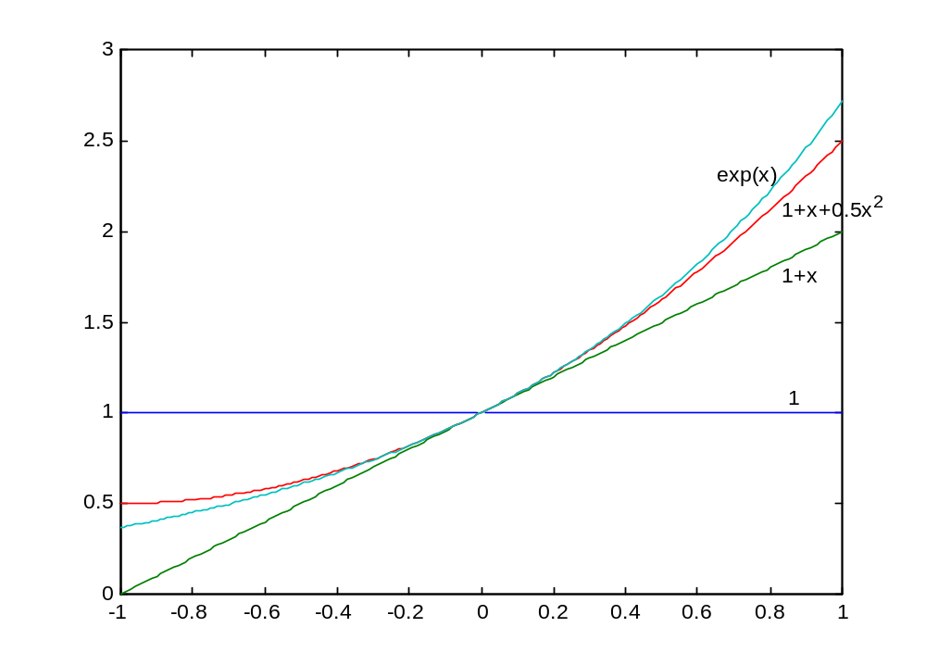
Taylor Series
Example 1

Slide 5
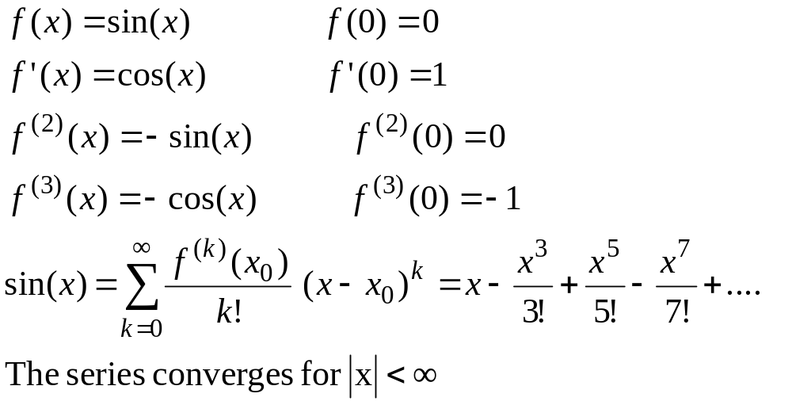
Taylor Series
Example 2

Slide 6
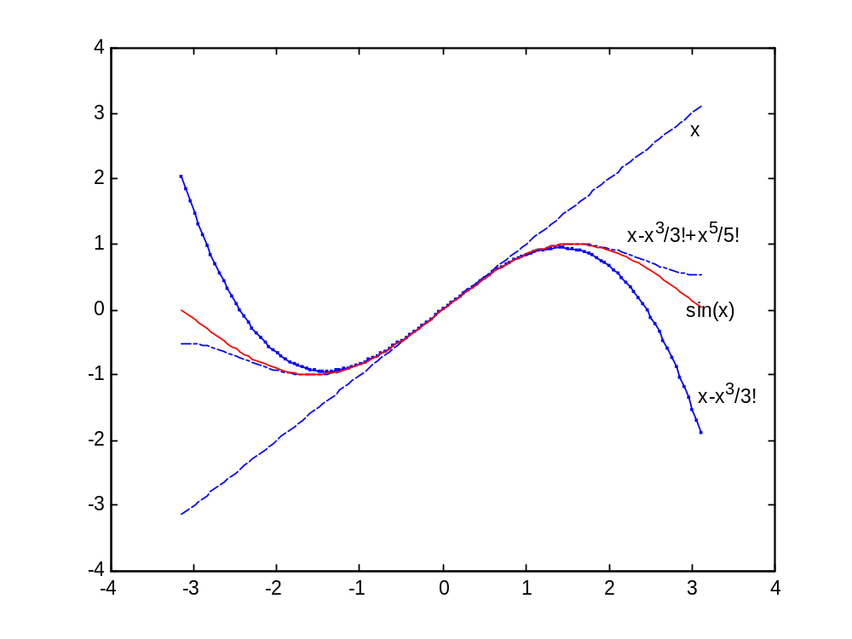

Slide 7
Convergence of Taylor Series
(Observations, Example 1)
The Taylor series converges fast (few terms are needed) when x is near the point of expansion c. If |x-c| is large then more terms are needed to get good approximation.

Slide 8
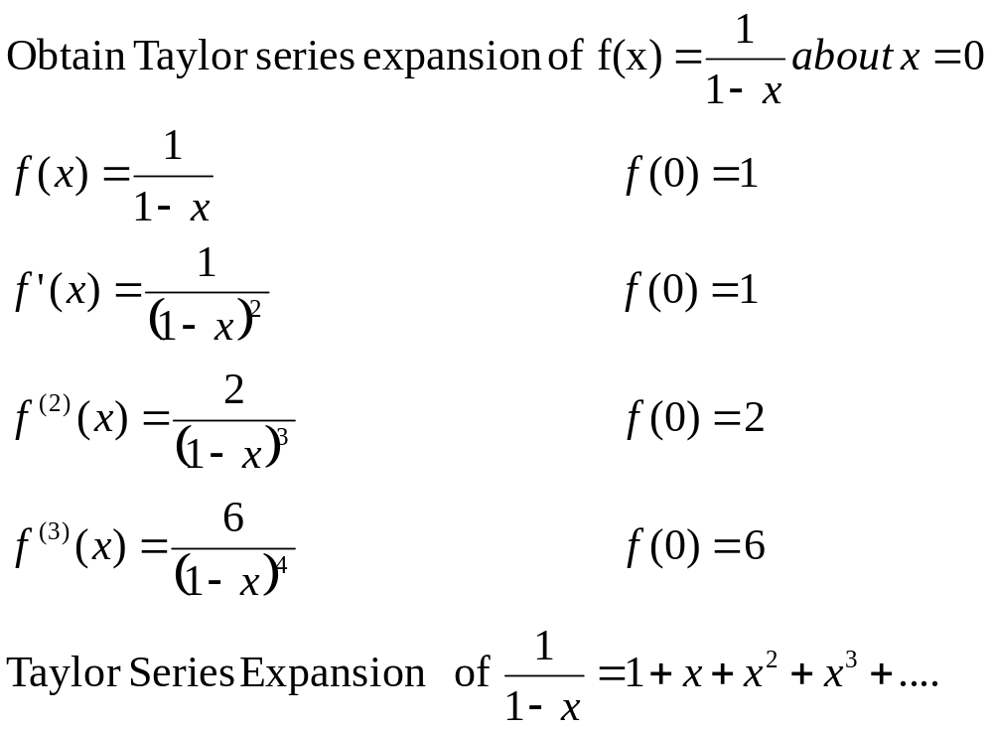
Taylor Series
Example 3

Slide 9
Example 3 remarks
Can we apply Taylor series for x>1??
How many terms are needed to get good approximation???
These questions will be answered using Taylor Theorem

Slide 10
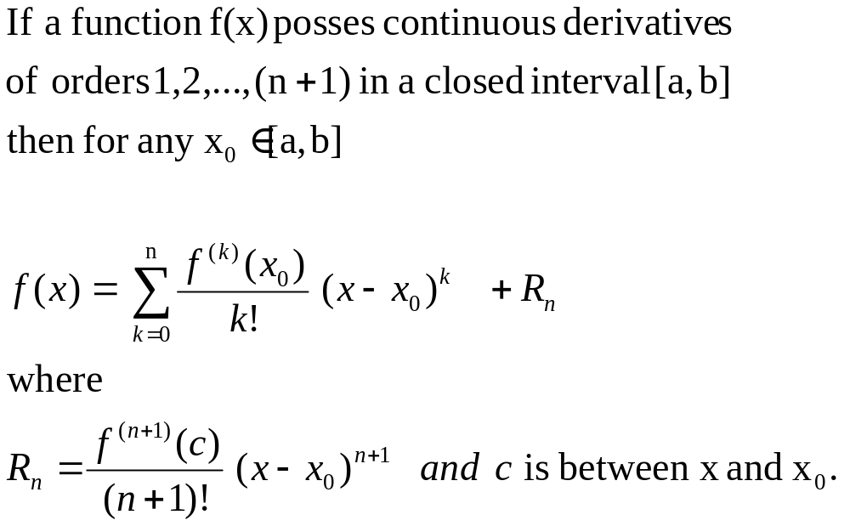
Taylor Theorem
(n+1) terms Truncated Taylor Series
Reminder

Slide 11
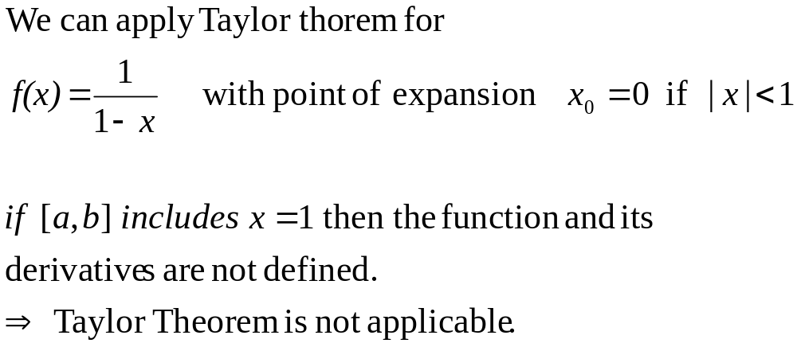
Taylor Theorem

Slide 12
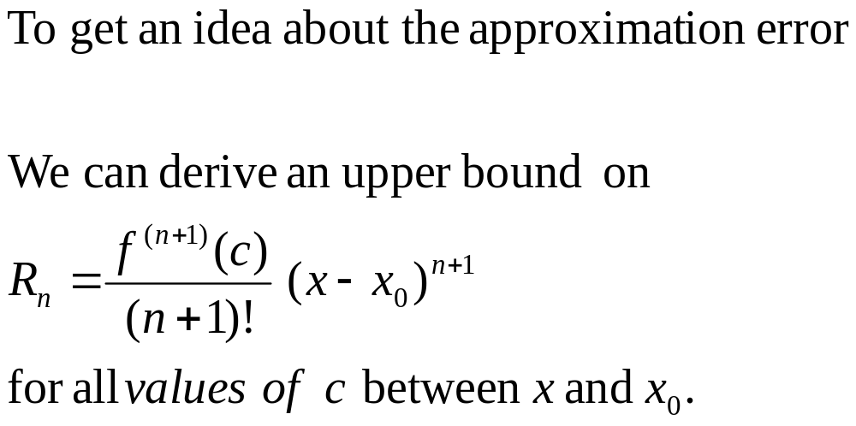
Error Term

Slide 13
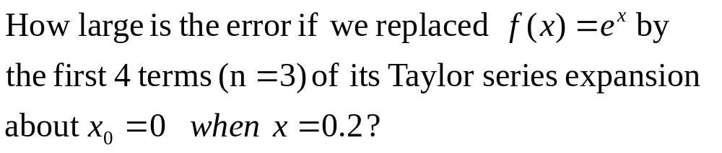
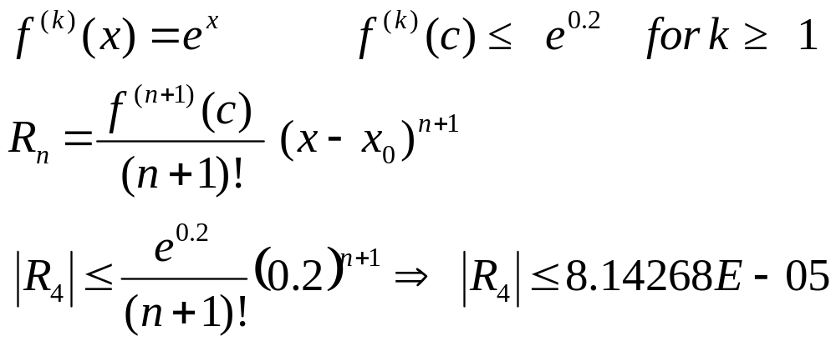
Error Term for
Example 4

Slide 14
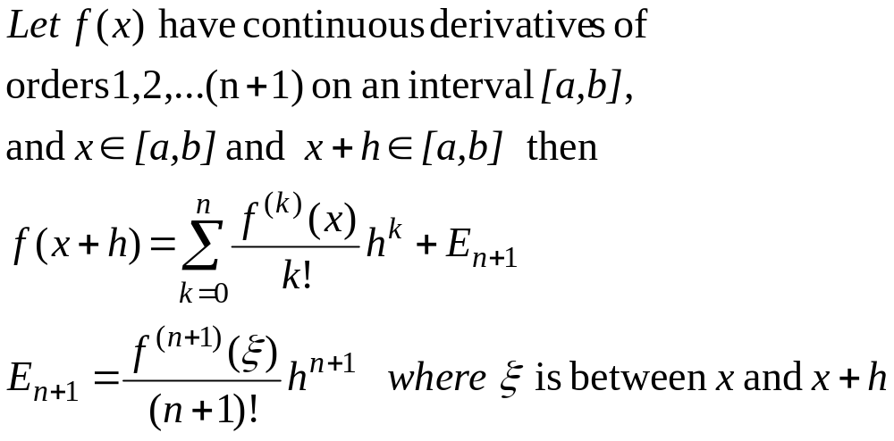
Alternative form of Taylor Theorem

Slide 15
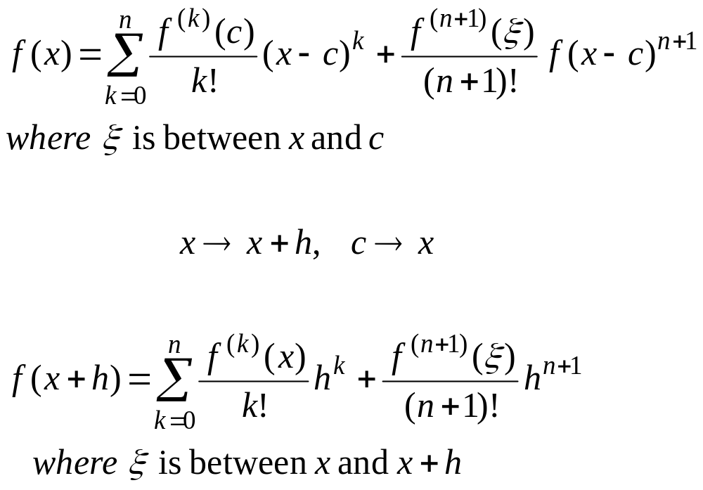
Taylor Theorem
Alternative forms

Slide 16
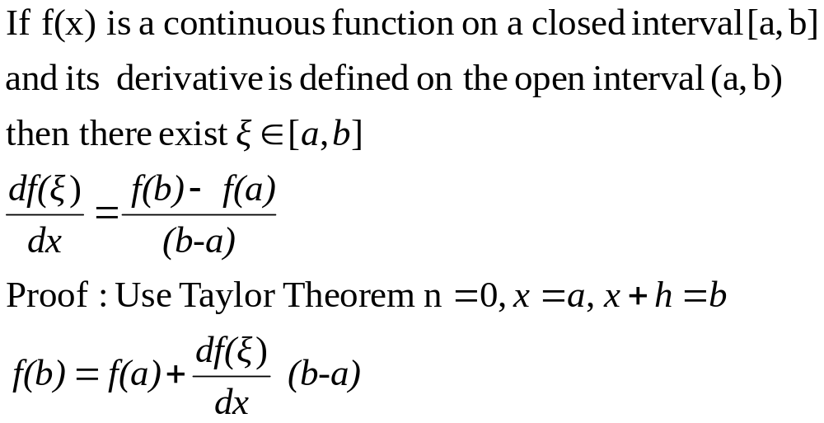
Mean Value Theorem

Slide 17
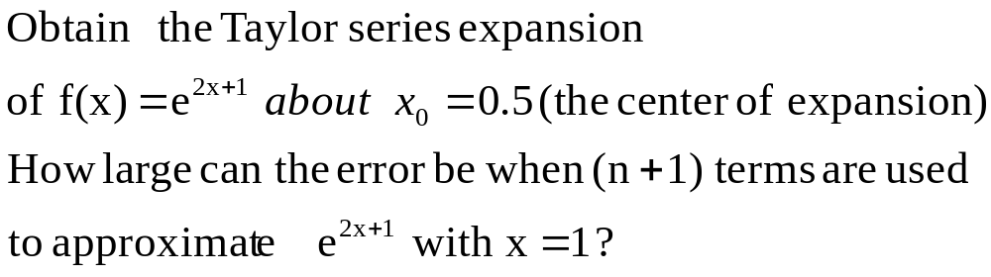
Example 6

Slide 18
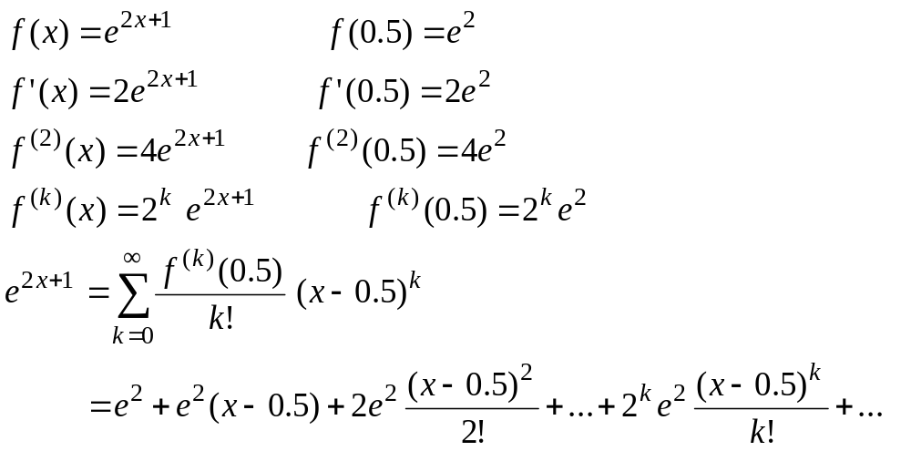
Example 6

Slide 19
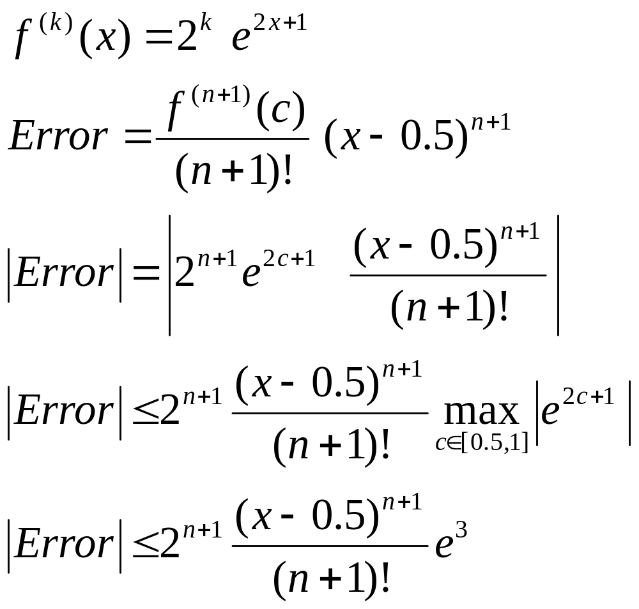
Example 6 Error term

Slide 20
REMARK
In this course all angles are assumed to be in radian unless you are told otherwise

