Slide 1
LECTURE # 5

Slide 2
INTERPOLATION
Calculation of the value of a function
Between known values

Slide 3
Introduction
Interpolation was used for long time to provide an estimate of a tabulated function at values that are not available in the table.
What is sin (0.15)?
x | sin(x)
0 | 0.0000
0.1 | 0.0998
0.2 | 0.1987
0.3 | 0.2955
0.4 | 0.3894
Using Linear Interpolation sin (0.15) ≈ 0.1493
True value( 4 decimal digits) sin (0.15)= 0.1494

Slide 4
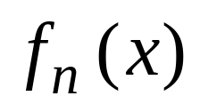
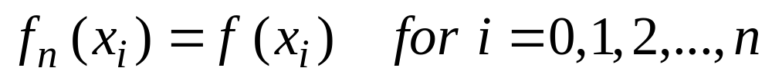
The interpolation Problem
Given a set of n+1 points,
find an n^{th} order polynomial
that passes through all points

Slide 5
Example
An experiment is used to determine the viscosity of water as a function of temperature. The following table is generated
Problem: Estimate the viscosity when the temperature is 8 degrees.
Temperature (degree) | Viscosity
0 | 1.792
5 | 1.519
10 | 1.308
15 | 1.140

Slide 6
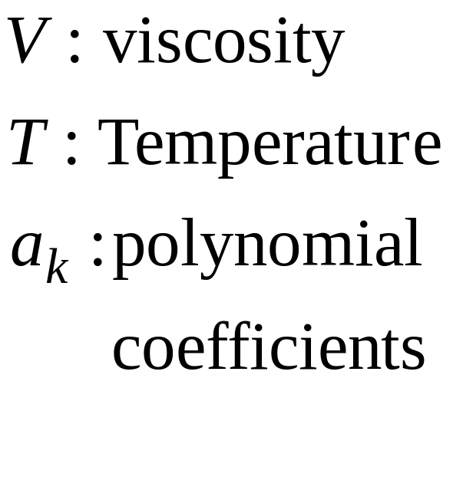
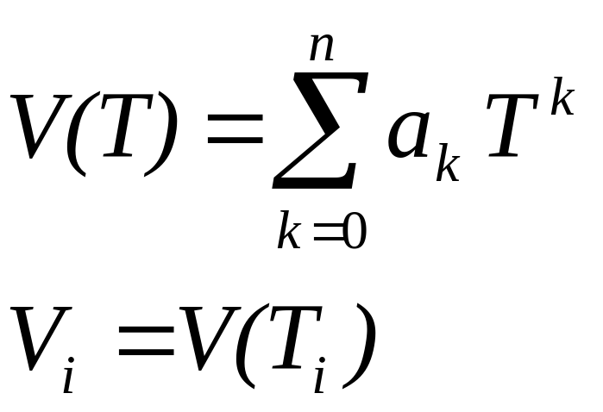
Interpolation Problem
Find a polynomial that fit the data points exactly.
Linear Interpolation V(T)= 1.73 − 0.0422 T
V(8)= 1.3924

Slide 7
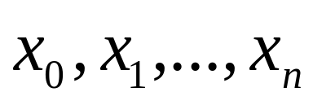
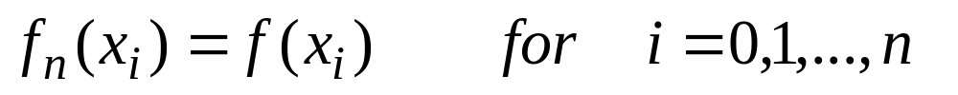
Existence and Uniqueness
Given a set of n+1 points
Assumption are distinct
Theorem:
There is a unique polynomial f_{n}(x) of order ≤ n such that

Slide 8
Examples of Polynomial Interpolation
Linear Interpolation
Given any two points, there is one polynomial of order ≤ 1 that passes through the two points.
Quadratic Interpolation
Given any three points there is one polynomial of order ≤ 2 that passes through the three points.

Slide 9
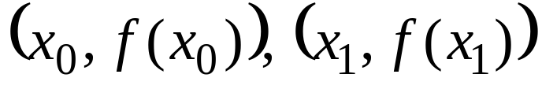
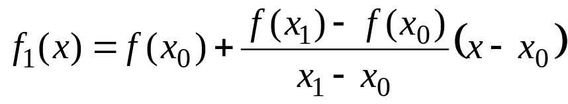
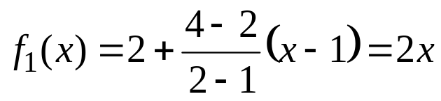
Linear Interpolation
475
Given any two points,
The line that interpolates the two points is
Example :
find a polynomial that interpolates (1,2) and (2,4)

Slide 10
The interpolation Problem
Given a set of n+1 points,
find an n^{th} order polynomial
that passes through all points

Slide 11
LAGRANGE INTERPOLATION

Slide 12








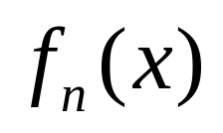

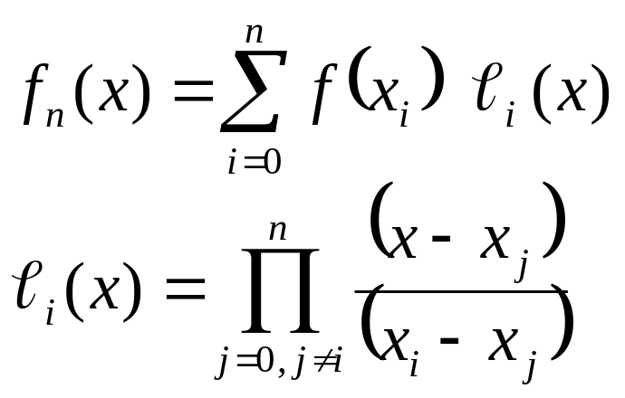
Lagrange Interpolation
486
 |  |  | ….
 |  |  | ….
Problem:
Given
Find the polynomial of least order such that
Lagrange Interpolation Formula

Slide 13
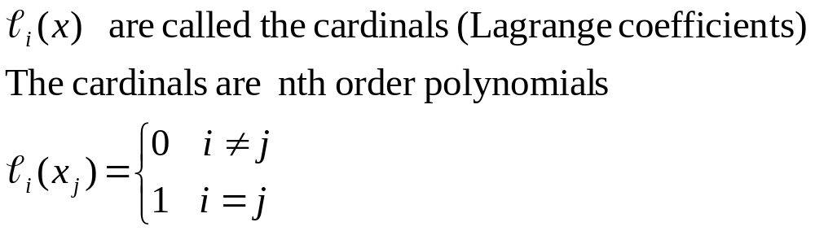
Lagrange Interpolation

Slide 14
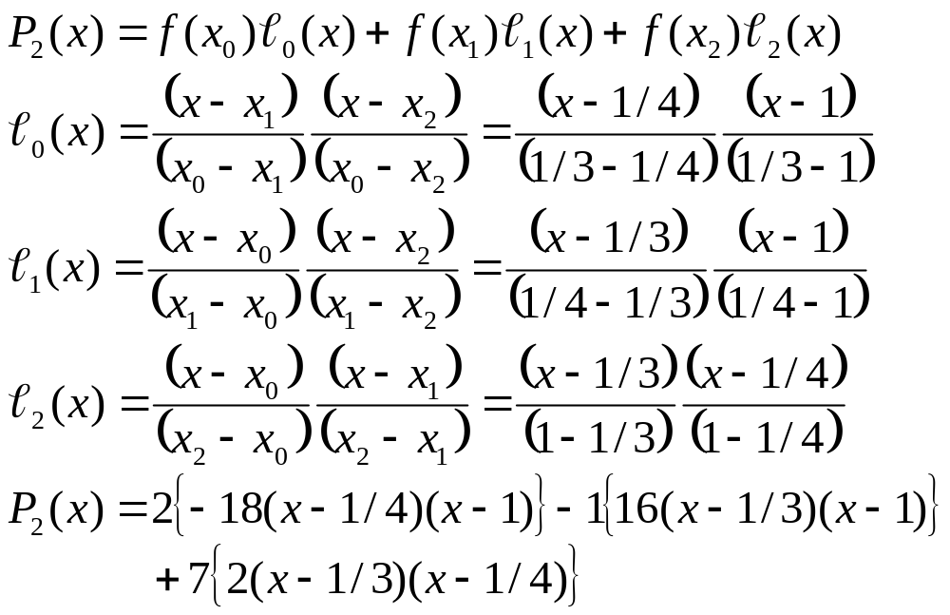
Lagrange Interpolation Example
x | 1/3 | 1/4 | 1
y | 2 | -1 | 7

Slide 15
Example
x | y
0 | 1
1 | 3
2 | 2
3 | 5
4 | 4

Slide 16
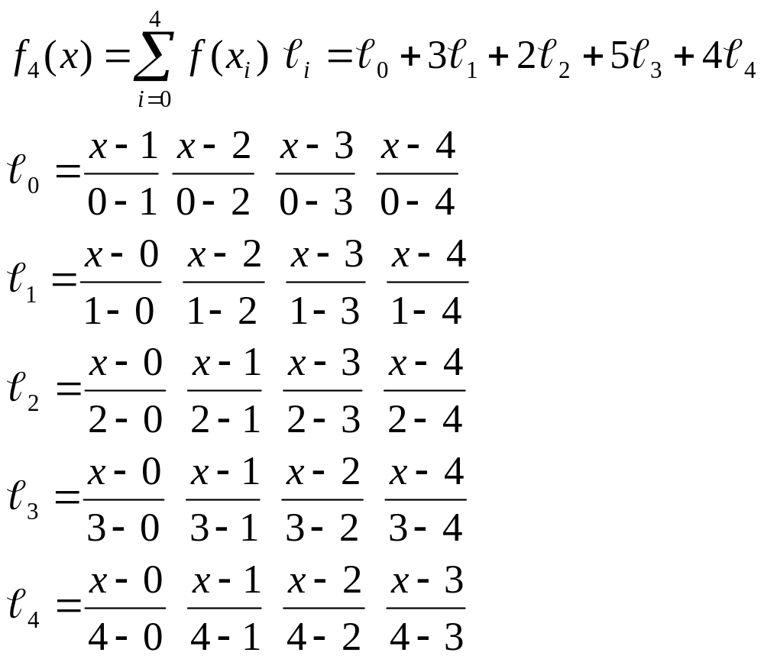
Interpolating Polynomial Using Lagrange Interpolation method

Slide 17
Errors in polynomial Interpolation
Polynomial interpolation may lead to large error (especially for high order polynomials)
BE CAREFUL

Slide 18
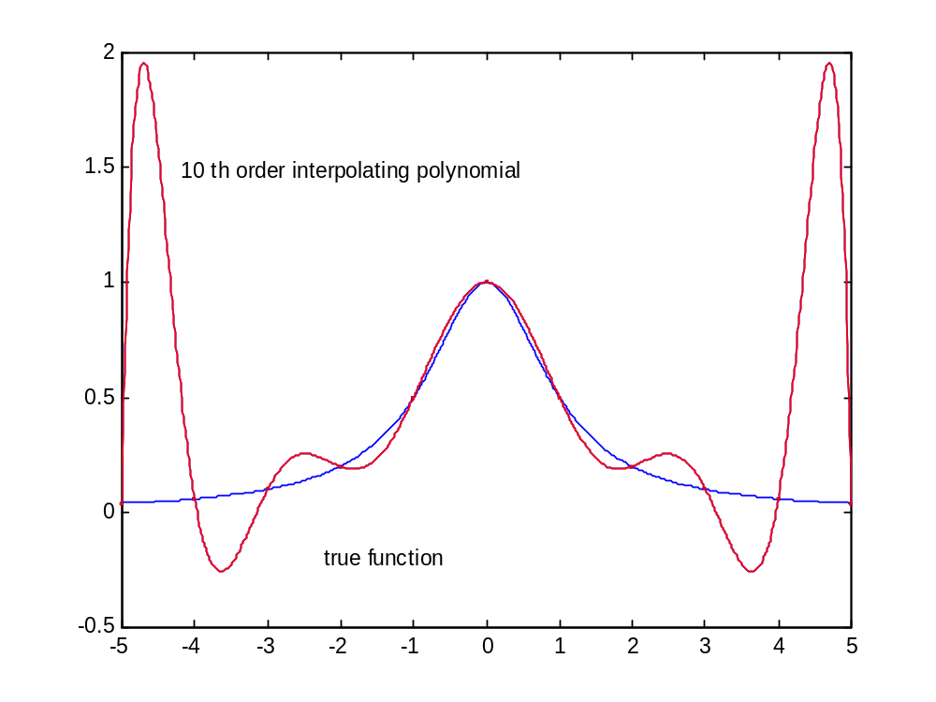
10 th order Polynomial Interpolation

