Slide 1
CPS 235 Object Oriented Programming Paradigm
Pointers

Slide 2
Pointers
Pointers are one of the most powerful and confusing aspects of the C language.
A pointer is a variable that holds the address of another variable.
CPS235:Pointers

Slide 3
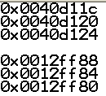
Addresses and the &(address-of) operator
#include<iostream>
#include<conio>
int x = 7;
int y = 8;
int z = 10;
void main()
{
int x1 = 7;
int y1 = 8;
int z1 = 9;
cout<<&x<<endl;
cout<<&y<<endl;
cout<<&z<<endl;
cout<<endl<<&x1<<endl;
cout<<&y1<<endl;
cout<<&z1<<endl;
getch();
}
CPS235:Pointers

Slide 4

sizeof operator
To check how much space a particular data type takes on your machine
void main()
{
cout<<"int takes:"<<sizeof(int)<<" bytes"<<endl;
cout<<"char takes:"<<sizeof(char)<<" bytes"<<endl;
cout<<"double takes:"<<sizeof(double)<<“ bytes"<<endl;
getch();
}
CPS235:Pointers

Slide 5
What is a pointer variable?
A pointer variable is a variable whose value is the address of a location in memory.
To declare a pointer variable, you must specify the type of value that the pointer will point to, for example,
int* ptr; // ptr will hold the address of an int
char* q; // q will hold the address of a char

Slide 6
Pointer Variables
A pointer is a variable that holds the memory address of another variable
  int *x;
  int foo = 12;
  x = &foo;
MEMORY
Address
0
1
2
3
4
5
81345
81346
81347
foo
123
...
...
x
3
CPS235:Pointers

Slide 7
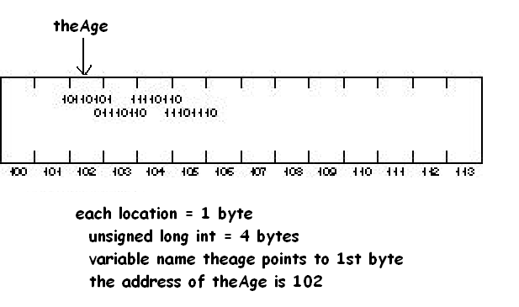
A little bit about memory
unsigned long int theAge;
CPS235:Pointers

Slide 8
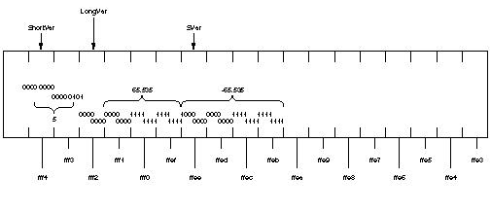
A little bit about memory
unsigned short shortVar= 5;
unsigned long longVar = 65535;
long svar = -65535;
CPS235:Pointers

Slide 9
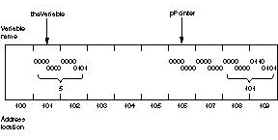
A little bit about memory
int theVariable = 5;
int * pPointer = &theVariable;
CPS235:Pointers

Slide 10
Pointer variables
  int *x; // pointer to an int
  char* y; //pointer to a char
  double* z; //pointer to a double
  char *ptr1, *ptr2, *ptr3; //three variables of type char*
You cannot do the following:
  double x = 15;
  int* p = &x; //compile-time error, the types do not match!
CPS235:Pointers

Slide 11
The size of pointers
The size of a pointer is dependent upon the architecture of the computer
  a 32-bit computer uses 32-bit memory addresses
  On a 64-bit machine, a pointer would be 64 bits (8 bytes)
char *pchValue; // chars are 1 byte
int *pnValue; // ints are usually 4 bytes
struct Something
{
int nX, nY, nZ;
};
Something *psValue; // Something is probably 12 bytes
cout << sizeof(pchValue) << endl; // prints 4
cout << sizeof(pnValue) << endl; // prints 4
cout << sizeof(psValue) << endl; // prints 4
CPS235:Pointers

Slide 12
Dereference Operator
The dereference operator (*) obtains the contents of the variable that is referenced by a pointer.
int N = 26;
int * pN = &N;
cout << *pN << endl; // "26"
CPS235:Pointers

Slide 13
Dereference Operator
The dereference operator can also be used to modify the contents of the referenced variable.
int N = 26;
int * pN = &N;
*pN = 35;
cout << *pN << endl; // 35
cout << N << endl; // 35
int y = *pN + 10;
cout << y << endl; //45
(*pN)++;
cout << *pN << endl; //36
cout << N << endl; //36
CPS235:Pointers

Slide 14
Two ways of using the asterik (*)
  int *p; //declaration: a pointer to an int
  *p = 37; //indirection/dereferencing a pointer to access the value of the variable pointed to by p
CPS235:Pointers

Slide 15
In short . . .
Declares a pointer
to an integer
int x = 10;
int *p ;
p = &x;
*p = 20;
& is address operator
gets address of x
* dereference operator
gets value at p
CPS235:Pointers

Slide 16
What would be the output?
void main()
{
int x = 20; //x is at address 0x0012ff88
int* p = &x; //p is at address 0x0012ff84
cout<<p<<endl<<&p<<endl<<*p;
getch();
}
CPS235:Pointers

Slide 17
Uninitialized Pointers
A pointer must have a value before you can dereference it
int *x;
*x=3;
int foo;
int *x = &foo;
*x=3;
Run-time ERROR!!!
x doesn’t point to anything!!!
this is fine
x points to foo
CPS235:Pointers

Slide 18
Initializing a Pointer
NULL is the best default value to assign to a pointer if you cannot assign it the address of a variable. A smart programmer will check for NULL before using the pointer.
int * pN = NULL;
.
.
// ...later,
if( pN != NULL )
*pN = 35;
CPS235:Pointers

Slide 19
Assigning Pointers
One pointer may be assigned to another, as long as they point to the same type. In this example, when pZ is dereferenced, it lets us change the value of N:
int N = 26;
int * pN = &N;
int * pZ;
pZ = pN;
*pZ = 35; // now N = 35
CPS235:Pointers

Slide 20
Assigning Pointers
Assigning a value from one pointer to another can be done by dereferencing both pointers.
int N = 26;
int * pN = &N;
int Z = 0;
int * pZ = &Z;
*pZ = *pN; // Z = 26
CPS235:Pointers

Slide 21
An Example
What does the memory look like after each statement?
void PointerTest() {
// allocate three integers and two pointers
int a = 1;
int b = 2;
int c = 3;
int* p;
int* q;
p = &a; // set p to refer to a
q = &b; // set q to refer to b
c = *p; // retrieve the value stored in the variable pointed to by p (i.e., a)and put it in c
p = q; // change p so that it points to the variable to which q is pointing
*p = 13; // dereference p to set the value of the variable pointed to by p (i.e., b)to 13 (*q is now 13 also)

Slide 22
Pointers to Objects
A pointer can also be used to point to an object of a user-defined class
class employee
{
int id;
public:
void display() { cout<<id; }
};
void main()
{
employee e1;
employee* ptr = &e1; //ptr is a pointer to an employee object
(*ptr).display(); //dereference the pointer to get the object pointed to by the pointer
ptr -> display(); //access object members using -> operator
}
CPS235:Pointers

Slide 23
Pointers and Arrays
The name of an array is in fact the address of the first element in the array
Saying array[3] tells the compiler to start with the memory address of the first element in array, jump three elements down in memory, and dereference
In other words, it says to return the element that is 3 away from the starting element
So if you have
  int array[5] = {1,2,3,4,5};
  cout<<array; is equivalent to cout<<&array[0];
  cout << array[2]; is equivalent to cout<<*(array+2)
CPS235:Pointers

Slide 24
Pointers and Arrays
The name of the array is infact a constant pointer
So, if you have int array[5] = {1,2,3,4,5};
you cannot write an expression of the following form
*(array++) ; //always use parentheses to avoid ambiguity
since this is incrementing the array variable but that is a constant
We can however write int* pArray = array;
And then use a statement pArray++;
Here, array is a constant pointer whereas pArray is a normal pointer
What happens when you write *(array+2) above?
Does it cause 2 bytes to be added to the address of the first element of the array?
CPS235:Pointers

Slide 25
Pointer arithmetic
Integer math operations can be used with pointers
If you increment a pointer, it will be increased by the size of whatever it points to.
int a[5];
int *ptr = a;
*(ptr+2)
*(ptr+4)
*ptr
a[0] a[1] a[2] a[3] a[4]
CPS235:Pointers

Slide 26
Traversing an Array
C and C++ programmers often use pointers to traverse arrays. At one time, such code ran more efficiently, but recent optimizing compilers make array subscripts just as efficient.
int scores[50];
int * p = scores;
for( int i = 0; i < 50; i++)
{
cout << *p << endl;
p++; // increment the pointer
}

Slide 27
Output?
  int main ()
  {
  int numbers[5];
  int * p;
  p = numbers; *p = 10;
  p++; *p = 20;
  p = &numbers[2]; *p = 30;
  p = numbers + 3; *p = 40;
  p = numbers; *(p+4) = 50;
  for (int n=0; n<5; n++)
    cout << numbers[n] << ", ";
    return 0;
  }
CPS235:Pointers

Slide 28
Pointers and Functions
Remember the swap function which we made to swap the values of two variables passed in main?
    void swap( int &x, int &y) {
    int tmp;
    tmp = x;
    x = y;
    y = tmp;
    }
    void main()
    {
    int a = 5;
    int b = 10;
    swap(a,b);
    }
CPS235:Pointers

Slide 29
Pointers and Functions
Three ways of passing parameters to a function
Pass by value: does not change the values of the variables in the calling program
Pass by reference: modifies the values of the variables in the calling program
Pass by pointer: also modifies the values of the variables in the calling program
CPS235:Pointers

Slide 30
Implementing swap with pointer arguments
    void swap( int *x, int *y) {
    int tmp;
    tmp = *x;
    *x = *y;
    *y = tmp;
    }
    void main()
    {
    int a = 5;
    int b = 10;
    swap(&a,&b);
    }
CPS235:Pointers

