Slide 1
CPS 235 Object Oriented Programming Paradigm
Polymorphism Part II

Slide 2
Pure Virtual Function
All of the virtual functions we have written have a body (a definition)
However, C++ allows you to create a special kind of virtual function called a pure virtual function (or abstract function) that has no body at all.
A pure virtual function simply acts as a placeholder that is meant to be redefined by derived classes.
To create a pure virtual function, rather than define a body for the function, we simply assign the function the value 0.
When we add a pure virtual function to our class, we are effectively saying, “it is up to the derived classes to implement this function”.
CPS235:Polymorphism

Slide 3
Abstract Classes
Two main consequences of using pure virtual functions
  First, any class with one or more pure virtual functions becomes an abstract base class, which means that it can not be instantiated.
  Second, any derived class must define a body for this function, or that derived class will be considered an abstract base class as well.
CPS235:Polymorphism

Slide 4
Abstract Classes & Pure Virtual Functions
Some classes exist logically but not physically.
Example : Shape
  Shape s; // Legal but silly..!! : “Shapeless shape”
  Shape makes sense only as a base of some classes derived from it. Serves as a “category”
  Hence instantiation of such a class must be prevented
class Shape //Abstract
{
public :
//Pure virtual Function
virtual void draw() = 0;
}
A class with one or more pure virtual
functions is an Abstract Class
Objects of abstract class can’t be
created
Shape s; // error : variable of an abstract class
CPS235:Polymorphism

Slide 5
Example
Shape
virtual void draw()
Circle
Triangle
public void draw()
public void draw()
CPS235:Polymorphism

Slide 6
Abstract Classes & Pure Virtual Functions
A pure virtual function not defined in the derived class remains a pure virtual function.
Hence derived class also becomes abstract
class Circle : public Shape { //No draw() - Abstract
public :
void print(){
cout << “I am a circle” << endl;
}
class Rectangle : public Shape {
public :
void draw(){ // Override Shape::draw()
cout << “Drawing Rectangle” << endl;
}
Rectangle r; // Valid
Circle c; // error : variable of an abstract class
CPS235:Polymorphism

Slide 7
Abstract classes
If a method is to be over-ridden by each child class, we can enforce this policy through the use of abstract classes
You can’t create an object of an abstract class ( a class with at least one pure virtual function)
You can also not pass or return an object of an abstract class by value
CPS235:Polymorphism

Slide 8
Abstract classes
It is still possible to provide definition of a pure virtual function in the base class
The class still remains abstract and functions must be redefined in the derived classes, but a common piece of code can be kept there to facilitate reuse
class Shape { //Abstract
public :
virtual void draw() = 0;
};
Shape::draw(){
cout << “Shape" << endl;
}
class Rectangle : public Shape
{
public :
void draw(){
Shape::draw(); //Reuse
cout <<“Rectangle”<< endl;
}
CPS235:Polymorphism

Slide 9
class Base
{
public:
virtual void show() = 0;
};
/////////////////////////////////////////////////////////
class Derv1 : public Base
{
public:
void show()
{ cout << "Derv1\n"; }
};
/////////////////////////////////////////////////////////
class Derv2 : public Base
{
public:
void show()
{ cout << "Derv2\n"; }
};
int main()
{
// Base bad; //ERROR
Base* arr[2];
Derv1 dv1;
Derv2 dv2;
arr[0] = &dv1;
arr[1] = &dv2;
arr[0]->show();
arr[1]->show();
return 0;
}
CPS235:Polymorphism

Slide 10
Example
class person
{
protected:
char name[40];
public:
void getName()
{ cout << “ Enter name: “; cin >> name; }
void putName()
{ cout << “Name is: “ << name << endl; }
virtual void getData() = 0;
virtual bool isOutstanding() = 0;
};
class student : public person {
private:
float gpa;
public:
void getData(){
person::getName();
cout << “ Enter student’s GPA: “; cin >> gpa;
}
bool isOutstanding()
{ return (gpa > 3.5) ? true : false; }
};
CPS235:Polymorphism

Slide 11
class professor : public person{
private:
int numPubs;
public:
void getData(){
person::getName();
cout << “ Enter number of professor’s publications: “;
cin >> numPubs;
}
bool isOutstanding()
{ return (numPubs > 100) ? true : false; }
};
int main() {
person* persPtr[100];
int n = 0;
char choice;
do {
cout << “Enter student or professor (s/p): “;
cin >> choice;
if(choice==’s’)
persPtr[n] = new student;
else
persPtr[n] = new professor;
persPtr[n++]->getData();
cout << “ Enter another (y/n)? “;
cin >> choice;
} while( choice==’y’ );
for(int j=0; j<n; j++) {
persPtr[j]->putName();
if( persPtr[j]->isOutstanding() )
cout<< “Outstanding”;
}
}
CPS235:Polymorphism

Slide 12
Virtual Destructor
If any of the functions in your class are virtual, the destructor should be virtual as well
class Base {
public:
virtual ~Base() {
cout << "~Base()" << endl;
}
};
class Derived : public Base {
public:
~Derived() {
cout << "~Derived()" << endl;
}
};
int main() {
Base* bp = new Derived; // Upcast
delete bp; // Virtual destructor call
}
CPS235:Polymorphism

Slide 13
Things to remember
Beginning a class method declaration with the keyword virtual in a base class makes the function virtual for the base class and all derived classes, classes further derived from derived classes, and so on…
dynamic binding is possible only for a base class pointer or reference to an object of the derived class
All those functions of the base class that need to be over-ridden in the derived classes should be made virtual
Constructors cannot be virtual
Destructors can be virtual
  You should provide a base class which has virtual functions with a virtual destructor even if the class does not need a destructor (i.e., it does not contain dynamic data)
CPS235:Polymorphism

Slide 14
Things to remember
friends can’t be virtual since they are not member functions
If a derived class does not redefine a virtual function, the base class version is used. If there is a chain of derived classes, then the most recently defined version of the virtual function is used
An abstract class demands that its pure virtual functions must be over-ridden in each derived class, otherwise the derived class also becomes abstract
CPS235:Polymorphism

Slide 15
Inheritance and Dynamic Memory Allocation
If a base class uses dynamic memory allocation and redefines assignment operator and copy constructor, how does it affect the implementation of the derived class?
  If the derived class does not itself use dynamic memory allocation, no special steps need to be taken
  If the derived class uses dynamic memory allocation, then the assignment operator and copy constructor need to be defined for the derived class as well
CPS235:Polymorphism

Slide 16
If the derived class does not use new
class base
{
private:
char* label;
int rating;
public:
base(const char* l = "null",int r = 0);
base(const base& rs);
virtual ~base();
base& operator = (const base& rs);
};
class lacksDMA : public base
{
private:
char color[40];
public:
...
};
CPS235:Polymorphism

Slide 17
If the derived class does not use new
There’s no need for defining a destructor. The default destructor will automatically call the base class destructor which will free the memory allocated in the base part of the object
There’s no need for defining a copy constructor since the default copy constructor will automatically call the base class copy constructor for copying the base part of the object
Assignment operator overloading is also not required for the same reason
CPS235:Polymorphism

Slide 18
If the derived class does use new
class hasDMA : public base
{
private:
char* style; //to point to dynamic memory
public:
...
};
For this class, you will have to define destructor, copy constructor and assignment operator
CPS235:Polymorphism

Slide 19
If the derived class uses new
Destructor
base::~base()
{
delete [] label;
}
hasDMA::~hasDMA()
{
delete[] style;
}
CPS235:Polymorphism

Slide 20
If the derived class uses new
Copy Constructor
base::base(const base& rs)
{
label = new char[strlen(rs.label)+1];
strcpy(label,rs.label);
rating = rs.rating;
}
hasDMA::hasDMA(const hasDMA& hs) : base(hs)
{
style = new char[strlen(hs.style)+1];
strcpy(style,hs.style);
}
CPS235:Polymorphism

Slide 21
If the derived class uses new
Assignment Operator
base& base::operator=(const base& rs)
{
if(this==&rs)
return *this;
delete [] label;
label = new char[strlen(rs.label)+1];
strcpy(label,rs.label);
rating = rs.rating;
return *this;
}
hasDMA& hasDMA::operator=(const hasDMA& hs)
{
if(this==&hs)
return *this;
base::operator=(hs); //copy base
style = new char[strlen(hs.style)+1];
strcpy(style,hs.style);
return *this;
}
CPS235:Polymorphism

Slide 22
stream operators
ostream& operator<<(ostream& os,const base& rs) //declared friend in class base
{
os<<"Label: " <<rs.label << endl;
os << "Rating: " << rs.rating << endl;
return os;
}
ostream& operator<<(ostream& os,const lacksDMA& rs) //declared friend in lacksDMA
{
os << (const base& )rs; //type casting //lacksDMA parameter to base argument
os << "Color: " <<rs.color << endl;
return os;
}
CPS235:Polymorphism

Slide 23
stream operators
ostream& operator<< (ostream& os, const hasDMA& rs) //declared friend in hasDMA
{
os << (const base& )rs; //type casting //hasDMA parameter to base argument
os << "Style: " <<rs.style << endl;
return os;
}
CPS235:Polymorphism

Slide 24
Recommended Reading
Bruce Eckel’s “Thinking in C++” available online at
  http://www.codeguru.com/cpp/tic/tic_c.shtml
CPS235:Polymorphism

Slide 25
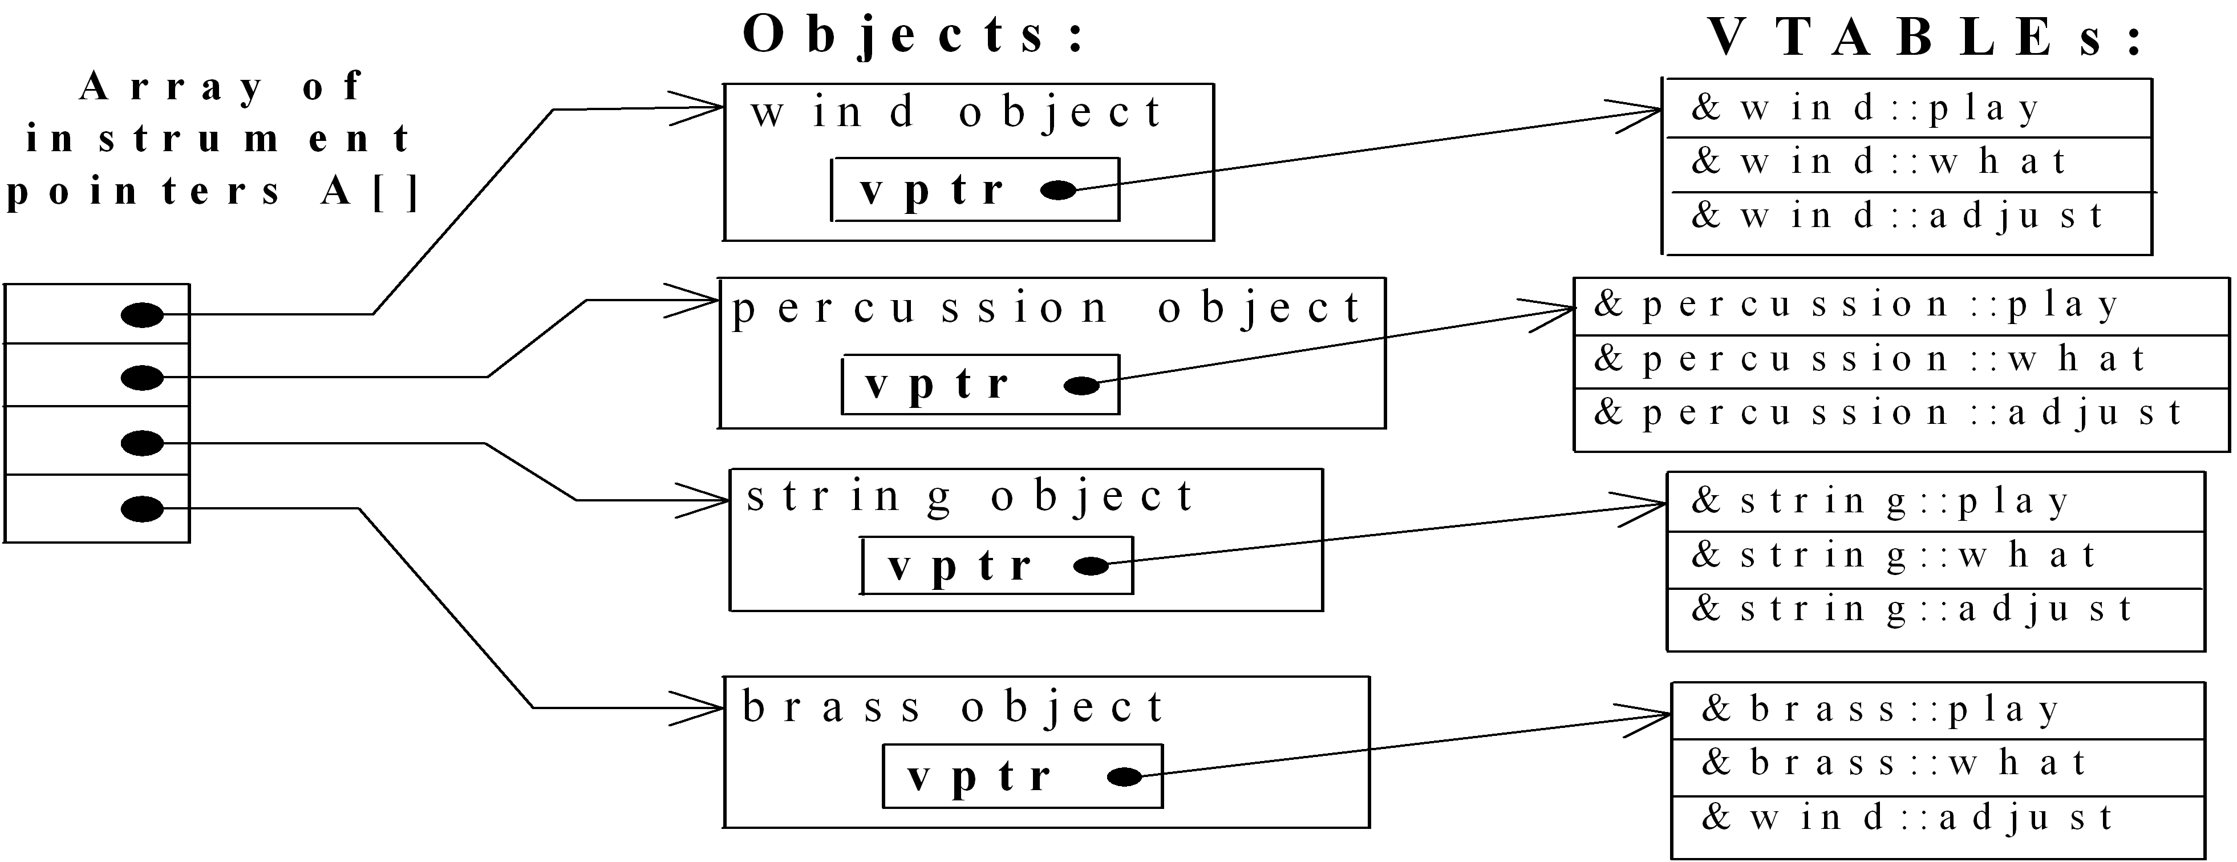
How C++ implements virtual binding
CPS235:Polymorphism

Slide 26
How C++ implements virtual binding
CPS235:Polymorphism

Slide 27
Cost of Polymorphism
VTABLE for every polymorphic class
VPTR embedded in every polymorphic object
Indirect function access
CPS235:Polymorphism

Slide 28
Another Example
class Base
{
public:
virtual void function1() {};
virtual void function2() {};
};
class D1: public Base
{
public:
void function1() {};
};
class D2: public Base
{
public:
void function2() {};
};
CPS235:Polymorphism

Slide 29
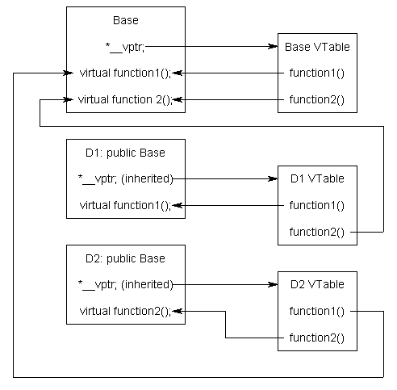
CPS235:Polymorphism

